Slide 1
How to Get Started Producing Scholarly Work
December 12, 2017
Notes:
Hello and welcome to the STFM Faculty for Tomorrow Webinar series! Today’s webinar session is called How to Get Started Producing Scholarly Work with Dr Dean Seehusen and Dr Christopher Morley. This is Webinar #8 out of a webinar series supported by the Faculty for Tomorrow Task Initiative. You can find recordings of all of the previous webinars in this series at STFM.org under Online Courses on the Webinar page. http://www.stfm.org/OnlineCourses/Webinars/F4T

Slide 2
STFM Faculty for Tomorrow Task Force
Faculty for Tomorrow is supported by the American Board of Family Medicine Foundation and the STFM Foundation
Stoney Abercrombie, MD
AnMed Health
Paul Gordon, MD, MPH University of Arizona
Kelly Jones, MD Univ. of Southern California
Emily Walters STFM Project Manager
Steven Lin, MD Stanford University
Cathleen Morrow, MD Geisel School of Medicine Dawn Pruett, MD McKay-Dee FMRP
Meaghan Ruddy, MA, PHD,
The Wright Center for GME
Paul Larson, MD, MS
University of Pittsburgh
Mary Theobald STFM VP of Communications
Stan Kozakowski, MD AAFP
Sonya Shipley, MD
University of Mississippi
Notes:
Faculty for Tomorrow is an initiative by STFM to address the shortage of family medicine faculty. It :
Provides resources and training for new faculty, including those moving from private practice to family medicine education.
Identifys and supports young family physicians with leadership potential.
Ensures leaders of institutions understand the time and competencies required to be faculty.
Expands STFM’s formal faculty recruiting efforts of residents.
Faculty for Tomorrow is supported by the American Board of Family Medicine Foundation and the STFM Foundation.

Slide 3
Panelists
COL Dean Seehusen, MD, MPH
Director of Medical Education / DIO Dwight D Eisenhower Army Medical Center Editorial Board, Family Medicine; Chairman of the CERA Steering Committee
Christopher P. Morley, PhD MA
Chair, Public Health & Preventive Medicine
Vice-Chair for Research, Family Medicine
SUNY Upstate Medical University
Editorial Board, Family Medicine; Editor-in-Chief, PRiMER

Slide 4
Comments or Questions?
Please use the webinar chat box to submit questions at any time!
Notes:
Please use the webinar chat box to submit questions at any time during this webinar! We’ll pause to answer your questions at intervals throughout this presentation.

Slide 5
Audience Poll
I’m currently a...
Resident or Fellow
Medical School Faculty
Residency or Fellowship Faculty
Non-faculty Teacher or Physician
Notes:
Thank you to those of you who answered some questions for our pre-webinar survey. Now we’d like to use a live poll with all of you to give us a sense of who’s in the audience today. I’ll activate a live poll with the GoToWebinar software.
I’m currently…
Resident or Fellow
Medical School Faculty
Residency or Fellowship Faculty
Non-faculty Teacher

Slide 6
Educational Objectives
By the end of this talk, learners will be able to:
List reasons for residents to do scholarship
List Boyer’s four categories of scholarship
Describe scholarship that is of meaningful and practical
Apply criteria to a research idea to determine if the project should be undertaken

Slide 7
Agenda
Review the ACGME philosophy on scholarly activity
Review the basics of scholarship and goals of scholarship
Define characteristics of scholarship
Define “Practical Scholarship”
Share some tools for generating and evaluating ideas
“Tips and Tricks” from a Research Professional

Slide 8
Audience Poll
What is the #1 reason YOU want to do scholarship?
A. It is required in my current position
B. Increase my chances of academic promotion
C. To improve my own medical practice
D. For the intellectual fun of it

Slide 9
COL Dean Seehusen, MD, MPH
Director of Medical Education / DIO Dwight D Eisenhower Army Medical Center Editorial Board, Family Medicine; Chairman of the CERA Steering Committee

Slide 10
Why Should Family Physicians Perform Scholarly Activity

Slide 11
Our Answers
Develop tacit knowledge of the scientific process

Slide 12
Our Answers
Develop tacit knowledge of the scientific process
Learn the language of scholarship

Slide 13
Our Answers
Develop tacit knowledge of the scientific process
Learn the language of scholarship
Develop comfort with reading medical literature

Slide 14
Our Answers
Develop tacit knowledge of the scientific process
Learn the language of scholarship
Develop comfort with reading medical literature
Develop critical appraisal skills

Slide 15
Our Answers
Develop tacit knowledge of the scientific process
Learn the language of scholarship
Develop comfort with reading medical literature
Develop critical appraisal skills
Develop the ability to translate scholarship into clinical practice

Slide 16
Our Answers
Develop tacit knowledge of the scientific process
Learn the language of scholarship
Develop comfort with reading medical literature
Develop critical appraisal skills
Develop the ability to translate scholarship into clinical practice
Putting that all together……to become better doctors

Slide 17
Our Answers
Develop tacit knowledge of the scientific process
Learn the language of scholarship
Develop comfort with reading medical literature
Develop critical appraisal skills
Develop the ability to translate scholarship into clinical practice
Putting that all together……Train better doctors
Turn a minority of family physicians into life-long scholars

Slide 18
Research Participation Pyramid
AGENDA SETTER
RESEARCH DIRECTOR
PRINCIPAL INVESTIGATOR
COLLABORATOR
UTILIZER
CONSUMER
Seehusen DA, Mainous AG 3rd, Chessman AW. Creating a Centralized Infrastructure to Facilitate Medical Education Research. Annals of Family Medicine. In Press

Slide 19
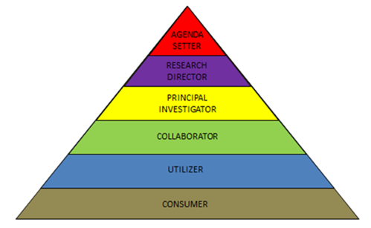
Research Participation Pyramid
Leadership
Generation
Translation
Seehusen DA, Mainous AG 3rd, Chessman AW. Creating a Centralized Infrastructure to Facilitate Medical Education Research. Annals of Family Medicine. In Press

Slide 20
Audience Poll
What level of the research participation pyramid are you currently on?
A. Agenda setter/Research director
B. Principal investigator
C. Collaborator
D. Utilizer
E. Consumer

Slide 21
Basics of Scholarship

Slide 22
Types of Scholarship
Boyer’s description of scholarship
Scholarship of discovery
Generates new knowledge utilizing the scientific method
Scholarship of application
Translating knowledge into practical use
Scholarship of integration
Taking knowledge from varied sources and connecting them in meaningful ways
Scholarship of education
Communication of knowledge to learners
Boyer, E. (1990). Scholarship reconsidered: Priorities for the professoriate. Princeton, NJ: The Carnegie Foundation for the Advancement of Teaching.

Slide 23
Scholarship of Discovery
Discovery is foundational
Generation new knowledge
Should a high priority for residents
Direct experience with the scientific method
PI/QI done well can be Scholarship of Discovery

Slide 24
What are the ingredients of scholarship?

Slide 25
What Counts as Scholarship?
Five universal ingredients (steps) of scholarship:
Begins with a scholarly question
A systematic search for existing literature
Gathering of data
Original
Existing
Analysis and synthesis of the data
Presentation of findings

Slide 26
 | Case Report | Research | PI/QI Project | Scholarship of Teaching
Begins with a scholarly question | What does this case add to the existing literature? | How are these variables related? | Can "X" outcome be improved by making "Y" change? | What is the evidence-based way to treat this condition?
A systematic search for existing knowledge | Literature search, discussions with experts | Literature search focused on prior research in the area | Literature search, discussions with peers, existing best practices | Literature search prioritizing systematic reviews and guidelines
Gather data | Collate previous cases, comparing and contrasting | Outcomes data generated through scientific method | Outcomes data generated through scientific method | Collate data, comparing strength of evidence
Analyze and synthesize the data | Generate lessons learned, advice for other providers | Statistical analysis of relationship between variables | Analysis (may not be statistical) of relationship between variables | Determine best evidence-based answer and strength of recommendation
Present findings | Published paper, poster or oral presentation | Published paper, poster or oral presentation | Presentation, could result in publication | Presentation to learner audience of choice

Slide 27
Barriers to Scholarship
Personal interest
Personal expertise
Mentorship and professional expertise
Time
Funding
Functional information technologies

Slide 28
Audience Poll
Which of these is the greatest barrier for YOU?
A. Personal interest
B. Personal expertise
C. Lack of access to mentorship or professional expertise
D. Resources—time and/or money
E. Functional information

Slide 29
Practical Research
Practice-based Research…
done everyday

Slide 30
If You Decide to Do Research….
Use your current patient population
Or a patient population readily accessible by you
Look at something you are already doing
Compare outcomes of alternative practice styles
Evaluate data that is already being collected
Look for previously unrecognized associations
Utilize less rather than more resources
Chances are you’ll have no choice
Cleaver study design is the key to inexpensive research
Explore practices that could change other physician’s practices TOMORROW

Slide 31
What Do We Know Works?
DeHaven et al identified six essentially ubiquitous characteristics of residency programs successful in research:
program director support
dedicated time
faculty involvement in research (esp. the PD)
a formal research curriculum/journal club
an easily accessible research professionals
opportunities for residents to present their research
Dehaven MJ, Wilson GR, O’Connor-Kettlestrings P. Creating a research culture: what we can learn from residencies that are successful in research. Fam Med 1998; 30(7):501-7.

Slide 32
Some Additional Tools
The better the original question, the better the final product

Slide 33
Three Ideas a Day
Do the Math

Slide 34
Three Ideas a Day
If only 1 in 1000 ideas is “good”:
By “good” I mean leads to a completed project and an associated presentation or publication in the peer-reviewed literature
You have one good idea a year
Enough to sustain a very busy and successful career
If only 1 in 10,000 ideas is “great”:
By “great” I mean a publication that impacts the way people practice, or the way they think about a topic
You have one great idea per decade
2-3 practice changing publications is a highly successful career

Slide 35
FINER Criteria
F –
I –
N -
E –
R –

Slide 36
FINER Criteria
F – Feasible
I – Interesting
N - Novel
E – Ethical
R – Relevant

Slide 37
Exercise: Apply the FINER Criteria
A resident in a small rural residency would like to investigate whether or not offering $1 lottery tickets to patients in the month of their 50th birthday will increase the rate of colonoscopy uptake within the residency’s family medicine clinic population.
A local supermarket has agree with donate the ticket in exchange for minimal advertising.

Slide 38
Q & A
What other questions do you have?
Please use the webinar chat box to submit your questions!
Notes:
At this time, we’d like to take a moment to answer some audience questions. If you haven’t already, you can submit your question through the webinar chat box labeled “Questions.” We’ll get through as many as we can in the remaining time! The first question is...

Slide 39
Christopher P. Morley, PhD MA
Chair, Public Health & Preventive Medicine
Vice-Chair for Research, Family Medicine
SUNY Upstate Medical University
Editorial Board, Family Medicine; Editor-in-Chief, PRiMER

Slide 40
Let’s Go Back to the RESEARCH QUESTION
This is your FIRST STEP. A good Research Question will
Guide Study Design
Suggest Methods
Will point to necessary data sources & variables and
Will be ANSWERABLE
A HYPOTHESIS might be part of the research question, although some research questions may be descriptive
See: “Research questions, hypotheses and objectives,” Farrugia et al, 2010. https://www.ncbi.nlm.nih.gov/pmc/articles/PMC2912019/

Slide 41
RESEARCH QUESTIONS The Good, the Bad, and the Ugly
GOOD Research Questions
Descriptive Study: “What demographic and clinical factors predict poor A1C control in low-income patients in our practice?” (Retrospective exploratory analysis)
Hypothesis Test: “Do Low-Income Patients (LIPs) have poorer A1C outcomes in our patient panel, when controlling for other predictors?”
BAD Research Question
“How many of our patients have poorly-controlled A1C?”
UGLY Research Question
“How bad is our diabetic patient panel?”

Slide 42
RESEARCH NEEDS
Now that you have a research question, use it to help identify:
Where you need help (teams should be complementary, not completely duplicative)
Your sources of data
What you will need to clean and analyze your data
Will you need IRB approval? Start early!
Do you have an eventual target journal in mind? (More on this in a second)

Slide 43
RESEARCH Methods and Team
Form your team early!
If you need statistical, methodological, or design support, incorporate those individuals as co-investigators from the start.
Bad design or poor data collection at the start is often not fixable by adding a skilled methodologist or analyst at the middle or end of a project!
You don’t like cleaning up after another clinician’s mistakes, do you? And…sometimes it is not possible. Keep that analogy in mind – talk to methods partners and mentors early in the process.
Partnership is key.

Slide 44
RESEARCH Methods and Team
Statistical analysis: possibly a colleague with a Master’s degree (e.g. MPH), but look outside as well
Database support: skill set overlaps with, but is not the same as, statistical support – e.g. an EHR query writer may know nothing about statistical analysis, and vice versa)
Qualitative Analysis: Not all projects involve quantitative analysis. Consider open interviews, focus groups, content analysis etc.
Potential Partners:
Grad students or Junior Faculty in Health Services Research, Public Health, Sociology, Medical Anthropology, Psychology, Biostatistics, Economics etc. may all have expertise you need…and you have content THEY need!
Other residents or residency faculty with background training in these areas

Slide 45
Targeting Presentation & Publication
Do you have a conference in mind? Try writing your abstract ahead of time. These often are short (~300 words), and help visualize the end product of what you are trying to achieve.
Look at relevant journal content. Are you answering a question that needs answering?
See the JANE interface at Biosemantics.org: http://jane.biosemantics.org/

Slide 46
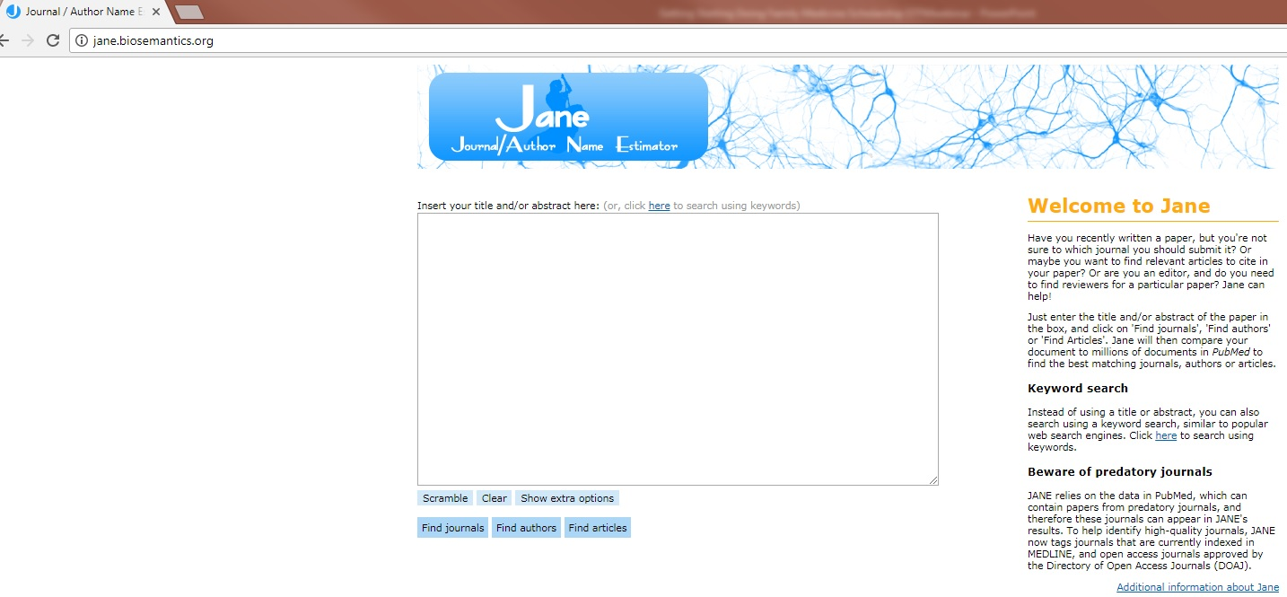
http://jane.biosemantics.org/

Slide 47
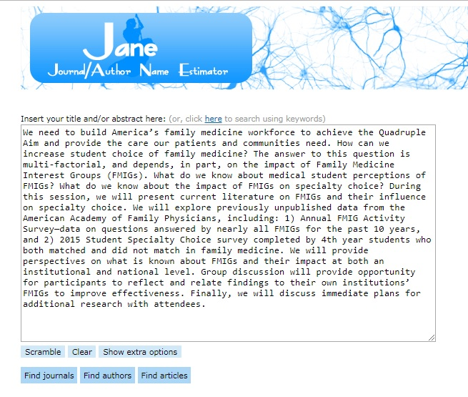
http://jane.biosemantics.org/

Slide 48
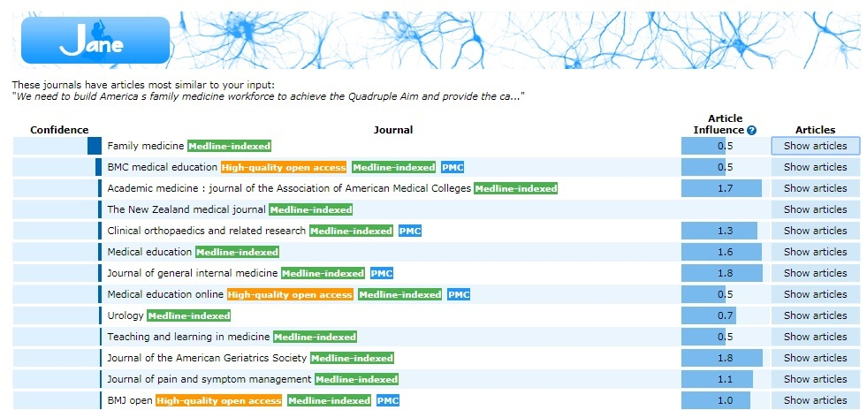
http://jane.biosemantics.org/

Slide 49
Resources
Research Methods Knowledge Base:
https://socialresearchmethods.net/
Office of Behavioral & Social Science Research:
http://www.esourceresearch.org/tabid/36/Default.aspx
Robert Wood Johnson Foundation – Qualitative Research:
http://www.qualres.org/
Very basic online statistics text:
http://onlinestatbook.com/2/index.html

Slide 50
Take Homes
Performing scholarship will make you a better doctor (provider)
Five characteristics of scholarship
Three ideas a day
FINER criteria
Refine your research question
Identify and incorporate all team members as early as possible

Slide 51
Q & A
What other questions do you have?
Please use the webinar chat box to submit your questions!
Notes:
Great, thank you so much, Dr Seehusen and Dr Morley! At this time, we’d like to take a moment to answer some audience questions. If you haven’t already, you can submit your question through the webinar chat box labeled “Questions.” We’ll get through as many as we can in the remaining time! The first question is...

Slide 52
Post-Webinar Survey
We appreciate your feedback!
Please complete the brief survey we will send via e-mail.
THANK YOU!
Notes:
Thank you again, Dr Seehusen and Dr Morley, for sharing your advice on getting started producing scholarly work with us today! And thanks to our audience for taking part in this webinar! A recording of this webinar will be available at stfm.org under online courses/webinars within 24 hours of this live event. Please take a moment to complete the brief post-webinar survey we will send you via e-mail so we can continue to serve you better with our presentations. Thanks again for joining us for this Faculty for Tomorrow presentation. Have a great afternoon!

