Slide 1
ERAS is changing. Are you ready?
Joint Webinar with AAFP & STFM
Annie Rutter, MD, MS, FAAFP
Santina Wheat, MD
Raj Woolever, MD, FAAFP
Notes:
Good afternoon and welcome. Thank you for joining us today for ERAS is changing. Are you read? A joint webinar sponsored by STFM and AAFP. My name is Dr. Annie Rutter and I serve on the Board of Directors of STFM and am chair of the medical student education committee. IN my day job, I am the Director of Medical student education at Albany Medical College in Albany NY and have been involved in advising students through the family medicine match process for over a decade.
I am joined today by two residency program directors who also serve on the Board of Directors for the Association of Family Medicine Residency Directors. Dr. Tina Wheat, Program director at McGaw Northwestern Family Medicine residency program outside of Chicago, a teaching health center program. She is also vice chair of diversity, equity and inclusion for the department of Family & Community Medicine. Dr. Raj Woolever is the program director and the Portsmouth regional hospital tufts University school of medicine family medicine residency program in Portsmouth NH. He is also the immediate past present of the Family medicine Education Consortium board of trustees.
We have support today from staff at both STFM and AAFP, including Dr. Karen Mitchell, Vice President of Education who will help moderate the Q&A portion of our webinar.
We are going to start with some background and information about the MyERAS changes, then transition to our panel discuss where you all can submit questions for our presenters.

Slide 2
What we’ll talk about today
Explain the three new elements of MyERAS: Experiences, geographic preferences, and program signaling
Describe how applicants can share information with programs about their medical education journey
Optimize the use of geographic preferences and program signaling
Notes:
So here are our objectives for today.
Throughout the talk we are going to focus on a few key features:
--data we already know: the changes have been part of the supp app for the last several years, AAMC has been gathering and analyzing data. Recognizing that FM isn’t like other specialties ( number of programs, geographic variation, etc), but a lot of this data can be extrapolated to help us in FM determine how things are going to go
--some of this data is survey data: PDs, applicants and advisors, guiding how to utilize this changes to get the right resident in the right program.
--more data to come—while this doesn’t help our current class of applicants, studying this process and its implications overtime will be the best way for us to learn how it is impacting our applicants, programs and our family medicine workforce.

Slide 3
Who are you?
Polls

Slide 4
Background: The Family Medicine Match

Slide 5
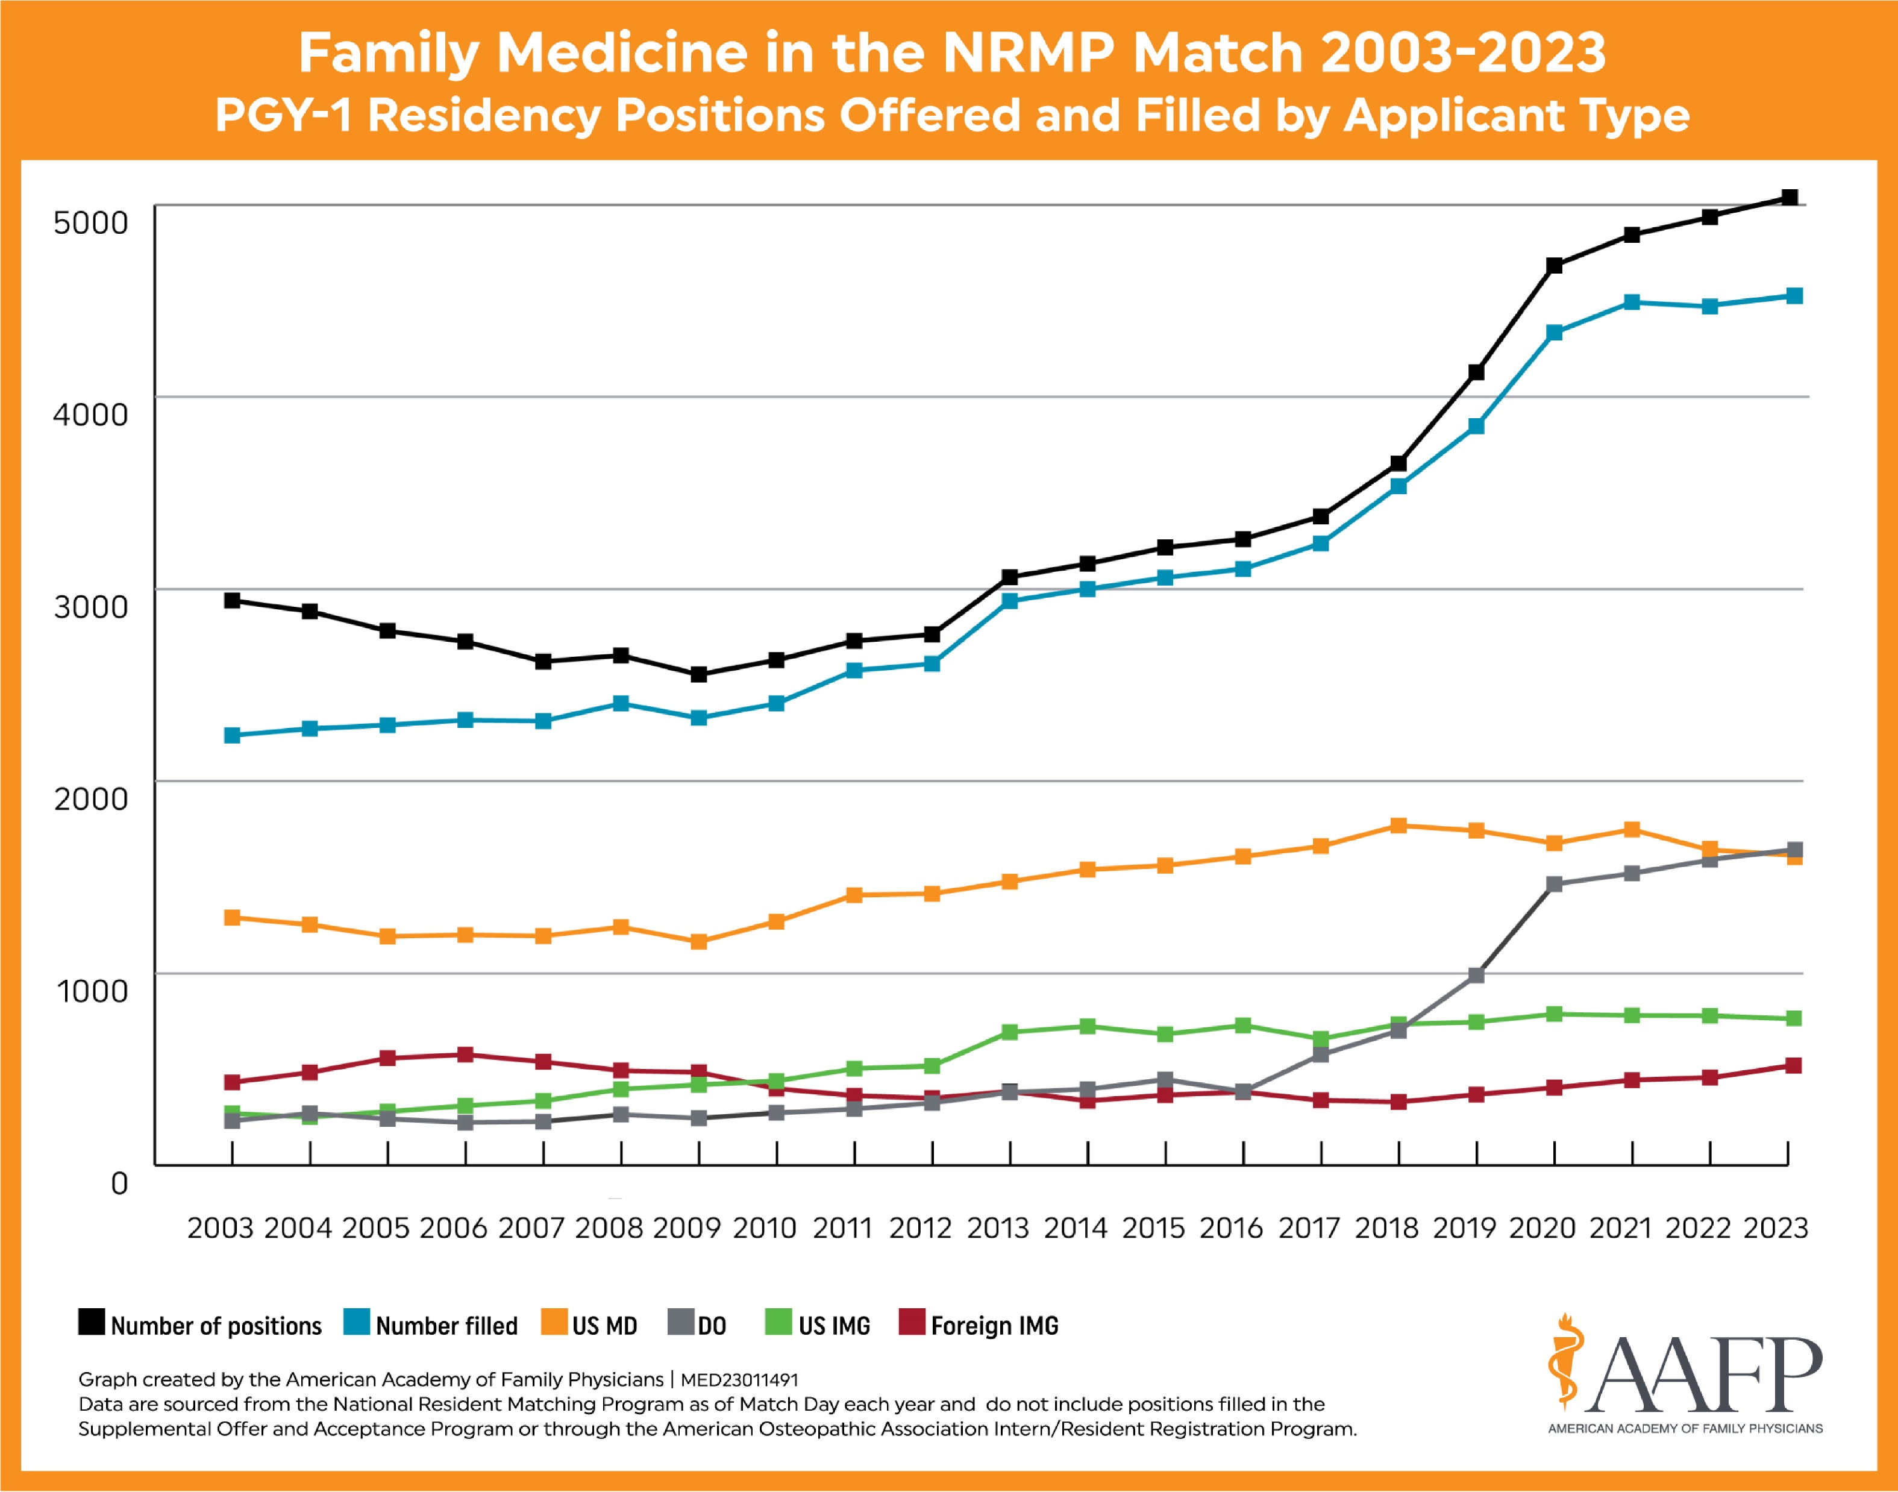
Does not include SOAP
Notes:
Data about FM match numbers over the last 20 years. We have seen an overall increase in number of FM positions, and an increase in the number of positions filled (although leveled off a bit the last three years. Increease in DO applicants matching, with large uptick around the time of the single match process. And a relatively flat line regarding US IMG and IMG as US MDs filling those positions.

Slide 6
Background: The Family Medicine Match
In 2023 how many applications did applicants submit, on average, to family medicine residencies (includes SOAP)
US DO – 49
IMG – 58
US MD – 32
In 2023 how many applications did family medicine programs receive, on average (includes SOAP)
Total - 918
US DO – 179
IMG – 629
US MD - 111

Slide 7
Background: The Family Medicine Match
12,934 applicants in 2022-23
773 programs in 2022-23
SOAP 2023
217 programs unfilled in main match (28%)

Slide 8
How do students decide where to apply? (from applicant ERAS survey 2023)
Geographic location of program
Close to family/friends
Alignment of program strengths with career interests
Perceived good fit
Perceived chance of interview offer
Strength of program’s clinical training
Future fellowship training opportunities
Program culture/resident camaraderie
Diversity of faculty and/or residents
Diversity of patient population

Slide 9
Organizations
National Residency Matching Program (NRMP) - private, non-profit organization established in 1952
Electronic Residency Application Service (ERAS) – Run by the American Association of Medical Colleges (AAMC)

Slide 11
Supplemental ERAS Application Goals
Update questions on the ERAS application to reflect current context
Help applicants share more information about themselves and their medical education journey
Drive holistic review in a high-volume application context by providing better information about applicants’:
-Past experiences
-Geographic preferences
-Interest via program signals

Slide 12
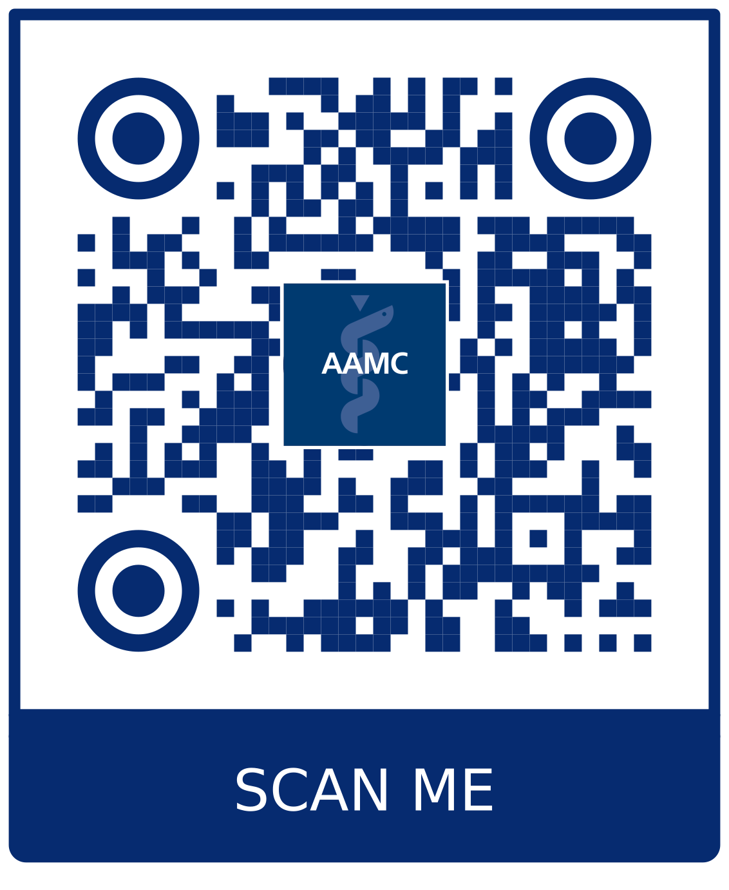
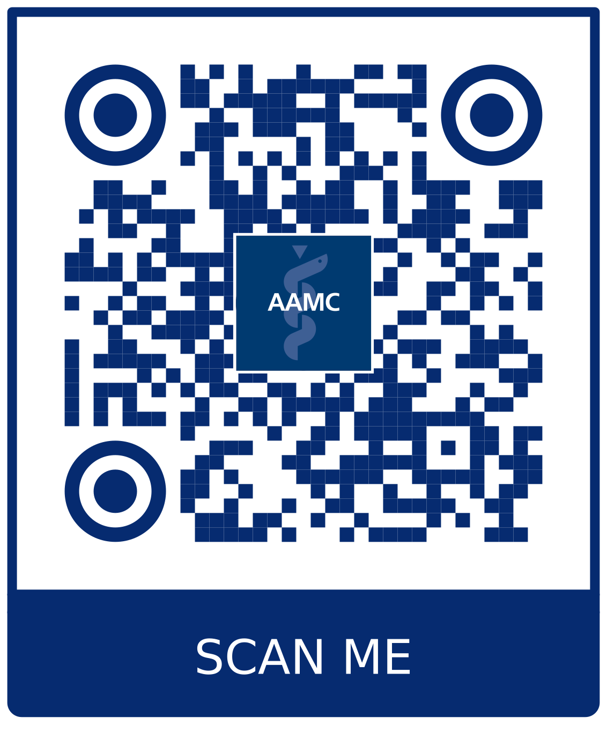
For more information:
Supplemental ERAS Application Data and Reports:
What’s New in the 2024 MyERAS Application
The MyERAS Application and Program Signaling for ERAS 2024
Notes:
You can find more information about data, changes and details for programs by taking a picture of these slides and utilizing the QR code.

Slide 13
MyERAS Experience Updates
ERAS 2024
Notes:
Lets take each of these new/update elements in turn. First, Experience Updates

Slide 15
Experience Types
Education/training
Military service
Professional organization
Extracurricular activity, club, hobby
Research
Teaching/mentoring
Volunteer/service/advocacy
Work

Slide 16
Program Director survey 2023: How are meaningful experiences used?
As part of a holistic application review to decide whom to interview (46% important or very important)
As a tie breaker for deciding whom to interview (28% important or very important)
To prepare for the interview (50% important or very important)

Slide 17
Medical school advisor survey - Experiences
57% of respondents agreed or strongly agreed that the Other Impactful Life Experiences essay will help programs put the main ERAS application in context
55% of respondents agreed or strongly agreed that identifying the most meaningful past experiences helps programs get a better picture of each applicant

Slide 18
Geographic Preferences and Settings
ERAS 2024

Slide 19
Geographic Preferences: Overview
Goals for Geographic Preferences Section:
Provide a process for sharing geographic preferences that enhances accuracy and fairness
Communicate the importance of geography for an applicant
Provide an opportunity to share preferences for regions and location setting
Geographic Preferences

Slide 20
Geographic Preferences and Settings Location: Biographic Information Section of the MyERAS application
Geographic division preference
Select up to three geographic divisions
Indicate no preference
Opportunity to explain
Setting preference
Indicate a degree of preferences for an urban or rural setting
Urban, urban/suburban, suburban, suburban/rural, rural
Indication no preference
Opportunity to explain

Slide 21
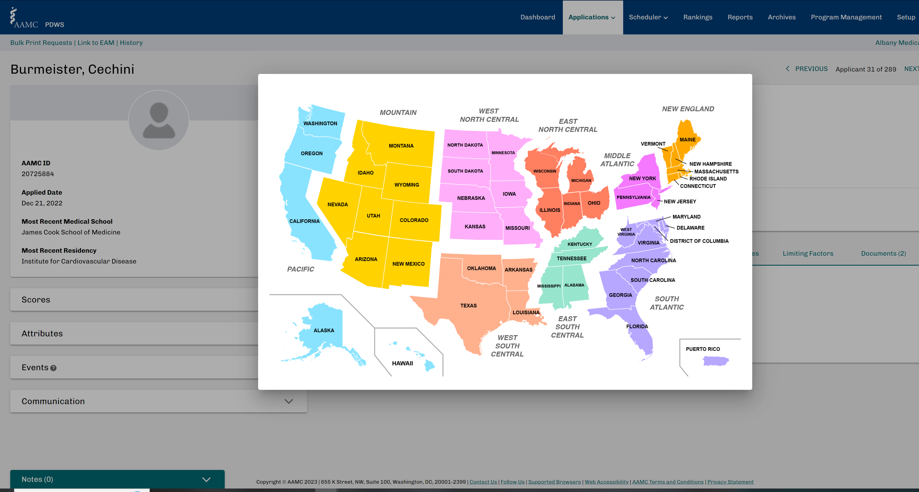
Geographic Preferences
Geo Preferences will contain Division and Setting sub-sections along with a map detailing the various US divisions.

Slide 22
2022-2023 ERAS geographic preferences
Internal Medicine (Categorical)
66% of applicants indicated a geographic preference
33% indicated no preference
Pediatrics
73% of applicants indicated a geographic preference
26% indicated no preference
Notes:
What do we know from other specialties regarding geographic preferences thus far?

Slide 23
2022-2023 ERAS rural/urban preference
Internal Medicine (Categorical)
60% indicated no preference
36% slight or strong preference for urban
Pediatrics
50% of indicated no preference
47% slight or strong preference for urban
Notes:
It will be interesting to see how this impacts FM applicants

Slide 24
Program Director survey 2023: How are geographic preferences used?
As a screening tool, before a more thorough application review (54% important or very important)
As part of a holistic application review to decide whom to interview (53% important or very important)
As a tie breaker for deciding whom to interview (51% important or very important)

Slide 25
Medical school advisor survey 2023
I advised applicants to select geographic divisions that accurately reflect their true preferences, regardless of their competitiveness (78% agreed or strongly agreed)

Slide 26
Program Signals
ERAS 2024
Notes:
Third and final my ERAS element to change this year is the program signals

Slide 27
Program Signals: Overview
What is a program signal?
Program signals offer applicants the opportunity to express interest in a residency program at the time of application
Program signals are intended to be used by programs as one of many data points in deciding whom to invite to interview.
Program Signals

Slide 28
5
Notes:
Be sure to discuss the background on this—
Students are concerned that adding program signals is TOO much and “one more thing” making it very overwhelming. Let’s be sure to calm their fears and support them that this will be another tool programs will use, but other things matter more!

Slide 29
Rotating students or “home” students should signal preferred programs
The AAMC provided all participating specialties with guidance about home and away rotations. The AAMC suggests that applicants signal their most interested programs regardless of whether they are home or away rotations. This is the most fair and equitable process for all applicant types (MD, DO, and IMGs) and provides all programs that participate in receiving signals with the same information about interest level.
Notes:
There are lots of things to consider with program signals.

Slide 30
Program Director survey 2023: How are program signals used?
As a screening tool, before a more thorough application review (70% important or very important)
Including in a composite filter to conduct holistic reviews (62% important or very important)
As part of a holistic application review to decide whom to interview (67% important or very important)
As a tie breaker for deciding whom to interview (65% important or very important)

Slide 31
Program Director survey 2023: Program signals
Program signals helped me identify applicants whom I would have otherwise overlooked
75% agreed or strongly agreed
Applicants who signaled my program were more likely to accept interview invitations
60% agreed or strongly agreed

Slide 32
Medical school advisor survey 2023
85% of respondents advised their students to signal programs that accurately reflected their true preferences
75% of respondents tailored their advice about signaling programs based on their students’ competitiveness
70% agreed or strongly agreed preference signals may help students be noticed by programs in which they have the most interest
90% of respondents suggested to students they should signal a mix of less and more competitive programs

Slide 33
Applicant survey 2023 – What strategies did you use when deciding what programs to signal?
Signal programs you felt you would have less difficulty getting into (17%)
Signal a mix of less and more competitive programs (64%)
Signal programs you felt you would have more difficulty getting into (19%)

Slide 34
Notes:
So what’s the date behind this? Here’s what happened in internal medicine last year.
Y axis: number of applicants
X asix is the individual programs.
Program signals are a small percentage of total applicants received. Overall tendency toward those programs who receive more applicantions get more signals, but even those programs with relatively fewer applicants, get some signals!

Slide 35
Internal Medicine 2022-23
Notes:
Another way to show the same thing---no program received more than 30% signals for the total number of applicants. And many were under 10%

Slide 37
Pediatrics 2022-23

Slide 38
Key Takeaways
Notes:
So our key takeaways:
Based on the research and feedback, programs are looking for applicants to indicate their true preferences and intentions. Please continue to advise your applicants to be honest and share their true preferences.
Applicants are using a variety of experience types, key characteristics, and focus areas – there is no one blueprint that applicants are using and that is exactly what we wanted to see. You all know better than anyone else that each of your applicants is unique and the newly designed experiences section is allowing your applicants to share their individuality in new and standardized ways. It structures the collection of information from applicants to help programs while trying to understand mission fit.
Geographic preferences are working as they were designed to.
For the first time, applicants are able to express to programs the regions or areas of the country where they want to be and why (perhaps it’s that they have support systems, family or friends in the area), and this is assisting programs by helping them identify applicants they may have otherwise overlooked and/or who may be a better fit for their program’s location.
In most specialties, geographic preference alignment and “no preference” resulted in higher probabilities of interview invitation. The 5 specialties this did not apply to:
Misaligned slightly > than No Preference for: Adult Neuro (1-2%), Interventional Radiology (4%), Peds (2%)
Misaligned = No preference: IM, Gen Surg
When considering geographic preferences alone: the highest likelihood of interview invitation occurred when an applicant’s geographic preference aligned with the program’s location.
Program signals are working as they were designed and intended to. In all specialties, sending a signal increased the likelihood of an interview invitation. When considering geographic preferences and program signals together: The highest likelihood of interview invitation occurred when an applicant signaled the program AND their geographic preference aligned with the program’s location.
There are little to no group differences by applicant type (MD, DO, IMG), race/ethnicity and gender.
Most applicants sent the maximum number of signals:
MD applicants sent slightly more signals than did DO applicants in: Interventional Radiology and Orthopedic Surgery
And MD applicants sent slightly more signals than did IMG applicants in: ▪Emergency Medicine, Interventional Radiology, Obstetrics and Gynecology, Orthopedic Surgery, and Psychiatry

Slide 39
AAMC ERAS materials
>95% of students and advisors agreed the AAMC ERAS Application Materials are helpful

Slide 40
For more information:
Supplemental ERAS Application Data and Reports:
What’s New in the 2024 MyERAS Application
The MyERAS Application and Program Signaling for ERAS 2024
Notes:
You can find more information about data, changes and details for programs by taking a picture of these slides and utilizing the QR code. Also recorded webinars reviewing the data for other specialties IN DEPTH.

Slide 41
Family Medicine Specific Takeaways
5 program signals
To be used at time of application, not rank list
Support AAMC statement: signal top choices, regardless of “home” program or away rotations
Programs should provide info about:
If/how they will use signals
The holistic review criteria used to select applicants for interview
Interview methods (virtual, in-person)
Supported by AAFP, CAFM organizations (STFM, AFMRD, ADFM, NAPCRG) https://www.afmrd.org/p/cm/ld/fid=1
AAFP Commission on Education will take on the analysis of FM data
Notes:
Holistic review criteria such as years since med school graduation, passing step scores, etc.

Slide 42
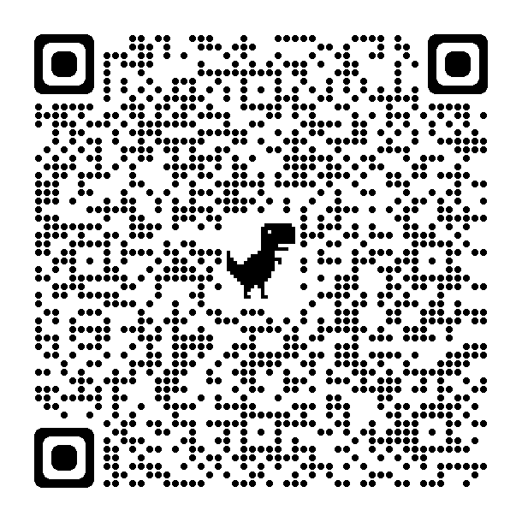
AAFP Resources for ERAS Updates

Slide 43
Q&A
Notes:
Now I would like to re-introduce our panelists, Dr. Tina Wheat and Dr. Raj Woolever, FM residency program directors. Our moderator will be Dr. Karen Mitchel, Vice President of Education at the American Academy of Family Physicians. Dr. Mitchell, I will turn things over to you.

