Slide 1
Organizing for Teams at Scale
Care Team Transformation at Mayo Clinic
Family Medicine Leaders Consortium
August 16, 2024
David Rushlow, M.D.
Chair, Family Medicine, Mayo Clinic
Image copyright Shutterstock
©2022 Mayo Foundation for Medical Education and Research | slide-1

Slide 2
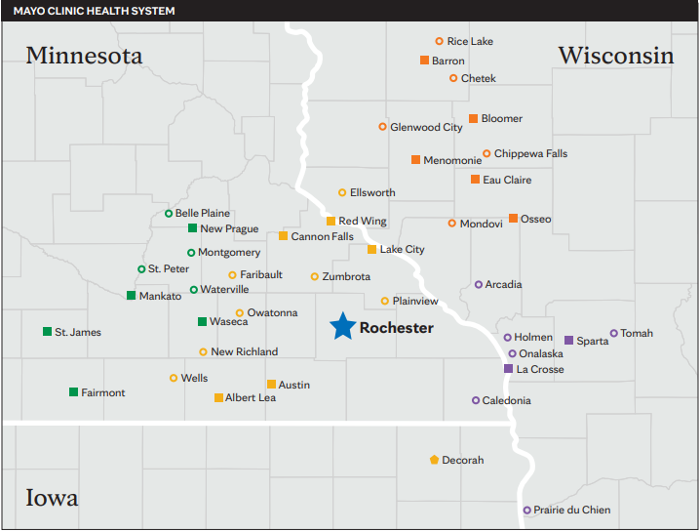
Mayo Midwest - Who Are We?

Slide 3
Mayo Midwest Family Medicine
Ma | Rochester | NWWI | SWWI | SEMN | SWMN | Total
Total Sites | 5 | 10 | 8 | 13 | 9 | 45
MD/DO | 61 | 68 | 53 | 46 | 47 | 275
NP/PA (APP) | 58 | 45 | 25 | 68 | 57 | 253
Residents | 27 | 15 | 18 | 0 | 15 | 75
Total Patient | 70,678 | 92,710 | 64,265 | 113,640 | 73,702 | 414,995
Care Teams | 11 | 23 | 27 | 27 | 28 | 116
Average Panel Size (FTE adjusted) | 2537 | 2076 | 2107 | 2298 | 1556 | 2115

Slide 4
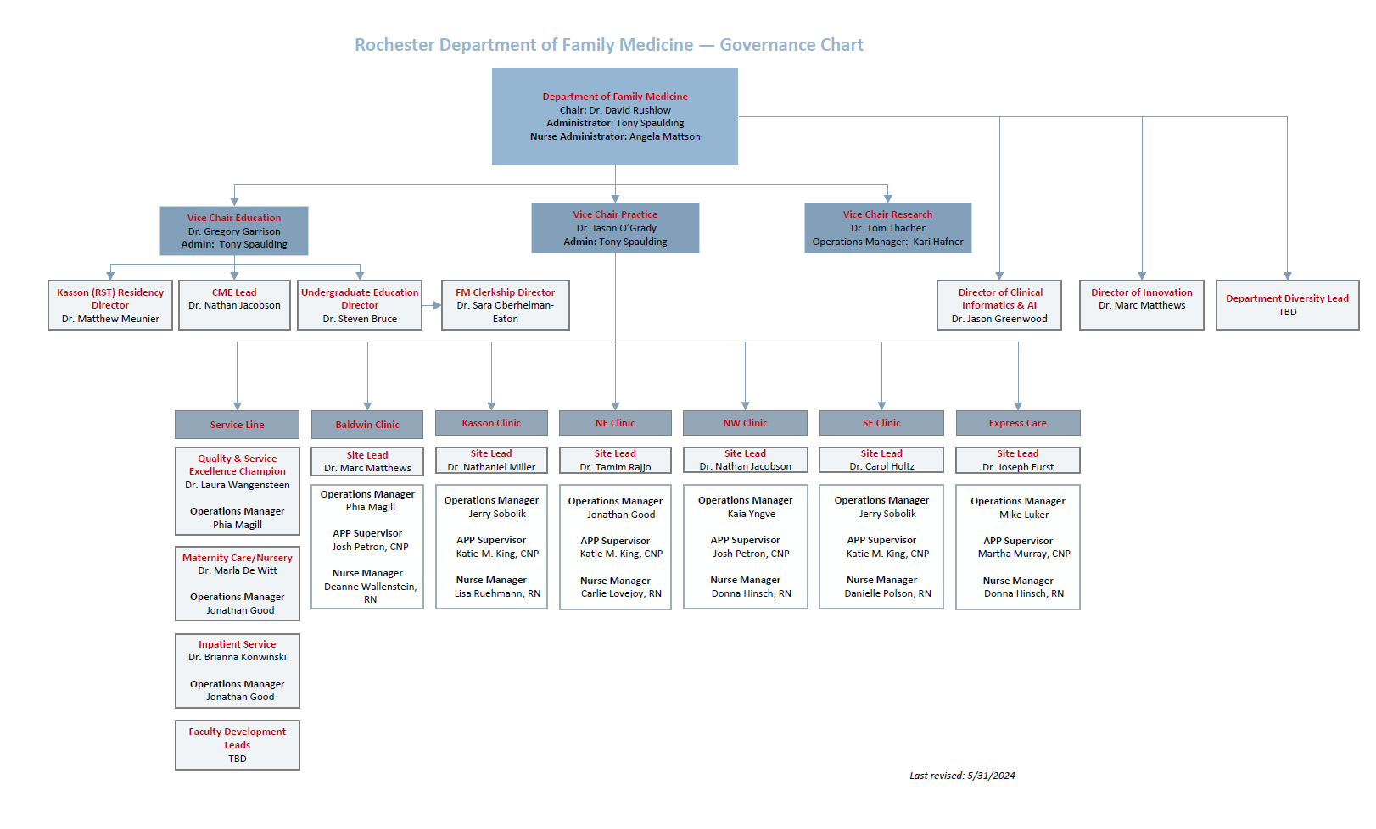

Slide 5
Focus for Care Team Transformation Taking Better Care of More People
Improve Quality of Care
Chronic disease management
Disease prevention/ wellness
Patient Satisfaction
Enhance Access
Strengthen Continuity
Expand Panel size/clinician
Current goal = 2200 risk adjusted patients/physician
Maintain workable templates for synchronous care
30 min visit duration, 30hr visit care 10hr non visit care/week
Inspire Care Team satisfaction

Slide 6
Care Team Composition Current State
Clinicians – MD/DO, APP – NP/PA
Paneled practices
Outpatient clinic, Hospital, OB, niche practices
Nursing – RN, LPN, CMA
Patient triage, rooming, after visit cares, in basket, phone
Desk Operations
Patient check-in, Appointment scheduling
Pharmacists
Synchronous and Asynchronous consultations, Medication management
Integrated Behavioral Health
Integrated Behavioral Health – Imbedded social work, psychology
Integrated Community Specialties
Cardiology, Neurology, Orthopedic Surgery, Spine, GI, Endocrinology, Dermatology, Occ Med, Podiatry, Geriatrics

Slide 7
Future Care Team Innovations
Role of non licensed roomer
Digital advances to speed rooming workflow
Patient self rooming
Expand virtual visit utilization
Advanced pre-visit triage
Right patient, Right time, Right model of care
Virtual 24/7/365
Digital self triage with option of virtual clinician visit
Ambient Documentation/AI assisted in-basket management

Slide 8
Key Metrics focused on Quadruple Aim The Needs of the Patient Come First – Mayo Clinic primary value
Quality outcomes – Disease management, prevention
Patient satisfaction – Press Ganey survey, complaints/complement
Staff satisfaction – annual staff survey, leadership rounding
Access – lag times, continuity, fill rates, OPV’s, virtual visit %
Finance – Revenue, Expense, NOI/margin, cost/panel pt.
Operations – panel size, staffing to workload, forecasting to adjust capacity.
These metrics drive request for approval for future staffing

Slide 11
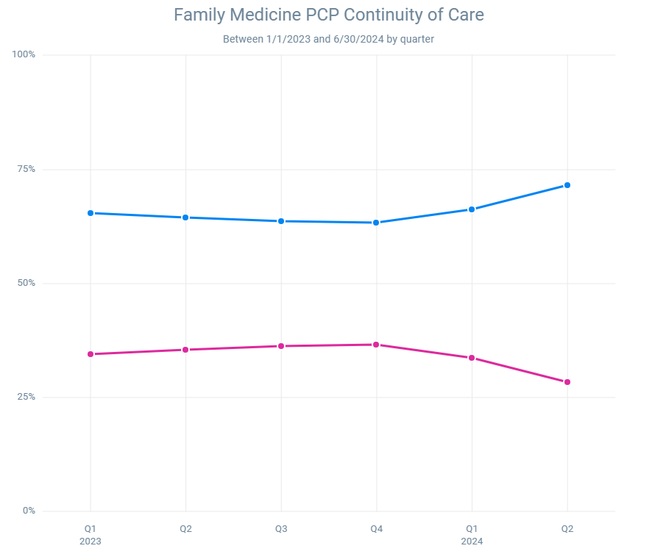
Provider Continuity of care
Q1 66.2%, increased from 65.5% prior Q1
Excludes Same Day/PST appts
Notes:
Epic SlicerDicer Family Medicine PCP Continuity of Care
Excludes Same Day/PST appts

Slide 12
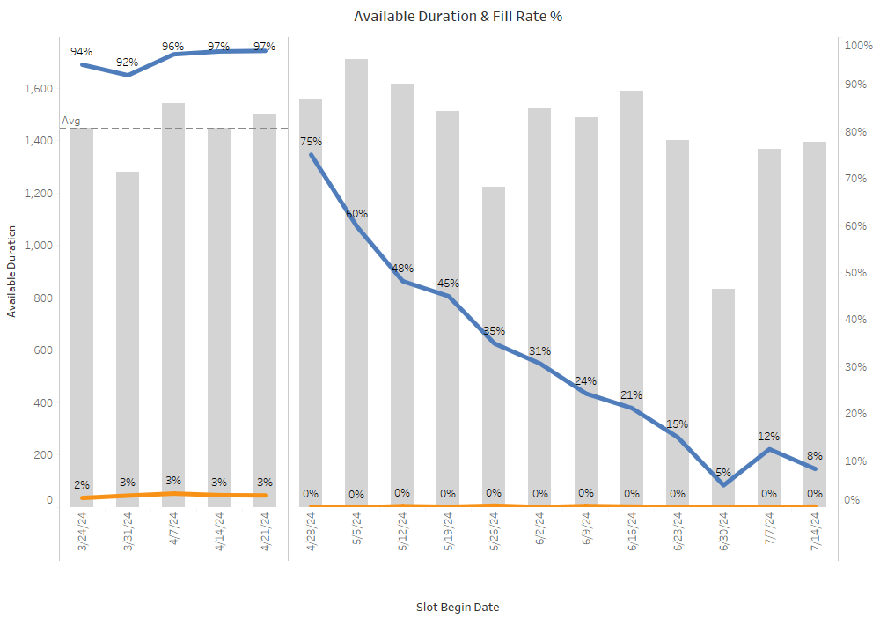
Provider Capacity
Future Weekly Availability & Fill Rates
Fill Rates increased the past 3 weeks
Current Week
as of 4/27
Notes:
https://vprod.mayo.edu/#/site/oam/views/AccessGateway/Capacity/b799e27f-9831-4eba-83be-6e58d7d1a2c3/PrimaryCareFAMWeekly?:iid=1
Capacity tab
Available Duration and Fill Rate % graph
Off-Template Time includes appts booked into time outside of available time. This include appt overbooks (booked on a slot that is greater than the number of regular openings, e.g. seeing more than one patient when you are only templated for one), appts booked during unavailable time, or appts booked onto templates without a pattern. Excludes appts over Clinical Outpatient and Supervising/Precepting.

Slide 13
Central Strategic Programs
Model Unit
Typical Family Medicine unit in composition and structure
Consist of change agents with proven track record
Coordination through Department leadership and healthcare engineers
Rapid cycle PDSA, data driven with planned phases
iLab – Waking the sleeping giant
An interface between family medicine and digital innovators within and outside Mayo to help advance strategic priorities
A branch of our research shield to design, test and implement promising AI/digital technology.
Examples – Ambient documentation, AI-ECG, digital EHR assistant

Slide 14
QUESTIONS & ANSWERS

