Slide 1
Health Policy: Discuss # 2

Slide 2
What thoughts do you have now about Health Policy?
What thoughts do you have on the “Sick Around the World” video?

Slide 3
International Comparisons
In three sentences, please summarize the findings of the paper.
Describe which data are the most convincing to support the finding.
Why do you think the authors chose to study this? What agenda could they have?
Describe the faults that you can find with the paper.
What is your opinion about the findings? Do you agree or disagree and why?

Slide 4
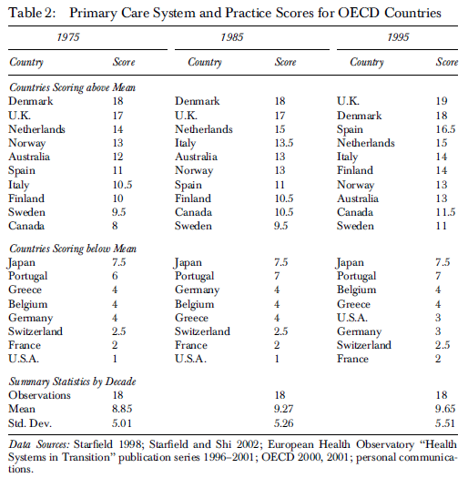

Slide 5
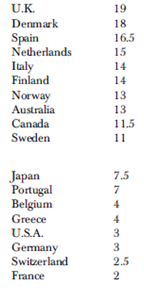

Slide 6
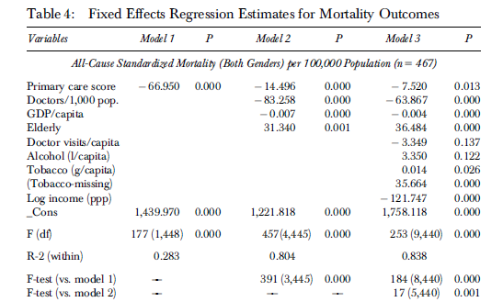

Slide 7
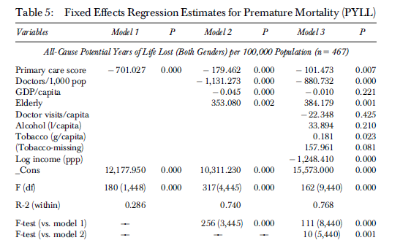
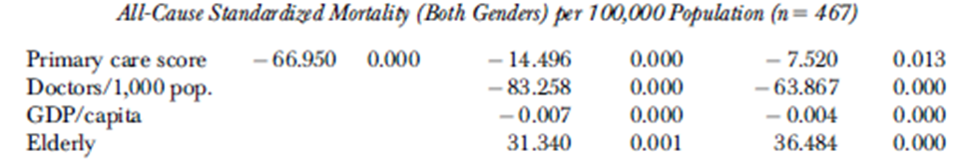

Slide 8
State Comparisons
In three sentences, please summarize the findings of the paper.
Describe which data are the most convincing to support the finding.
Why do you think the authors chose to study this? What agenda could they have?
Describe the faults that you can find with the paper.
What is your opinion about the findings? Do you agree or disagree and why?

Slide 9
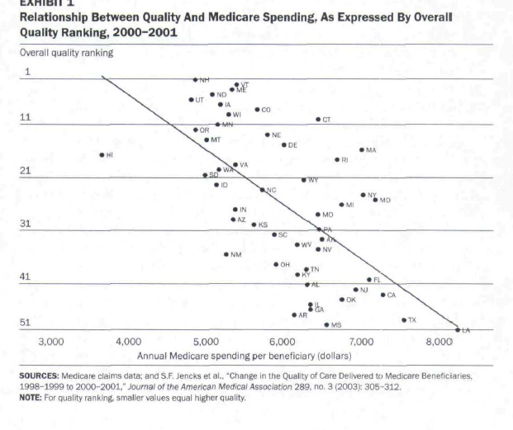

Slide 10


Slide 11
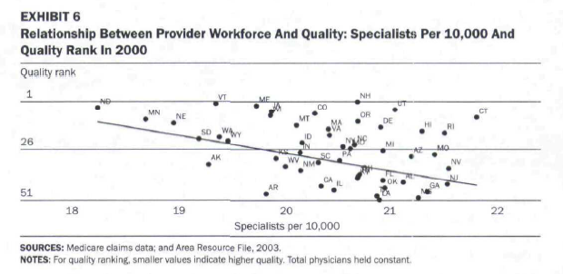

Slide 12
