Slide 1


Value of Measuring Longitudinal Continuity of Care
Notes:
Warren

Slide 2

Longitudinal Continuity of Care (CoC) Measure
Bice-Boxerman Index: A score closer to 0 indicates high fragmentation across multiple clinicians while a score closer to 1 signifies high continuity with one clinician
Performance Threshold: The ABFM uses 0.7 as the threshold score for high continuity
Clarifying Denominator: only patients with at least two visits are included
With Medicare data we can measure continuity for more than 50,000 Family Physicians and assess their attachment to a health system
Notes:
Bob

Slide 3
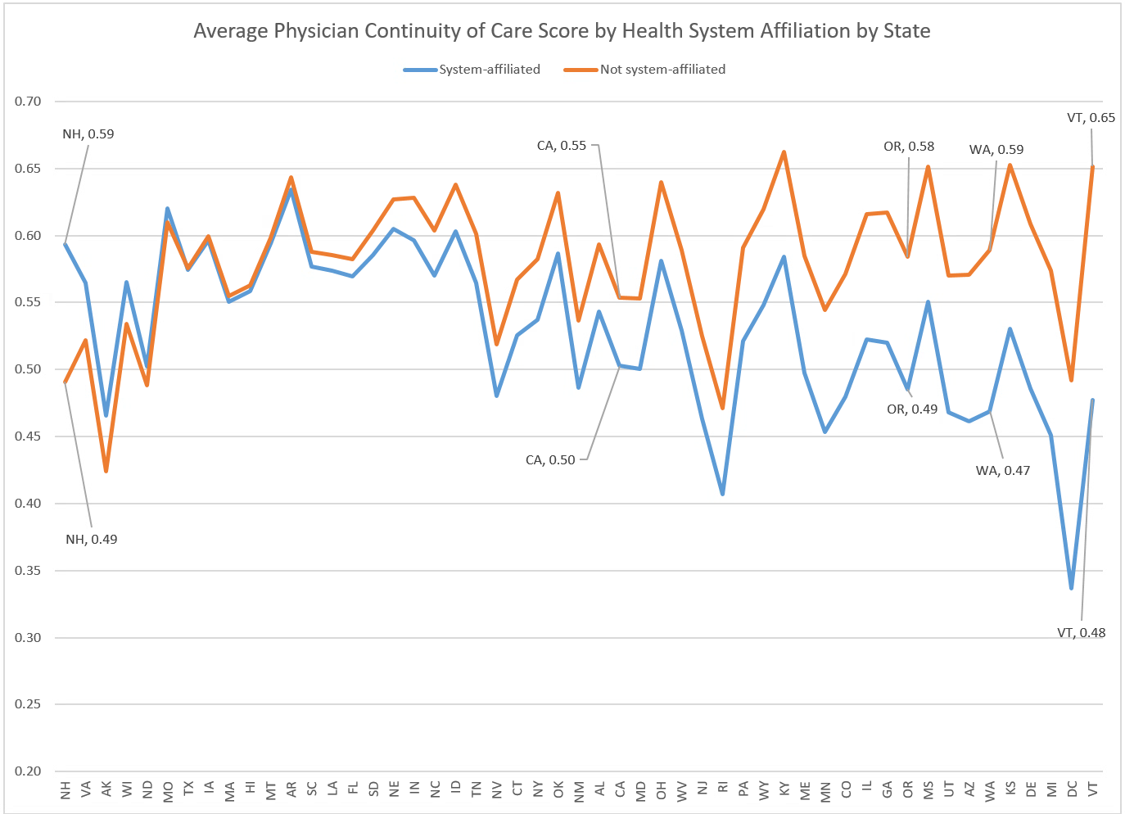

Slide 4
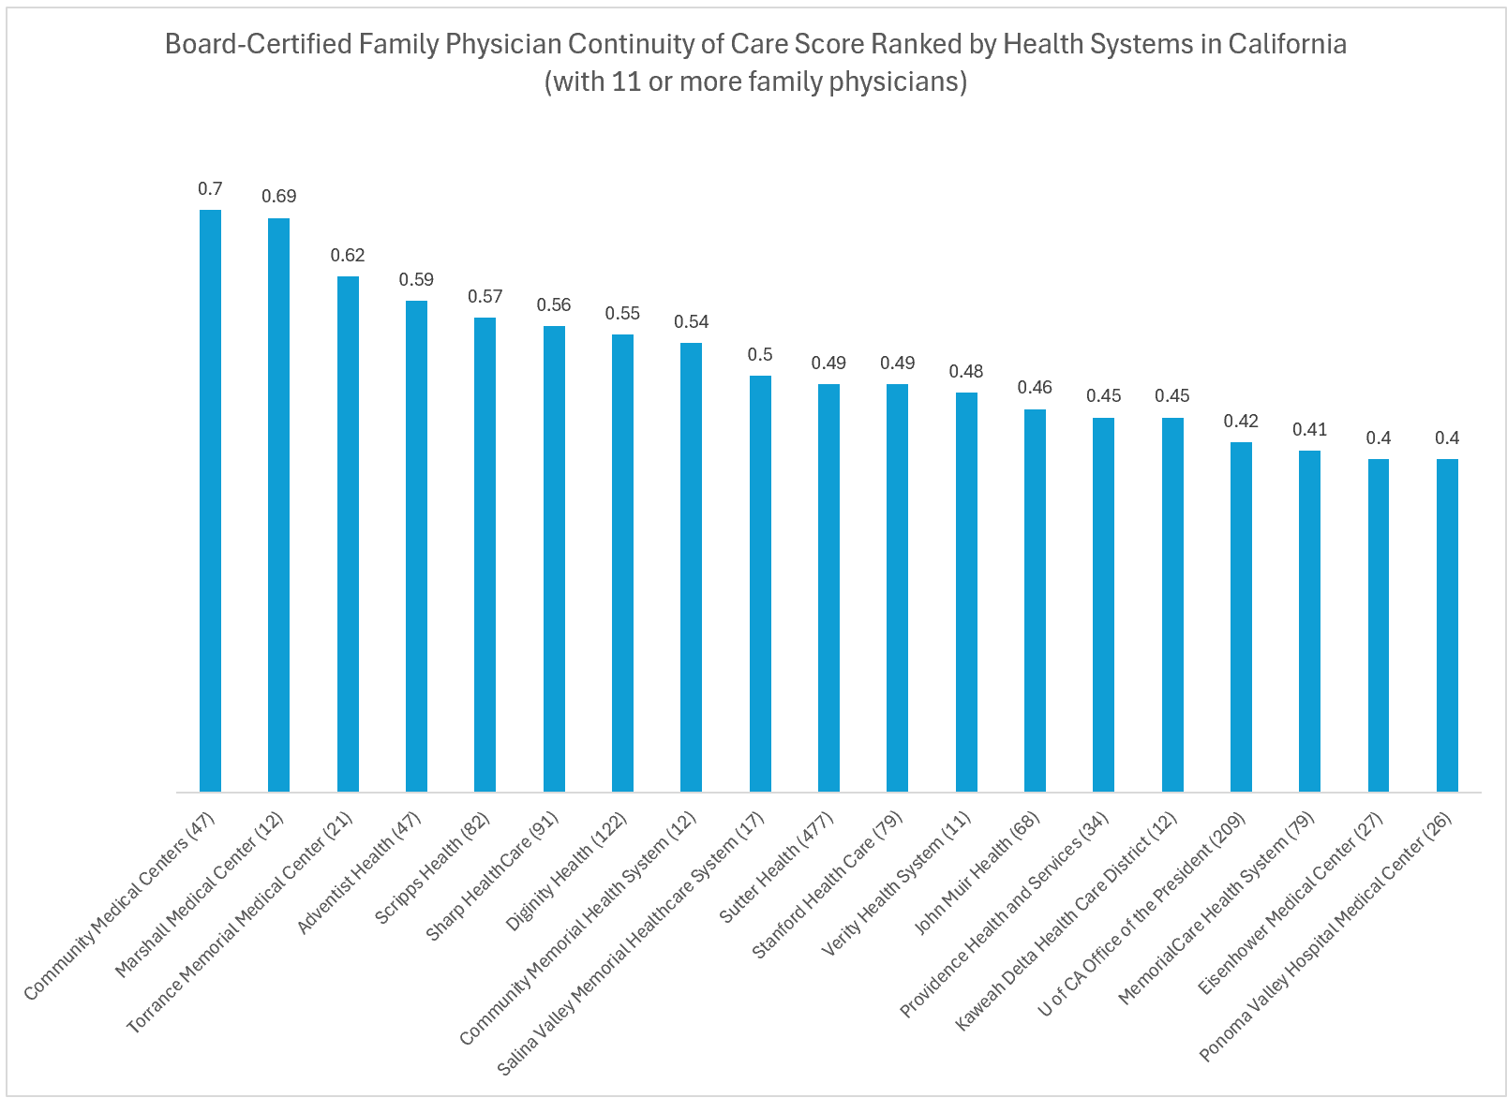
0.7
CoC Scores by Health System
0.4
Community Health Centers
Pomona Valley Hospital Med Ctr
* Analysis of 2016 Medicare FFS claims, ABFM certified physicians
Notes:
Bob

Slide 5
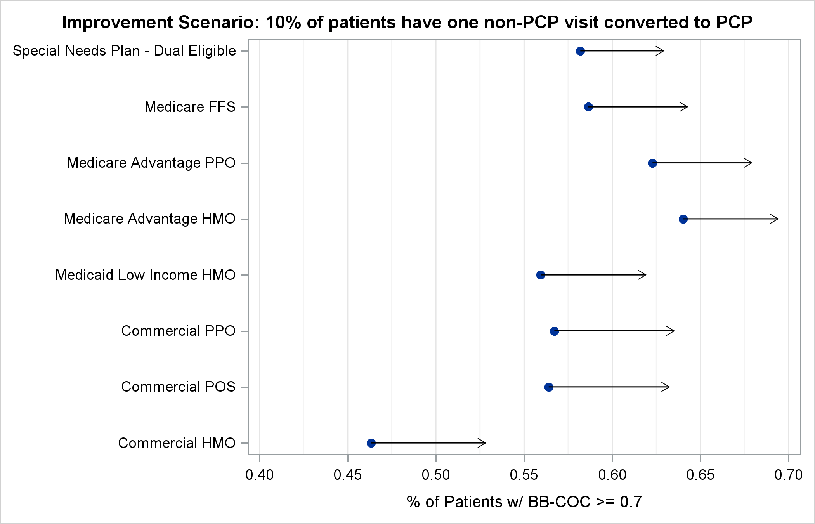
Improvement
Achievable
CoC Scores after 10% of Patients convert from one Non-Attributed PCP Visit to an Attributed PCP*
*Scenario conducted using 2021 Virginia All-Payer Claims Database
Notes:
Poonam

Slide 6
When patients and family caregivers are part of an ongoing, long-term relationship with a clinician…
Their health is better in a wide range of chronic disease areas including diabetes, asthma, cancer, and dementia and there is reduced mortality
There are lower healthcare costs, including total costs, emergency department costs, nursing home costs, and hospital admissions costs
There is higher clinician and patient satisfaction
There is reduced healthcare utilization
The loss of longitudinal relationships in primary care results in approximately
$979 million in excess health care expenditures for public and private payers annually
The greater the improvement in Continuity, the greater positive impact on outcomes and costs
Notes:
Bob

Slide 7
Physicians with higher continuity had lower total cost of care for patients
Family Physicians in California
Continuity Score | N | Total Average Costs (S.D.)
<0.3 | 173 | $17,860 (+/- $10,562)
0.3-0.5 | 1,311 | $14,366 +/-$7,367
0.5-0.7 | 1,430 | $13,837 (+/-$8,660)
>0.7 | 932 | $12,657 (+/-$6,064)
~30% difference
*Analysis of 2016 Medicare FFS claims, ABFM certified physicians
Notes:
Bob

Slide 8
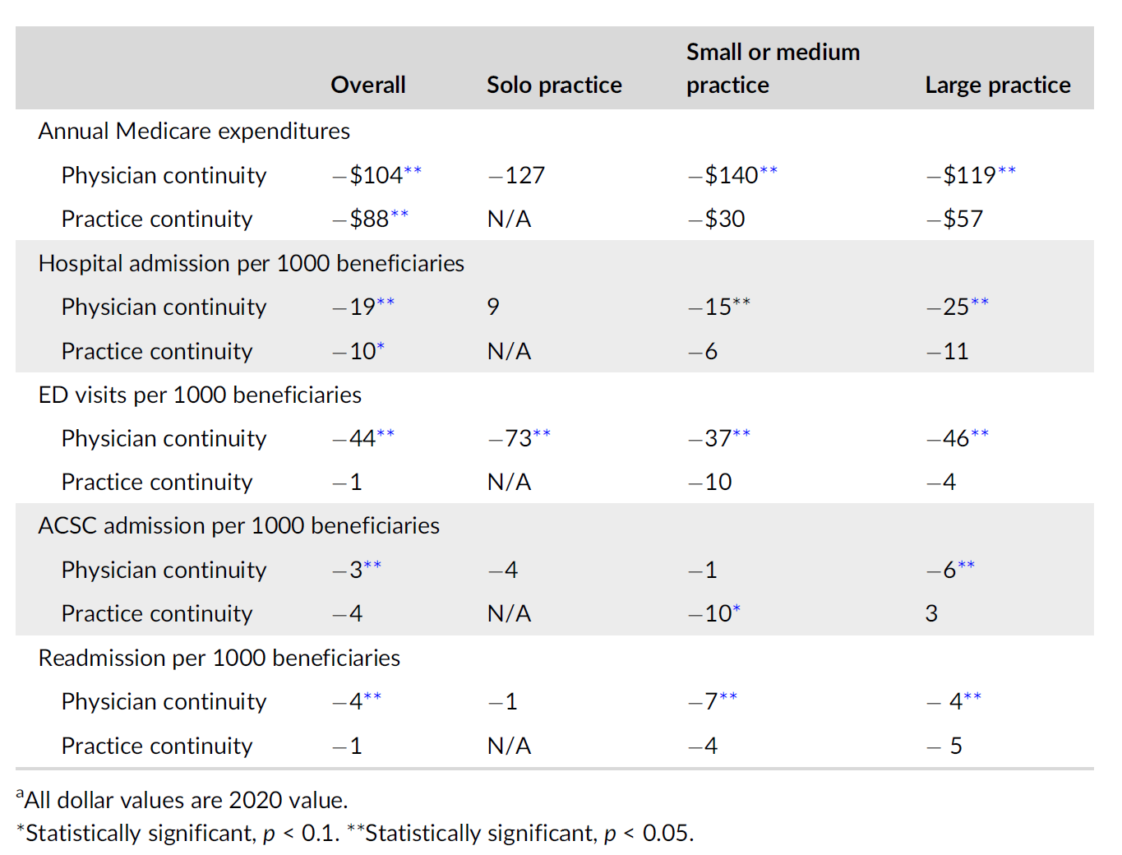
Physician vs Practice Level Continuity
Impact of 0.1 Increase in CoC Scores on Various Outcomes
Physician & practice levels associated with lower expenditures and better outcomes
Physician-level more impact on outcomes
No reliable approach to team-based practice
Notes:
Poonam

