Slide 1
Bright Spot: Establishing a Department of Family & Community Medicine at GW
P
Andrea Anderson, MD, M.Ed., FAAFP
Associate Professor, Associate Chief of the Division of Family Medicine
Chair, American Board of Family Medicine (ABFM)
Associate Professor I Division of Family Medicine
The George Washington School of Medicine and Health Sciences

Slide 2
Discussion Items
Brief History of Family Medicine at GW SMHS
Benefits of Departments of Family Medicine
Intersection of Family Medicine and Population Health
Future Directions and Lessons Learned

Slide 3
Family Medicine at GW – a brief history

Slide 8
Educational Excellence & Innovation
The GW academic medical enterprise has a reputation for leadership and innovation in medical and health sciences education. We will continue that tradition through an innovative curriculum, an emphasis on population health, health equity and antiracism, support for faculty excellence, and the application of new educational technologies across all our learning environments.

Slide 9
Excellence in Core Research Areas
The GW academic medical enterprise is at the leading edge of high-impact medical and health sciences research and a leader in the translation of discoveries into clinical care and improved health equity. Our future prioritizes areas of strength which will drive growth and excellence in research – from discovery to implementation.

Slide 10
Distinction in Health Care Delivery
GW clinicians aspire to provide the highest quality of care to our patients. We embrace novel approaches to providing value-driven health care to serve the needs of all patients to achieve health care that is accessible and equitable in outcomes.

Slide 11
Location in Our Nation's Capital
The GW academic medical enterprise is strategically located in Washington, D.C, providing unparalleled opportunities to integrate leadership, policy, and advocacy into our education, research, and service activities.

Slide 12
Benefits of Family Medicine

Slide 13
Benefits of Family Medicine Departments
Academic family medicine physicians embrace the interdisciplinary team approach
Ideal for interprofessional education
Training medical students, physician assistant students, nursing students, and behavioral health students to work as a team
Academic family medicine physicians engage in health services research and team based science
Increase the GW academic medical enterprise participation in population health and health services research as well as community engagement
More faculty to mentor students interested in both family medicine and population health
Increase access to primary care at GW and expand the workforce broadly
Increases patient referrals/patient pathway to specialty care services
Provide continuity of care throughout the life course
Enhances community engagement in research and patient advocacy

Slide 16
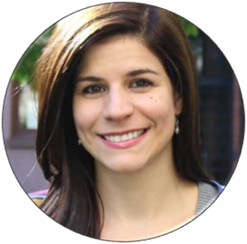
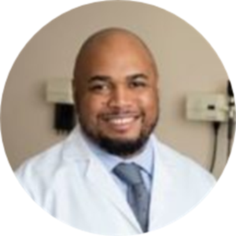
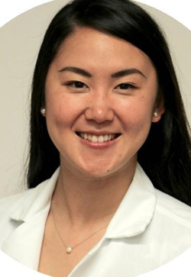
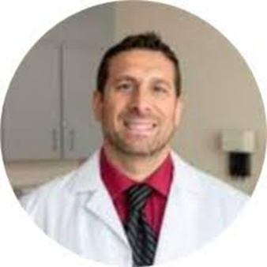
Department of Emergency Medicine’s Family Medicine Section
Maria Portela, MD, MPH
Chief
Assistant Professor
Andrea Anderson, MD, MEd, FAAFP
Associate Chief
Associate Professor
Marcus Davis, MD
Assistant Professor
Emmeline Ha, MD
Assistant Professor
Joel Willis, DO, MPAS, MPhil, MS
Assistant Professor

Slide 17
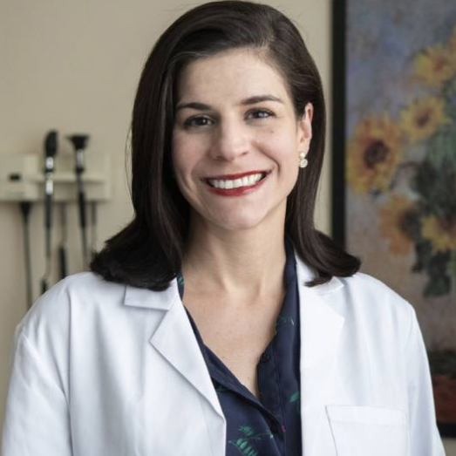
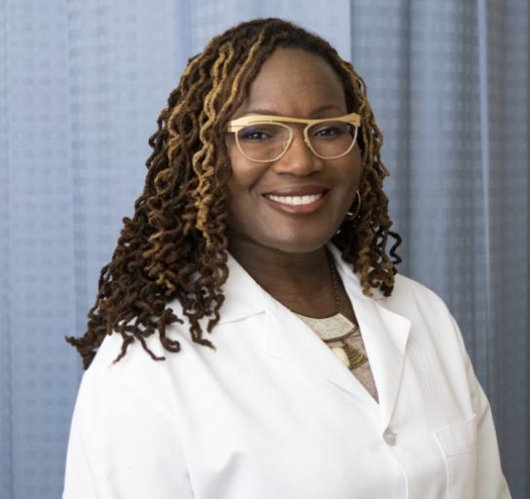
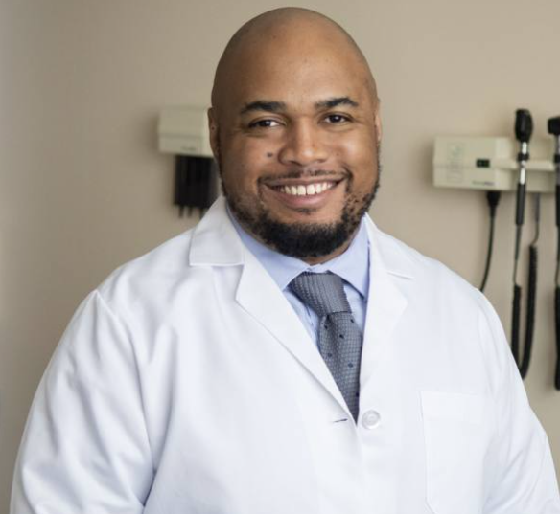
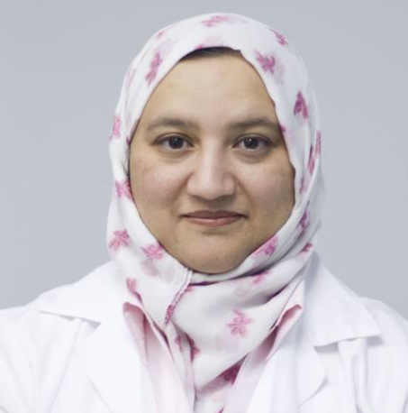
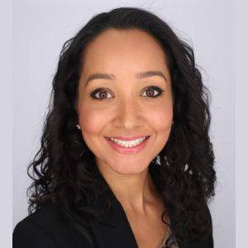
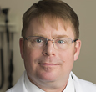
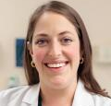
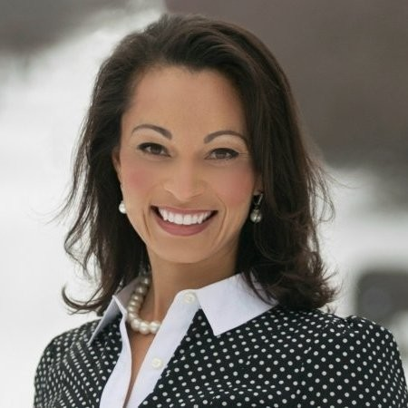
FINAL ROUND!

Slide 18
Department of Emergency Medicine’s Family Medicine Section
Engage in the provision of clinical services as part of the GW MFA Community Primary Care Initiative (formerly the Immediate Primary Care Program)
Actively serve as clinician educators in various academic programs within the GW SMHS & GW Milken Institute School of Public Health
Engage in medical education outcomes research, healthcare workforce research, and health services research
From 2019-2023, the Family Medicine Section faculty published over thirty (30) peer review manuscripts with several of them published in prominent journals such as JAMA, Health Affairs, Annals of Family Medicine, American Family Physician, Annals of Internal Medicine, Academic Medicine, and the Journal of the American Board of Family Medicine
Locally and nationally recognized leaders, holding numerous positions in professional societies, boards, and commissions

Slide 19
Family Medicine Section Achievements
Partners with the American Board of Family Medicine’s (ABFM) Center for Professionalism & Value (CPV) in Health Care to operate the CPV-GWU Health Policy Research Fellowship
Graduated 4 fellows, all of whom hold leadership positions in the health equity space, two of them within our Section, while practicing clinically and continuing to publish
Recently received an endowment from the ABFM Foundation, making this a financially sustainable program

Slide 20
Intersection of Family Medicine and Population Health

Slide 21
Intersection of Population Health & Family Medicine
Family Medicine
Prevention and Health Promotion
Interprofessional Teamwork
Community Health
Social Determinants of Health

Slide 22
Future Directions

Slide 23
Next Steps
Developing an academic Department of Family and Community Medicine with core faculty to support clinical, educational, and research programs aligned with the GW academic medical enterprise strategic plan.
Developing a full-scope family medicine clinical service to meet community needs and satisfy ACGME requirements for family medicine training.
Developing GW family medicine educational programs including an ACGME accredited residency program and clerkships for medical students and PA students
Strengthening family medicine research programs with a focus on population health and health services research

Slide 24
Lessons Learned
Coalition Building
Alignment with Strategic Priorities
Stakeholders in key places
Student and Community Passion
Persistence
Data, Data, Data
Support from the Family of Family Medicine

Slide 25
References
Ha, E., Taskier, M., Anderson, A., Martinez, M. P., & Bazemore, A. W. (2024). Setting the Target: Comparing Family Medicine Among US Allopathic Target Schools. Family Medicine, 56(5), 280–285. https://doi.org/10.22454/FamMed.2024.510377

Slide 26
Acknowledgements
Emmeline Ha, MD
LaQuandra Nesbitt, MD

