Slide 2
Create a Publishable Family Medicine Research Project in Six Easy Steps
A URiFM | PRiMER Collaboration
#URiFM
@PRiMER_Journal

Slide 3
URiFM Scholarship Work Group
Cesar A. Gonzalez, PhD, ABPP Clinical Health Psychologist Associate Program Director, Family Medicine Residency Mayo Clinic, Rochester, MN
Angela Antonikowski, PhD Clinical Health Psychologist
Chief Health Equity, Diversity & Inclusion Officer Albany Medical College, Albany, NY
Magdalena Pasarica, MD, PhD Family Medicine Physician & Nutritionist
Medical Education and Family Medicine University of Florida, Orlando, FL
Jay-Sheree Allen, MD Family Medicine Physician CentraCare Long Prairie, MN
Tyson Pankey, PhD, MPH Clinical Health Psychologist Duke University, NC
Mindy Householder
STFM Partner
STFM, Leawood, KS
#URiFM
URiFM = Underrepresented in Family Medicine

Slide 4
URiFM Scholarship Group
Research Skills
Jay-Sheree Allen, MD
Angela Antonikowski, PhD
Cesar Gonzalez, PhD
Tyson Pankey, PhD, MPH
Magdalena Pasarica, MD, PhD
Mindy Householder
To increase the percentage of URiFM students, residents, and faculty who have the skills to produce scholarly research
#URiFM

Slide 5
URiFM Scholarship Work Group
Lack of publications
Low URM Faculty Rates
Lack of community research among racial/ethnic minority populations
Disparity in URM
academic leaders
Lack of URM representation and visibility in academic medicine
Problem
Lack of URM researchers in family medicine
Less tailored prevention and intervention
URM nonengagement in
academic medicine
Effects
Health inequities
and disparities
Not understanding impact of
research on health disparities/inequities
Perceived lack of research funding
for minority issues
Lack of tangible
research skills
Root Causes
Low SES/
Lack of Resources
Hidden curriculum/ micro-barriers
Lack of URM mentorship
Patterns of research exclusion/control
Perceived lack of ability by others
Disadvantaged Status
Limited exposure
to research
Racism in
academic medicine
Lack of URM visibility in research
#URiFM
[STFM Diversity Initiative: URiFM Scholarship Work Group]

Slide 6
Scholarship Work Group Activities
Upcoming: Writing Labs/Retreats/WAG; Online Community of URiFM Scholars
@PRiMER_Journal
#URiFM
Notes:
Twitter Chats (Awareness-building)
Webinars (Knowledge)
Workshops (Skills Development)
3 Twitter Chats
3 webinars
1 Workshop
Upcoming Writing

Slide 7
An open access scholarly journal of STFM
-PRiMER is committed to justice, equity, diversity, and inclusion
-Editor working group
-Partnership with URiFM Scholarship Work Group to support the Group’s mission
-Editorial Board transparent pathway and selection process
-Editor-Mentor pilot program for URiFM submitting authors
@PRiMER_Journal #URiFM
Notes:
Amanda

Slide 8
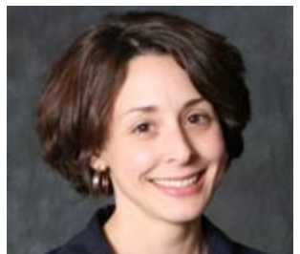
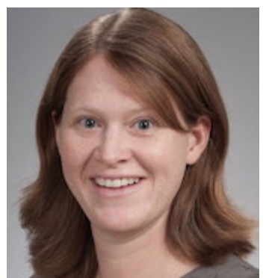
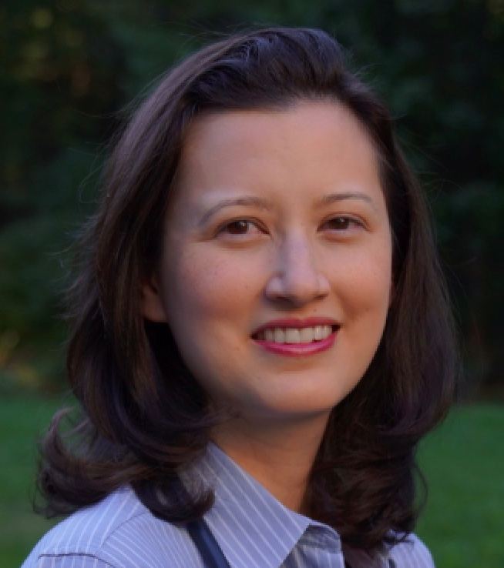
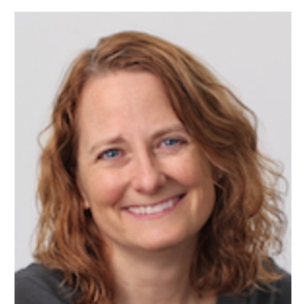
Associate Editors on today’s webinar
Kristen Bene PhD
UCHealth Fort Collins, CO
Amanda Kost, MD, MEd
U Washington, WA
Amy Lee, MD
Tufts University, MA
Andrea Wendling, MD
Michigan State, MI
@PRiMER_Journal #URiFM
Notes:
Amanda

Slide 9
Agenda
Presentation (20 min)
Small Group Breakout Session (20 min)
Large Group Report Out and Wrap Up (10 min)
Notes:
Amanda

Slide 10
Learning Objectives
By the end of this workshop, participants should be able to:
Describe Glassick’s six step approach.
Apply one approach to systematic inquiry to an area of research interest.
Critique a current research project for areas of strengths and areas for improvement.
Notes:
Amanda - 7:10pm

Slide 11
A Systematic Approach to Inquiry
Glassick’s Six Steps
Clear goals
Adequate preparation
Appropriate methods
Significant results
Effective presentation
Reflective critique

Slide 12
Clear Goals
Choose something you care about a lot (because you are going to spend a lot of time on this project!)
How does this project fit into your larger scholarship goals?
Seek an answer that is important to the field.
Ask a clear research question or formulate a clear hypothesis.
Ask yourself “What do you want to be able to say at the end, if your project worked?”
Build a clear, achievable, measurable project.
Notes:
Amy
https://meridian.allenpress.com/jgme/article/10/1/1/33521/A-Toolkit-for-Medical-Education-Scholarship
https://www.ncbi.nlm.nih.gov/pmc/articles/PMC4936839/
https://meridian.allenpress.com/jgme/article/4/1/111/200291/Meeting-the-Scholarly-Project-Requirement?searchresult=1
https://journals.lww.com/academicmedicine/fulltext/2000/09000/boyer_s_expanded_definitions_of_scholarship,_the.7.aspx
https://www.researchgate.net/publication/12326832_Scholarship_in_Teaching_An_Imperative_for_the_21st_Century

Slide 13
Adequate Preparation: Reviewing the Literature
Conduct a baseline literature search.
Where are the gaps?
Where is there a need for more information?
Think expansively.
Then, ask yourself “Is this project publishable?"
Consider areas of study adjacent to your topic.
Consider past terminology.
Who is my audience?
Will anyone care and want to read this now that I know what is already out there?”
Notes:
Kristen
Conduct a baseline literature search. to see if this question has been adequately answered in the literature, or if and where there are gaps.
Sufficient baseline knowledge and resources about the topic. Where is there a need for more research to inform practice or teaching?
-Think expansively about literature that might be similar or adjacent to what you want to study, and how that impacts how people think about this topic?
-Is this project publishable? Who is your audience? Will anyone care and want to read this?
-Historical, national, organizational or policy background that is important to write about in the manuscript to frame your scholarship
-A refined research question or hypothesis, based on the above
-You should be able to write a preliminary “background” section at this point
-Write as you go

Slide 14
Adequate Preparation: Writing the Literature Review
Frame your scholarship appropriately:
Historical
National
Organizational
Policy
You should have written a preliminary “background and introduction” section of your manuscript by this point
Write as you go.
Propose a refined research question or hypothesis, based on the above.
Funnel approach.
Notes:
Kristen
Conduct a baseline literature search. to see if this question has been adequately answered in the literature, or if and where there are gaps.
Sufficient baseline knowledge and resources about the topic. Where is there a need for more research to inform practice or teaching?
-Think expansively about literature that might be similar or adjacent to what you want to study, and how that impacts how people think about this topic?
-Is this project publishable? Who is your audience? Will anyone care and want to read this?
-Historical, national, organizational or policy background that is important to write about in the manuscript to frame your scholarship
-A refined research question or hypothesis, based on the above
-You should be able to write a preliminary “background” section at this point
-Write as you go

Slide 15
Appropriate Methods and Meaningful Results
Designing your methods:
consider the Who, What, Where, When, and How of your study
Study design: What
Study participants: Who
Setting: Where and When
Data Collection and Data Analysis: How
Notes:
Andrea
Study design: randomized controlled trial, prospective/retrospective cohort, cross sectional, etc. Recruitment, inclusion/exclusion criteria Setting: where, when follow up surveys, etc. Intervention, tools, variables, missing data, etc.

Slide 16
Appropriate Methods and Meaningful Results
Make sure your methods answer your study questions
Write your methods section with enough detail that someone could replicate your study
Study objectives, methods, and results need to be congruent
Include an IRB statement
Methods section of Proposal can be used for final paper
Results section should flow from methods
Try to get numbers in tables--and to write with words
Highlight the most meaningful results
No results in methods… and no methods in results
Notes:
Andrea

Slide 17
Effective Presentation
Read the instructions to authors (conferences or manuscripts)
JANE to find your journal!
Writing tips -just do it (Pomodoro), active voice, schedule time to this
One idea per paragraph, tell a story
https://jane.biosemantics.org/
Notes:
Amanda

Slide 18
Reflective Critique
Discussion of strengths and limitations of ALL aspects of the study.
But I don't want to tell the journal my study sucks!
Pointing out limitations actually helps readers feel better about it!
Next steps - how does this fit into what is known about the topic?
Did you answer the question you set out to answer? What is the next question?
Design, measures, procedure, sample & analysis.
Notes:
Amanda
Explicit theoretical framework
No mention at all.
Reference to broad theoretical basis.
Reference to a specific theoretical basis.
Explicit statement of theoretical framework and/or constructs applied to the research.
Statement of aims/objectives in main body of report
No mention at all.
General reference to aim/objective at some point in the report including abstract.
Reference to broad aims/objectives in main body of report.
Explicit statement of aims/objectives in main body of report.
Clear description of research setting
No mention at all.
General description of research area and background, e.g. ‘in primary care’.
General description of research problem in the target population, e.g. ‘among GPs in primary care’.
Specific description of the research problem and target population in the context of the study, e.g. nurses and doctors from GP practices in the east midlands.
Evidence of sample size considered in terms of analysis
No mention at all.
Basic explanation for choice of sample size. Evidence that size of the sample has been considered in study design.
Evidence of consideration of sample size in terms of saturation/information redundancy or to fit generic analytical requirements.
Explicit statement of data being gathered until information redundancy/saturation was reached or to fit exact calculations for analytical requirements.
Representative sample of target group of a reasonable size
No statement of target group.
Sample is limited but represents some of the target group or representative but very small.
Sample is somewhat diverse but not entirely representative, e.g. inclusive of all age groups, experience but only one workplace. Requires discussion of target population to determine what sample is required to be representative.
Sample includes individuals to represent a cross section of the target population, considering factors such as experience, age and workplace.
Description of procedure for data collection
No mention at all.
Very basic and brief outline of data collection procedure, e.g. ‘using a questionnaire distributed to staff’.
States each stage of data collection procedure but with limited detail, or states some stages in details but omits others.
Detailed description of each stage of the data collection procedure, including when, where and how data were gathered.
Rationale for choice of datacollection tool(s)
No mention at all.
Very limited explanation for choice of data collection tool(s).
Basic explanation of rationale for choice of data collection tool(s), e.g. based on use in a prior similar study
Detailed explanation of rationale for choice of data collection tool(s), e.g. relevance to the study aims and and assessments of tool quality either statistically, e.g. for reliability & validity, or relevant qualitative assessment.
Detailed recruitment data
No mention at all.
Minimal recruitment data, e.g. no. of questionnaire sent and no. returned.
Some recruitment information but not complete account of the recruitment process, e.g. recruitment figures but no information on strategy used.
Complete data regarding no. approached, no. recruited, attrition data where relevant, method of recruitment.
Study Methodology
Quantitative
Qualitative
Mixed Methods
Fit between research question and method of analysis
No mention at all.
Method of analysis can only address the research question basically or broadly.
Method of analysis can address the research question but there is a more suitable alternative that could have been used or used in addition to offer greater detail.
Method of analysis selected is the most suitable approach to attempt answer the research question in detail, e.g. for qualitative IPA preferable for experiences vs. content analysis to elicit frequency of occurrence of events, etc.
Good justification for analytical method selected
No mention at all.
Basic explanation for choice of analytical method
Fairly detailed explanation of choice of analytical method.
Detailed explanation for choice of analytical method based on nature of research question(s).
Evidence of user involvement in design
No mention at all.
Use of pilot study but no involvement in planning stages of study design.
Pilot study with feedback from users informing changes to the design.
Explicit consultation with steering group or statement or formal consultation with users in planning of study design.
Strengths and limitations critically discussed
No mention at all.
Very limited mention of strengths and limitations with omissions of many key issues.
Discussion of some of the key strengths and weaknesses of the study but not complete.
Discussion of strengths and limitations of all aspects of study including design, measures, procedure, sample & analysis.

Slide 19
Choose your preferred inquiry type
Notes:
Magdalena

Slide 20
Example of discovery educational scholarship
Sessions with same objectives delivered in 2 different ways
Study the learning outcome, engagement, student satisfaction, etc…
Example of teaching scholarship
Create a curriculum using a systematic approach
Study lessons learned
Examples of the 2 most popular types of educational inquiry
Notes:
Magdalena

Slide 21
Small Group Breakout Session
Notes:
(7:25pm)
Explain the three breakout room options – what will be covered
Select a volunteer to report out to the group.
-Does anyone have a project idea, but no goals yet?
-Does anyone have a project idea and goal, but needs to start preparation to refine goals?
-Some backup scholarship case examples to discuss, if no one has any examples they want to share

Slide 22
Group 1
Group 2
Group 3
Goals
and
Preparation
Methods
and
Results
Presentation
and
Reflection
Notes:
(7:45pm)
Amanda – verbalize “please move yourself to the breakout room”

Slide 23
Large Group Report Out
Notes:
7:45pm (start)

Slide 24
THANK YOU! Questions or Comments
Notes:
7:55pm

Slide 25
UPCOMING EVENTS STFM Medical Student Education, January 26-28, 2022: Become a Peer Review Rock Star: Top Ten Tips for Peer Review of Medical Education Research Succeeding as a Scholar Underrepresented in Medicine: A Beginner's Guide for Students, Residents, and Faculty

Slide 26
Contact Information
Contact Information:
PRiMER presenters
Kristen Bene kristen.bene@uchealth.org
Amanda Kost akost@uw.edu
Amy Lee amy.lee@tufts.edu
Andrea Wendling wendli14@msu.edu
Contact Information:
URiFM presenters
Magdalena Pasarica Magdalena.Pasarica@ucf.edu
Tyson Pankey Tyson.Pankey@duke.edu
Angela Antonikowski AntoniA@amc.edu
Cesar Gonzalez Gonzalez.Cesar@mayo.edu

