Slide 1
Family Medicine in the House
Hospital Medicine:
Foundational to Training and Practice
FMLC Debate
Stephen A Wilson, MD, MPH, FAAFP

Slide 2
Why bother?

Slide 3


Slide 4
In the definition
Family medicine is the medical specialty that provides first contact as well as continuous, comprehensive health care for individuals, families and communities across their entire lifespan, while also including care of all genders and reproductive stages. This specialty is distinctive in its broad integration of biological, clinical and behavioral sciences, ensuring a holistic approach to patient care. Family medicine engages in education and advocacy efforts to promote the health and well-being of all individuals while removing barriers to equitable care for all populations. (1984) (September 2024 COD)
https://www.aafp.org/about/policies/all/family-medicine-definition.html

Slide 5
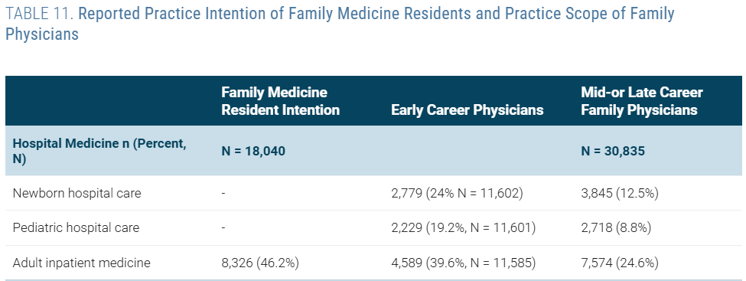
We already do it
9% of FM residency graduates become hospitalists
25% of FM physicians provide adult inpatient care as part of their scope of practice
6. What Do Family Physicians Do? - The Family Medicine Fact Book
Notes:
6. What Do Family Physicians Do? - The Family Medicine Fact Book

Slide 6

Critical in academic settings
Coin of the realm in AHC
Research questions

Slide 7

Good for patients; Good for us
Intellectual stimulation
  Learners
  Attendings
Deceased burnout
Patients want it
  Continuity
  TOC
Separates us from NP/PA
Burnout and Scope of Practice in New Family Physicians
The Association of Practice Type and the Scope of Care of Family Physicians
Family medicine attributes related to satisfaction, health and costs | Family Practice | Oxford Academic
Notes:
Burnout and Scope of Practice in New Family Physicians – Weidner et al
Early career family physicians who provide a broader scope of practice, specifically, inpatient medicine, obstetrics, or home visits, reported significantly lower rates of burnout. Our findings suggest that comprehensiveness is associated with less burnout, which is critical in the context of improving access to good quality, affordable care while maintaining physician wellness.

Slide 8
Value of Family Doctors in Hospital Medicine
Holistic Patient Care
  Family Medicine’s Critical Role in Building and Sustaining the Future of Hospital Medicine
Continuity Across Care Settings
  Family Medicine’s Critical Role in Building and Sustaining the Future of Hospital Medicine
Cost-Effective and High-Value Care
  Family Medicine’s Critical Role in Building and Sustaining the Future of Hospital Medicine
Versatility and Breadth of Training
  AAFP-SHM Joint Statement on Hospitalists Trained in Family Medicine | AAFP
Improved Health Outcomes
  The value of family medicine
Notes:
Family Medicine’s Critical Role in Building and Sustaining the Future of Hospital Medicine –Austad et al
AAFP-SHM Joint Statement on Hospitalists Trained in Family Medicine | AAFP
The value of family medicine – Kolber et al
Holistic Patient Care FM trains in the biopsychosocial model, which helps contextualize illness within the patient’s life. This leads to more empathetic, patient-centered care and better communication with patients and families.
Continuity Across Care Settings Their dual roles in outpatient and inpatient care allow for smoother transitions, reducing readmissions and improving follow-up. This continuity is especially beneficial in safety-net hospitals and underserved communities.
Cost-Effective and High-Value Care Family doctors often practice judicious restraint in ordering tests and procedures, helping control healthcare costs while maintaining quality.
Versatility and Breadth of Training Their training spans pediatrics, obstetrics, geriatrics, and internal medicine, making them adaptable to diverse inpatient populations and capable of managing complex cases.
Improved Health Outcomes Increasing the number of family physicians in a population correlates with lower mortality rates, fewer hospitalizations, and better chronic disease management.

Slide 9
Reasons Why Family Doctors Should Practice Hospital Medicine
Addressing Workforce Shortages
  AAFP-SHM Joint Statement on Hospitalists Trained in Family Medicine | AAFP
Educational Impact
  AAFP-SHM Joint Statement on Hospitalists Trained in Family Medicine | AAFP
Enhanced Career Satisfaction
  Family Medicine Hospitalists Three Years Out of Residency: Career Flexibility or a Threat to Office-Based Family Medicine? | American Board of Family Medicine
Flexibility and Career Options
  Family Medicine Hospitalists Three Years Out of Residency: Career Flexibility or a Threat to Office-Based Family Medicine? | American Board of Family Medicine
Training and Professional Growth
  Family Medicine’s Critical Role in Building and Sustaining the Future of Hospital Medicine
Notes:
AAFP-SHM Joint Statement on Hospitalists Trained in Family Medicine | AAFP
Family Medicine’s Critical Role in Building and Sustaining the Future of Hospital Medicine –Austad et al
Family Medicine Hospitalists Three Years Out of Residency: Career Flexibility or a Threat to Office-Based Family Medicine? | American Board of Family Medicine – Cancino and Jack
Addressing Workforce Shortages Demand for hospitalists exceeds supply, especially in rural and underserved areas. Family physicians can help fill this gap effectively.
Educational Impact Many FM hospitalists are involved in training residents and medical students, shaping the next generation of physicians
Enhanced Career Satisfaction FM hospitalists report higher job satisfaction, better pay, and improved work-life balance compared to outpatient-only peers.
Flexibility and Career Options Practicing hospital medicine allows family doctors to explore different career paths without abandoning their core identity as comprehensive care providers.
Training and Professional Growth Hospital medicine offers exposure to acute care, interdisciplinary teamwork, and opportunities for leadership in hospital administration and policy.

Slide 10
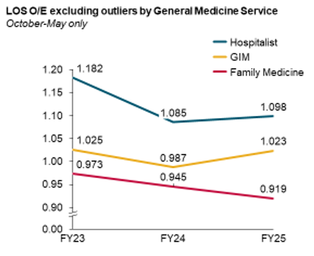
Value of Scale
Critical mass (“too big to fail”) → presence and be able to improve care
  Boston University
  Cabarrus
  UNC
  UPMC St Margaret / Some other community hospitals
The more you do, the more you do and get to do
15% of all discharges in tertiary care hospital
Seat at the table
Vice Chair is also Associate CMO
Adding a 4th FM service

Slide 11

Metrics
LOS
Discharge before noon
TOC
Continuity (inpatient and outpatient)
Patient experience

Slide 12
Impact of Scale – New Staffing Models
Can you rotate 1 week out of 6-12 weeks?
AM presence only?
3 or 4 days at time vs. 7 days
Hospitalist model - 7 days/12 hours/day on alternating weeks
Do all FM Hospitalist have to be in continuity outpatient role to be authentic? Team-based care?
Our model
3 FM inpatient teams staffed with 2 faculty (7A-5P)
Evening service staffed 5P-12A with 1 faculty
Obs Days 7A-7P
Obs Night 7P-7A
Some fuller vs full vs FM hospitalist scope
Pending 4th service (FM4) – will be faculty only – 12 patients; 7d x 10 hr

Slide 13

Should Family Medicine be in the Hospital?
Yes, we should be there
  Outcome
  Patient
  Doctors
  Potential
We should increase our presence
  Influence
  Try to Make Inpt Medicine More Family-Medicine-y Again
Measure things that matter to patients and system and physicians
Different/New models
  Increase faculty interest
  Flexibility for faculty
Potential to bridge gaps between community and hospital care, foster system-wide improvements

