Slide 1

Family Physicians
& Social Drivers of Health
Melissa R. Stephens, MD, MS, FAAFP, DABFM

Slide 2
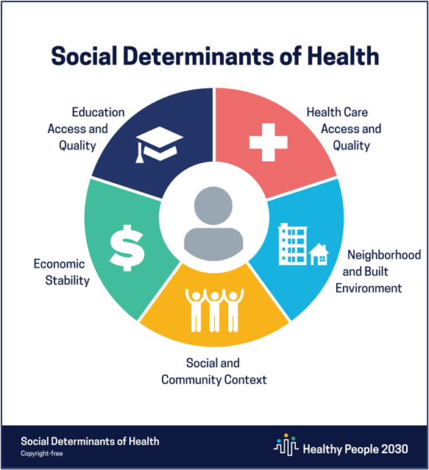
Why should we address SDOH?
SDOH are drivers of moral, ethical, and economic considerations for today’s family physicians
SDOH account for as much as 80% of patient health outcomes
Six or more unfavorable SDOH = 8x risk for premature mortality
Health disparities cost $42 billion in lowered productivity and $93 billion in excess medical costs per year
Value-based care (VBC) prioritizes health outcomes and risk reduction
Comprehensiveness is associated with improved preventive health care and chronic disease management and lower ED and hospital utilization
Notes:
References:
Berwick DM. The Moral Determinants of Health. JAMA. 2020;324(3):225–226. doi:10.1001/jama.2020.11129
Bundy, J. D., Chen, J., Yang, Q., Zheng, Z.-J., & Lewis, C. E. (2023). Social determinants of health and premature death among adults in the USA from 1999 to 2018: A national cohort study. The Lancet Public Health, 8(6), e422–e431. https://doi.org/10.1016/S2468-2667(23)00086-6
Magoon, V. (2022). Screening for social determinants of health in daily practice. Family Practice Management, 29(2), 6–11.
McCarthy, M. L., Li, Y., Elmi, A., Wilder, M. E., Zheng, Z., & Zeger, S. L. (2022). Social determinants of health influence future health care costs in the Medicaid cohort of the District of Columbia study. The Milbank Quarterly, 100(3), 761–784. https://doi.org/10.1111/1468-0009.12582
Phillips, W. R., & Herbert, C. P. (2022). What makes family doctors the leaders we need in health care? Canadian Family Physician, 68(11), 801–802. https://doi.org/10.46747/cfp.6811801
Schultz, S., & Glazier, R. (2023). Patients of comprehensive primary care physicians receive better care and have better outcomes: Findings from Ontario, Canada. Annals of Family Medicine, 21(Suppl 1), 3735. https://doi.org/10.1370/afm.21.s1.3735

Slide 3
SDOH Screening Opportunities
Screening tools: AAFP EveryONE Project, PRAPARE (Protocol for Responding to and Assessing Patient Assets, Risks, and Experiences), EHR community vital signs
ICD-10 “Z” codes (Z55-Z65) can be used to document SDOH and benefit VBC
Workflow integration is possible:
  Make the SDOH screening tool part of health risk assessments
  Send the SDOH screening tool electronically prior to the visit
  Make SDOH screening questions part of the rooming process
  Teach clinic staff to link patients with community resources
Team-based care is key:
  Social workers
  Care coordinators
  Community health workers
Notes:
References:
Bazemore, A. W., Cottrell, E. K., Gold, R., Hughes, L. S., Phillips, R. L., Angier, H., Burdick, T. E., Carrozza, M. A., & DeVoe, J. E. (2016). “Community vital signs”: Incorporating geocoded social determinants into electronic records to promote patient and population health. Journal of the American Medical Informatics Association, 23(2), 407–412. https://doi.org/10.1093/jamia/ocv088
Magoon, V. (2022). Screening for social determinants of health in daily practice. Family Practice Management, 29(2), 6–11.
Moen, M., Storr, C., German, D., Friedmann, E., & Johantgen, M. (2020). A review of tools to screen for social determinants of health in the United States: A practice brief. Population Health Management, 23(6), 422–429. https://doi.org/10.1089/pop.2019.0158

Slide 4

Practice Challenges for Family Physicians
85% of physicians believe social needs are directly related to poor health but 80% of physicians are not confident in their ability to address patients' social needs
Time pressure: 15–20-minute visits leave little room for SDOH work in the clinic
Resource gaps: small/independent practices often lack staff & analytics needed for SDOH
Payment misalignment: fee-for-service rarely covers social care interventions
Family physicians are essential connectors—but can't do it alone
Notes:
References:
Magoon, V. (2022). Screening for social determinants of health in daily practice. Family Practice Management, 29(2), 6–11.

