Slide 2
Access, Access, Access…
Towards Measuring
What We Want to Manage…
Warren P. Newton, MD, MPH
On behalf of the Making Primary Care Primary for Population Health (MP3)
Health Systems Learning Collaborative
2025 FMLC Summer Retreat
August 14, 2025

Slide 3
MP3 Collaborative
Learning Health System collaborative: they send teams, share data and commit to disseminate.
10 Large health systems (more than 100 physicians) with family physicians heading the organization or primary care service line.
3 meetings/cycle; systems attend in teams of 3-4; share data/results each meeting
Over 7000 family doctors, 12000 primary care clinicians
Baylor Scott & White
Boston University
Inova
Kelsey Seybold
Lehigh
Mayo
Mercy
University of Toronto
UNC Health System
UPMC
Notes:
During today’s presentation you will receive an update regarding ABFM certification requirements and what physicians need to do to successfully maintain their certificate. I will have an opportunity to cover the following:
Why ABFM Board Certification?
Describe what’s new in ABFM's current certification program
Share recent enhancements to improve your experience
Introduce "Certification 2025” - and how the 5-Year Cycle will work
This presentation is one that focuses on advancing clinical care by helping to ensure physicians understand the steps that it takes to maintain board certification as well as the benefit their certification has for their patients. We will emphasize the importance of not only knowledge self-assessment but that of quality improvement.

Slide 4
What is the biggest challenge you face?
For access: “you can’t manage what you don’t measure”
Access Metrics and Benchmarks +
Teams, Panel Size and Continuity
Access
Access
Access

Slide 5
MP3: What should we measure for access – and what are benchmarks?
Team: MD/DO plus NP/PA + MA/LPN +/- Behavioralist +- Pharm D +-RN (Mayo will report example later)
2 or more visits in 18 month, balanced regularly…
Panel Size: 1600-1800, adjusted for age, comorbidities—similar to ABFM data…
Access to continuity– Time to third available in 14 days, 7 for an acute problem
Combine in person + virtual + hybrid to the personal physician/team
Measure at both personal physician + team
? Telephone/Portal response time—at most 48-72 hours, 7 days a week
Other measures: lag time

Slide 6
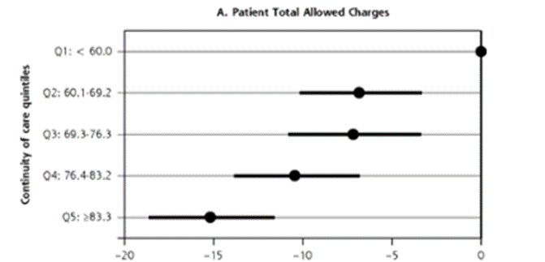
MP3: Continuity as a “balancing” measure…
Bice-Boxerman allows calculation from CPT codes; similar to UPC and other measures…
Recommendation: target of .7 for personal physician and .85 for team
Every .1 increase in continuity decreases costs of care and hospitalizations, with both personal physician and team effects. ACGME RC set at .4 for PGY2-3 as an interim measure…
(Zhou Y et al. Health Serv Res. 2022;57:914–929.)

Slide 7
Next Steps
Rediscover “open access” and connect to the access imperative Practice redesign to support access plus continuity (Kong, Weir):
Integrate in person, hybrid and virtual (Koopman); link system changes to patient experience (Greenberg)
Experiments with new kinds of teams: one MD/DO to 2-4 NP/PA (Ramm) and new measures (fill rate, lag time)
Measurement of continuity throughout specific systems, TINs and practices (MP3, ABFM this fall).
Identification of best practices to improve continuity at the practice and system level + PI modules (Phillips; ABFM, ABFM F Center for Professionalism and Value this year)
Engage insurers and others (California, Humana, NCQA, Ford, DPC networks) to incent continuity (ABFM F Center for Professionalism and Value this year)

Slide 8
Comments/Questions?

