Slide 1
Improving patient experience through scribe/AI support of documentation
Grant Greenberg MD MA MHSA
Lehigh Valley-Jefferson Health

Slide 2

Ambient AI/Scribe Support at LVHN
Rapid Evolution from In-Person to Virtual Asynchronous to Ambient AI
Intent always based on desire to improve clinician retention through enhanced administrative support, leading to improved overall wellbeing
Yes to the above, and…..

Slide 3
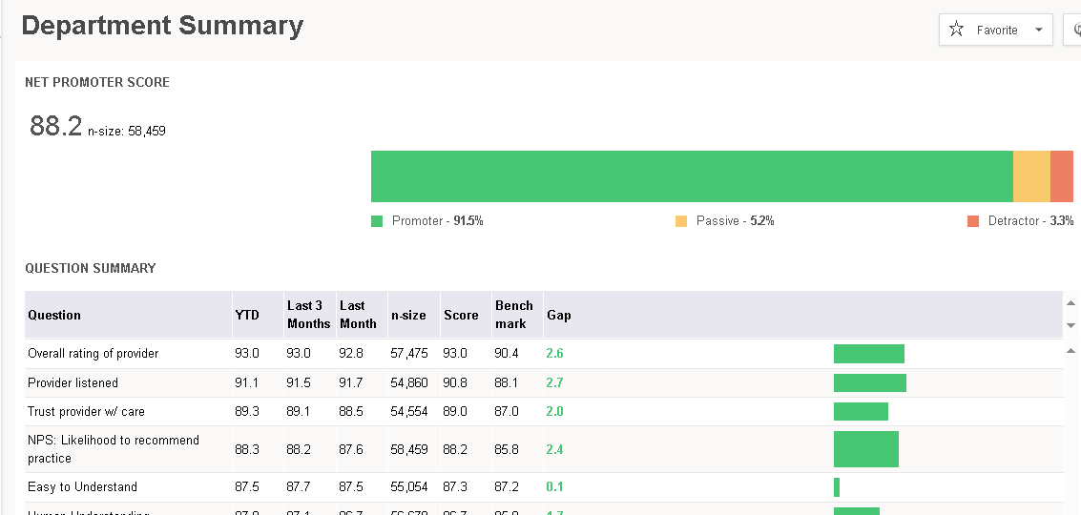

Slide 4
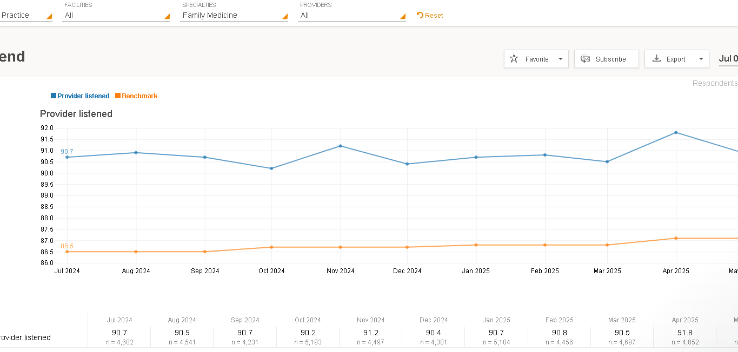

Slide 5
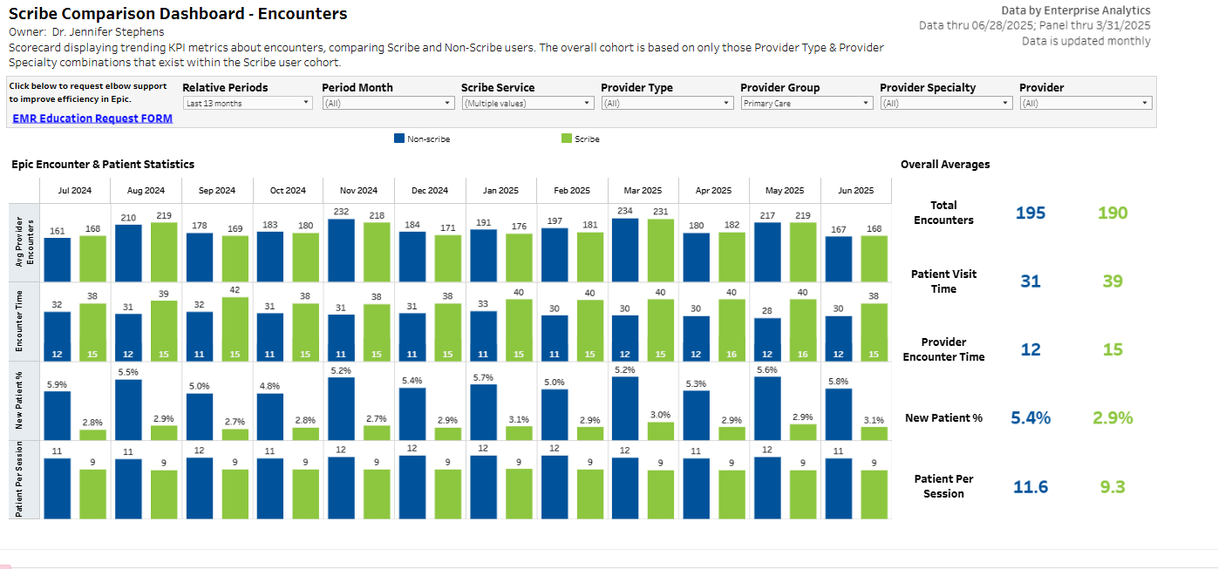
Notes:
409,000 encounters for scribe, 891,000 encoutners for non-scribe (number of encounters contributing to this data is large

Slide 6
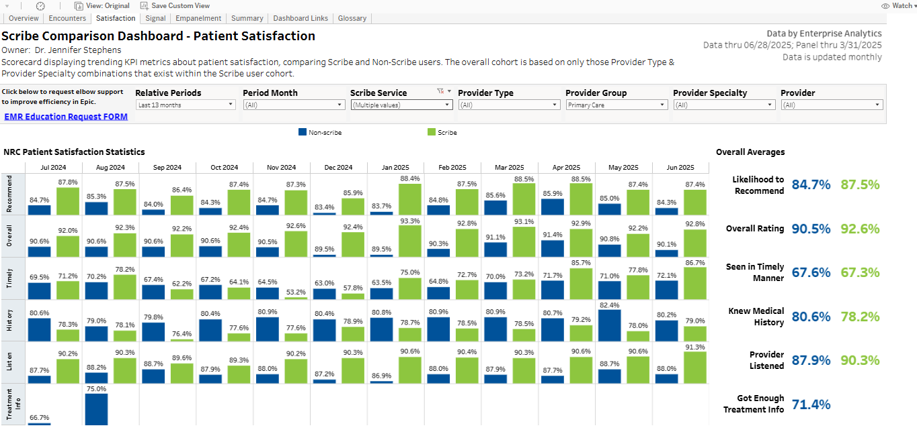

Slide 7
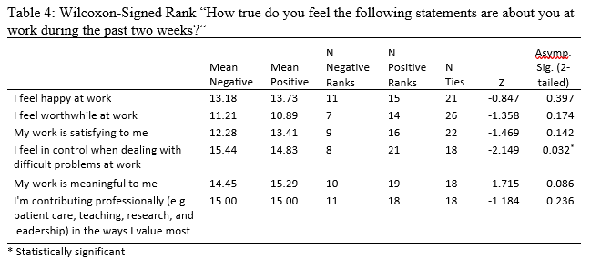

Slide 8
