Slide 1
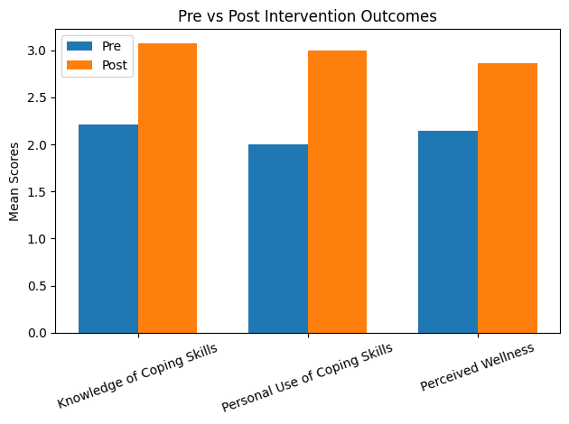
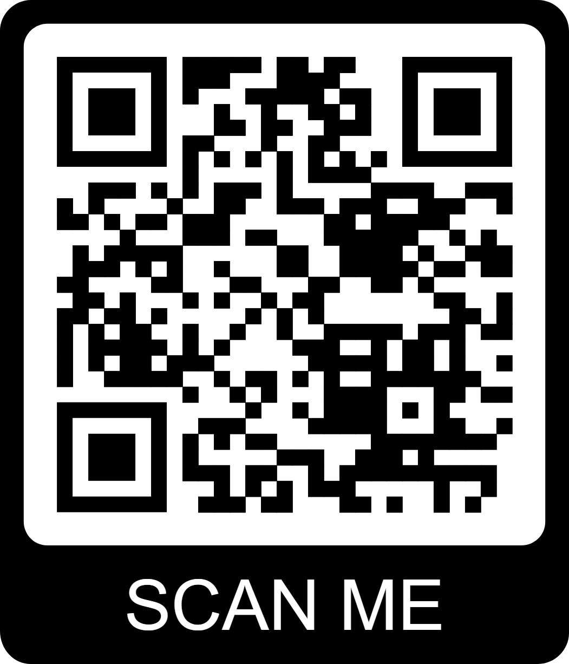
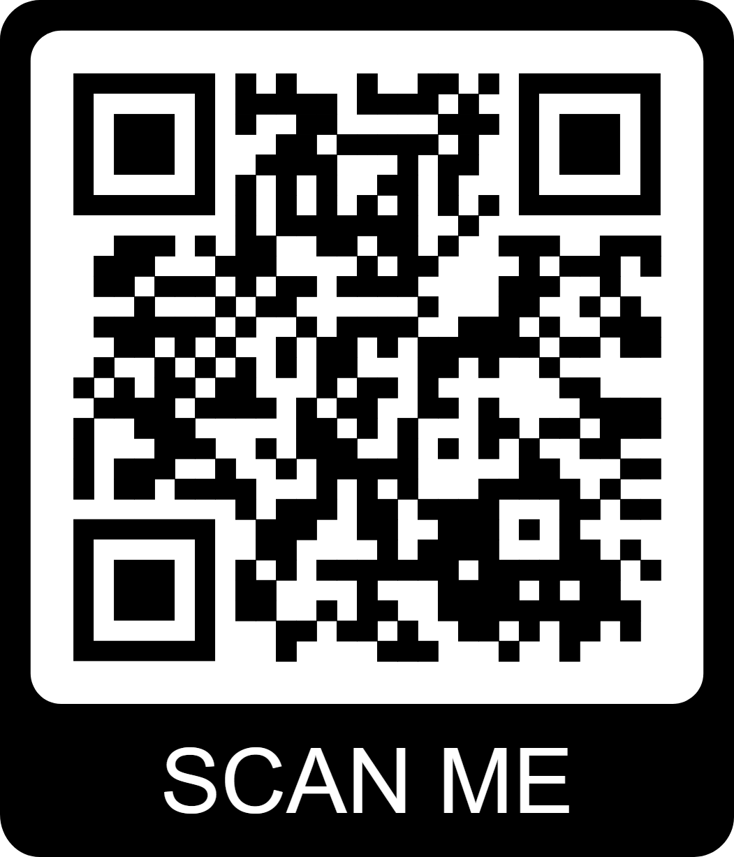

Teaching coping skills in the behavioral health curriculum increased knowledge and use of coping skills, and positively impacted residents perceived overall wellness.
Non-Cognitive Predictors of Student Success: A Predictive Validity Comparison Between Domestic and International Students
Will Teaching Coping Skills in the
Behavioral Health Curriculum Increase Perceived Overall Wellness?
Melissa Castello, MSCP & Aaron Grace, Psy.D.
DISCUSSION
Further research to determine if there were higher scores in resident competencies and wellness for those who participated in the training as compared to those who did not.
Currently, the only data available to validate the effectiveness of this training is resident feedback and testing scores from in-service examinations. Resident feedback is consistent with the data from 2025 in service test scores, which show that most Forbes Family Medicine residents have scored above average on questions related directly to behavioral science.
The results of this study combined with other data indicates that teaching coping skils during didactics has the potential to improve resident education and wellness.
RESOURCES
Mian A, Kim D, Chen D, Ward WL (2018). Medical Student and Resident Burnout: A Review of Causes, Effects, and Prevention. J Fam Med Dis Prev 4:094. doi.org/10.23937/2469-5793/1510094
BACKGROUND:
It is widely known that resident physicians suffer from burnout at some point during their training. Research suggests that changes in curriculum can help combat burnout in resident physicians and medical students. The goal of this project is to determine whether overall resident education and wellness can be enhanced by teaching coping skills during didactics.
METHODS
Pre-test surveys were completed by residents to determine their baseline level of knowledge in coping skills and to measure their perceived overall wellness.
A one hour didactic training was then delivered on coping skills.
8 weeks after the didactic was taught, the post-survey data was collected.
Used SPSS to analyze the data.
RESULTS
Paired-samples comparisons showed the following results:
Increased knowledge of coping skills (M-pre = 2.21, M-post = 3.07).
Increased personal use of coping skills (M-pre= 2, M-post= 3).
Increased perceived wellness (M-pre = 2.14, M-post = 2.86).
Take a picture to download the survey and teaching materials.
Notes:
Notes:
In Powerpoint, click View > Guides
Keep text within gutter guides.
Author list: Don’t split names onto two lines (e.g., “Jimmy [break] Smith”). If that happens, use a new line, unless you need the space. Bold the first names of anybody who’s presenting in person.
Intro/methods/result: Do not drop below font size 28, but if you have extra space, jack up the font size until the space is full.
Do not use color in the sidebars except in graphs/figures. It’ll pull attention from the center and slow interpretation for passersby.

