Slide 1
Co-designing the future of primary care with patients and the public
Tara Kiran
Fidani Chair in Improvement and Innovation, University of Toronto
Scientist, MAP Centre for Urban Health Solutions
Family Physician, St. Michael’s Hospital, Unity Health Toronto
Family Medicine Leadership Consortium Summer Retreat
Washington DC, USA
Aug 15, 2024
With funding from:
In Partnership with:
ourcare.ca

Slide 2
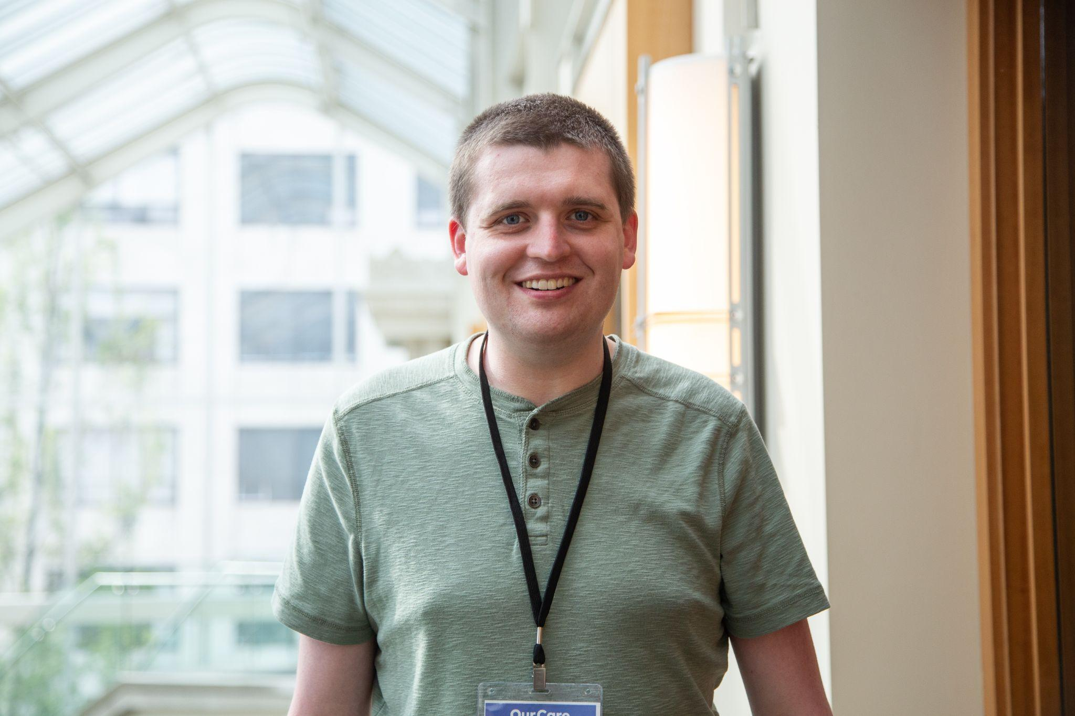
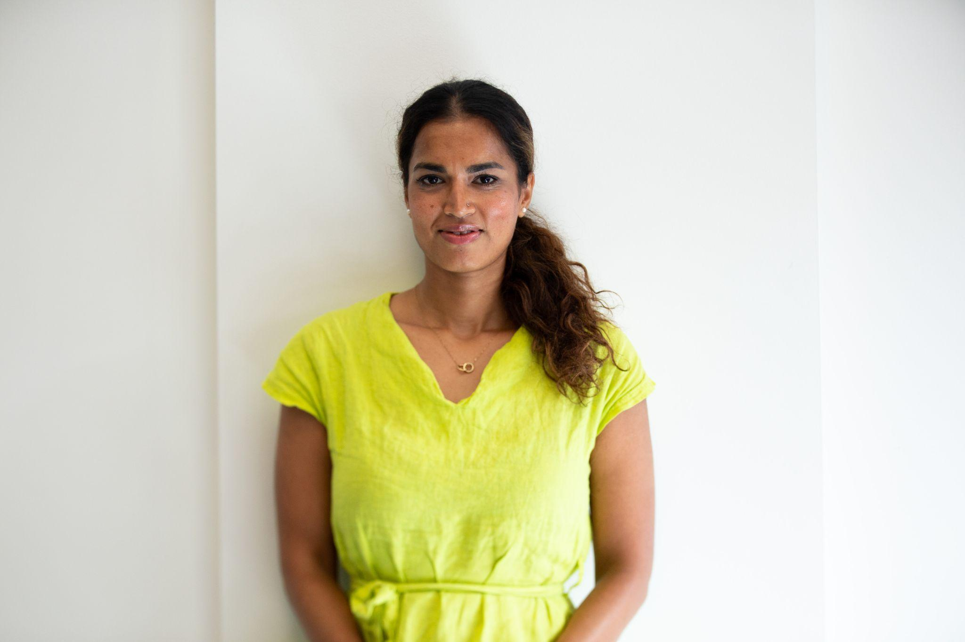
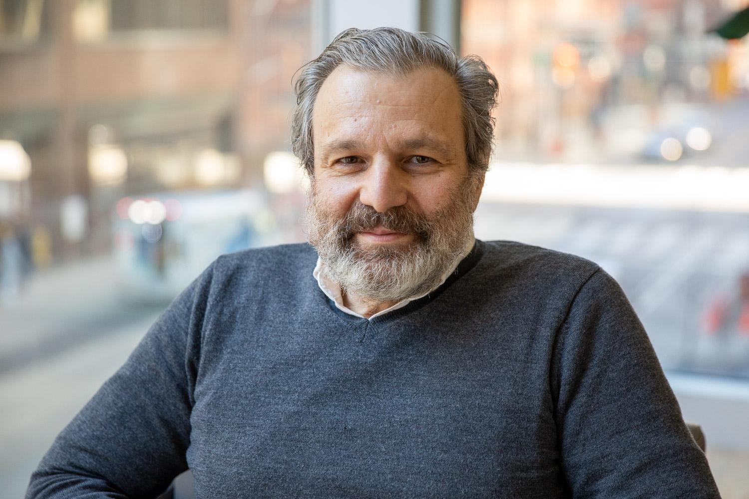
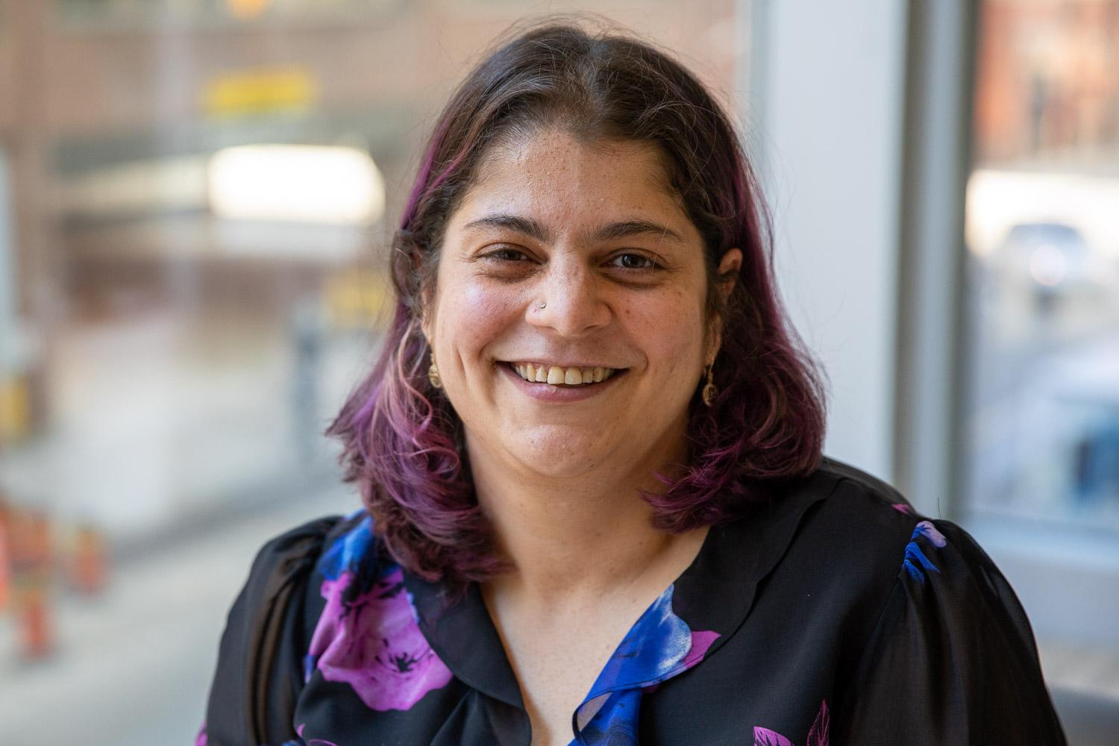
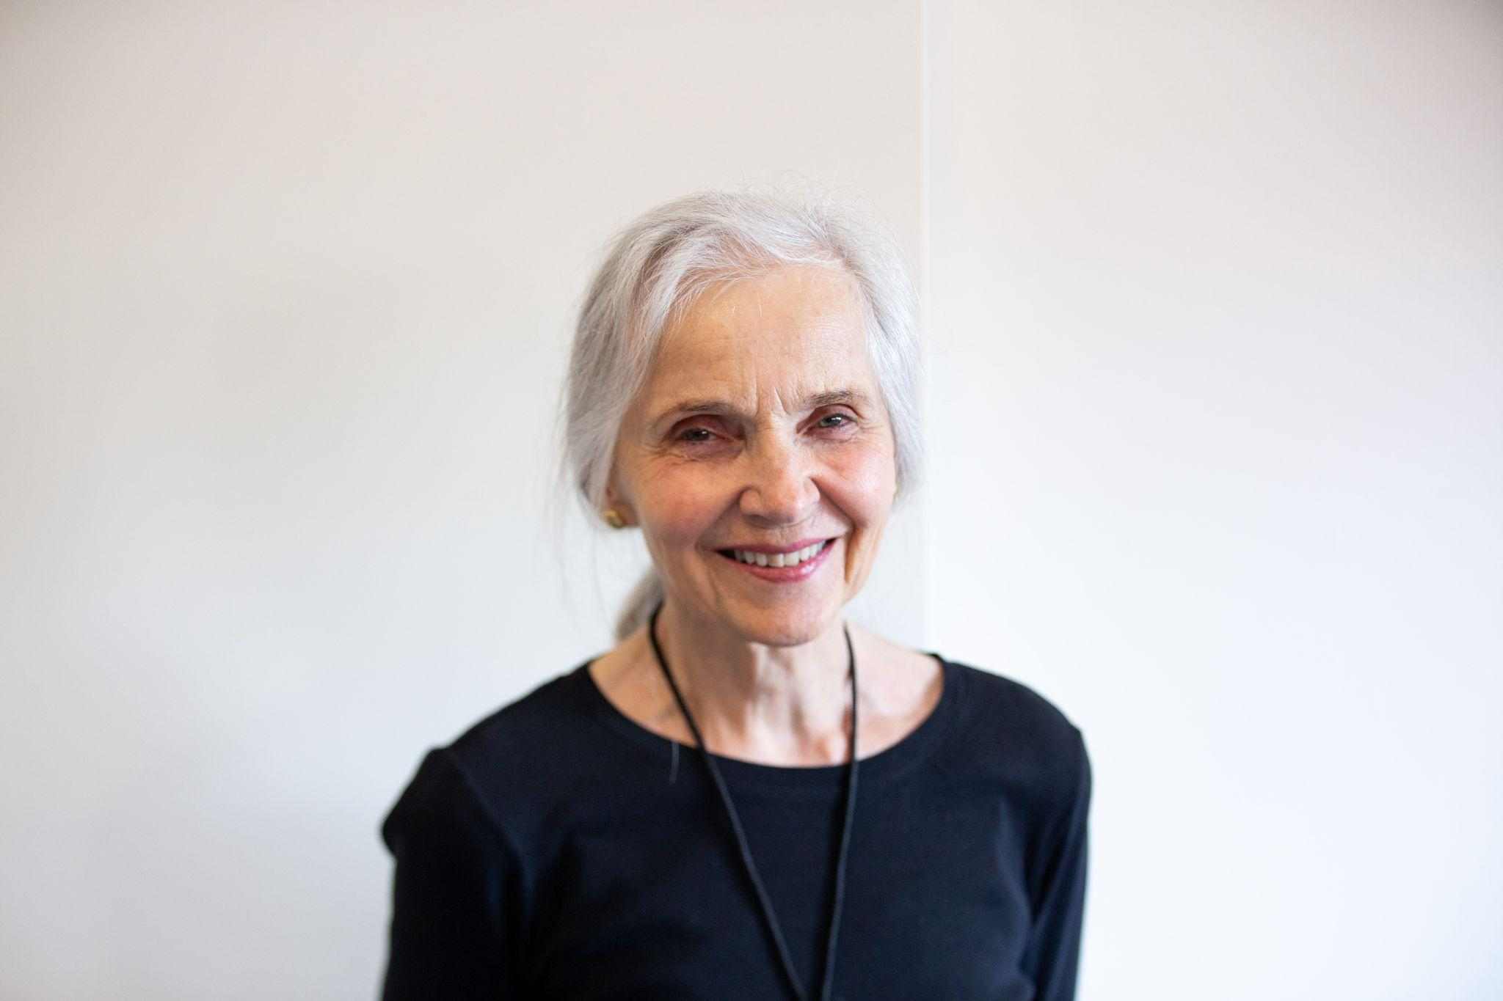
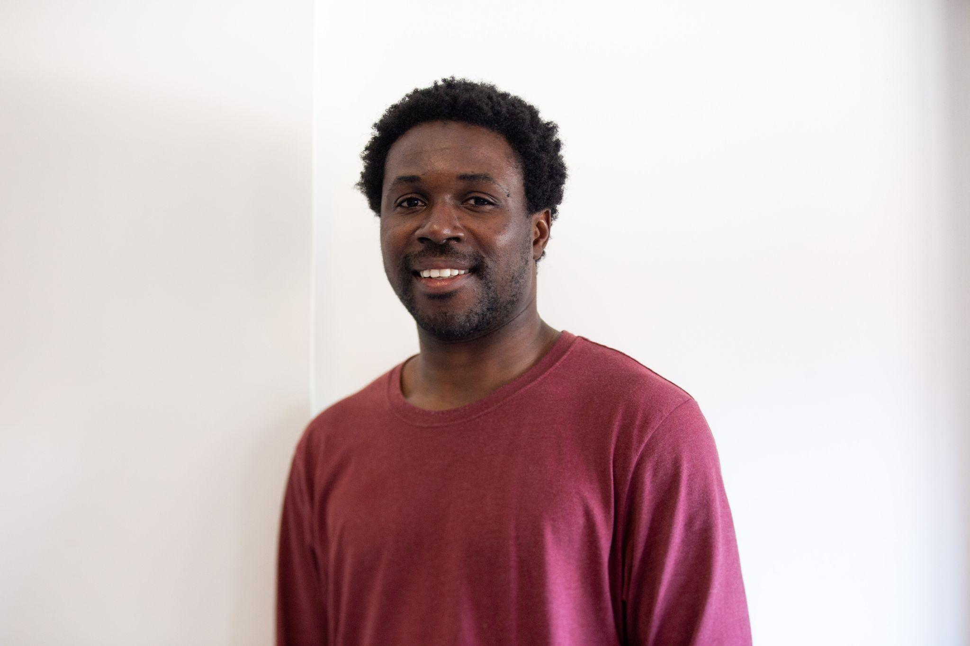
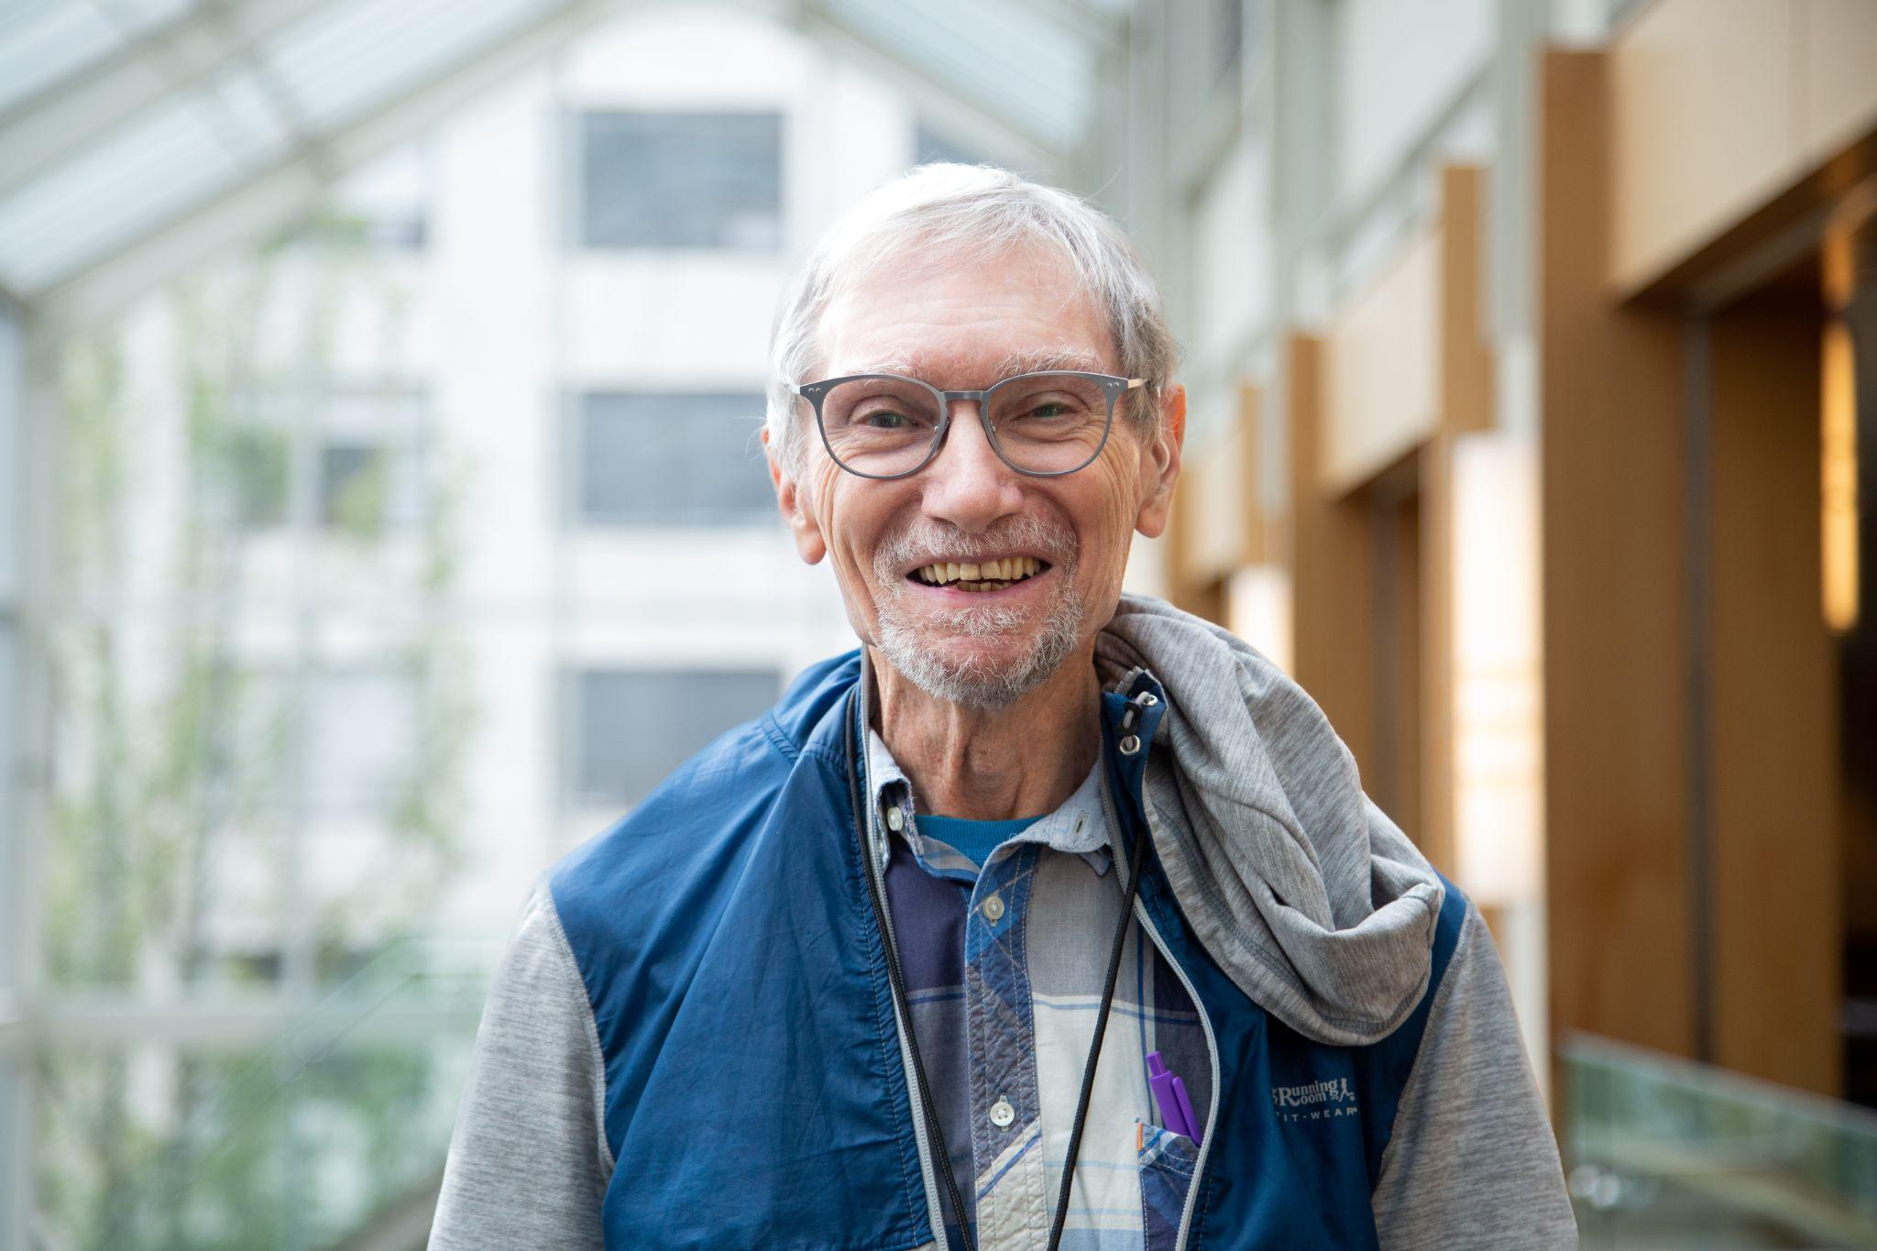
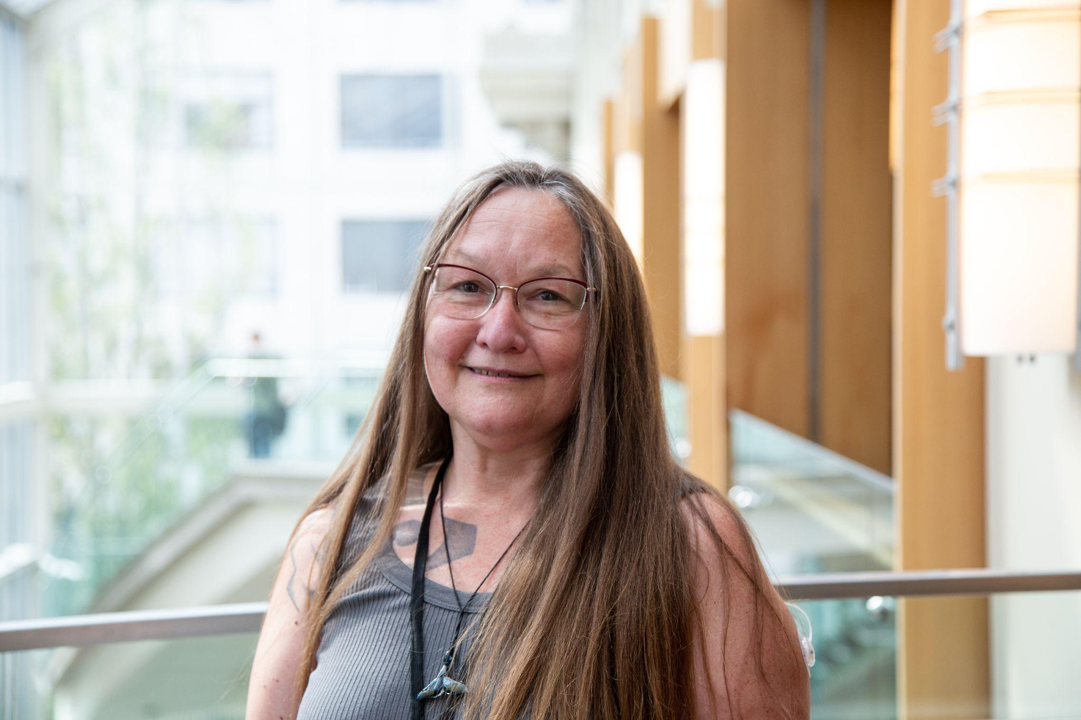
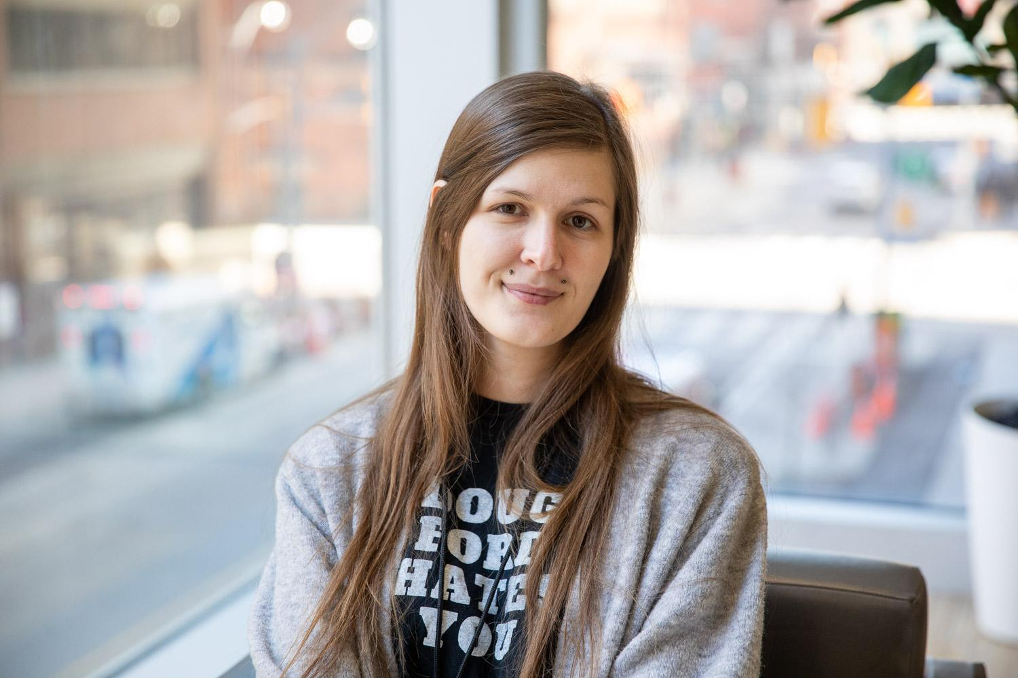
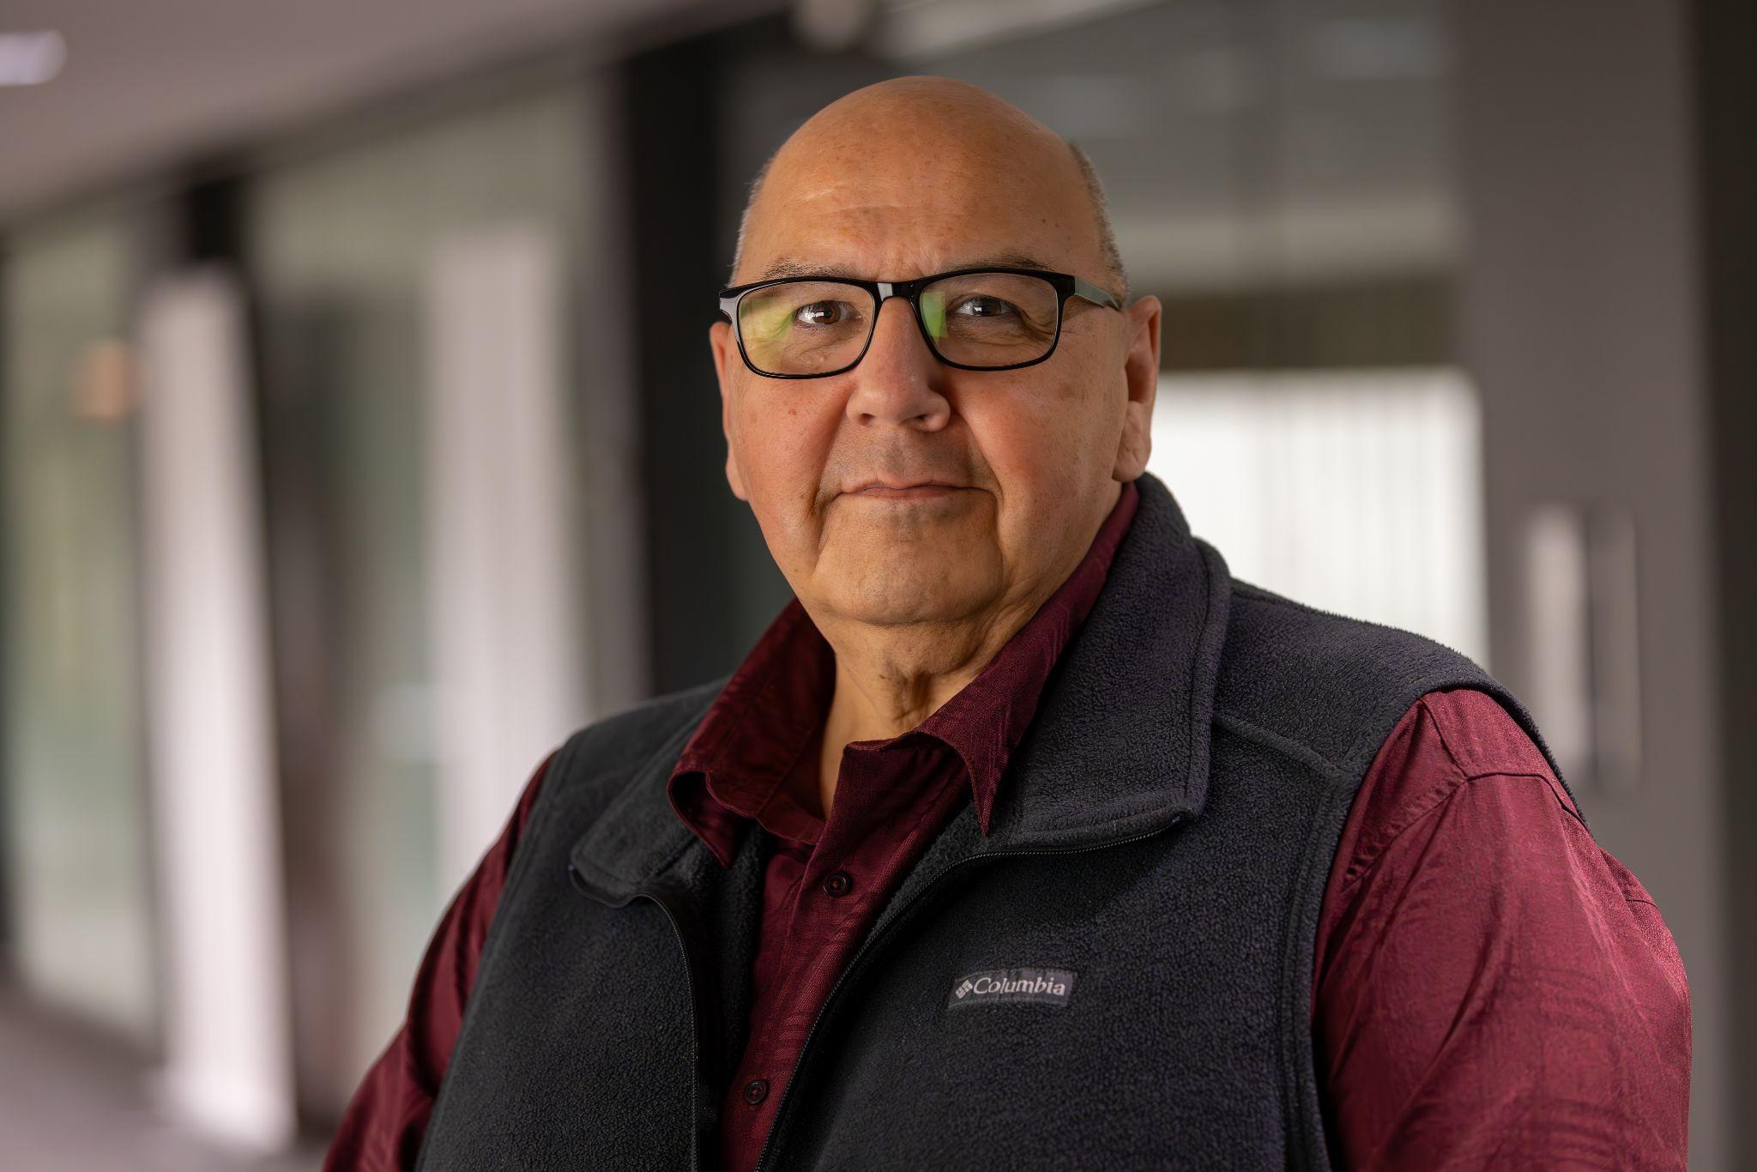
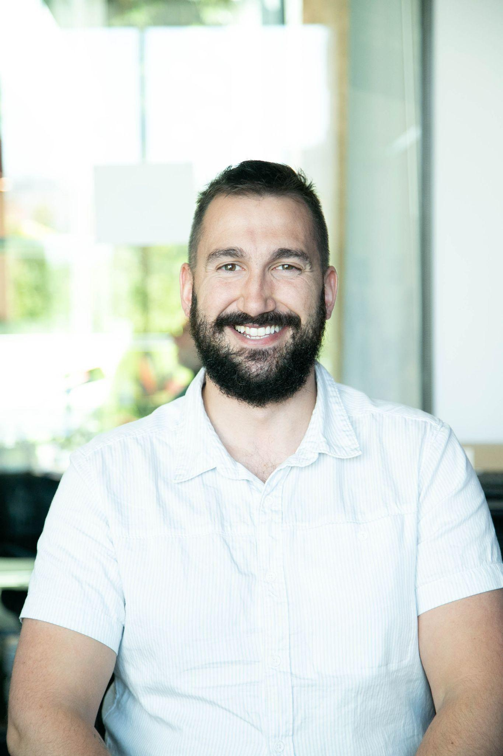
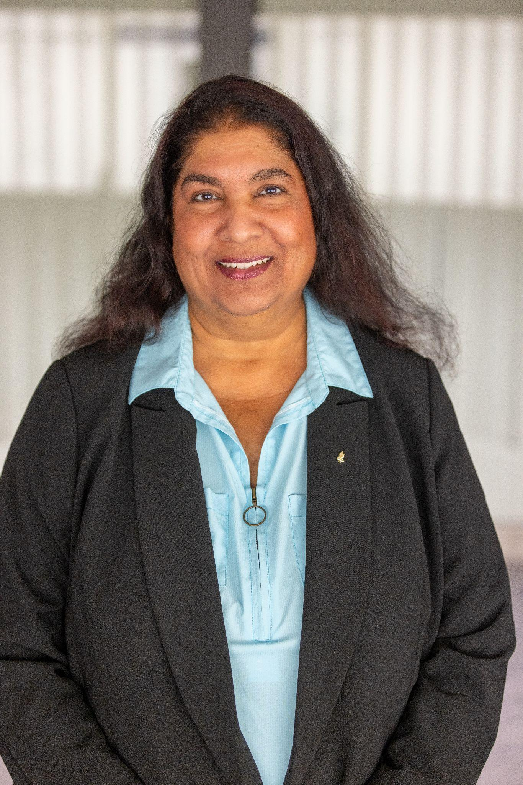
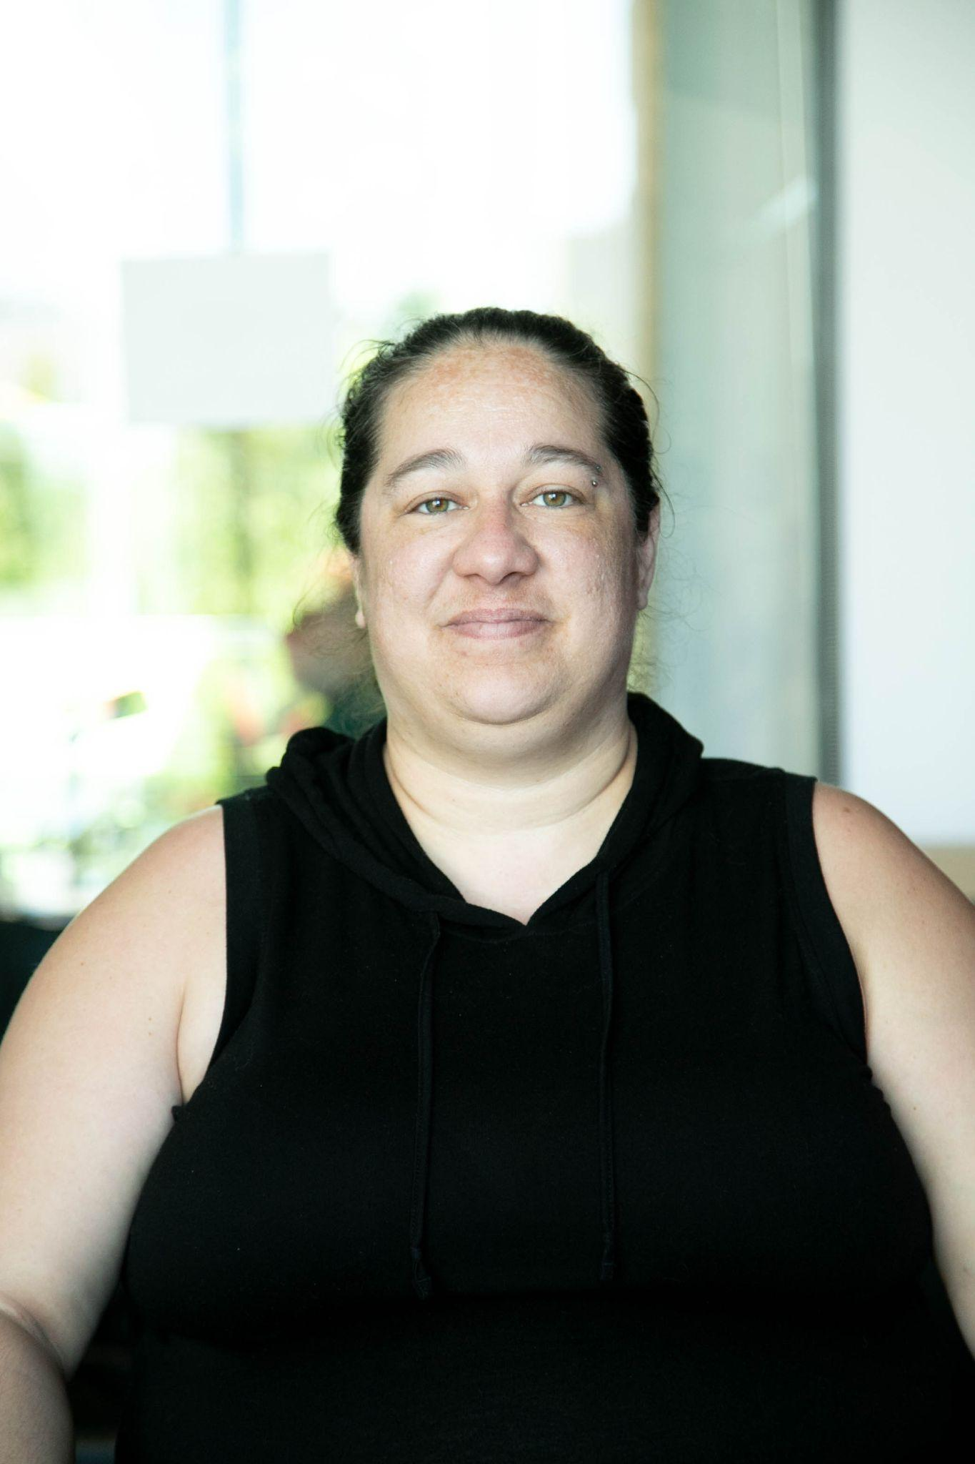
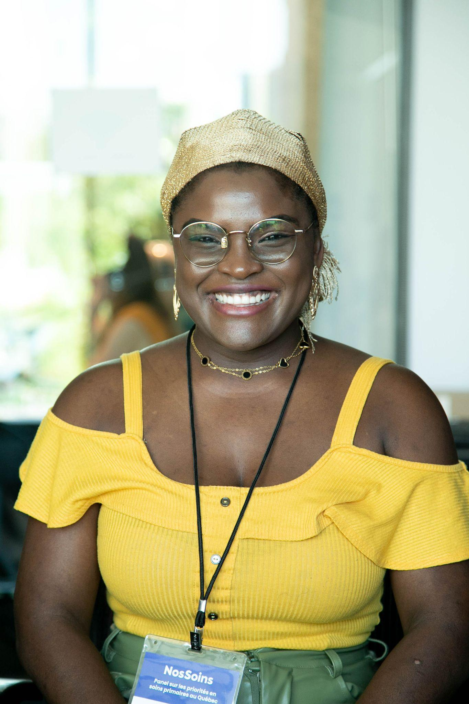
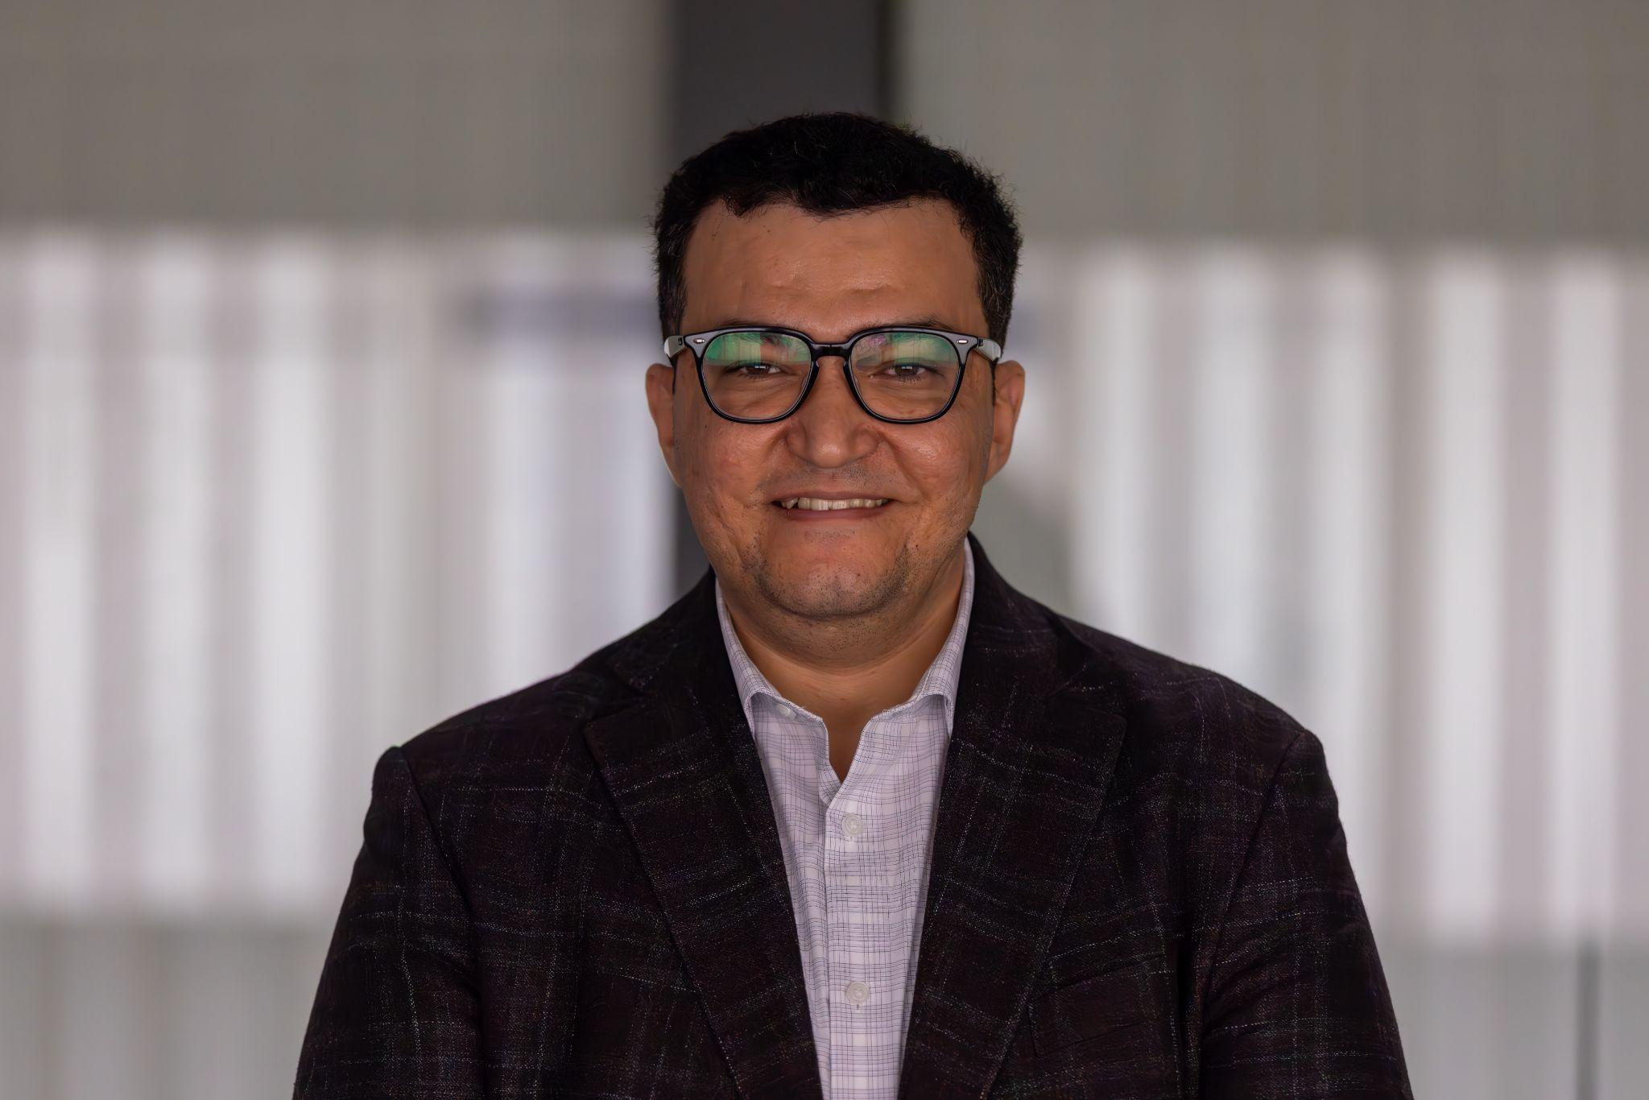
Notes:
National version

Slide 3
Over 16 months, OurCare engaged nearly 10,000 people across Canada to understand their experiences, perspectives and priorities for primary care.
OurCare | NosSoins
ourcare.ca

Slide 4
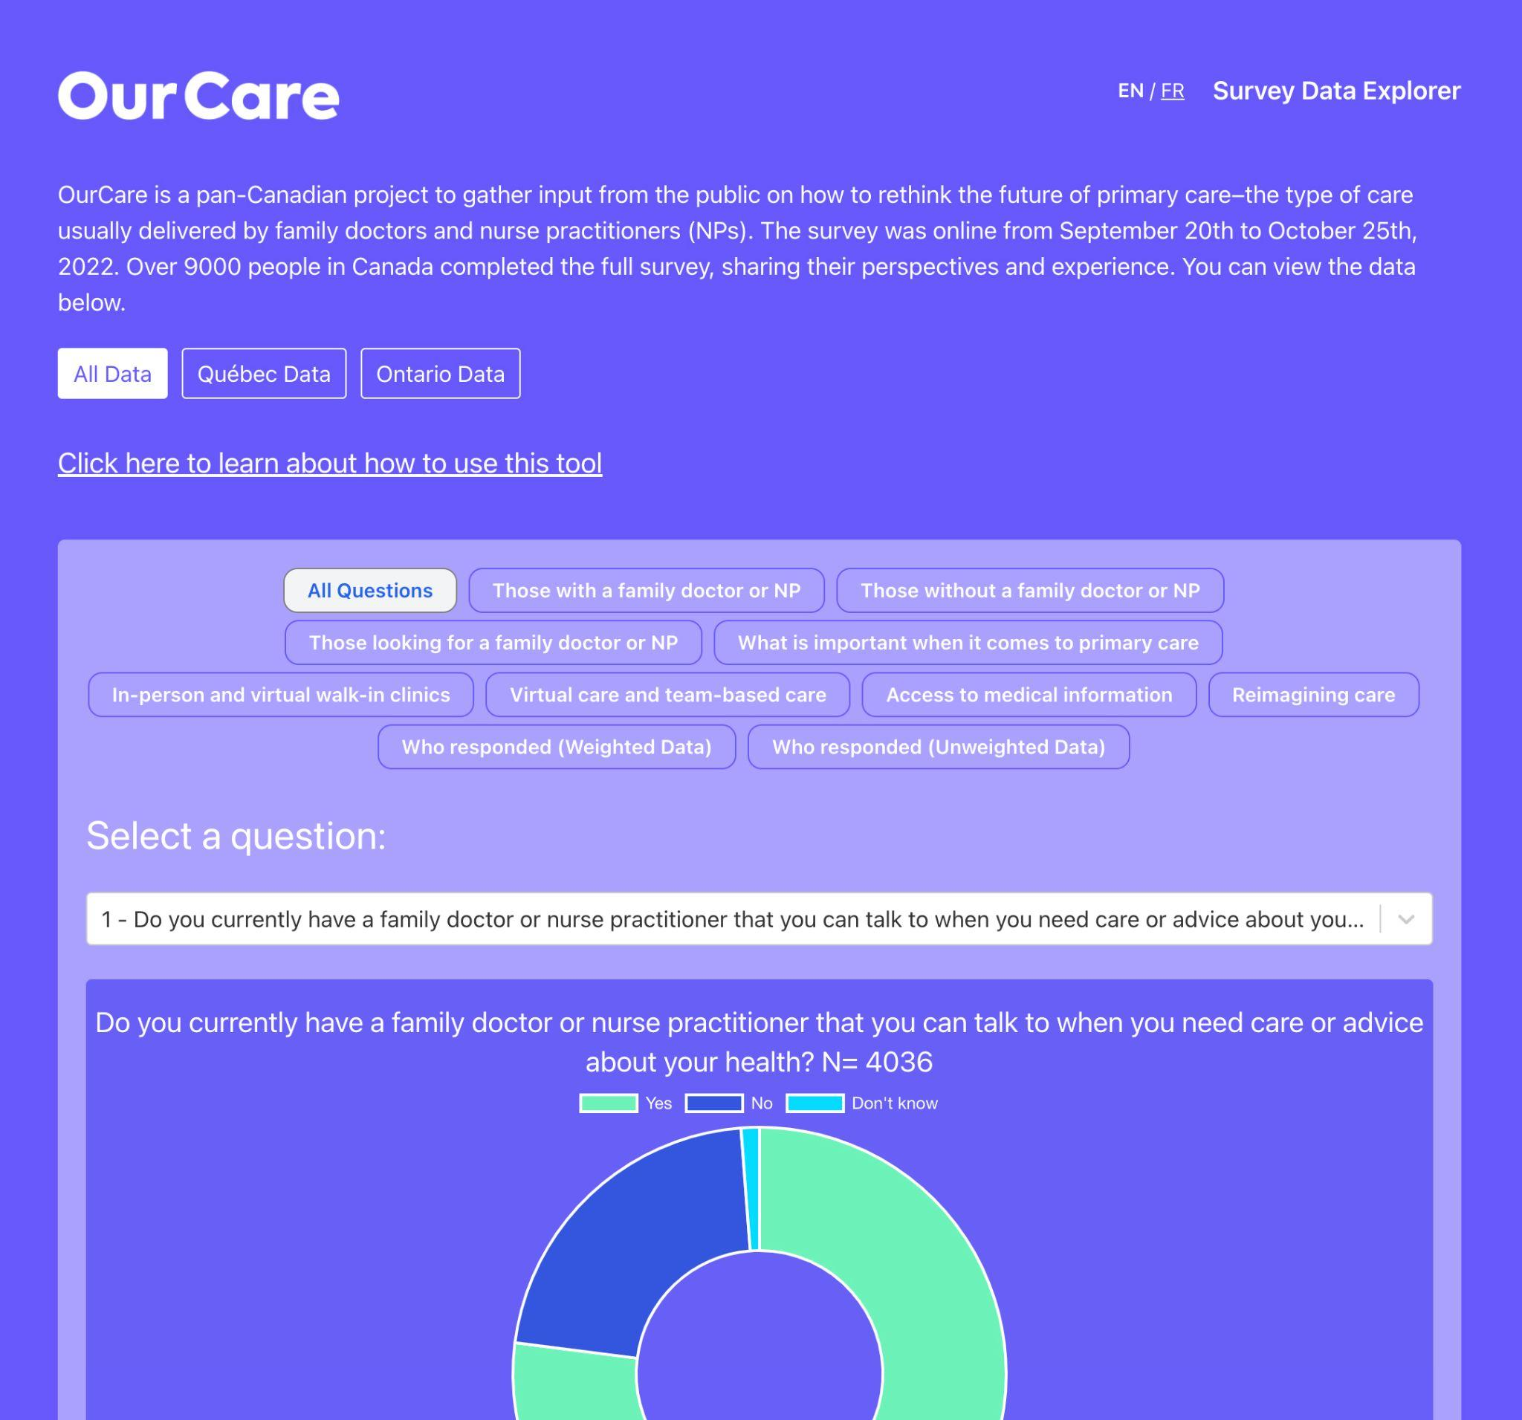
One National Survey
9000+ responses
OurCare | NosSoins
ourcare.ca

Slide 5
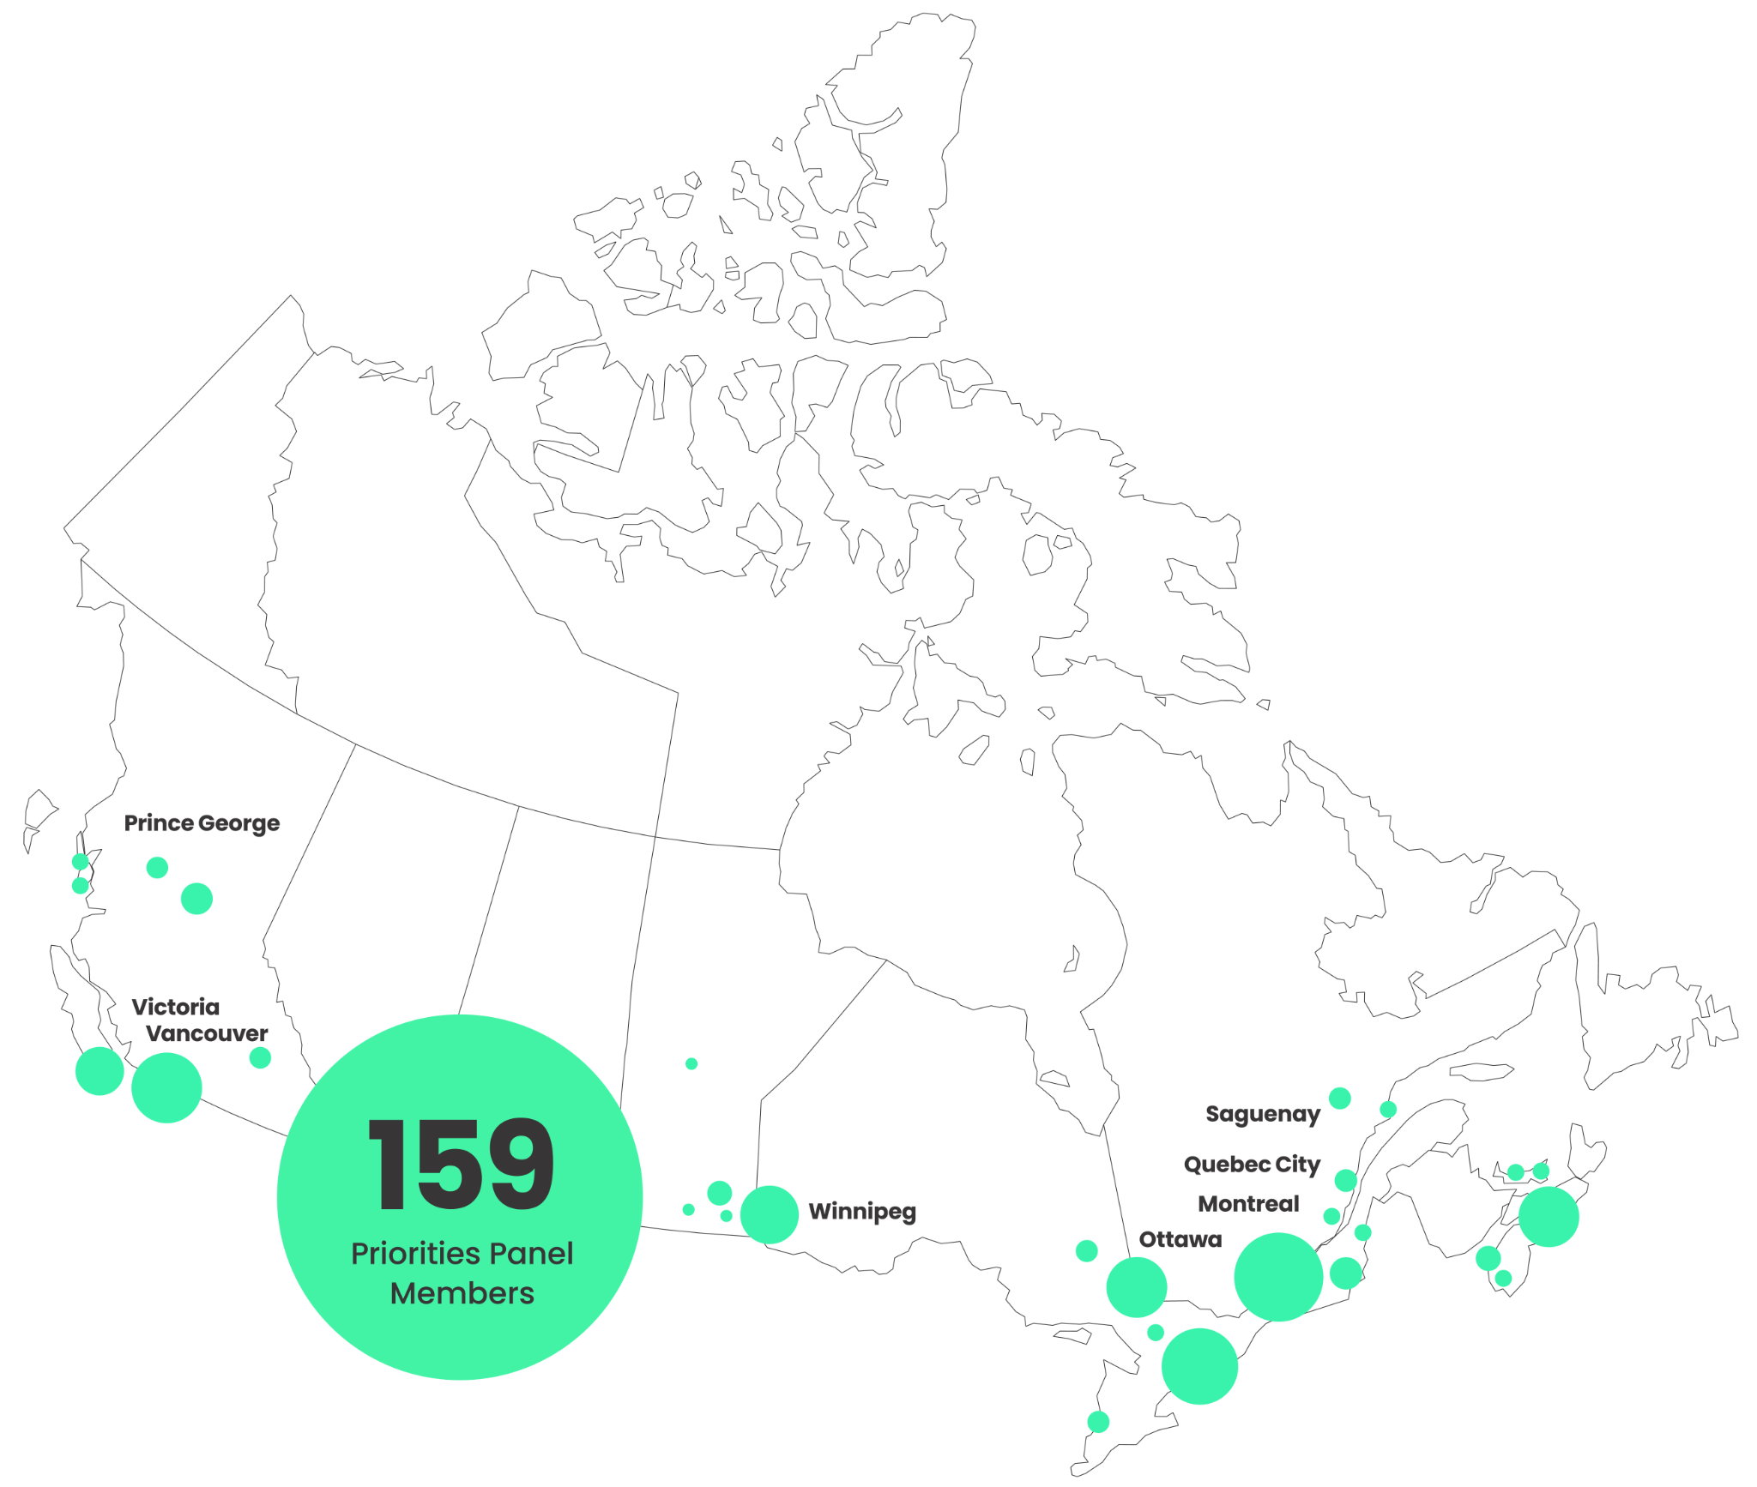
Five Provincial
Panels
150+ participants
OurCare | NosSoins
ourcare.ca

Slide 6
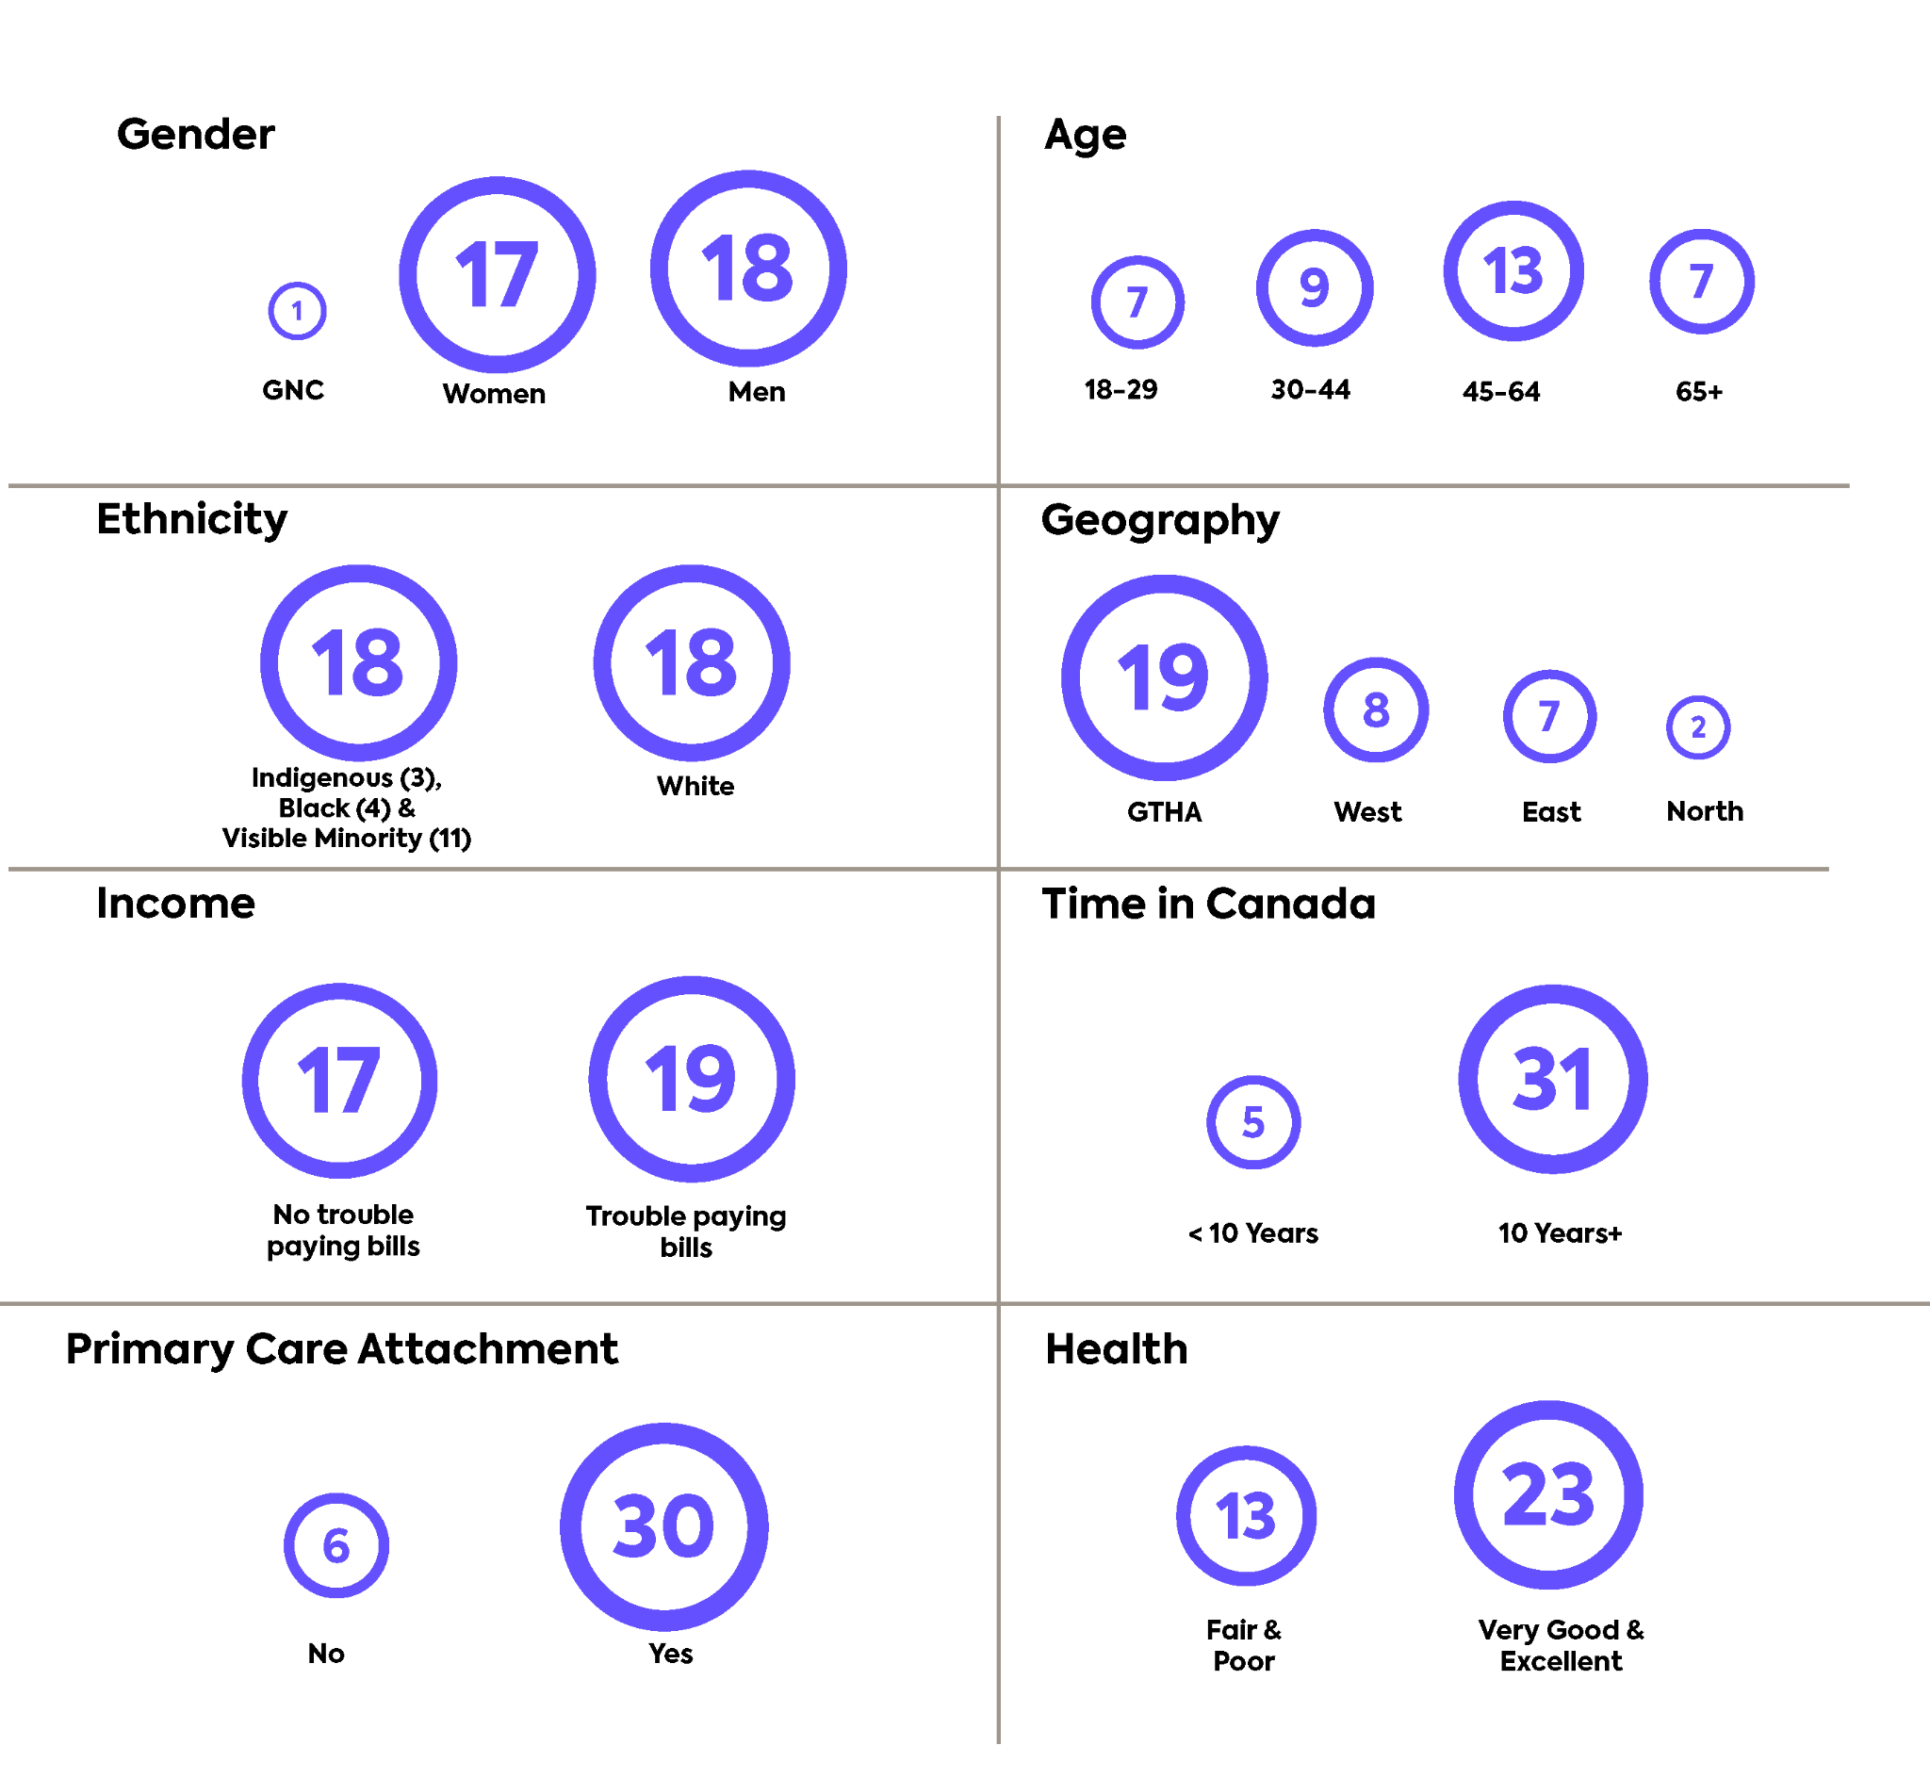
Ontario Priorities Panel
35 Ontario residents
Randomly selected from a pool of +1,250 volunteers
Extra representation to equity-deserving groups: ethnicity, income, time in Canada
ourcare.ca
ourcare.ca

Slide 7
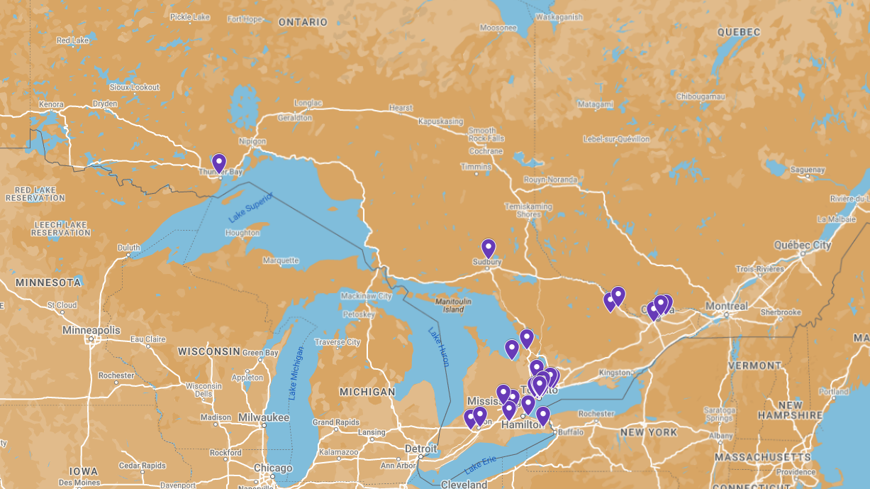
Ontario in a room
East 7 West 8
GTA 19 North 2
Notes:
MAPS: https://www.google.com/maps/d/edit?mid=17IHNSFyzFcv-b0A3PCwf0FTZLveJBC4&usp=sharing https://drive.google.com/drive/folders/1EYCr7TqBnYUUW0EJKP2hvUqiGviMeZTu

Slide 8
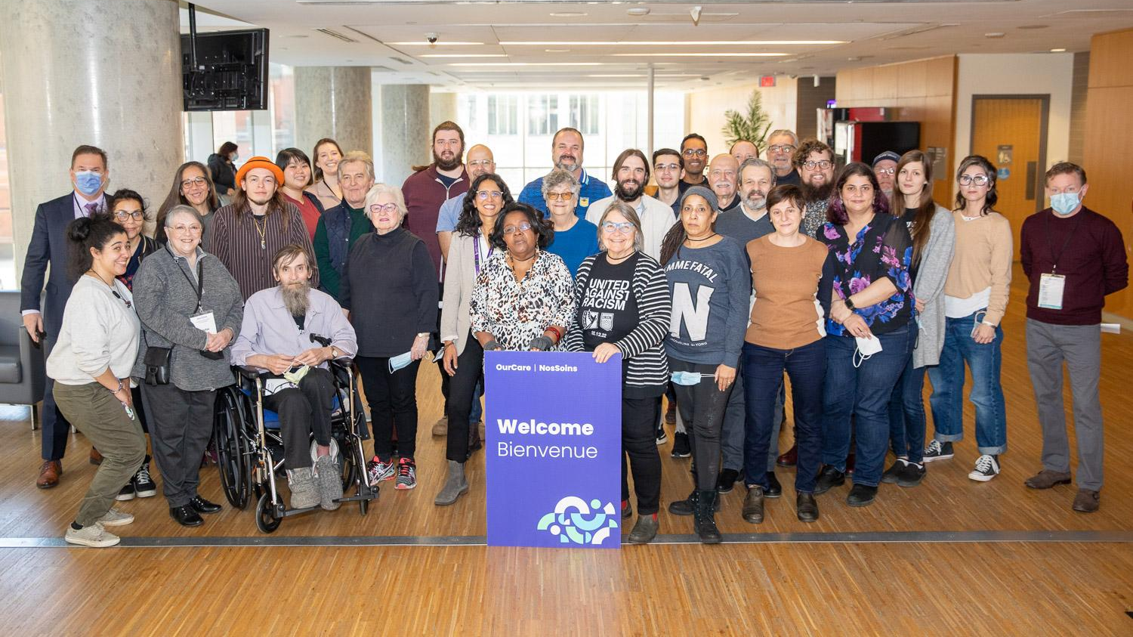

Slide 9
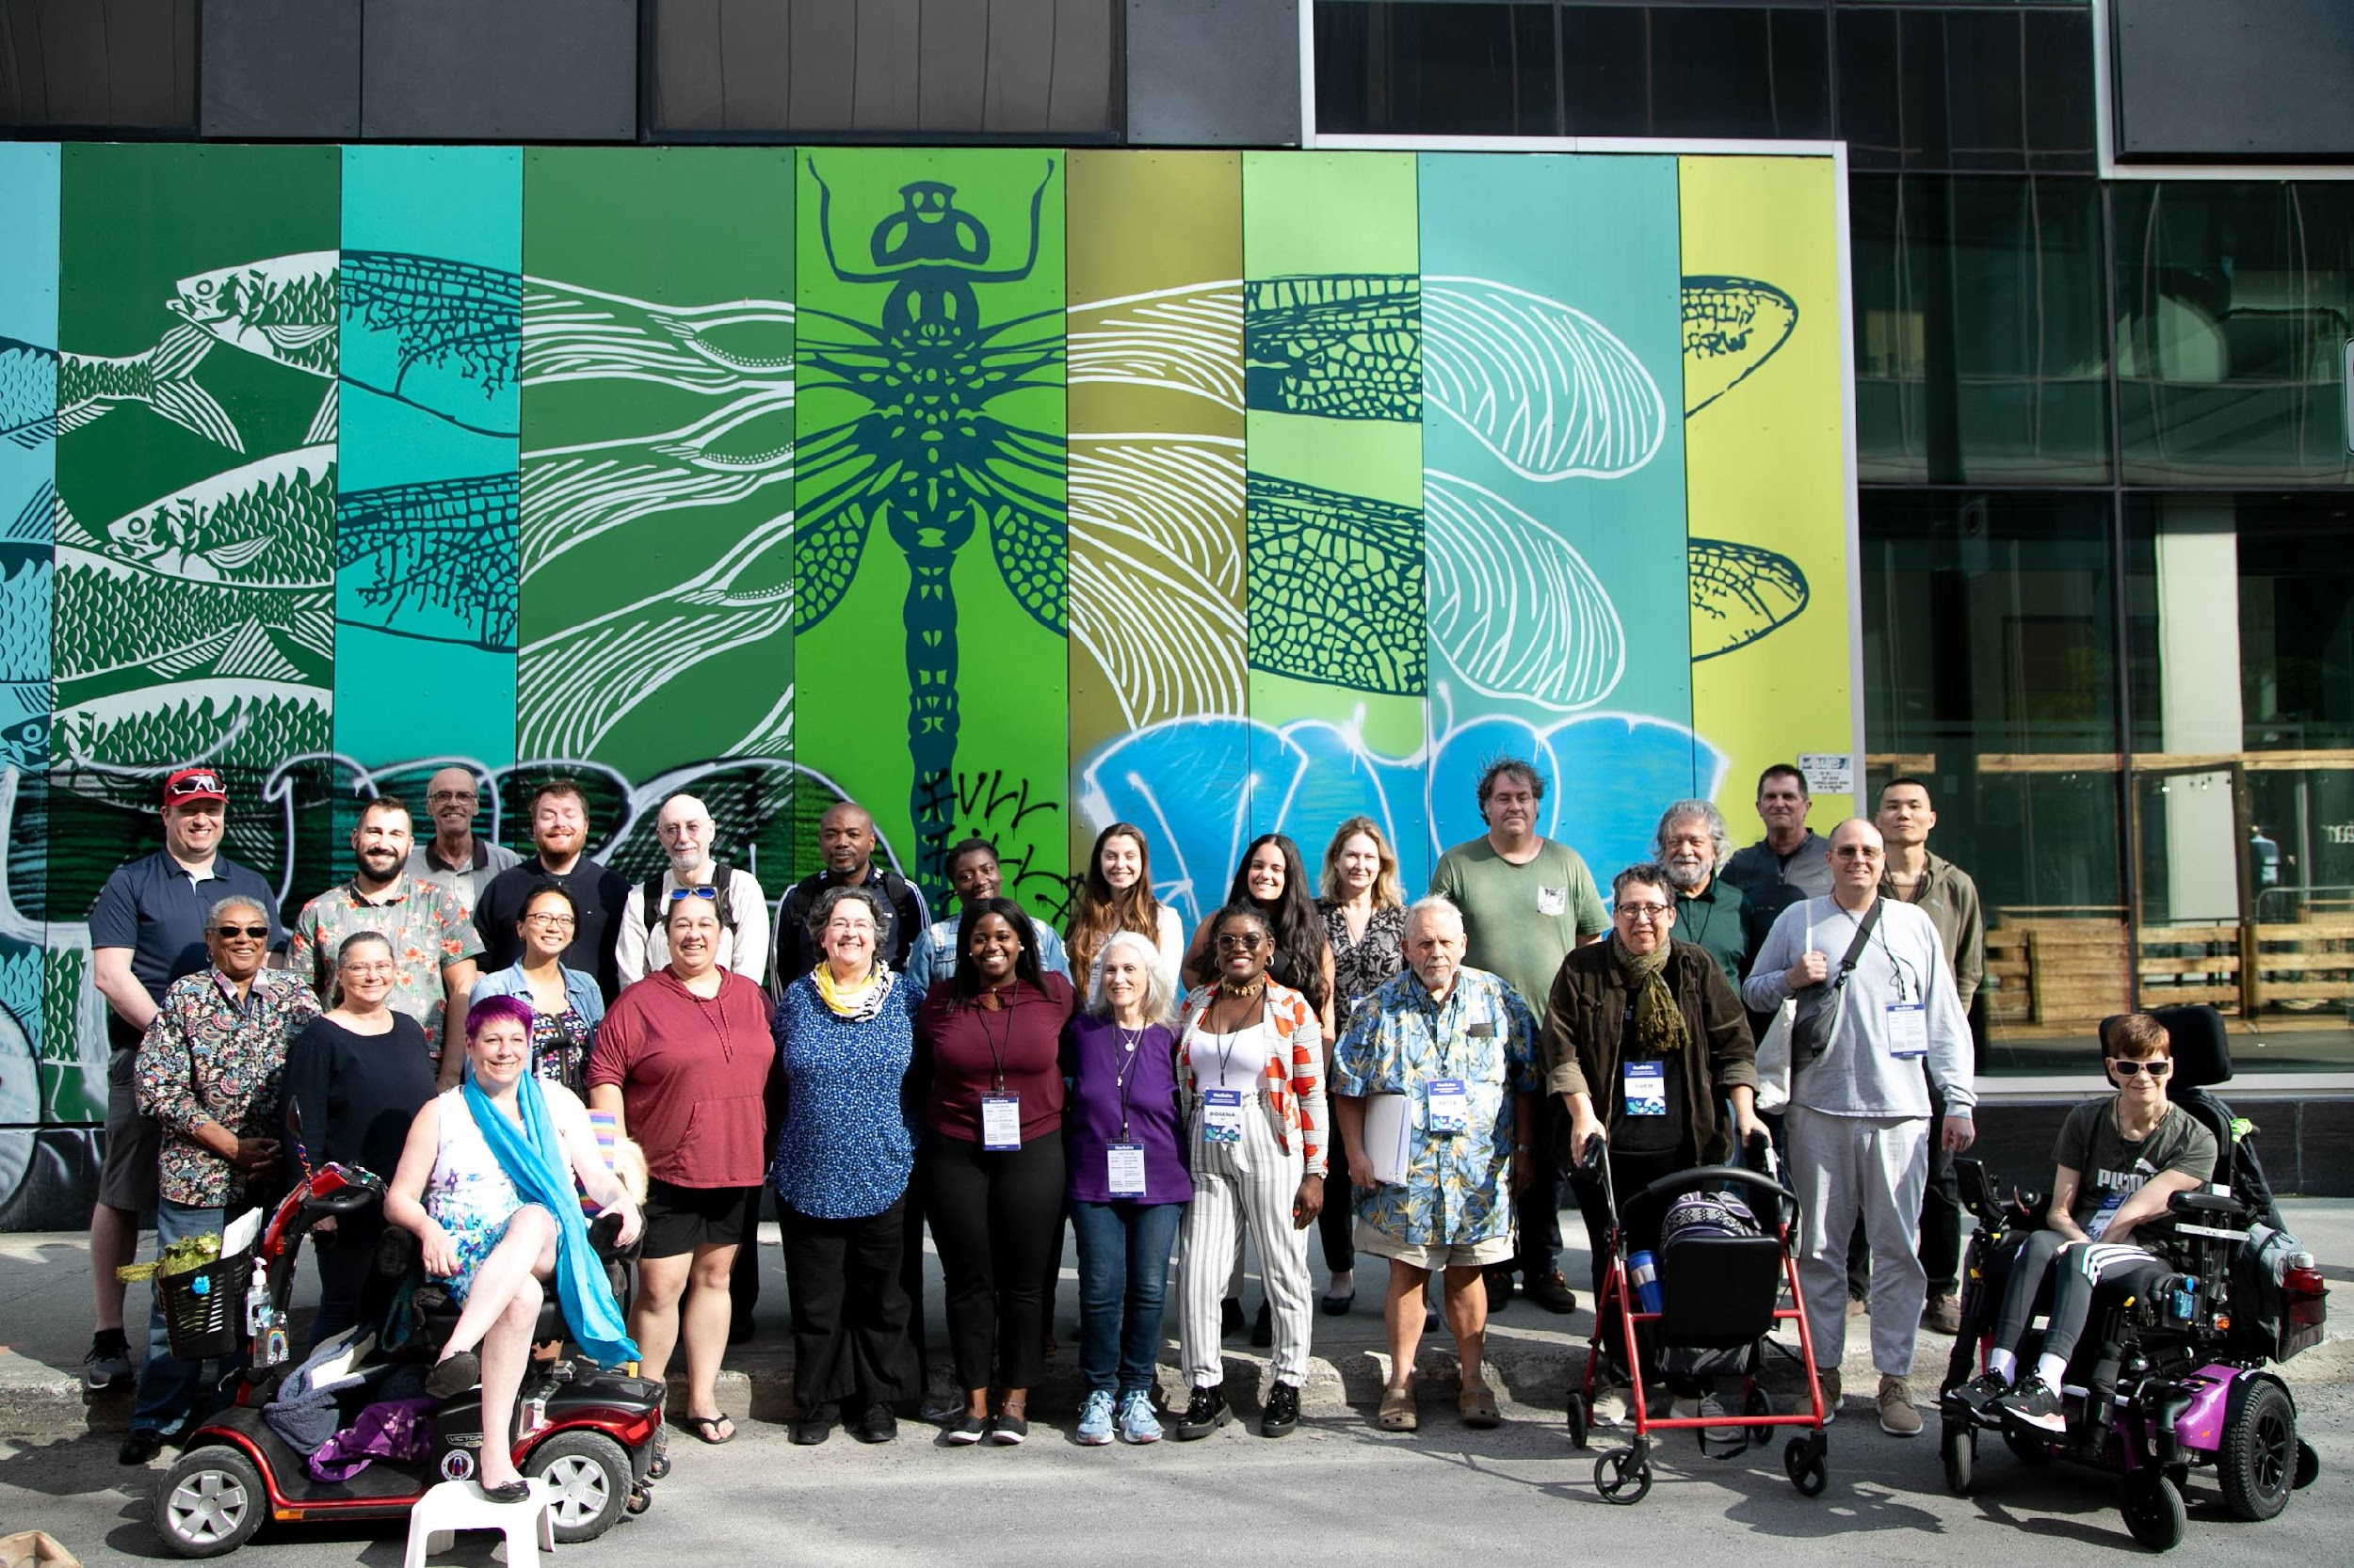

Slide 10
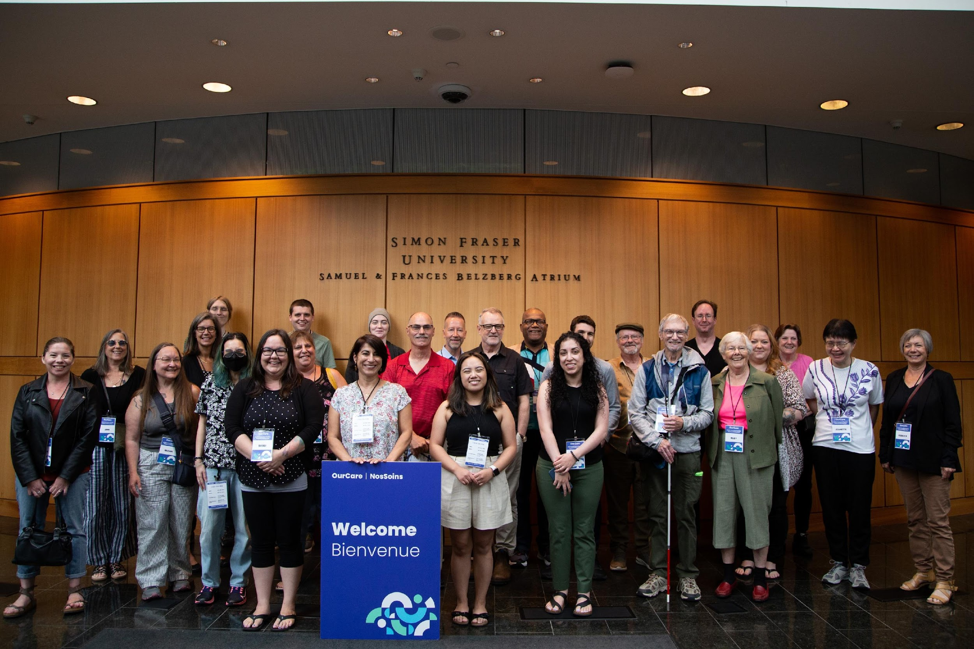

Slide 11
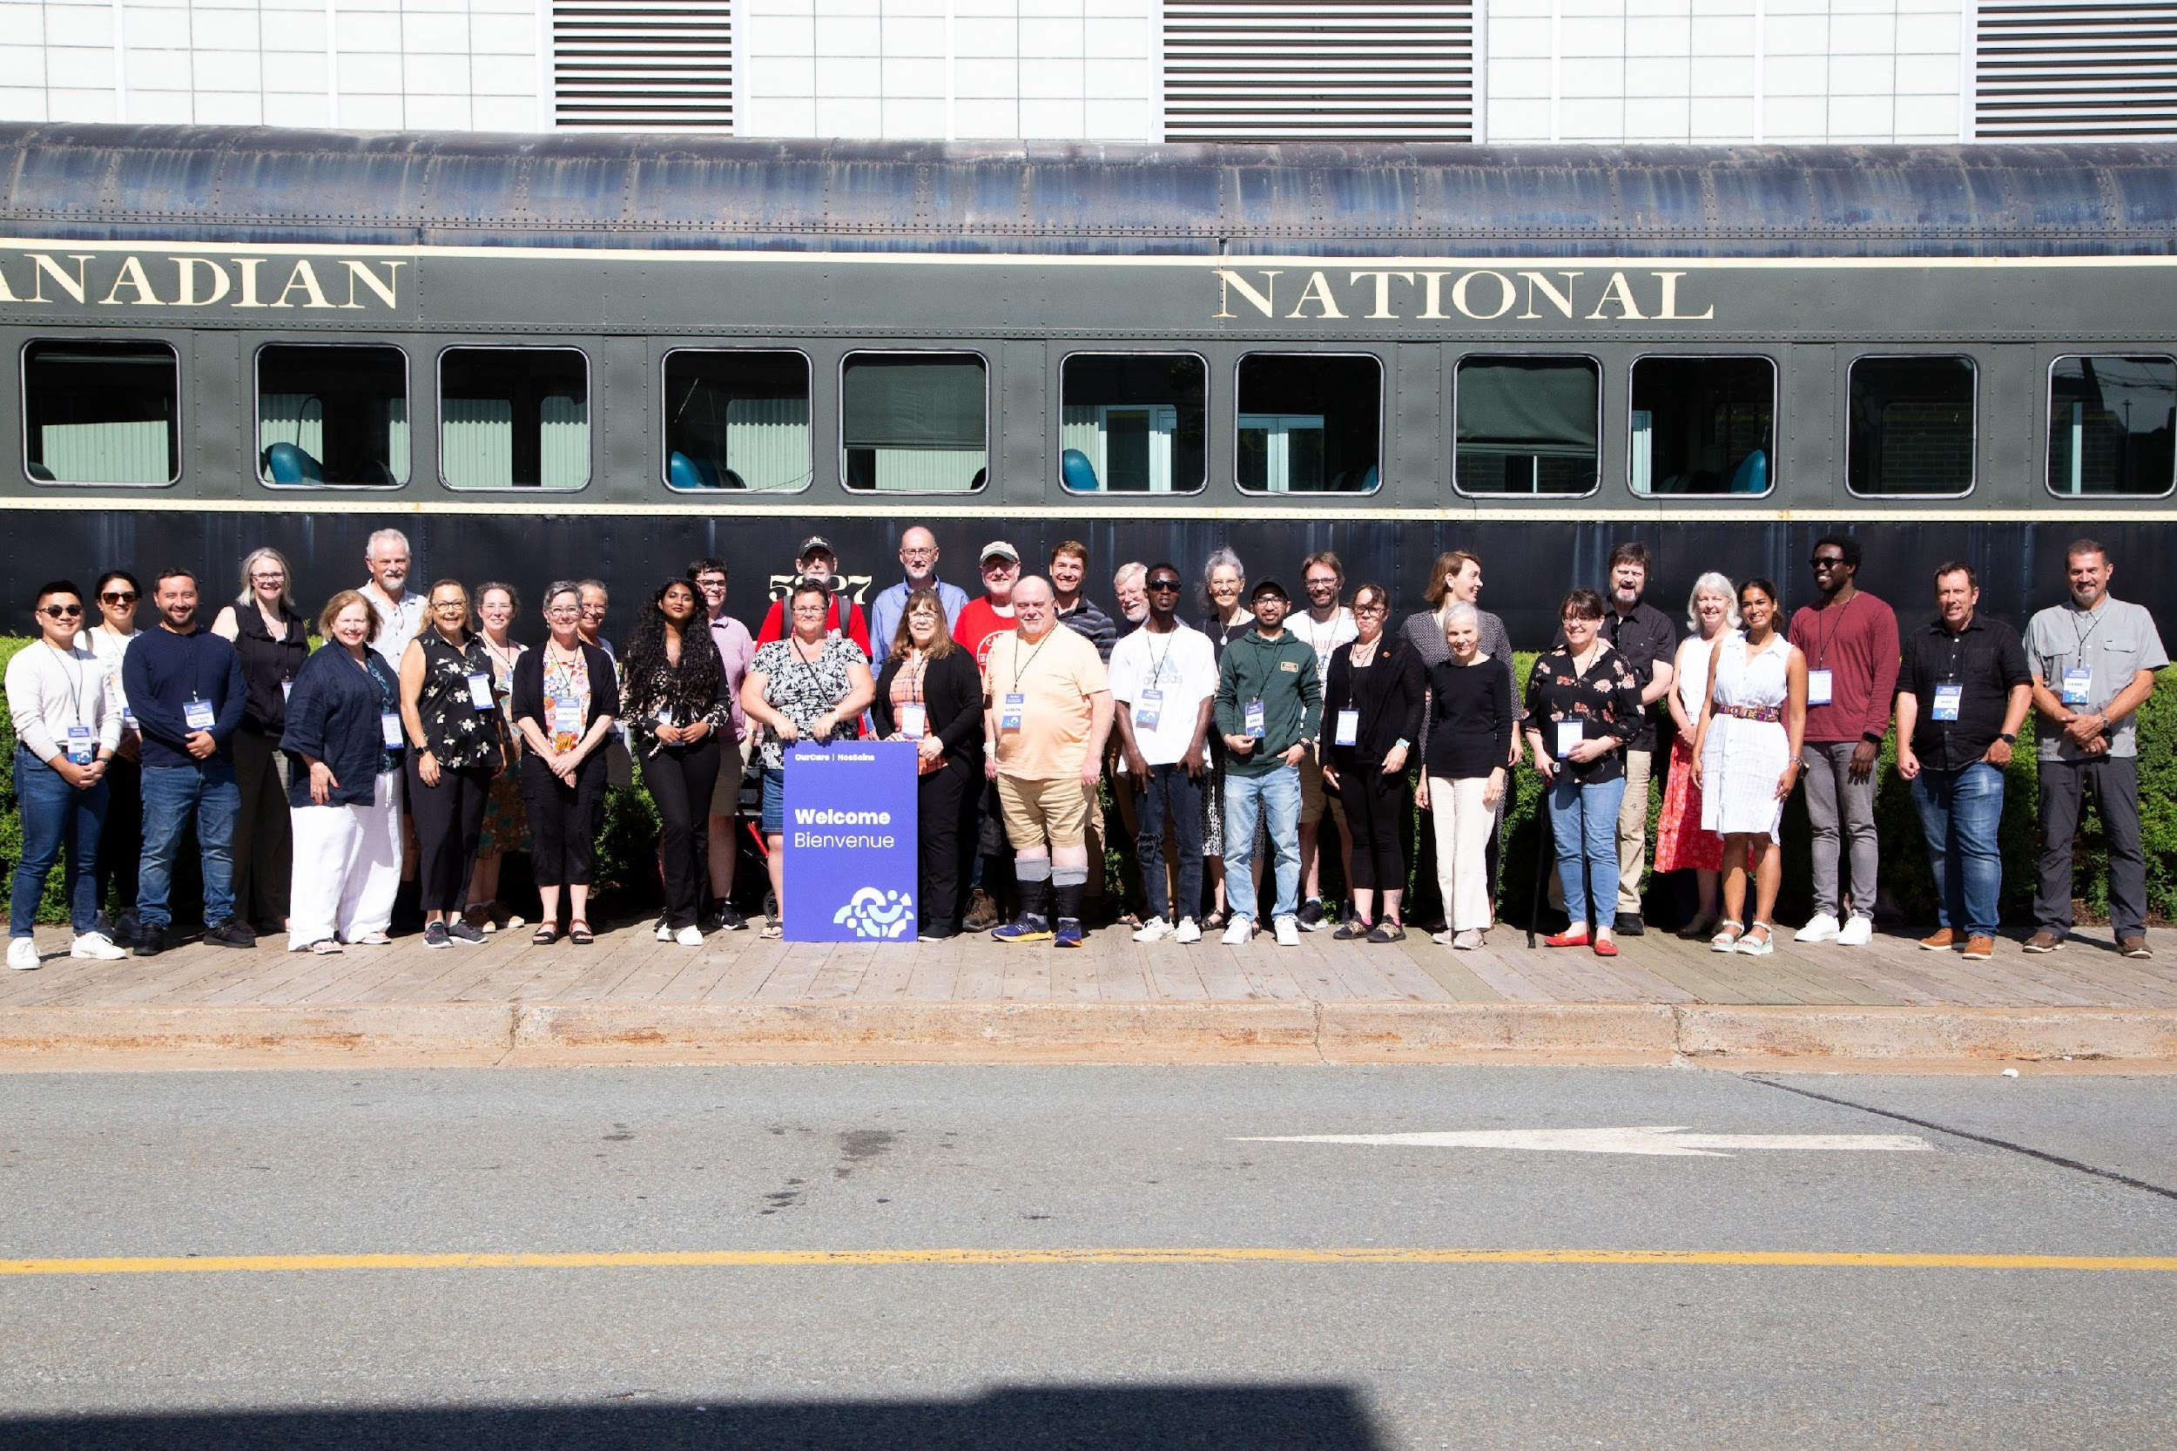

Slide 12
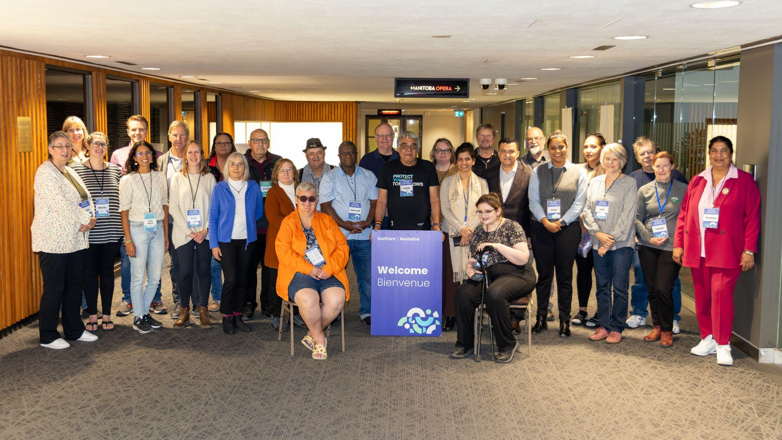

Slide 13
Ten Community
Roundtables
190+ participants
British Columbia
People with Disabilities
Newcomers
Manitoba
Indigenous Youth
Newcomers
Ontario
African, Caribbean & Black Community
Newcomers
Quebec
Newcomers & Low-Income
Racialized & Newcomer LGBTQIA+
Nova Scotia
Refugee Claimants
Black Nova Scotians of African Descent
OurCare | NosSoins
ourcare.ca

Slide 14
Ten Community Roundtables, 190+ participants
British Columbia
People with Disabilities
Newcomers
Manitoba
Indigenous Youth
Newcomers
Ontario
African, Caribbean
& Black Community
First Nations, Inuit
& Métis
Quebec
Newcomers & Low-Income
Racialized & Newcomer LGBTQIA+
Nova Scotia
Refugee Claimants
Black Nova Scotians
of African Descent
OurCare | NosSoins
ourcare.ca

Slide 15
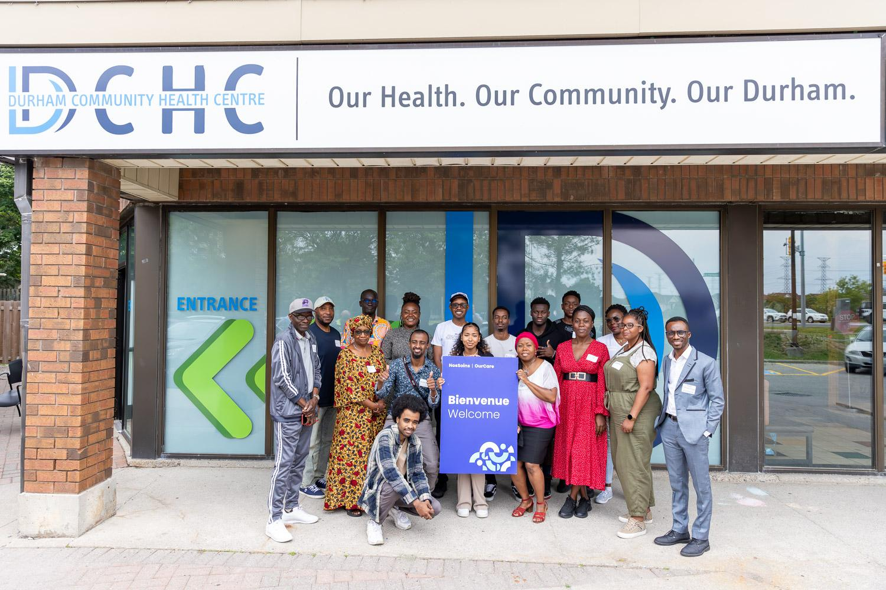

Slide 16
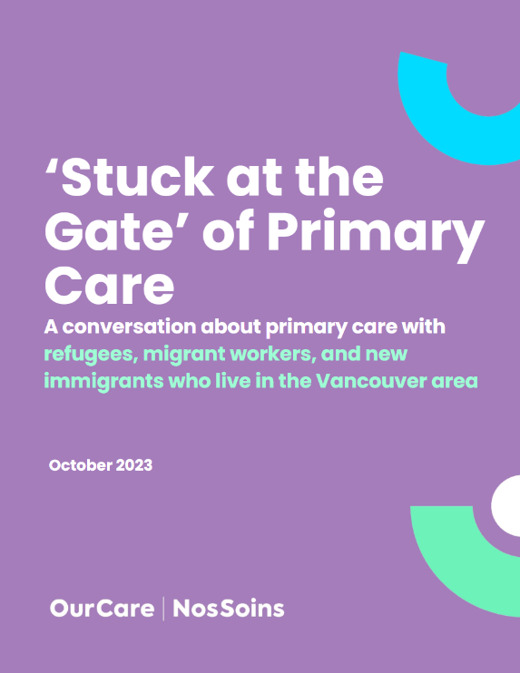
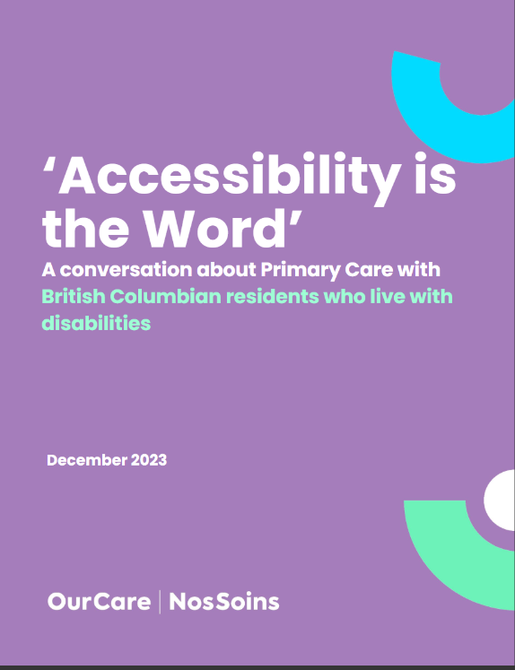
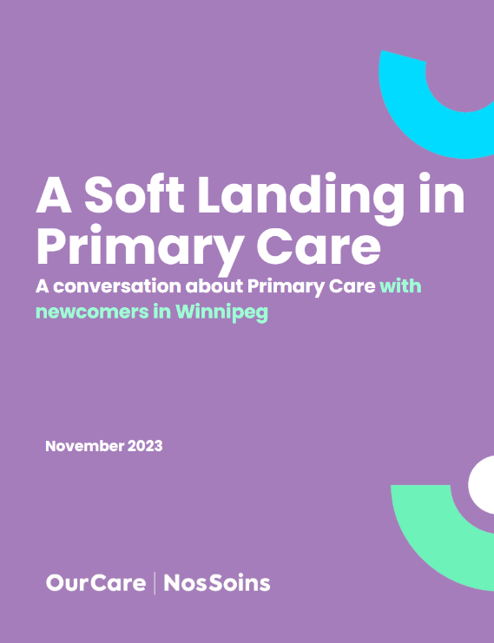
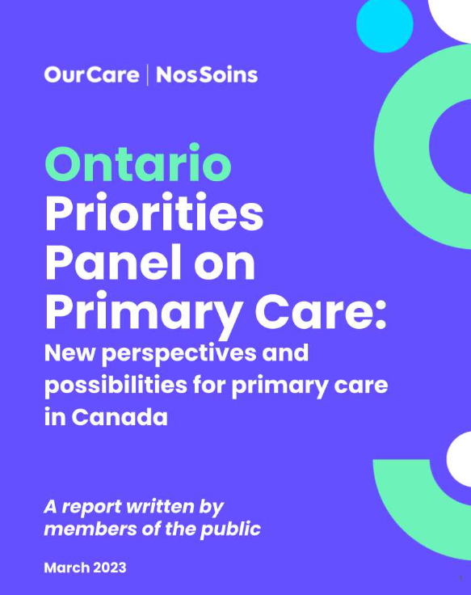
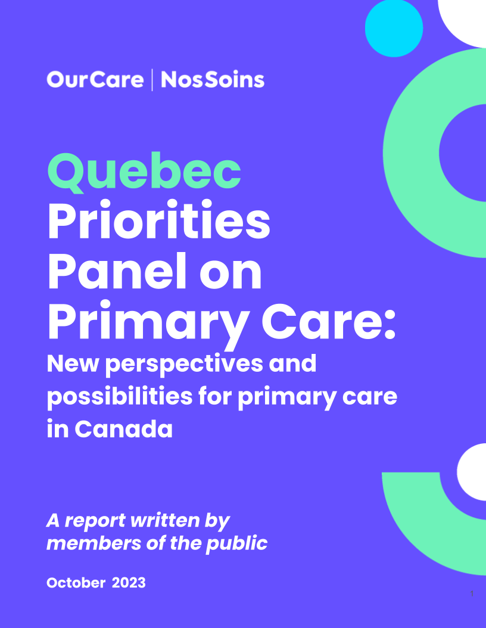
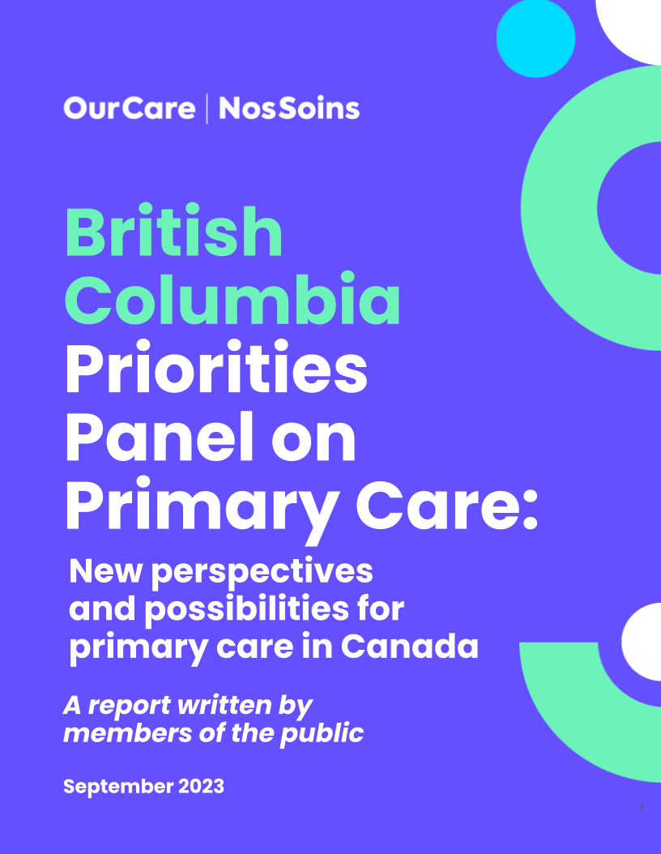
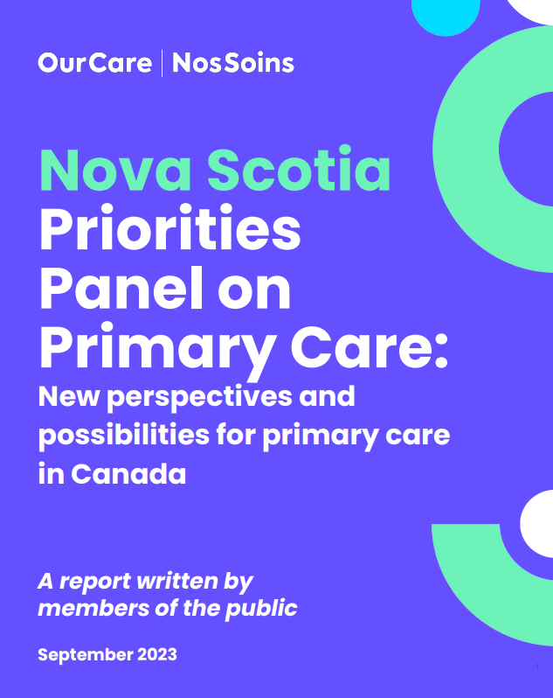
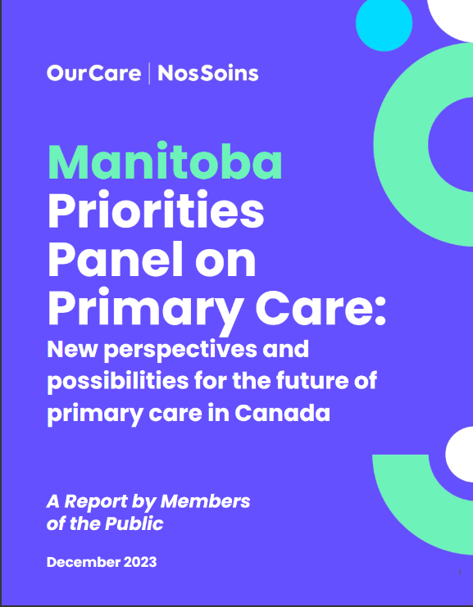
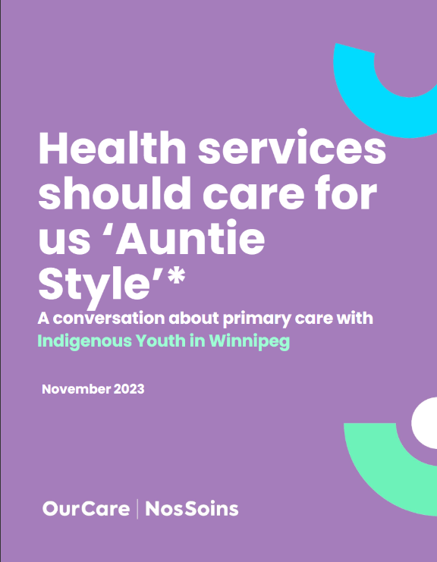
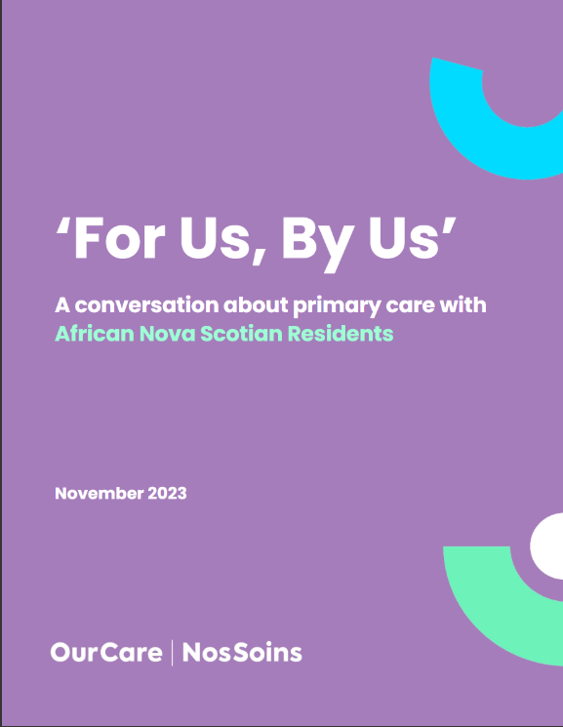
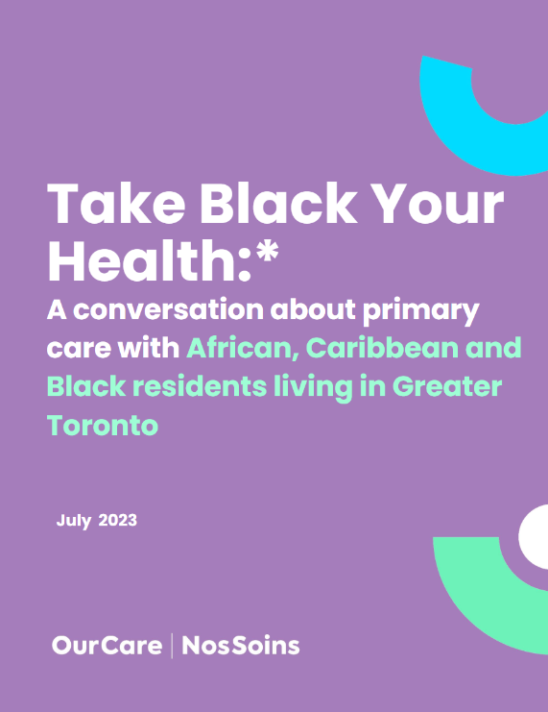
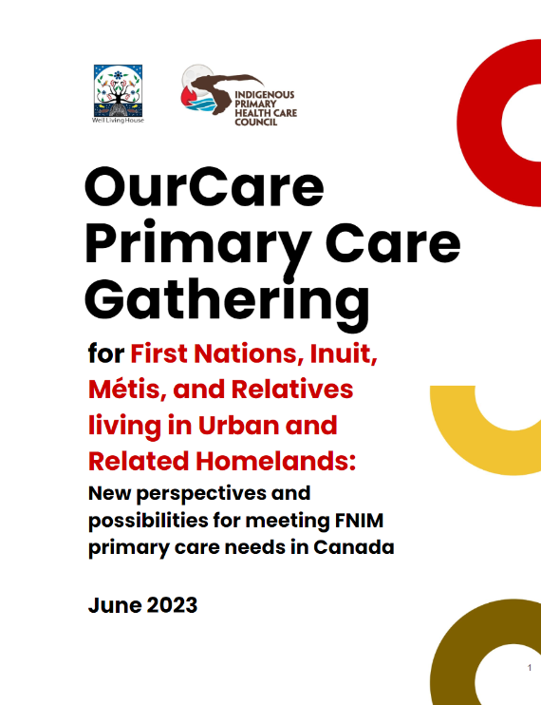

Slide 17
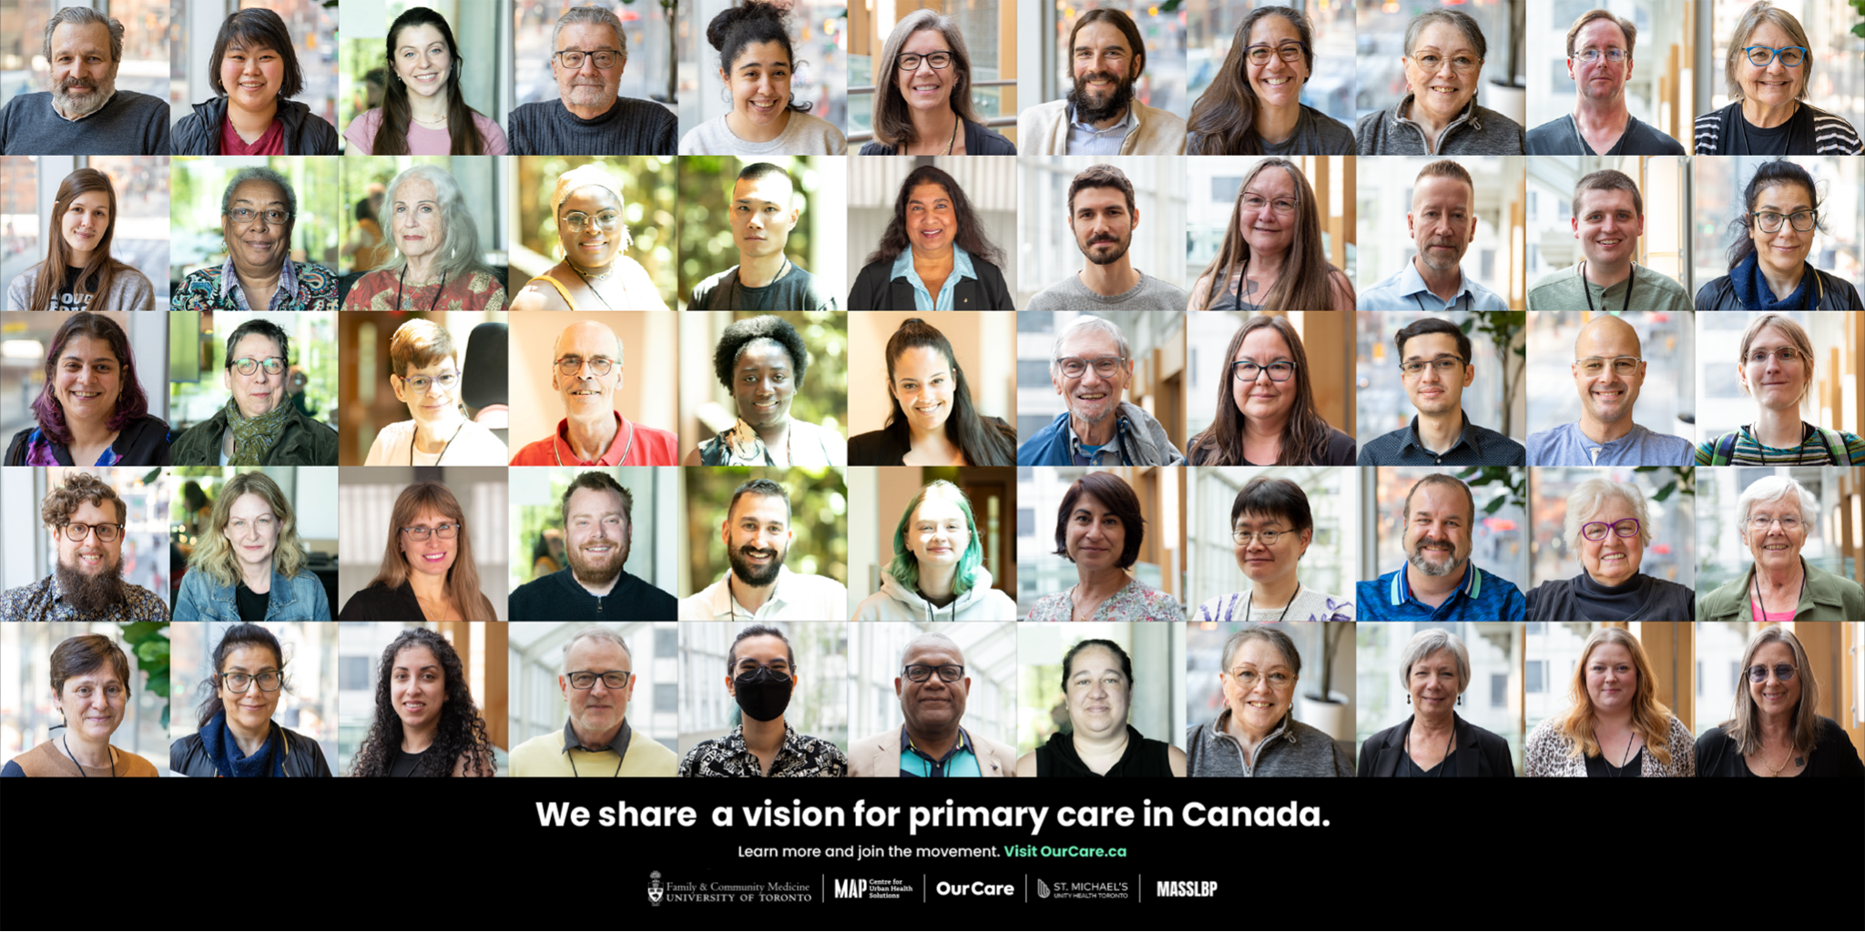

Slide 18
A Standard
for the Future
of Primary Care
OurCare | NosSoins
ourcare.ca

Slide 20
A Standard
for the Future
of Primary Care
OurCare | NosSoins
ourcare.ca

Slide 21
The OurCare Standard
1. Everyone has a relationship with a primary care clinician who works with other health professionals in a publicly funded team.
2. Everyone receives ongoing care from their primary care team and can access them in a timely way.
4. Everyone can access their health record online and share it with their clinicians.
3. Everyone’s primary care team is connected to community and social services that together support their physical, mental and social well-being. ​
5. Everyone receives culturally safe care that meets their needs from clinicians that represent the diversity of the communities they serve.
6. Everyone receives care from a primary care system that is accountable to the communities it serves.

Slide 22
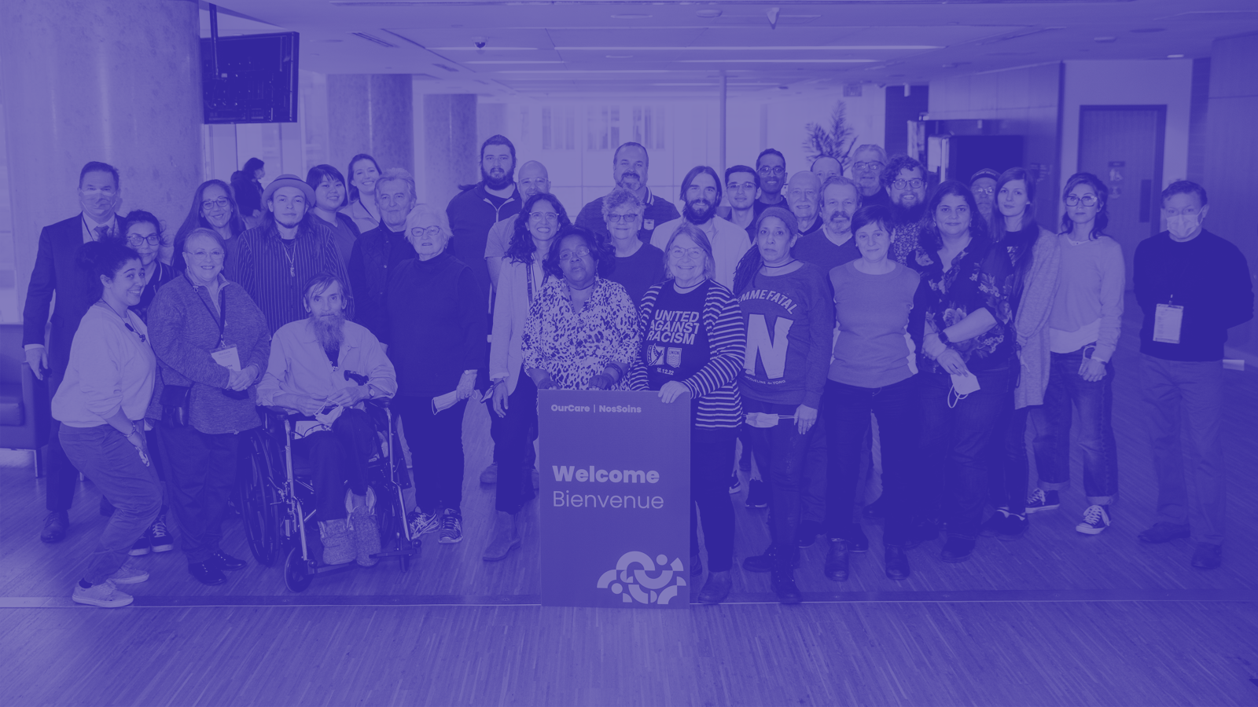
Where are we now?
ourcare.ca

Slide 23
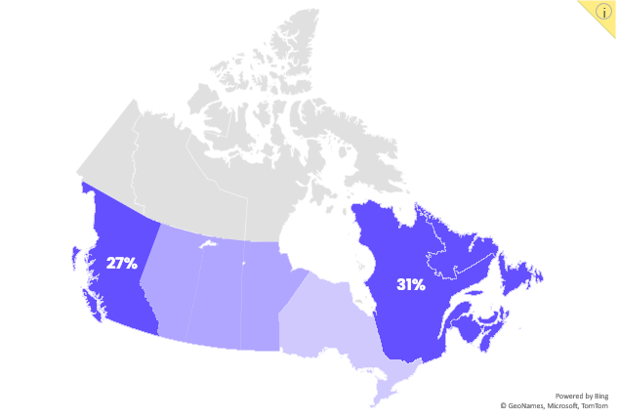
The OurCare study surveyed a diverse group of more than 9,000 people across Canada (Sept-Oct 2022) about their care experiences and what’s important to them when it comes to family doctor care. Learn more at OurCare.ca.
More than 6.5 million adults in Canada don’t have a regular family doctor or NP – that’s more than 1 in 5 adults.
22% of people in Canada age 18+ do not have a family doctor or nurse practitioner (NP) who they see regularly for care.
More people in Québec, British Columbia, and the Atlantic region reported not having a family doctor compared with people in Ontario and the prairie region.
31%
16%
13%
Explore the data yourself: data.ourcare.ca

Slide 24
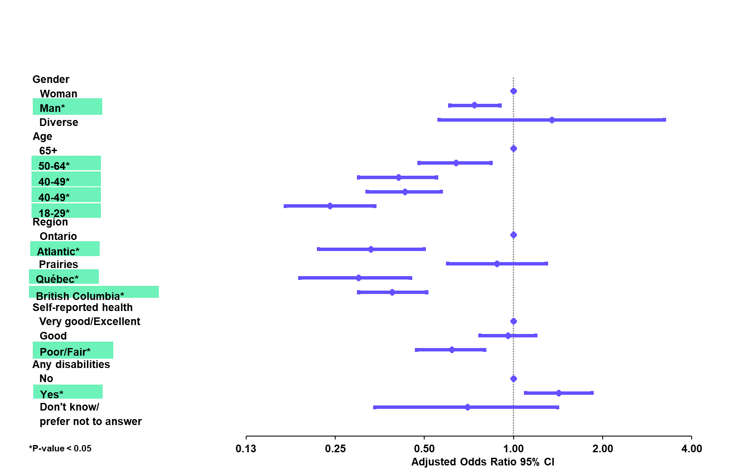
Adjusted Odds of Reporting Having a Family Doctor or NP
CMAJ May 2024

Slide 25
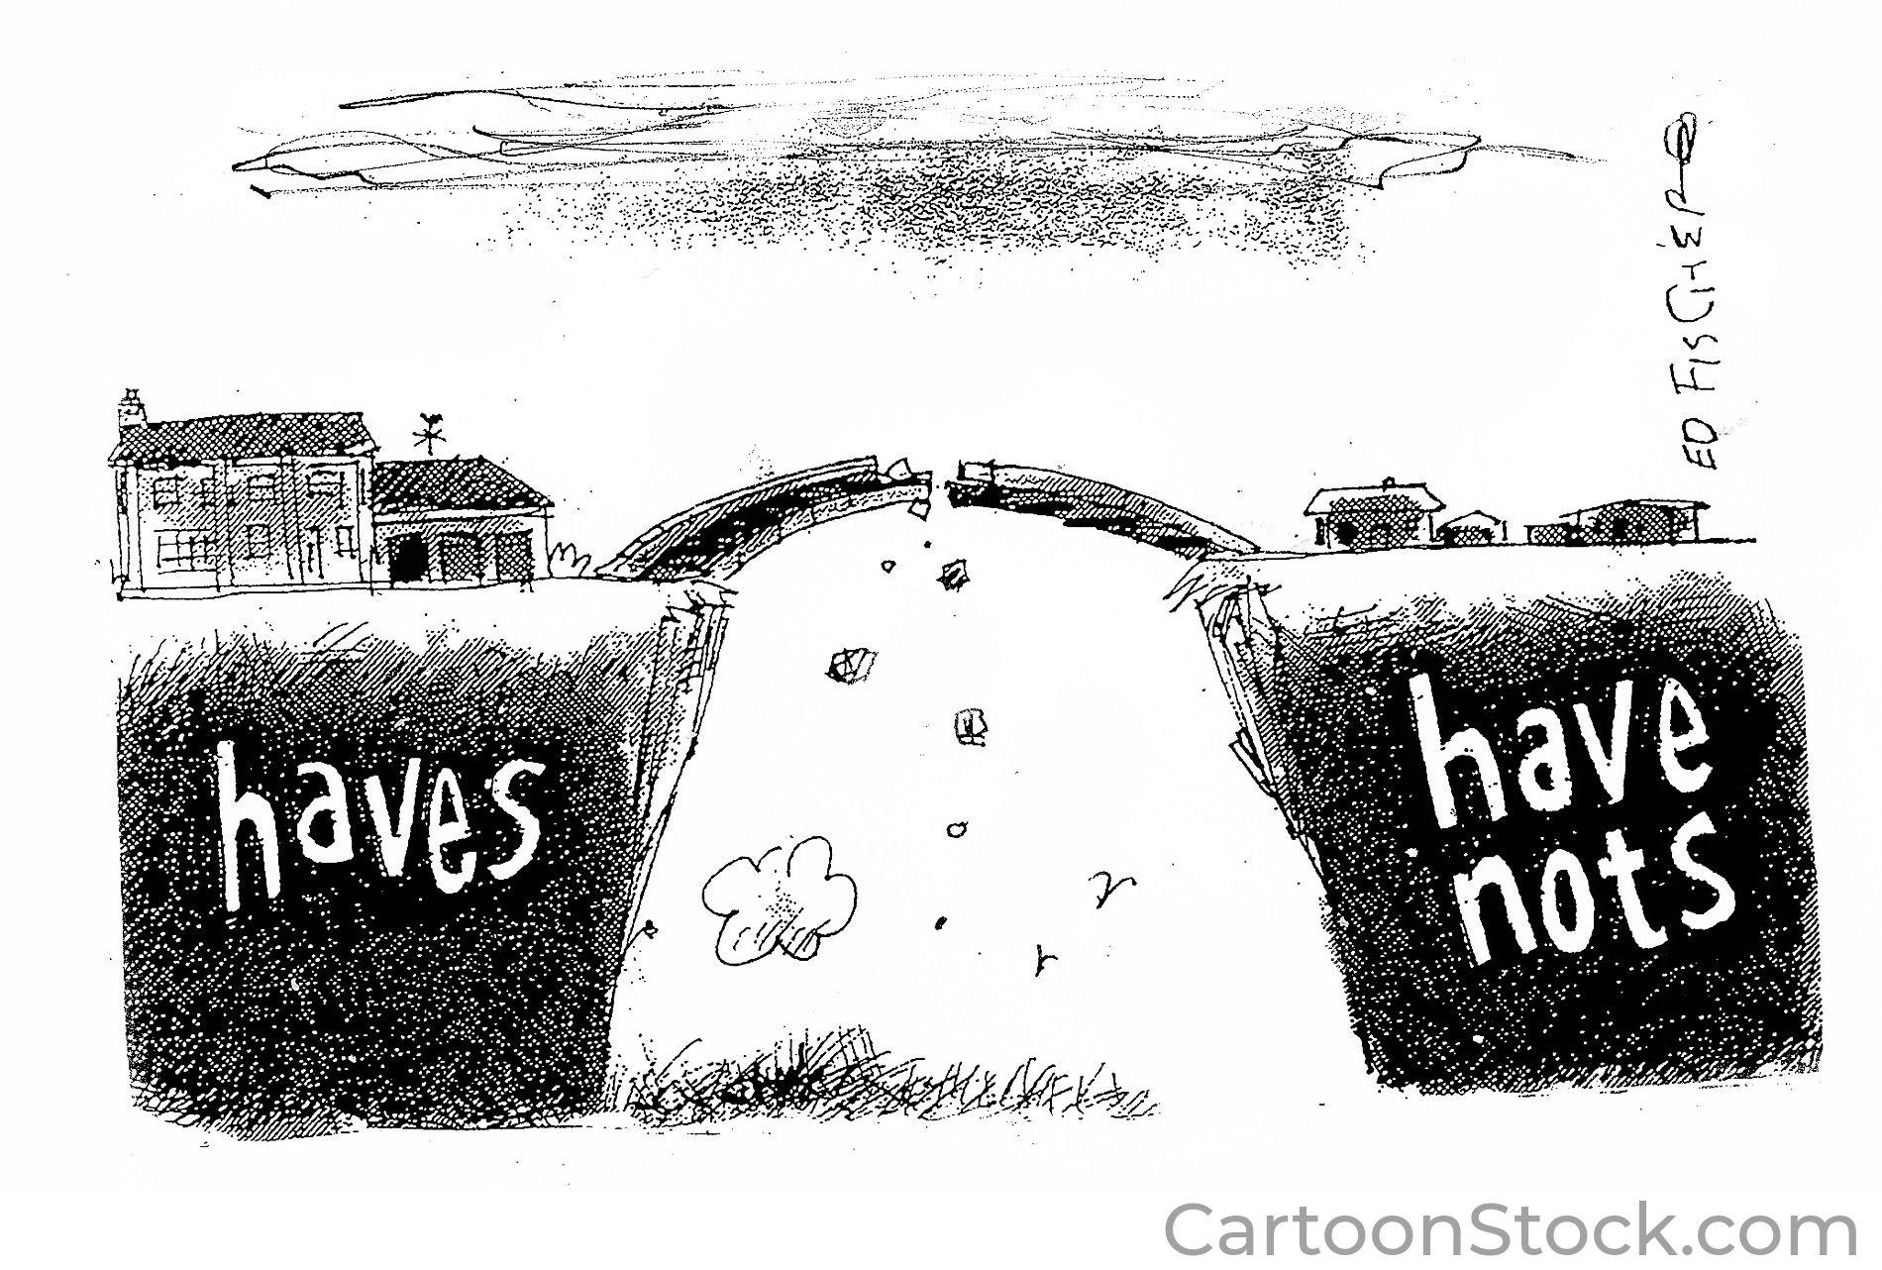

Slide 26
How can we advance their vision?
Design for 100% attachment
Invest more in primary care
Scale up community-governed teams
Legislate interoperability
Remove access barriers
ourcare.ca

Slide 27
OurCare Partners
Ontario Advisory Group
Alliance for Healthier Communities Association for Family Health Teams of Ontario
Black Physicians Association of Ontario Canadian Institutes of Health Research Carea Community Health Centre College of Family Physicians of Canada Health Commons Solutions Lab, Sinai Health System Indigenous Physicians Association of Canada Indigenous Primary Health Care Council Department of Family Medicine, McMaster University Department of Family Medicine, University of Ottawa Department of Family Medicine, Queen's University Dalla Lana School of Public Health, University of Toronto Department of Family and Community Medicine, University of Toronto Northern Ontario School of Medicine
Nurse Practitioners’ Association of Ontario
Ontario College of Family Physicians
Ontario Health
Ontario Medical Association Ontario Ministry of Health Restore Medical Clinics Upstream Lab
Women’s College Hospital
National Collaborating Organizations
Black Physicians of Canada Canadian Institute for Health Research Canadian Medical Association College of Family Physicians of Canada Health Canada Healthcare Excellence Canada Indigenous Physicians Association of Canada
National Primary Care Leaders
Canadian Association for Health Services & Policy Research Dalhousie University University of Alberta University of British Columbia University of Saskatchewan
ourcare.ca

Slide 28
OurCare Partners (Cont’d)
Quebec Advisory Group
Association québécoise des medecins du sport et de l'exercice (AQMSE)
Cree Board of Health and Social Services of James Bay
Collège Québécois de Médecins de Famille
Commissaire à la santé et au bien-être (CSBE)
Département régional de médecine générale (DRMG) Montréal
Direction de santé publique de l'Estrie
Fédération des médecins omnipraticiens du Québec
McGill University
Ministère de la Santé et des Services sociaux (MSSS)
Ordre des infirmières et infirmiers du Québec (OIIQ)
Ordre des pharmacists du Québec
Universite de Montreal
Université Laval
Université de Sherbrooke
British Columbia Advisory Group
BC Association of Community Health Centres
BC College of Family Physicians
BC Family Doctors
BC Patient Safety & Quality Council
Canadian Medical Association
Centre for Health Services and Policy Research
Doctors of BC
First Nations Health Authority
Interior Health
Island Health
North Shore Division of Family Practice
Nurses and Nurse Practitioners of British Columbia (NNPBC)
Providence Health Care
Rural Coordination Centre of BC
Simon Fraser University
University of British Columbia
BC Ministry of Health
Family Practice Services Committee (FPSC)
Fraser Health
Vancouver Division of Family Practice
Nova Scotia Advisory Group
Dalhousie Medical School, Dalhousie University
Department of Health and Wellness, Government of Nova Scotia
Department of Family Medicine, Dalhousie University
Doctors Nova Scotia
IWK Department of Family Medicine
Mi’kmaw Native Friendship Centre
Nova Scotia Health Authority
Nova Scotia College of Family Physicians
Pharmacy Association of Nova Scotia
Nurse Practitioner Association of Nova Scotia
Primary Health Care and Chronic Disease Management Network, Nova Scotia Health Authority
Tajikemɨk
Manitoba Advisory Group
Department of Family Medicine, University of Manitoba
Doctors Manitoba
First Nations Social Secretariate of Manitoba
Interlake-Eastern Health Authority
Manitoba Association of Senior Communities
Manitoba College of Family Physicians (MCFP)
Manitoba Health
Northern Health Authority
Nurse Practitioner Association of Manitoba
Patient Network
Prairie Mountain Health
Province of Manitoba
Office of community Engagement, University of Manitoba
Ongomiizwin Institute of Health and Healing, University of Manitoba
Shared Health
Winnipeg Regional Health Authority (WRH)
ourcare.ca

Slide 29
A major survey of what Canadians expect from their healthcare system
Massive new survey finds widespread frustration with access to primary health care
Feb. 28, 2024
Feb. 27, 2024
Reorganizing primary care could alleviate family doctor crisis
What is and isn't working to fix the family doctor shortage?
Jun. 24, 2023
Apr. 27, 2023
National survey highlights worsening primary care access
Toronto residents increasingly don’t have a family doctor. Here’s why
Apr. 24, 2023
Apr. 6, 2023
We need bold reform to fix family health care
OurCare survey highlights lack of access to primary care
Feb. 07, 2023
Jan. 24, 2023

Slide 30
What do Canadians want for their health care?
10,000 Canadians were asked how to improve health care. Here's what they said
Mar. 1, 2024
Feb. 27, 2024
Revolutionizing Canada's Primary Care: Expanding Teams, E-Records, and Fast-Tracking Foreign Docs
Massive new survey finds widespread frustration with access to primary health care
Feb. 27, 2024
Feb. 27, 2024
Primary-care teams, access to health records key fixes for family doctor crisis: report
Voices for Change: The OurCare Project Unveils a New Vision for Canada's Primary Care
Feb. 26, 2024
Feb. 26, 2024
Indigenous youth want more Indigenous-led models, support to access health care in Winnipeg, report says
System redesign, not incremental improvement, needed to erase family doctor shortage, report author says
Feb. 26, 2024
Feb. 26, 2024

Slide 31
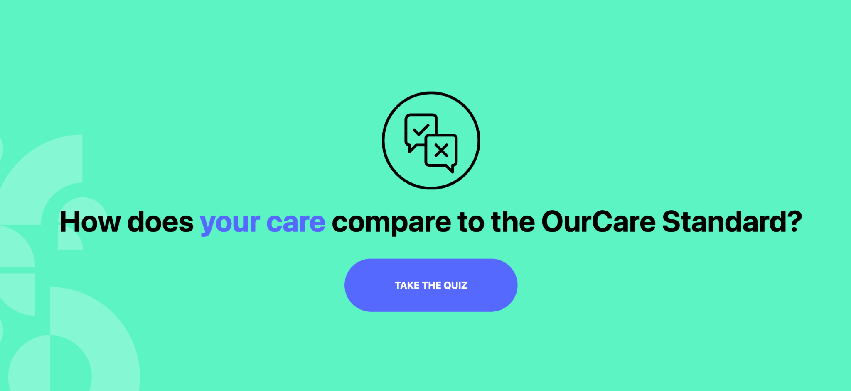
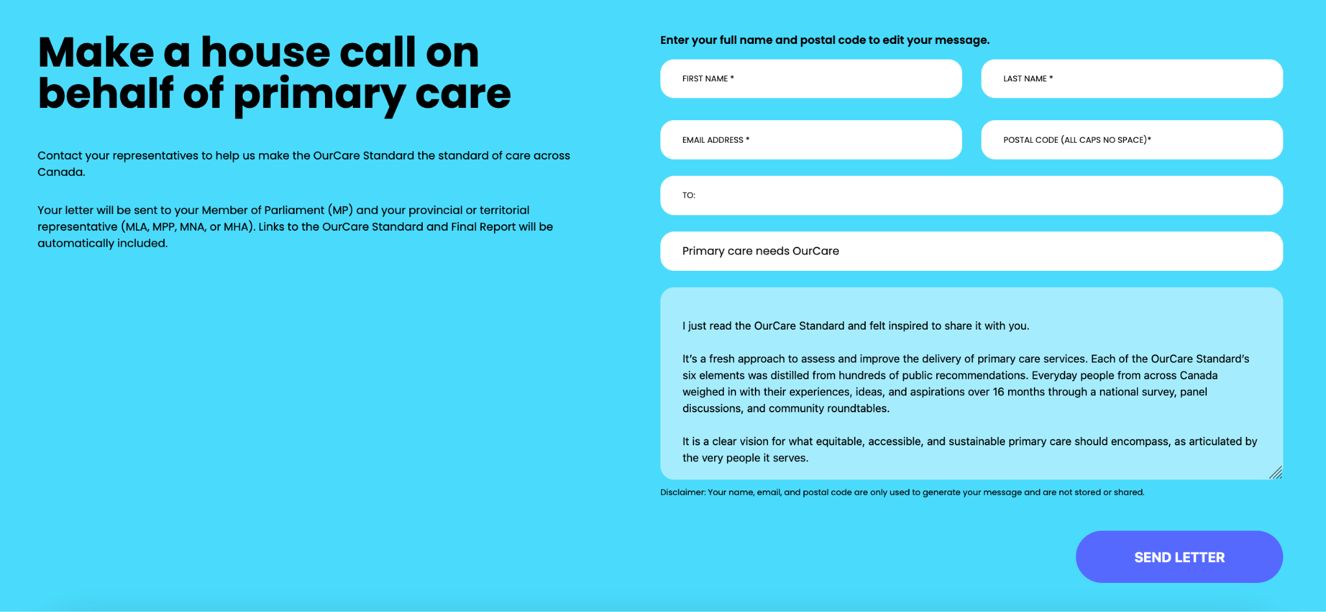
OurCare.ca
Ourcare.ca

Slide 33
Thank you to our funders
The OurCare initiative is made possible through financial contributions from Max Bell Foundation, Even the Odds, and Health Canada. The views expressed herein do not necessarily represent the views of our funders.
NosSoins est rendue possible grâce aux contributions financières de la Fondation Max Bell, d'Even the Odds et de Santé Canada. Les opinions exprimées ici ne représentent pas nécessairement celles de nos bailleurs de fonds.

Slide 34
Thank you to our team, collaborators & funders and the many participants from across the country who volunteered their time
Visit OurCare.ca to learn more
Email: tara.kiran@utoronto.ca
In partnership with:
MASSLBP

