Slide 1

The Imperative of Practice Redesign:
Key Access Concepts from Bright Spot Practices
Marianna Kong, MD
UCSF Center for Excellence in Primary Care
Notes:
Set the conceptual framework/recap basic concepts, confusing with operational view of access etc, miss forest for trees
Set the stage for Sam/Jason

Slide 2
Access to Care Defined
Patients can get care WHEN, WHERE, and HOW they need it.
Care with timeliness, proximity, and appropriate to best meet needs.
Notes:
Broader definition beyond just “fast”
Patient perspective: did you get your care in a timely way/in a way that worked for you?

Slide 3


Access to…
Visits (In person, phone, video)
  Established patients
  New patients/community-level access
“Asynchronous” care
  Population health management
  Non-visit communication – ex. care coordination needs, refills, forms, etc.
  General phone access
  Portal access
  Non-visit models to address patient needs
Notes:
Contextualize the part of access we're talking about (non visit based care), access to what? Telehealth, asynchronous communication, access to the team?
Lots of different angles to consider
→Data: TNAA is not the whole picture
We are usually talking about visit/encounter access
Care models of the future need to be thinking about how care might be most efficiently/effectively delivered outside traditional visits. Need to evolve in conjunction with driving change in payment models

Slide 4
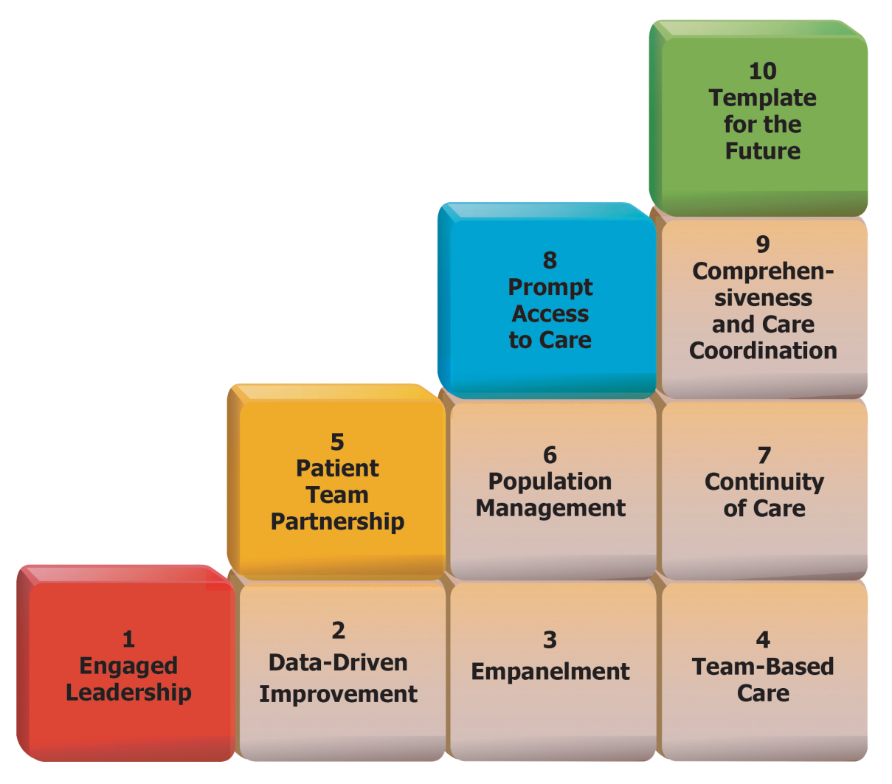
Access – an advanced Building Block
Need strong foundations in the basic Building Blocks to make substantial progress on access
Bodenheimer T, Ghorob A, Willard-Grace R, Grumbach K. The 10 building blocks of high-performing primary care. Ann Fam Med. 2014 Mar-Apr;12(2):166-71.
Notes:
Access is an advanced building block - strong foundations in empanelment, team based care, and data-driven improvement need to be in place to make substantial progress on access

Slide 5
Good Access = Balancing
Capacity + Demand
Capacity
Demand
Clinician FTE
# days open
# appointment slots
# of types/lengths of appointments
Other services (i.e. Behavioral Health, RN Visits)
Panel size
Return intervals
Seasonal
Inefficient visits (ex. physical then lab results)
Patient population needs (chronic & complex, acute, preventative)
Notes:
Framework to understand how to improve access

Slide 6


For good access, capacity = demand
Increase Capacity:
  More visits per day
  More days per year
  Other team members adding capacity
  No-show reduction
Reduce Demand:
  Reduce panel size
  More efficient alternatives to visits (ex. portal, group visits, using technology)
  Do more at each visit, reduce visit return rate
  Improve continuity
Notes:
Increase capacity
↑ time spent in clinic, or ↑ visits per clinic
↑ teamwork – shifting preventive & chronic care tasks to free up clinician capacity
Reduce demand, # of visits per patient/year by:
↑ continuity
↓ the visit return rate
↑ service at each visit
Using alternative encounters (phone, email, group visits)
- efficiency - converting traditional visit demand into alternative (and theoretically more efficient) ways to address needs

Slide 7
For good access, capacity = demand
Increase Capacity:
  More visits per day
  More days per year
  Other team members adding capacity
  No-show reduction
Reduce Demand:
  Reduce panel size
  More efficient alternatives to visits (ex. portal, group visits, using technology)
  Do more at each visit, reduce visit return rate
  Improve continuity
2:1 upskilled medical assistant to clinician ratio (Bellin Health, University of Colorado)
RNs, pharmacists, behavioral health, physical therapists, etc.

Slide 8
For good access, capacity = demand
Increase Capacity:
  More visits per day
  More days per year
  Other team members adding capacity
  No-show reduction
Reduce Demand:
  Reduce panel size
  More efficient alternatives to visits (ex. portal, group visits, using technology)
  Do more at each visit, reduce visit return rate
  Improve continuity
Opportunity for innovation
Consider time/resources for the alternatives
Payment models need to evolve

Slide 9
Use existing capacity more efficiently
Capacity
Demand
Inefficient matching of capacity to demand
→Change how appointments are scheduled to minimize appointment mismatch
Advanced access:
Most efficient to minimize time between when appointment demand is presented and when it is met → Maximize flexibility by having most appointments still open to address issues as they come in
Notes:
Besides directly increasing capacity/reducing demand, also area to consider of how efficiently we’re using our capacity to meet demand.
Problems in matching capacity to offer appts with demand for appts on day to day basis, maybe more so than absolute lack of capacity.
--matching supply to demand is not static, variation in demand, queuing theory
--demand highly predictable, not really insatiable
--lengths of queues in most systems remain steady at given number of weeks/months, rather than growing w/o limit
--Practices w/adv access have not seen increases in visit rates; ex Kaiser saw demand for visits per pt per year drop by 10%
Advanced access = Reducing time between when demand is presented and when it is met; doing today's work today
Optimizing capacity versus creating capacity
Shuffling/upfronting to use capacity more strategically/efficiently; optimizing/minimizing wasted capacity (template changes, reduce no-shows)

Slide 10
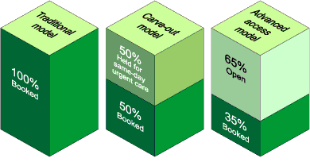
Advanced/open-access
Traditional: schedule completely booked in advance; same-day urgent care is deflected or piled on top of existing appointments
Carve-out: some slots are held for same-day urgent care; same-day non-urgent requests are deflected
Advanced access: majority of appointment slots open for patients who call same day (routine & urgent) – “doing today's work today”
Murray M, Tantau C. Same-day appointments: exploding the access paradigm. Fam Pract Manag. 2000 Sep;7(8):45-50. PMID: 11183460.
https://www.aafp.org/pubs/fpm/issues/2000/0900/p45.html#fpm20000900p45-bt2
Notes:
Traditionally unless medically urgent, just adding appointments to the back of the line.
Carveout
- Reduces number of slots available to meet todays demand, pushes more nonurgent demand into future
When reserving more time than needed/used, is wasted
informal systems to steal appointments/fill frozen slots early; Temptation to open further in advance when there’s “not enough appointments”
inaccurate triage decisions (worried well vs stoic sick)
Traditional and carveout scheduling wastes time/resources triaging/delaying care, managing intentionally created delay
Adv access - % of open slots at beginning of day around 50%, vs 10%. Should only be those made by clinician discretion or pt preference. maximizes flexibility to meet daily demand
Advanced access uses the concept that for a given panel size, there’s a steady state of backlog. Instead of constantly working with the 3 month backlog, have a dedicated plan/upfront investment to work down the backlog and then address patient appt requests same day.
-urgent care --> creates add'l f/u with PCP; advance access prioritizes continuity by all PCPs having availability
just in time, lean principles
reduce appt types - keep simple, flexible

Slide 11
Measuring Day-to-day Appointment Capacity + Demand
Capacity
Demand
# Clinicians in clinic
# appointment slots per clinician
(Room availability)
(Variation due to vacations, sick leave, etc.)
# of patient calls/requests for the day
# walk-ins
# follow-up appointments generated by clinicians
Use to precisely predict daily and seasonal patterns of demand
Proactively reallocate capacity to times of greater demand
Murray M, Berwick DM. Advanced access: reducing waiting and delays in primary care. JAMA. 2003 Feb 26;289(8):1035-40. doi: 10.1001/jama.289.8.1035. PMID: 12597760.
Notes:
Goal to predict demand and proactively manage supply in response (vs control/forcibly limit demand)
Demand is usually predictable
Data at level of precision most systems don't look at; day to day
Demand = # patient calls for requests/appts in a day, plus number of walk ins, plus f/u appts generated by clinicians
retrospective "demand" actually measures historic supply; need to measure prospectively
-Predict demand surges, daily and season fluctuations; restrict prescehduled appts and increase capacity on those days
(reallocate supply to days of week with greater demand, ex Mondays,after vacations)
know supply and make staffing contingencies for times of low supply

Slide 12
Open access at Banner Health/University of Arizona
Initially implemented in 2003. All appointments opened when the day began. Patients could not make appointments in advance. TNAA was zero.
Some patients loved open access; others wanted to make appointments in advance.
The clinic began to open appointment slots one week in advance. TNAA is no more than 7 days. No-show rate is low.
When patients need to schedule follow-up in advance, front desk uses a reminder system to call the patient one week before that date.
Notes:
Benefits pts preferring same-day access, harder for those with chronic conditions/elderly/those who have trouble with navigating appt system

Slide 13
No-show reduction (wasted capacity)
No-shows reduce capacity, and that capacity is gone forever
No-show rate is proportional to the number of days between when a patient makes an appointment and the date of the appointment
Reminder/confirmation systems help somewhat
The best way to reduce no-shows is to only open appointments <2 weeks in advance - benefit of advanced access
Bennett KJ, Baxley EG. The effect of a carve-out advanced access scheduling system on no-show rates. Fam Med. 2009 Jan;41(1):51-6.
Rivas J. Advanced Access Scheduling in Primary Care: A Synthesis of Evidence. J Healthc Manag. 2020 May-Jun;65(3):171-184.
Notes:
-no shows and lead time of making appt = wasted capacity; mismatch
2020 systematic review on AA (18 studies):
AA scheduling may reduce appointment scheduling wait time (83%) and no-show rates (67%), increase patient volume (50%) and productivity of providers (83%), and decrease emergency and urgent care visits (75%).
Patient and staff satisfaction, continuity of care, revenue, and quality of care outcomes were mixed in terms of improvement.

Slide 14
Advanced access successes
South Central Foundation, Alaska
From 9% to 57% of appointments open during the next month
Centra, Central DuPage Health System, Illinois
TNAA from >35 days to 0-3 days
Patient satisfaction from 72%ile to 85%ile
Continuity from 40% to 75%
Bellevue Hospital outpatient departments, New York
TNAA from 12 weeks to 1-3 days
Patient satisfaction increased 25%
Murray M, Bodenheimer T, Rittenhouse D, Grumbach K. Improving timely access to primary care: case studies of the advanced access model. JAMA. 2003 Feb 26;289(8):1042-6.

Slide 15

Common implementation challenges
Panel sizes
  Balancing panels between clinicians
  Overall over-empanelment
Working down the backlog
Protecting continuity
Patient expectations/trust
Scheduling system inefficiencies
  Ex. difficult phone appointment systems
Murray M, Bodenheimer T, Rittenhouse D, Grumbach K. Improving timely access to primary care: case studies of the advanced access model. JAMA. 2003 Feb 26;289(8):1042-6.
Notes:
Panel leveling, ongoing monitoring
Backlog = reservoir of unmet demand
At given panel size, steady state of backlog. Figure out your capacity and work down backlog
Retraining culture/patients, building trust
Managing patient expectations
Staff buy-in; Resist temptation to open further in advance

Slide 16

Take-home points
Need strong foundations in empanelment, team-based care, and data-driven improvement
Need the right data to fully understand demand
Managing demand by right-sizing panels
Adding capacity with teams
Optimizing existing capacity with advanced access concepts & appointment template changes
Care models of the future vs. traditional visit-based care model

