Slide 1

The 80-90% Question:
What Should Family Medicine Be Responsible For & Who is Responsible?
A Leadership Conversation on Identity, Policy, and Practice

Slide 2



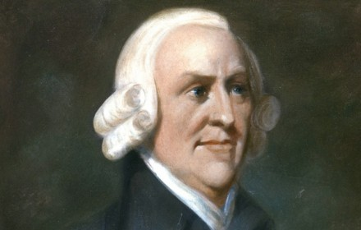
The Case for Subspecialized Care?
Notes:
Division of Labor Supports Specialization
Smith's view: Productivity increases when tasks are broken into narrower parts and performed by specialists (e.g., pin factory example).
Application to health care: Smith might initially favor subspecialization, as it allows individuals to develop deep expertise, leading to technical efficiency and innovation.
Smith's caution: Excessive specialization can make workers "as stupid and ignorant as it is possible for a human creature to become" (Book V).
Application: In health care, Smith might recognize that generalists (e.g., family physicians) are crucial where broad, contextual knowledge of the patient is more valuable than isolated technical skill — particularly in rural areas or when managing complex, multi-system illness.
Smith’s Theory of Moral Sentiments emphasizes sympathy, duty, and justice.
Application: Smith might argue that a comprehensive, generalist approach better serves the common good, especially for the poor and underserved who need longitudinal, integrated care. He’d see health as a public interest, where over-fragmentation of care undermines relational trust and continuity.
Market Failures and Imperfect Information
Smith acknowledged markets don’t work well in contexts of asymmetrical information and externalities.
Asymmetrical information: Patients can’t judge what care they need, unlike choosing bread or shoes. The supplier (doctor) often decides the demand.
Externalities: The public health effects of widespread primary care access (e.g. fewer hospitalizations, better chronic care) aren’t captured in individual transactions.
Skewed incentives: Markets reward what is billable (procedures, subspecialty care), not what is most valuable for health (continuity, prevention, comprehensive care).
Undersupply of generalists: Even if generalists offer better population outcomes, their lower pay and undervaluation in the system mean fewer doctors choose generalism, a classic example of market failure.
Adam Smith’s concept of the invisible hand suggests that individuals pursuing their own self-interest can unintentionally benefit society—but this mechanism breaks down in health care. Unlike typical markets, health care involves asymmetric information, skewed incentives, and public health externalities. These distortions lead the market to overproduce subspecialists, who are better compensated, and underproduce generalists, despite their greater value for population health, continuity, and equity. Smith would likely argue that while specialization brings efficiency, intentional policy is needed to support comprehensive, generalist care as a public good.

Slide 3
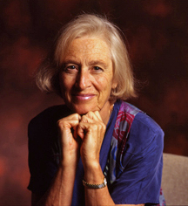
Barbara Starfield: The Case for Generalism in HC
4Cs
There is now good evidence, from a variety of studies at national, state, regional, local, and individual levels that good primary care is associated with better health outcomes (on average), lower costs (robustly and consistently), and greater equity in health
“Comprehensiveness appears to be the most powerful of the features of primary care associated with improved health outcomes and reduced costs”
-Starfield, 2005,
The Milbank Quarterly
“Capable of meeting 80–90% of individuals’ health care needs across a lifetime”
Notes:
Barbara Starfield argues that comprehensiveness in primary care is a foundational attribute that enhances health outcomes, reduces costs, and improves equity—outperforming more specialized systems on nearly every measure. Building on Adam Smith’s recognition that markets can misallocate resources, she would show that health systems emphasizing specialty care produce worse outcomes at higher cost. Comprehensiveness ensures that a wide range of health needs are met within primary care, reducing unnecessary specialist use, improving coordination, and strengthening person-focused care over time. Rather than relying on the invisible hand, she emphasizes that effective health systems must deliberately invest in comprehensive primary care as a core organizing principle, because its benefits are systemic, not incidental

Slide 4
Breadth & Aspirational definitions: PC & FM
1996: Institute of Medicine defined primary care as:
“…the provision of integrated, accessible health care services by clinicians who are accountable for addressing a large majority of personal health care needs, developing a sustained partnership with patients, and practicing in the context of family and community.”
2004: Future of Family Medicine
“New Model practice will commit to providing the full basket of clinical services offered by family medicine …”
2014: Family Medicine for America’s Health
“Family physicians are personal doctors for people of all ages and health conditions. They are a reliable first contact for health concerns and directly address most health care needs.”
Notes:
The Patient Protection and Affordable Care Act (ACA) of 2009 has returned attention to primary care and its role in achieving the nation’s Triple Aim of improved population health and patient care, while achieving lower costs.¹ Decades of evidence support primary care’s potential as an antidote to healthcare costs whose growth has outpaced the overall economy for decades and which faces additional burdens from an aging, enlarging, and increasingly insured population.^{2,3} Among the definitional features of primary care thought to be responsible for its positive impact is comprehensiveness, or the ability to care for a broad spectrum of health problems. The Institute of Medicine, in an often-referenced 1996 publication on primary care, defined comprehensiveness as “…the provision of integrated, accessible health care services by clinicians who are accountable for addressing a large majority of personal health care needs.”⁴ The value of this function of primary care was reiterated by the World Health Organization in 2008. ⁵ To serve as first contact for undifferentiated illness, another primary care principle, requires comprehensiveness to effectively differentiate symptoms and complaints, diagnose and engage in treatment where necessary. . Likewise, continuity in the patient relationship, one of the most studied of primary care features, relies upon comprehensiveness, as does coordination of these relationships across many settings. In theory, comprehensiveness is supposed to make delivery of “the right care, at the right time, in the right place,” and the avoidance of more costly care later more likely.

Slide 5
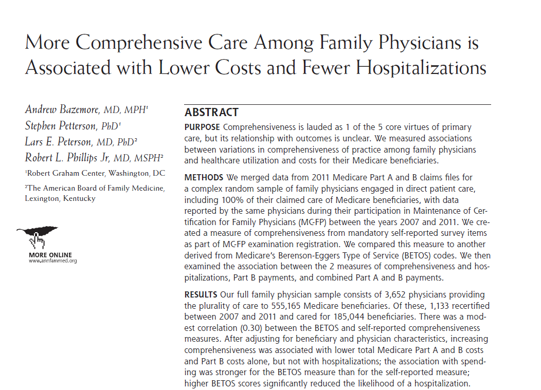

Hey Smith, could Measureable Generalism actually be Efficient?

Slide 6
Breadth of FP services – waning?
And yet, a declining number of FPs are
practicing women’s health care
caring for children
delivering babies
performing many procedures (e.g. endoscopies
Meanwhile, newly graduated FPs
feel more prepared & intend to practice more broadly
but have a narrower scope of practice (SOP) than their predecessors
Weidner AKH, Phillips RL, Fang B, Peterson LE. Burnout and scope of practice in new family physicians. Ann Fam Med 2018
Xierali IM, Puffer JC, Tong STC, Bazemore AW, Green LA. The percentage of family physicians attending to women’s gender-specific health needs is declining. J Am Board Fam Med 2012
Tong ST, Makaroff LA, Xierali IM, et al. Proportion of family physicians providing maternity care continues to decline. J Am Board Fam Med 2012
Eden AR, Morgan ZJ, Jetty A, Peterson LE. Proportion of family physicians caring for children is declining. J Am Board Fam Med 2020
Bazemore AW, Makaroff LA, Puffer JC, et al. Declining numbers of family physicians are caring for children. J Am Board Fam Med 2012
Barreto T, Peterson LE, Petterson S, Bazemore AW. Family physicians practicing high-volume obstetric care have recently dropped by one-half. AmFamPhysician 2017

Slide 7
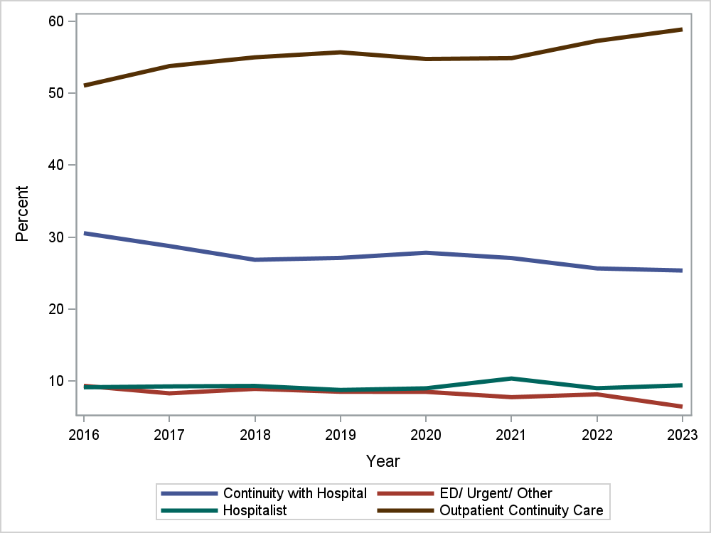
Breadth of Settings too? Less Inpt/Outpt

Slide 8
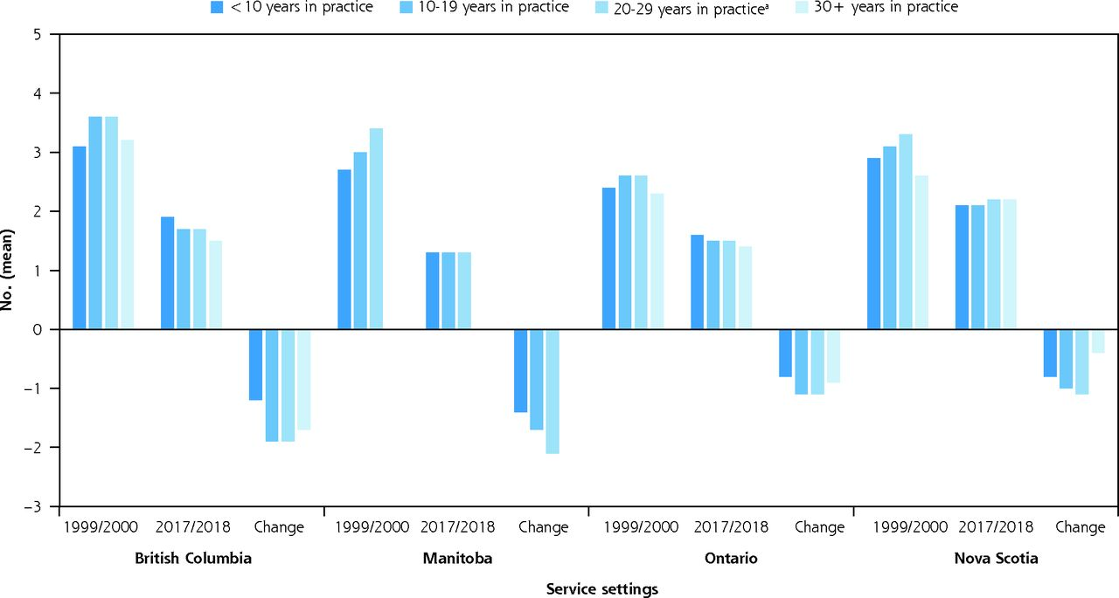
Similar trends in Canada:
2000 vs 2018 Scope Change in 4
Declining Comprehensiveness of Services Delivered by Canadian Family Physicians
Is Not Driven by Early-Career Physicians. Ann Fam Med. 2023 Mar-Apr

Slide 9
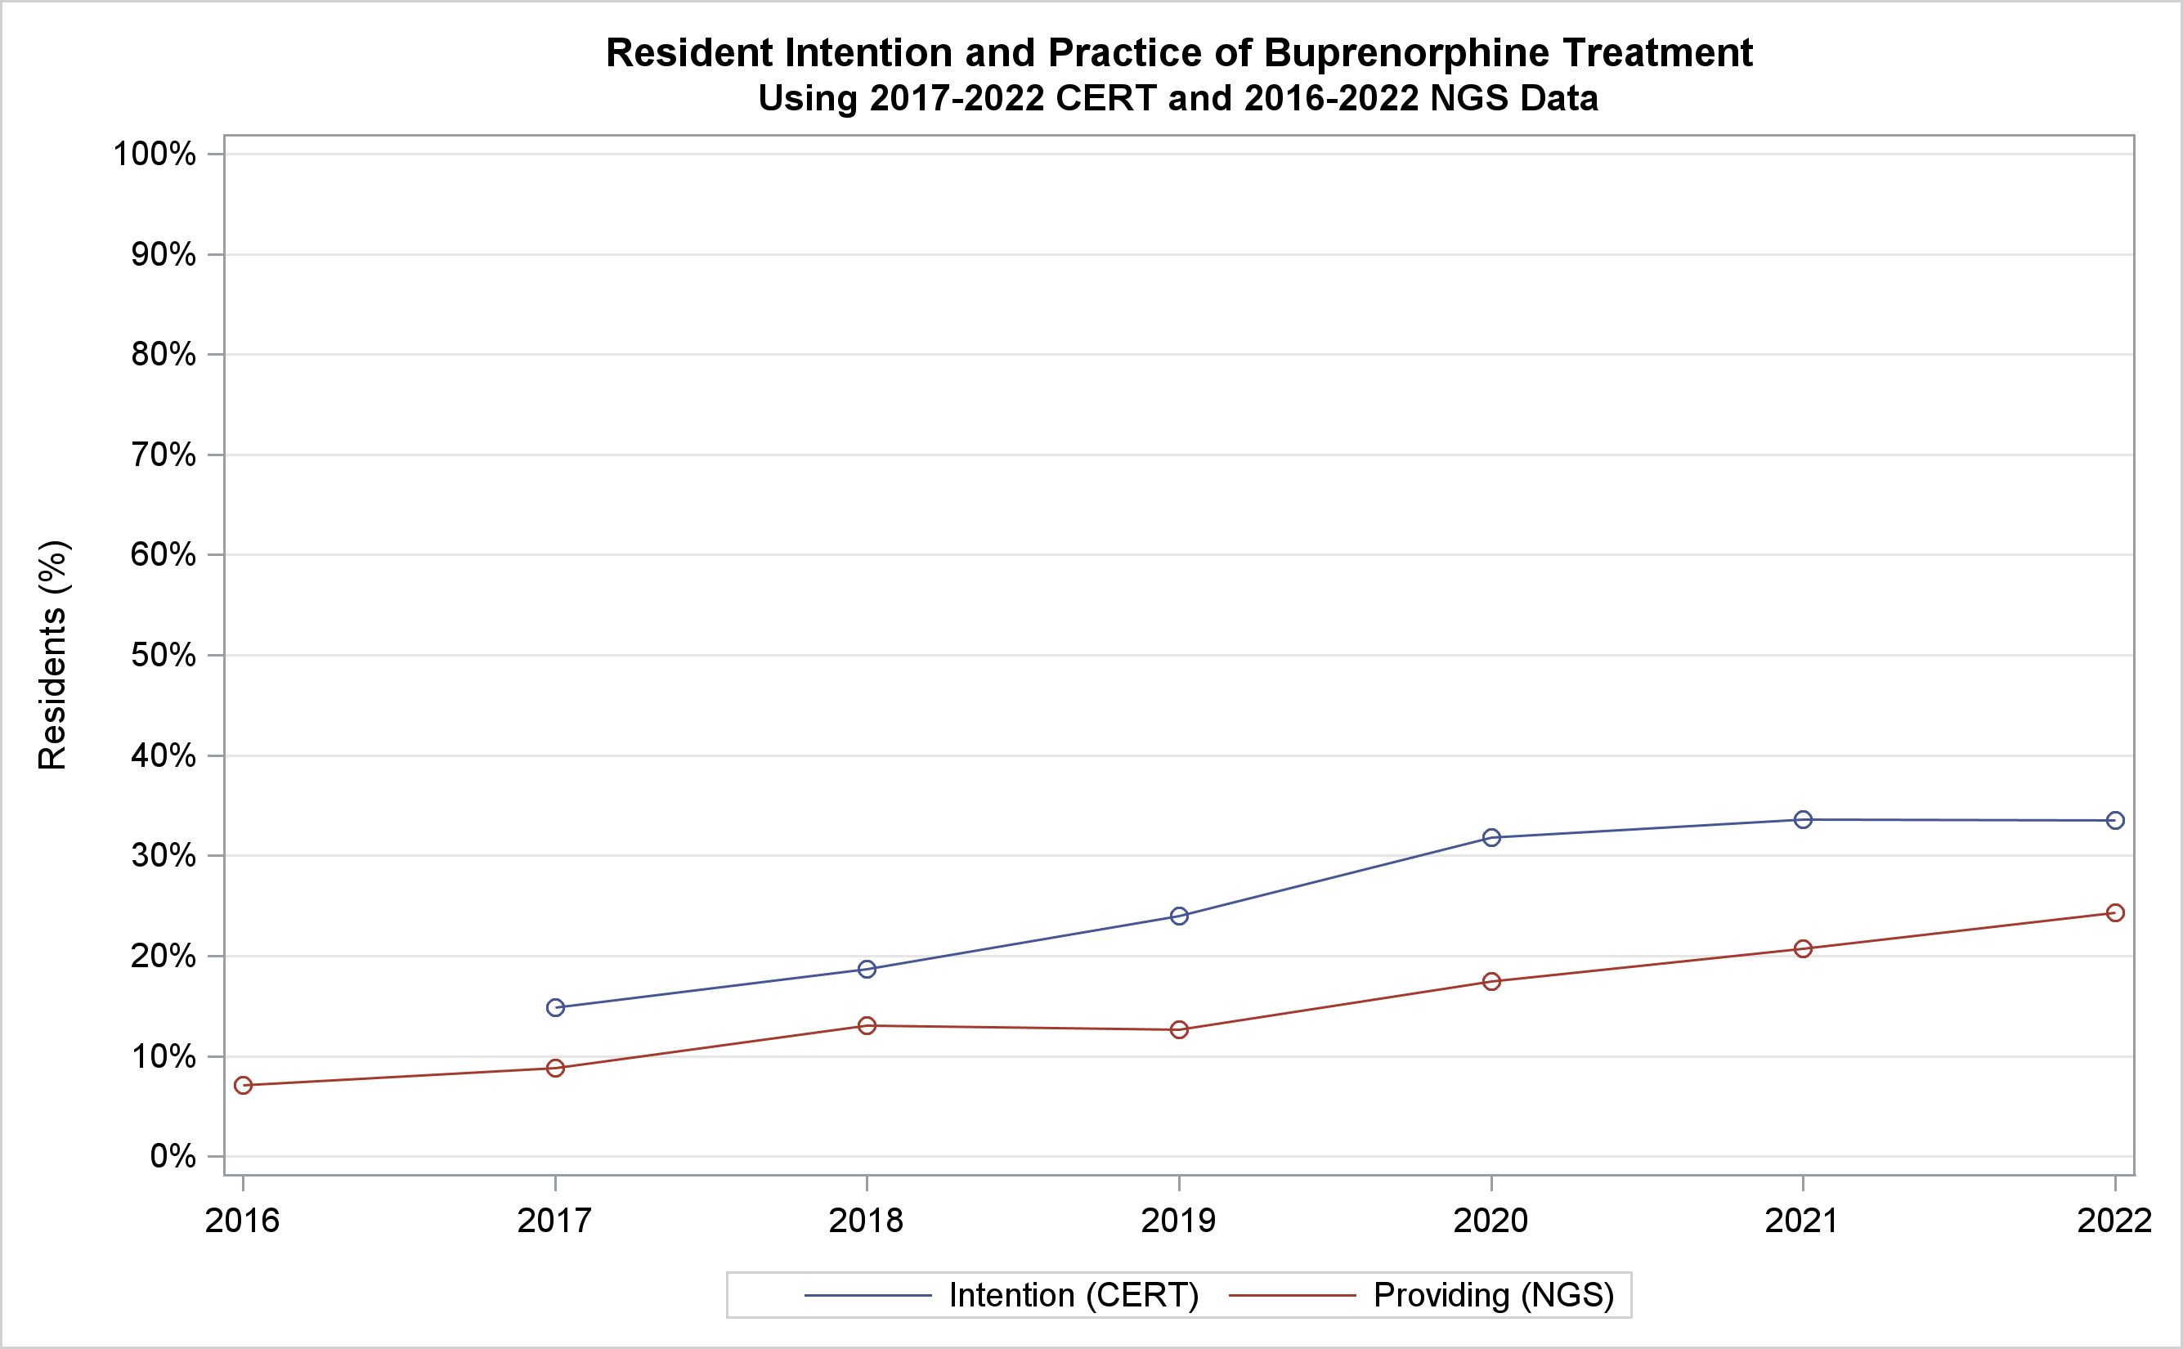
Some areas growing?: Trends in Intention and Practice for Buprenorphine Treatment by Residents
Red lines represent intention to practice by the same cohort of graduates

Slide 10

↑ Burnout
Overwork, admin burden push doctors to narrow their scope.
↑ Complex Patients
Aging, obesity, and multimorbidity raise care demands.
Payment/Perverse Incentives
RVUs, payment favors volume, not breadth
Delivery System
Employed FPs, hospital ‘service lines’ & credentialing limits OB, inpatient,& procedural roles. Access trumps breadth. Limited team support
Training Gaps
New grads lack exposures (care of children), modeling, support for broad care.

Slide 11
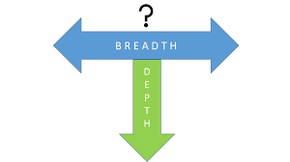
So what is Comprehensiveness in Family Medicine in 2025:

Slide 12
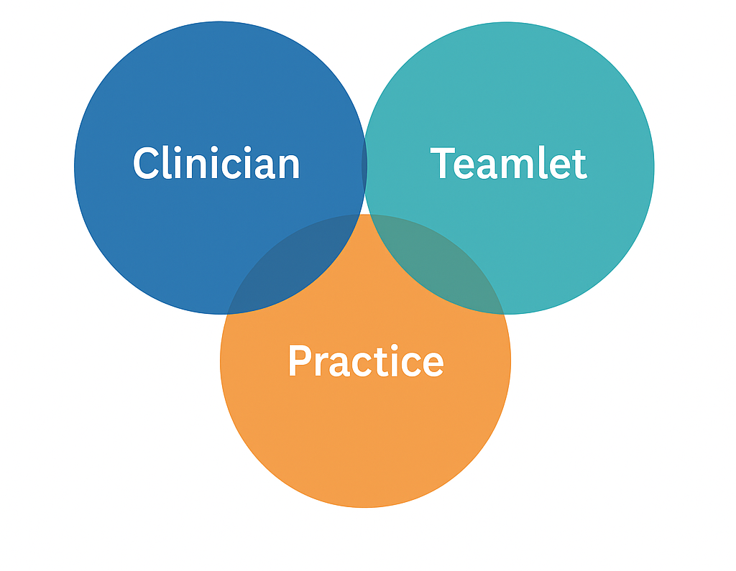
Comprehensiveness at what level?
Who’s Job is it?

Slide 13
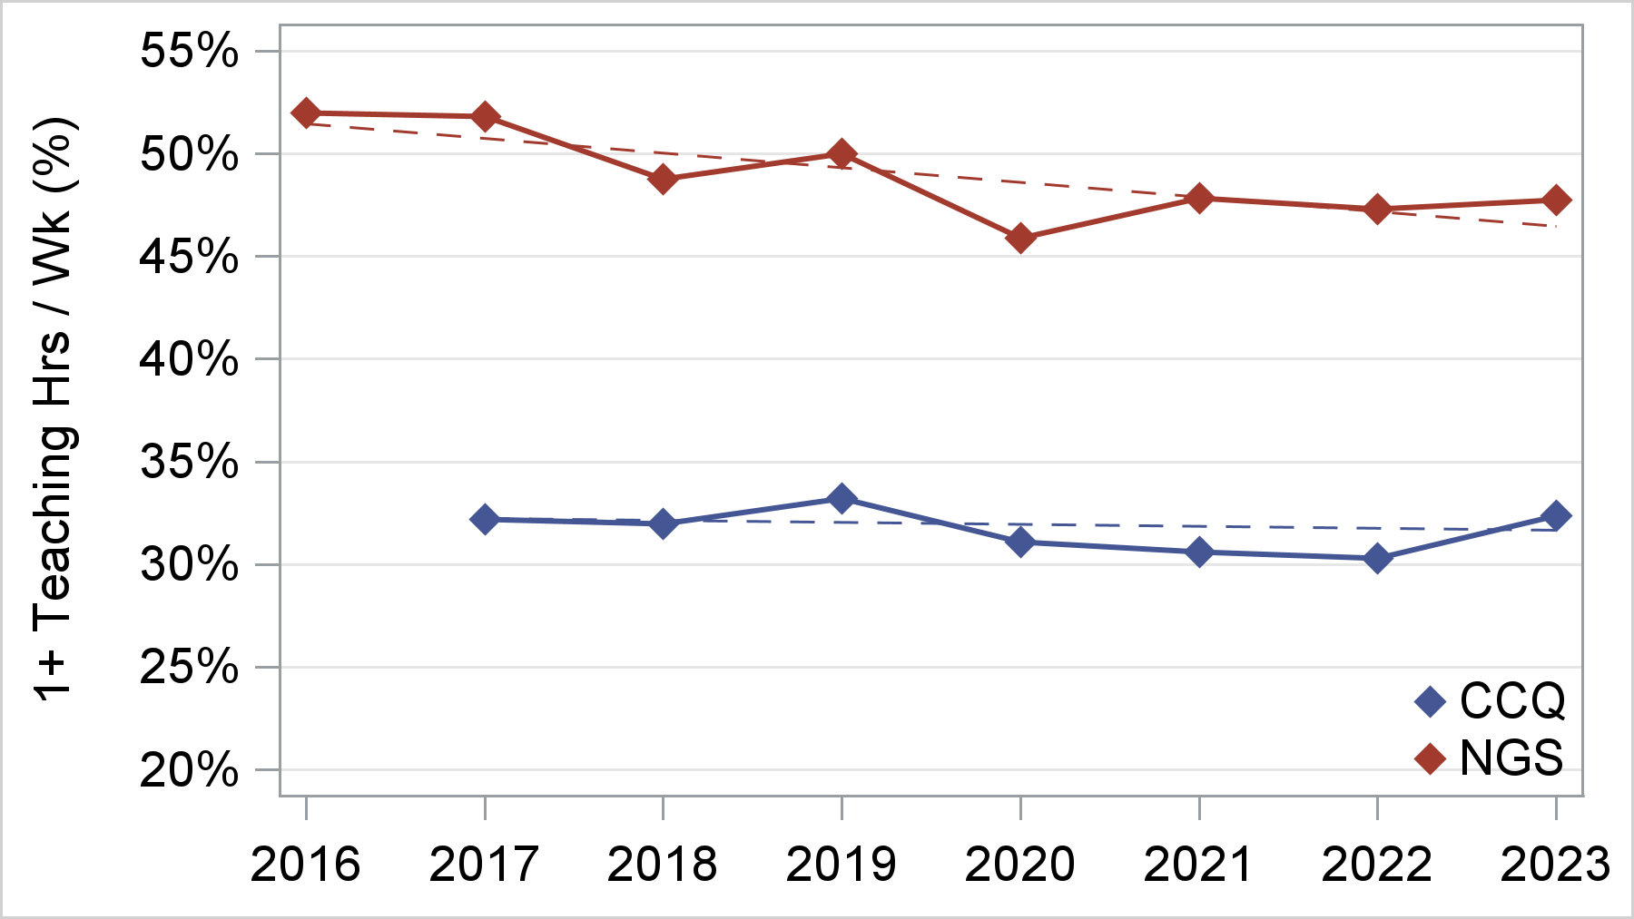
Participation in Teaching Over Time
(% c any teaching hours)
Notes:
Mismatch with last slide… there only 27% of NGS say they don’t teach but here it looks like 50% don’t… likely 20% are very low volume teachers..

Slide 14
Trends in Recent Graduates Going into Rural Practice
Notes:
Where’s the population located in the U.S.?

Slide 15



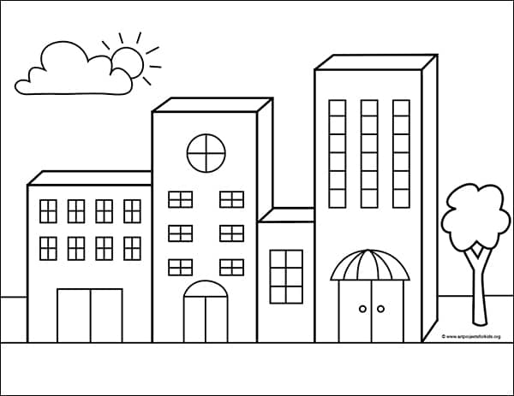
Do Early Career Rural FPs Stay Rural?
20%
2%
77%
2%
15

