Slide 1
Reflective Feedback Conversations
Stefanie White, MD
Stephenie Matosich, DO

Slide 2
Disclosures
The presenters have no conflicts of interest to disclose.

Slide 3
Objectives
After this seminar, participants will be able to:
List key aspects of reflective feedback conversations.
Identify how faculty can role-model receiving and incorporating feedback.
Describe how to guide residents in self-reflection and assessment based on evaluation data available to them.
Notes:
Before we dive into the objectives, we’re going to take a moment to see where everyone is at

Slide 4
Poll Question:
How comfortable do you feel giving positive feedback to a learner?
Very uncomfortable
Somewhat uncomfortable
Neutral
Somewhat comfortable
Very comfortable

Slide 5
Poll Question: How comfortable do you feel giving constructive feedback to a learner?
Very uncomfortable
Somewhat uncomfortable
Neutral
Somewhat comfortable
Very comfortable

Slide 6
What makes feedback effective?
And why is it so challenging?

Slide 7
Reflect
When have you received constructive feedback that was done well? What made it helpful and positive?
When have you given feedback well? Why did it work?
In contrast - when have you had negative experiences with feedback? Why?
Notes:
Have a share here 2min vs comments in the chat to be addressed later

Slide 8
Feedback is necessary…
Notes:
As much as we would like to think we know our own selves, we all have blind spots when it comes to our behavior and it’s impact on others. This is especially true in medicine, where learners often don’t have enough time for self reflection and observation. Part of our job to ensure competent and confident learners is to provide an accurate assessment of how they are performing. Sometimes self assessment is not enough!

Slide 9
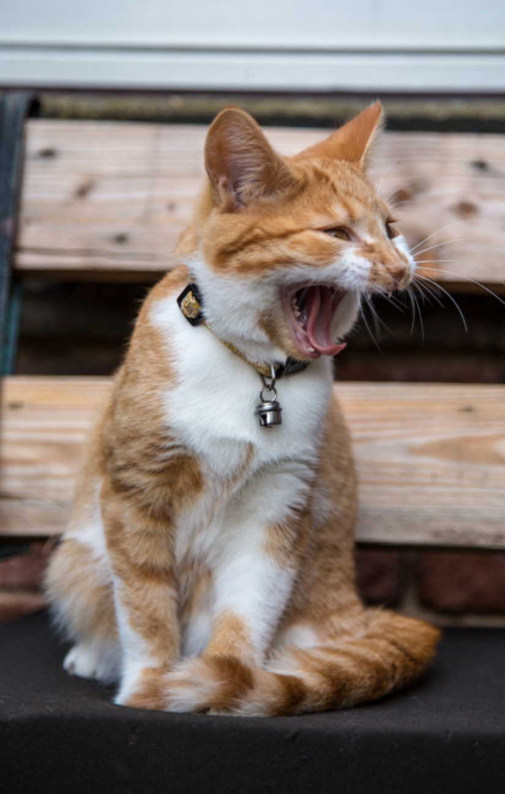
Feedback is necessary…
Notes:
As much as we would like to think we know our own selves, we all have blind spots when it comes to our behavior and it’s impact on others. This is especially true in medicine, where learners often don’t have enough time for self reflection and observation. Part of our job to ensure competent and confident learners is to provide an accurate assessment of how they are performing. Sometimes self assessment is not enough!

Slide 10
Feedback is necessary…
Notes:
As much as we would like to think we know our own selves, we all have blind spots when it comes to our behavior and it’s impact on others. This is especially true in medicine, where learners often don’t have enough time for self reflection and observation. Part of our job to ensure competent and confident learners is to provide an accurate assessment of how they are performing. Sometimes self assessment is not enough!

Slide 11
…But good feedback is hard
Humans are innately curious
Humans have a need to be accepted for who they are
Receiving feedback about oneself is a balance between these two needs
Notes:
This is not so challenging when providing compliments or positive feedback, but humans have an innate resistance to hearing criticism. We all have a deep need to learn about the world, but we also have a deep need to be accepted and loved for who we are. When we hear negative feedback about ourselves, it can often challenge our self-worth and identity.

Slide 12
Effective Feedback Framework
Vestibulum congue
Be curious
Vestibulum congue
Vestibulum congue
Be engaging
Be kind
Vestibulum congue
Be truthful

Slide 13
A positive feedback culture
Notes:
This could be a seminar series itself so I am just going to highlight a few key concepts

Slide 14
Culture
A set of shared attitudes, values, goals and practices that characterize an institution
A subjective experience
Notes:
https://www.merriam-webster.com/dictionary/culture

Slide 15
Importance
Allow the learner a sense of well-being and belonging
Causes stress, withdrawal, and perpetuates the problem
Ideal culture of feedback: assist learner in improving knowledge, skills, or attitude/behavior
Notes:
appreciative, kindhearted, respectful
On the positive side, it allows a learner the sense of well-being and belonging. On the flip-side, a negative culture can cause stress, withdrawal and perpetrate

Slide 16
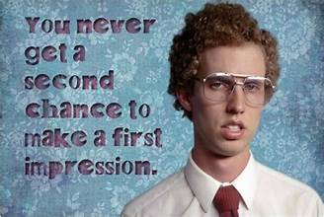
Feedback Culture
Teach residents EARLY your culture of formative feedback for growth
Continue to demonstrate it over time
Decrease stress to optimize growth
Continual work in progress
Notes:
There are many different aspects of your program culture. Make sure you present, define, and demonstrate the feedback culture early
“The learning environment includes the social, psychological, and physical contexts that affect or are affected by
academic activities. It involves perceived support structures available to students, level of autonomy for learning, students’ emotional response, and the inherent meaning that students find in the educational process.” Larson T, editors. 2018. Improving environments for learning in the health professions. New
York: Josiah Macy Jr. Foundation.

Slide 17
Faculty role model
Create opportunities for faculty to be observed by a colleague for feedback
Capitalize on the feedback from residents
Peer mentors or coaches
Notes:
One of the ways to set the stage is through faculty role modeling. Role modeling growth mindset and normalizing feedback supports the positive culture that will foster resident growth.

Slide 18
Engage Residents
Share stories with residents about personal growth
Ask for their feedback, make it routine and keep your own curiosity
Acknowledge difficulty on both sides
Allow for reflective feedback
Incorporate what you can at your program
Notes:
if you can share a story about the wards for a patient, why not do the same for feedback? It demonstrates vulnerability and builds trust

Slide 19
Benefits of Reflective Feedback
Key to improve self-driven change
Improve professional practice
Opportunity to learn from others
Encourages a growth mindset
Enhance wellness and resilience
Notes:
When you think about why we are presenting, as one small competent of competency based medical education. One goal is to support the lifelong learner.

Slide 20
Effective Feedback Framework
Vestibulum congue
Be curious
Vestibulum congue
Vestibulum congue
Be engaging
Be kind
Vestibulum congue
Be truthful

Slide 21
The details: quality reflective feedback in the moment

Slide 22
Structured feedback models
Consider using an established model or framework for feedback
ARCH, ADAPT, etc
Can be used for feedback to learners and peers

Slide 23
ARCH Model of Feedback
A = Allow/Ask for self-assessment
R = Reinforce what is being done well (attitudes, skills, and knowledge)
C = Confirm what needs Correction or improvement
H = Help the learner with an action plan for improvement and coach as needed
Dennis Baker S, Turner G, Bush SC

Slide 24
ADAPT
Learner Initiates |  | Coach Initiates
Reflect on learning goals Communicate your goals | Prepare for observation | Reflect on program & learner goals Orient learner to expectations
Try to be natural | Perform observation | Try to be natural
Reflect on observation ASK for feedback | Ask | Reflect on learner’s readiness ASK for their thoughts about the observation
Have a conversation about the feedback | Discuss | Coach observed, modificable, specific behaviors related to the task(s)
ASK for clarification | Ask | ASK the learner to clarify points, as necessary
Plan next steps with coach | Plan Together | Plan next steps with learner
Fainstad et al 2018
Notes:
https://sites.uw.edu/uwgme/adapt/

Slide 25
Effective Feedback Framework
Vestibulum congue
Be curious
Vestibulum congue
Vestibulum congue
Be engaging
Be kind
Vestibulum congue
Be truthful

Slide 26
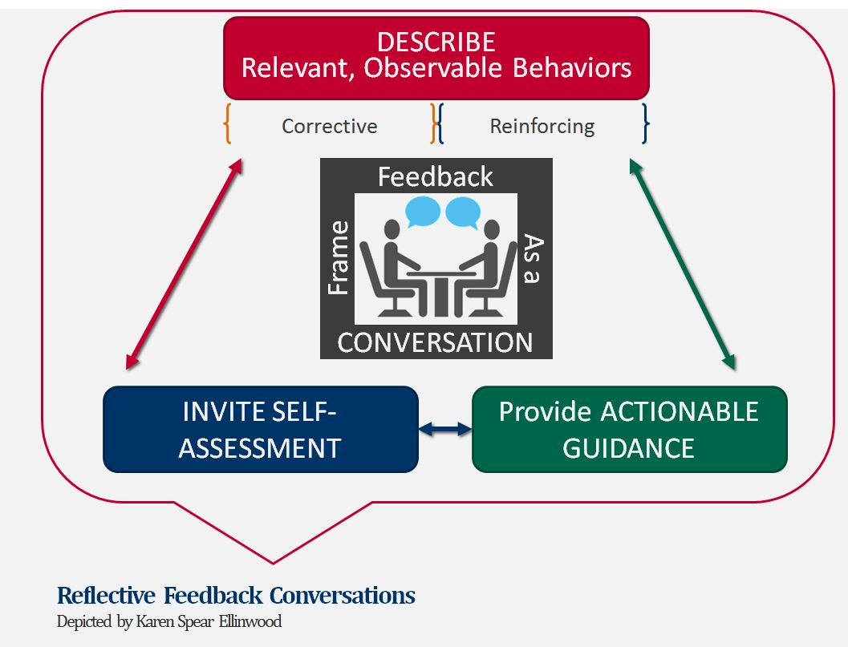
A coaching conversation
The Process of Reflective Feedback Conversations | Faculty Instructional Development (arizona.edu)

Slide 27
Set the Stage
Ideally prior to working together, take time to discuss a resident’s learning goals for the day
Think about the where, the when, and the “what you don’t know”
Private space
Not in a rush
Ask resident if they are in the right headspace for feedback
Signpost feedback
Announce that it’s happening
Make it clear whether this is formative vs summative feedback
Notes:
*** add something in here about how to catch residents in the middle of a busy day if they don’t pre huddle with sup

Slide 28
Start with self reflection
How do you think that went?
What do you think went well?
What aspect(s) of the encounter was challenging for you?
What would you do differently next time?
Next steps:
Would you like some suggestions for how to approach….

Slide 29
Provide your observations
Provide observed behaviors and observed impact
i.e. “When you looked at your watch, the patient seemed disheartened”
“When you don’t huddle with your MA prior to clinic, your MA feels disrespected”
Don’t assume the “why” behind the behavior –ask, be curious

Slide 30
What’s the Why?
Ask resident for their perspective on feedback given
What’s the why? Do they agree?
If your perspectives don’t match up - how to reconcile?
The story I make up . . .
I’m curious about . . .
Tell me more.
That’s not my experience (instead of “You’re wrong about her, him, them, it, this . . .”).
I’m wondering . . .

Slide 31
Creating an action plan
End with action items and a follow up plan
Let resident suggest action items
Provide your own suggestions if needed
Check in with the resident – how did that feel?
Ask for feedback on your feedback!

Slide 32
Example Case
Dr. Green, PGY-2

Slide 33
Your mission
Dr. Green is a kindhearted resident who you are supervising in clinic today. Faculty and staff have observed that Dr. Green is often behind in clinic and sometimes other residents end up picking up her patients at the end of the day.
You are hoping to observe her time management in clinic and provide effective coaching for her.

Slide 34
Effective Feedback Framework
Vestibulum congue
Be curious
Vestibulum congue
Vestibulum congue
Be engaging
Be kind
Vestibulum congue
Be truthful

Slide 35
Set the Stage
What do you discuss with Dr. Green before clinic?

Slide 36
Dr. Green’s clinic day
Throughout the day, Dr. Green took ~1 hour for a patient who was scheduled for a 30 minute establish care visit. The remainder of the day she runs about 30 minutes behind. She has not signed any notes by the end of the day. She did have a no-show so she was able to catch up and finish by 5 PM.

Slide 37
Starting the Conversation
How would you begin your feedback conversation with Dr. Green?

Slide 38
Dr. Green’s perspective
Dr. Green shares that she has a hard time saying “no” to patients, and ended up addressing 3 acute complaints and going over multiple chronic medications for the new patient, as well as ordering preventive screening exams.
She seems to not be too concerned with the issue because after all, she did catch up during her no-show.

Slide 39
Coaching
What will you say to Dr. Green to provide coaching or strategies for improvement?
How can you engage Dr. Green in coming up with her own next steps for success?

Slide 40
Putting it all together
Reflective summative feedback

Slide 41
Formative vs Summative
Formative feedback
coaching
low stakes
frequent
audience is the learner
Summative feedback
evaluative
high stakes
less frequent
audience is the general public

Slide 42
The same principles apply
When reflecting on summative feedback with advisee, you can use these same principles
Set the stage
Ask for self reflection
Provide observations (in this case, all available data - ITE score, evals from rotations, patients, staff, etc.)
Provide coaching
Create action steps (individualized learning plan)

Slide 43
Effective Feedback Framework
Vestibulum congue
Be curious
Vestibulum congue
Vestibulum congue
Be engaging
Be kind
Vestibulum congue
Be truthful

Slide 44
The Next Steps

Slide 45
Take Home Points
Giving effective feedback is hard and necessary
Create an effective feedback culture:
walk the talk: model how to receive feedback and normalize a culture where feedback is used for growth
When giving feedback: be kind, truthful, curious and engaging

Slide 46
Tips to start incorporating
Set a personal goal to give constructive feedback on a regular basis, using these principles
Ask residents for feedback on a regular basis
Share stories of personal growth with residents
Ask for feedback from a fellow faculty member

Slide 47
Questions and Answers

Slide 48
Upcoming webinars
Upcoming and On-Demand CBME Faculty Development Webinars (stfm.org)
August 14, 2024: STFM/AFMRD Webinar Fostering Master Adaptive Learning and a Growth Mindset in Your Program
September 18, 2024: STFM/AFMRD Webinar How to Effectively Use Electives to Help Residents Attain Competency in the Core Outcomes
October 9, 2024: STFM/AFMRD Webinar The Role of Resident Portfolios in Competency-Based Assessment
November 13, 2024: STFM/AFMRD Webinar Managing Assessment Burden in CBME

Slide 49
References
Brown B. Dare to Lead: Brave work. Tough Conversations. Whole Hearts. 1st edition. Random House, 2018
Dennis Baker S, Turner G, Bush SC. ARCH: A Guidance Model for Providing Effective Feedback to Learners. Accessed February 20, 2024 from https://www.stfm.org/publicationsresearch/publications/educationcolumns/2015/november/
Fainstad T, McClintock AA, Van der Ridder MJ, Johnston SS, Patton KK. Feedback Can Be Less Stressful: Medical Trainee Perceptions of Using the Prepare to ADAPT (Ask-Discuss-Ask-Plan Together) Framework. Cureus. 2018 Dec 11;10(12):e3718. doi: 10.7759/cureus.3718. PMID: 30906679; PMCID: PMC6428363.
Kraut A, Yarris LM, Sargeant J. Feedback: Cultivating a Positive Culture. J Grad Med Educ. 2015;7(2):262-264. doi:10.4300/JGME-D-15-00103.1
Larson T, editors. 2018. Improving environments for learning in the health professions. New York: Josiah Macy Jr. Foundation.
Page CP, Baker HM, Myerholtz L. Using a Delphi Technique to Define a Feedback Culture in Graduate Medical Education. Fam Med 2021;53(6)433-42. doi: 10.22454/FamMed.2021.600416
Ramani S, Könings KD, Ginsburg S, van der Vleuten CPM. Twelve tips to promote a feedback culture with a growth mind-set: swinging the feedback pendulum from recipes to relationships. Med Teach. 2019;41(6):625-631. doi:10.1080/0142159X.2018.1432850.

Slide 50
Thank you!

