Slide 1
The Rise of Multimorbidity and its Implications for Primary Care Practice
Arlene Bierman, M.D., M.S.
Chief Strategy Officer
Agency for Healthcare Research and Quality
Family Medicine Leadership Consortium
August 15, 2024

Slide 3
The Challenge: Demographics and Population Health (or the why)
The U.S. population is aging but our health system is woefully unprepared
The population age 65 and older increased from 40.3 million in 2010 to 55.8 million in 2020 (a 38.6% increase) and is projected to reach 94.7 million in 2060
Life expectancy and activity life expectancy are declining as inequities on these measures associated with race/ethnicity and socioeconomic position are widening
Low income and minority individuals age faster (weathering)
Much of this morbidity and mortality is preventable

Slide 4
Health System Transformation: Improving Care for People With MCC \
Healthcare in the U.S. falls short of achieving the objectives of improving individual and population health
Our health system is ill-designed to foster active/health aging –
Disease focused rather than person-centered
Focused on illness rather than wellness
Quality is suboptimal and care is fragmented, difficult to navigate, and burdensome
The cost of waste in the healthcare system has been estimated to ranged from $760 billion to $935 billion, accounting for approximately 25% of total healthcare spending
Economic analyses have found that a slowdown in aging that increases healthy life expectancy by 1 year is worth $38 trillion over one year, and $367 trillion over 10 years
Clinician burnout is a major problem has been exacerbated by the COVID pandemic: opportunity to improve clinician and patient experience

Slide 5
The Challenge of Multiple Chronic Conditions (MCC)
The Challenge of Multiple Chronic Conditions
Disease-specific vs. person-centered approaches. Disease-specific approach to care delivery and research is misaligned with the whole person-centered needs of patients and caregivers.
Interoperability obstacles in complex care. People with MCC require care in multiple settings, from multiple providers. Data do not easily move across settings of care.
Health equity. People from low-income backgrounds and under-represented racial or ethnic groups develop MCC at higher rates and earlier ages.
1IN 3
NEARLY
4 IN 5
&
People with MCC account for:
American Adults
Medicare Beneficiaries
64%
70%
83%
71%
93%
ARE LIVING WITH MCC, THE MOST COMMON CHRONIC CONDITION
OF ALL
Clinician Visits
OF ALL
In-Patient Stays
OF ALL
Prescriptions
OF ALL
Healthcare Spending
OF ALL
Medicare Spending
CMS 2018: https://www.cms.gov/data-research/statistics-trends-and-reports/chronic-conditions/chartbook-and-charts;
AHRQ 2010: https://www.ahrq.gov/sites/default/files/wysiwyg/professionals/prevention-chronic-care/decision/mcc/mccchartbook.pdf;
Quiñones, et al. Racial/ethnic differences in multimorbidity development and chronic disease accumulation for middle-aged adults. PLoS One, 2019;14(6), PMID: 31206556
Bierman et al, Transforming care for people with multiple chronic conditions: Agency for Healthcare Research and Quality's research agenda https://www.ncbi.nlm.nih.gov/pmc/articles/PMC8515222/pdf/HESR-56-973.pdf HSR, 2021
.

Slide 6
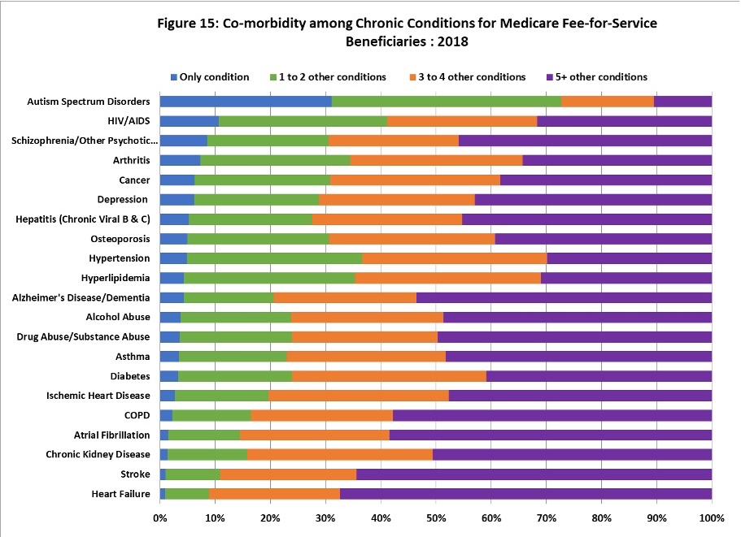
MCC and Common Chronic Conditions

Slide 7
Rising Prevalence of MCC A New Syndemic
King et. Al JABFNM 2010

Slide 8
AHRQ’s Vision for People Living with MCC
A sustainable healthcare system that delivers high-value coordinated, integrated patient-centered care based in primary care optimizing individual and population health by preventing and effectively managing multiple chronic conditions (MCC).

Slide 9
Addressing MCC Across the Continuum of Risk
Prevention interventions targeted at reducing the prevalence of common chronic disease risk factors with a particular focus on interventions to reduce the likelihood those “at risk” will go on to develop MCC
Targeted interventions to improve health and reduce the risk of adverse events and complications among those with multiple chronic conditions (e.g., diabetes, depression, and osteoarthritis) who are at “rising risk” for developing high needs and/or complex management issues.
Targeted interventions for those who have complex management issues and who are at “high risk” for avoidable adverse events, and require a focus on preventing decline, maximizing functioning, and improving quality of life.

Slide 10
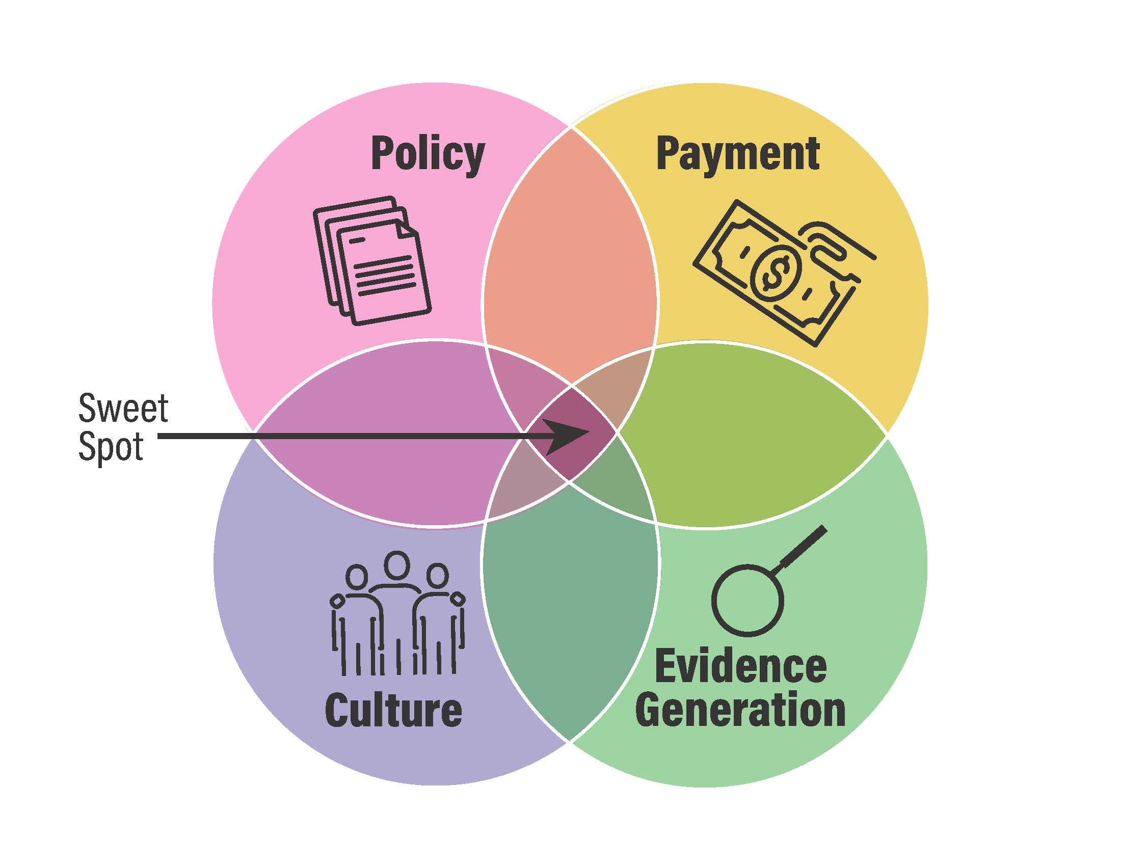
Health System Transformation and Aging Well The “Sweet Spot”

Slide 12
Medical Home

Slide 13
Medical Neighborhood

Slide 14
Health Community

Slide 15
Disruption and Primary Care

Slide 16
Person-Centered Care Planning for People Living With Multiple Chronic Conditions (PCCP4P)
Contract through AHRQ’s ACTION IV Network to OHSU
Technical Expert Panel
Partner’s Roundtable includes leadership from health systems, state health agencies, payers, professional societies, federal partners
Learning Community includes innovators, implementers, frontline workers, researchers
Summit Spring 2025

Slide 17
AHRQ’s Healthcare Extension Service
Goals
Accelerate the dissemination and implementation of PCOR evidence into practice
Reduce healthcare disparities among Medicaid beneficiaries, uninsured, and medically underserved
Notice of Information to Publish Notice of Funding Opportunity (NOFO) Announcements for AHRQ’s Healthcare Extension Service to Accelerate Implementation of Patient-Centered Outcome Research Evidence into Practice
Published June 6, highlighted 3 components
State-based Healthcare Cooperatives
A National Coordinating Center
A National Evaluation Center
AHRQ’s Healthcare Extension Service Initiative: Notice of Intent | Agency for Healthcare Research and Quality

Slide 18
Caminante, no hay camino, se hace camino al andar.
Antonio Machado
Traveler, there is
no path,
we make the path by walking

Slide 19
Alignment with Department and Administration Priorities
The U.S. Playbook to Address Social Determinants of Health
https://www.whitehouse.gov/wp-content/uploads/2023/11/SDOH-Playbook-4.pdf
Improving Health And Well-Being Through Community Care Hubs https://www.healthaffairs.org/content/forefront/improving-health-and-well-being-through-community-care-hubs
HHS Call to Action Addressing Health-Related Social Needs in Communities Across the Nation https://aspe.hhs.gov/sites/default/files/documents/3e2f6140d0087435cc6832bf8cf32618/hhs-call-to-action-health-related-social-needs.pdf
Report to Congress - Aging in the United States: A Strategic Framework for a National Plan on Aging
https://acl.gov/sites/default/files/ICC-Aging/StrategicFramework-NationalPlanOnAging-2024.pdf

Slide 20
NEW: Special Emphasis Notice (SEN) Improving Care for OlderAdults
Health Services Research to Improve Care Delivery, Access, Quality, Equity, and Health Outcomes for Older Adults” https://grants.nih.gov/grants/guide/notice-files/NOT-HS-24-013.html
This SEN conveys AHRQ’s interest in supporting health services research to conduct research that will address questions related to the development, implementation, evaluation, and scale of person-centered models of care to optimize physical and mental health, functional status, and the well-being among older adults. This SEN builds on AHRQ’s prior work, including the Optimizing Health and Function as We Age Roundtable Report , Research Agenda for Transforming Care for People with Multiple Chronic Conditions, and the Multiple Chronic Conditions e-careplan. It also supports AHRQ’s ongoing commitment to the inclusion of priority populations in health services research (About Priority Populations | Agency for Healthcare Research and Quality (ahrq.gov).

