Slide 1


Team Structure and Function Across a Large System
David Rushlow, M.D.
Chair, Family Medicine, Mayo Clinic
Family Medicine Leaders Council
August 15, 2025
©2025 Mayo Foundation for Medical Education and Research | slide-1

Slide 2
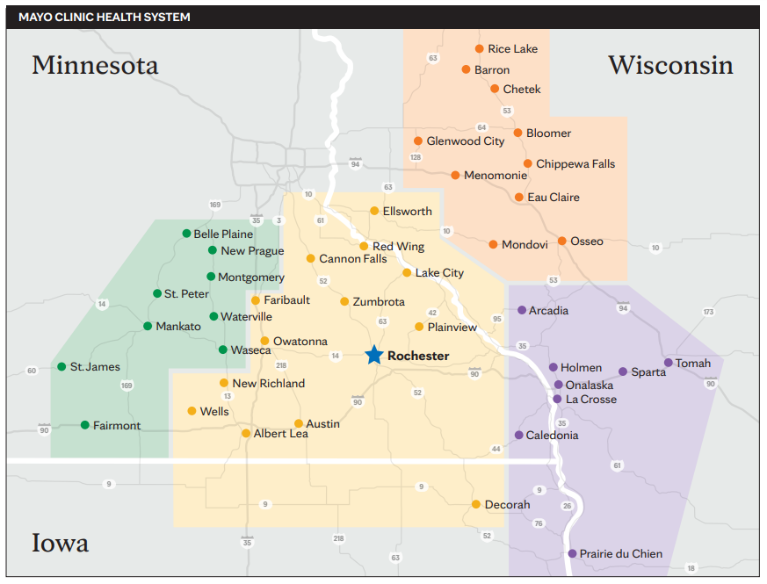
Mayo clinic midwest who are we?
©2025 Mayo Foundation for Medical Education and Research | slide-2
Image copyright Shutterstock

Slide 3
Mayo Clinic Midwest Family Medicine
 | Rochester | NWWI | SWWI | SEMN | SWMN | Total
Total Sites | 5 | 10 | 8 | 13 | 9 | 45
MD/DO | 61 | 68 | 53 | 46 | 47 | 275
NP/PA (APP) | 58 | 45 | 25 | 68 | 57 | 253
Residents | 27 | 15 | 18 | 0 | 15 | 75
Total Patient | 83,508 | 87,352 | 48,662 | 116,020 | 62,172 | 397,364
Care Teams | 11 | 23 | 27 | 27 | 28 | 116
Physician Panel Size (FTE adjusted) | 2537 | 2076 | 2107 | 2298 | 1556 | 2115

Slide 4
Focus for Care Team Transformation
Taking Better Care of More People
Improve quality of care
  Chronic disease management
  Disease prevention/wellness
  Patient satisfaction
Enhance access
Strengthen continuity
Expand panel size/clinician
  Current goal = 2,200 risk adjusted patients/physician
Maintain workable templates for synchronous care
  30 min visit duration, 12 slots/day, built in time for non-visit care
Inspire care team satisfaction

Slide 5
Care team composition current state
Clinicians – MD/DO, APP (NP/PA)
  Paneled practices
  Outpatient clinic, hospital, OB, niche practices
Nursing – RN, LPN
  Patient triage, rooming, after visit care, in-basket, phone
Desk Operations
  Patient check-in, patient rooming, appointment scheduling
Pharmacists
  Synchronous and asynchronous consultations, medication management
Integrated Behavioral Health
  social work, psychology, psychiatry
Integrated Community Specialties
  Cardiology, neurology, orthopedic surgery, spine, GI, endocrinology, dermatology, occ med, podiatry, geriatrics

Slide 6
Centralized Services
  Inpatient practice
  Video on Demand – 24/7, 365
  Scheduling – Digital Front Door
  Nurse Triage
  Complex Care Coordinator
  Social Work
  Asynchronous Patient Quality Improvement (Scheduled Outreach)
  Remote Monitoring
  COVID Care Team

Slide 7
Typical Care Team Composition
Clinicians
  5 physicians
  3-5 APP
Nursing
  2 RN
  4 LPN
Desk Operations/Rooming – 4
Medical Secretary – 1
Pharmacy – 0.25 – 0.5

Slide 8
Panel Attribution
All patients assigned to a panel
  Physicians higher risk (ACG)
Physician current panel size goals
  2200 FTE/risk adjusted
APP panel size – 1250 FTE adjusted
Piloting shared MD/APP panels

Slide 9
Key Metrics focused on Quadruple Aim
Mayo Clinic’s Primary value: The Needs of the Patient Come First
Quality outcomes: Disease management, prevention
Patient satisfaction: Press Ganey survey, complaints/complement
Staff satisfaction: Annual staff survey, leadership rounding
Access: Lag times, continuity, fill rates, OPVs, virtual visit %
Finance: Revenue, expense, NOI/margin, cost/panel pt.
Operations: Panel size, staffing to workload, forecasting to adjust capacity, Churn rate
  These metrics drive request for approval for future staffing.

Slide 10
Opportunities
Improve continuity from patient perspective (goal-75%)
Rebalance panels to improve over empanelment
Financial limitations with fee for service payor mix.
Inbasket burden for all care team members
Video Visit uptake

Slide 11
Thank You!

