Slide 1





Ontario primary care reform and next steps
Tara Kiran
Fidani Chair in Improvement and Innovation, University of Toronto
Scientist, MAP Centre for Urban Health Solutions
Family Physician, St. Michael’s Hospital, Unity Health Toronto
Family Medicine Leadership Council, Summer Retreat, American Board of Family Medicine
Alexandria, Virginia, USA
Aug 14, 2025,
With funding from:
In Partnership with:
ourcare.ca

Slide 2
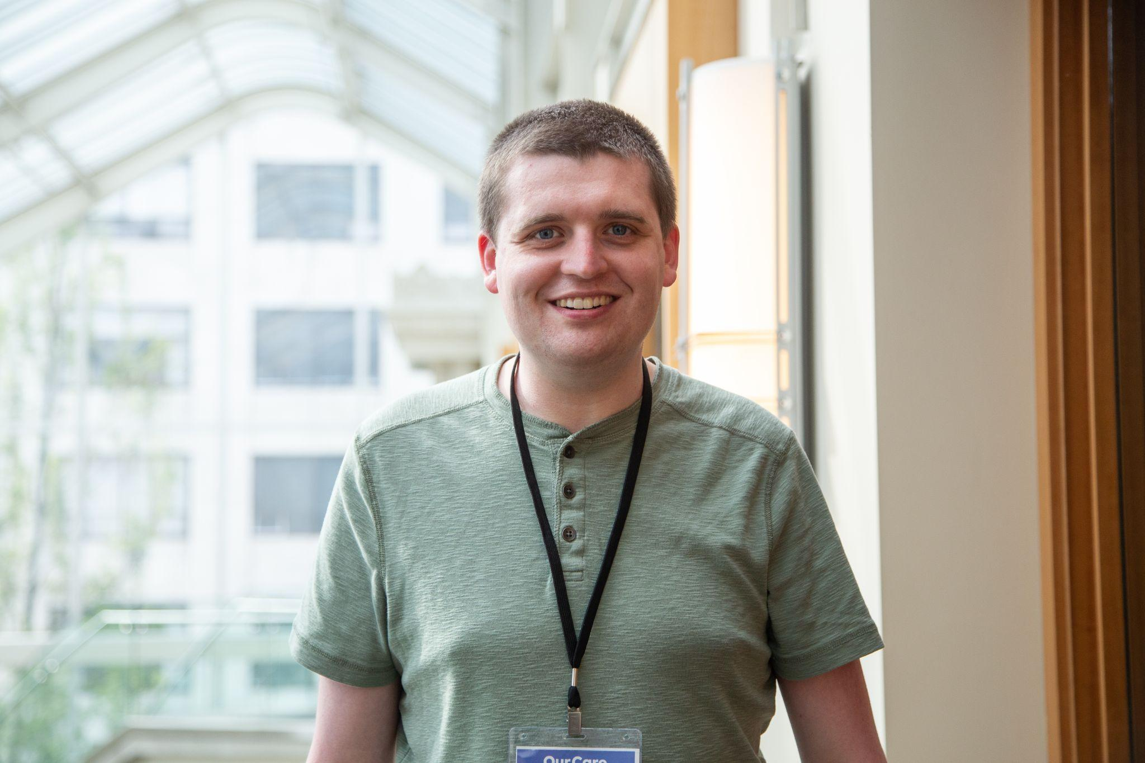
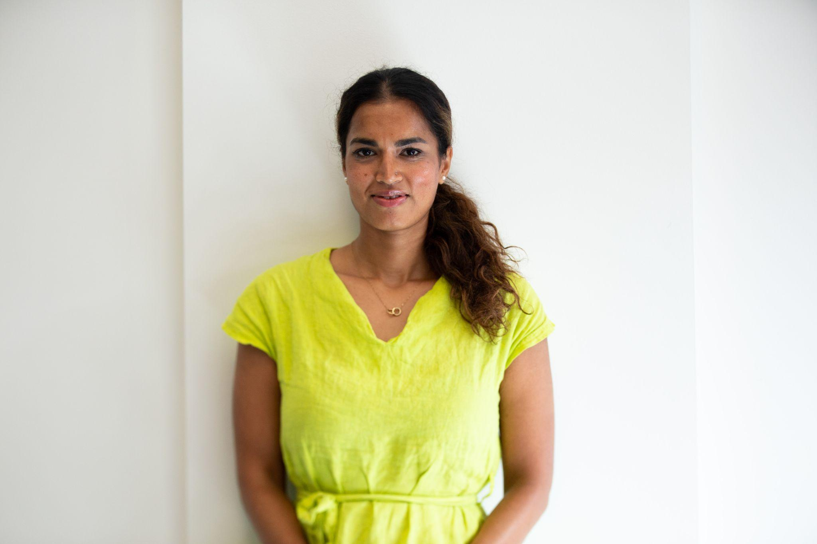
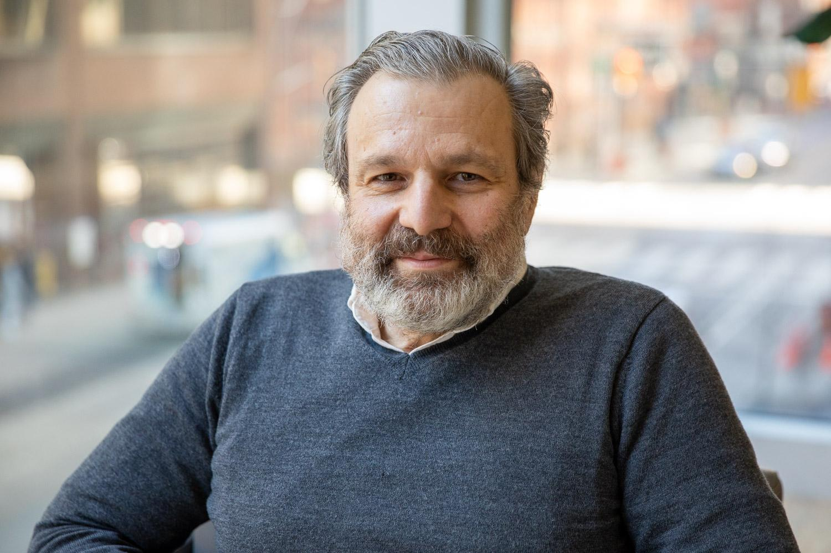
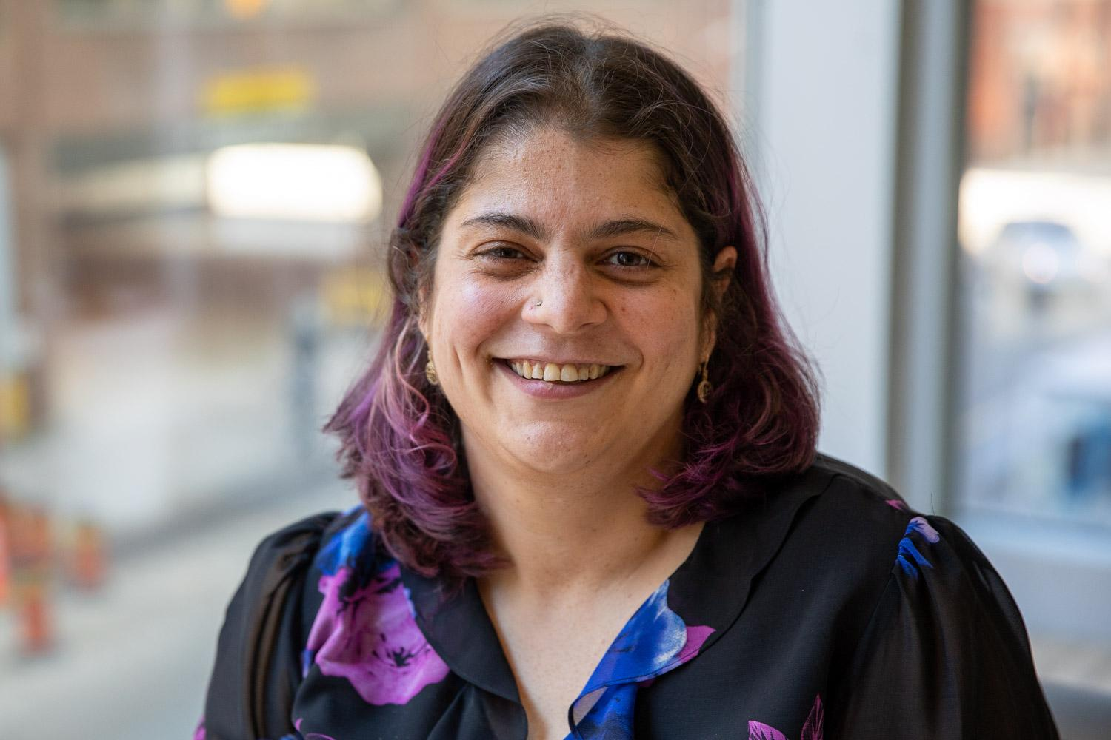
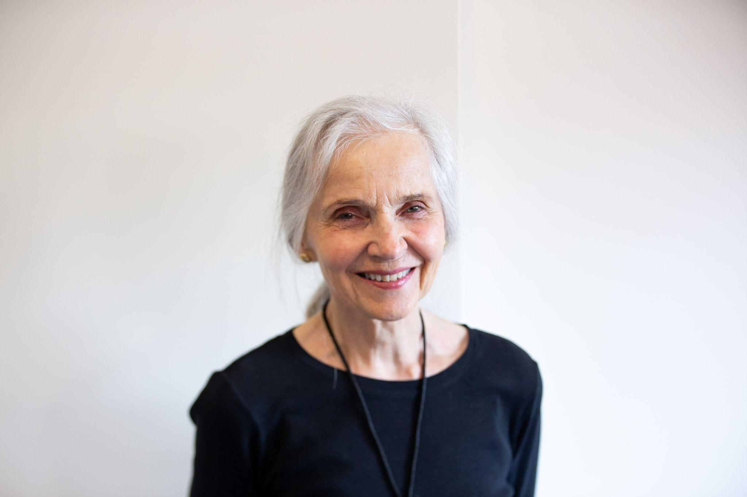
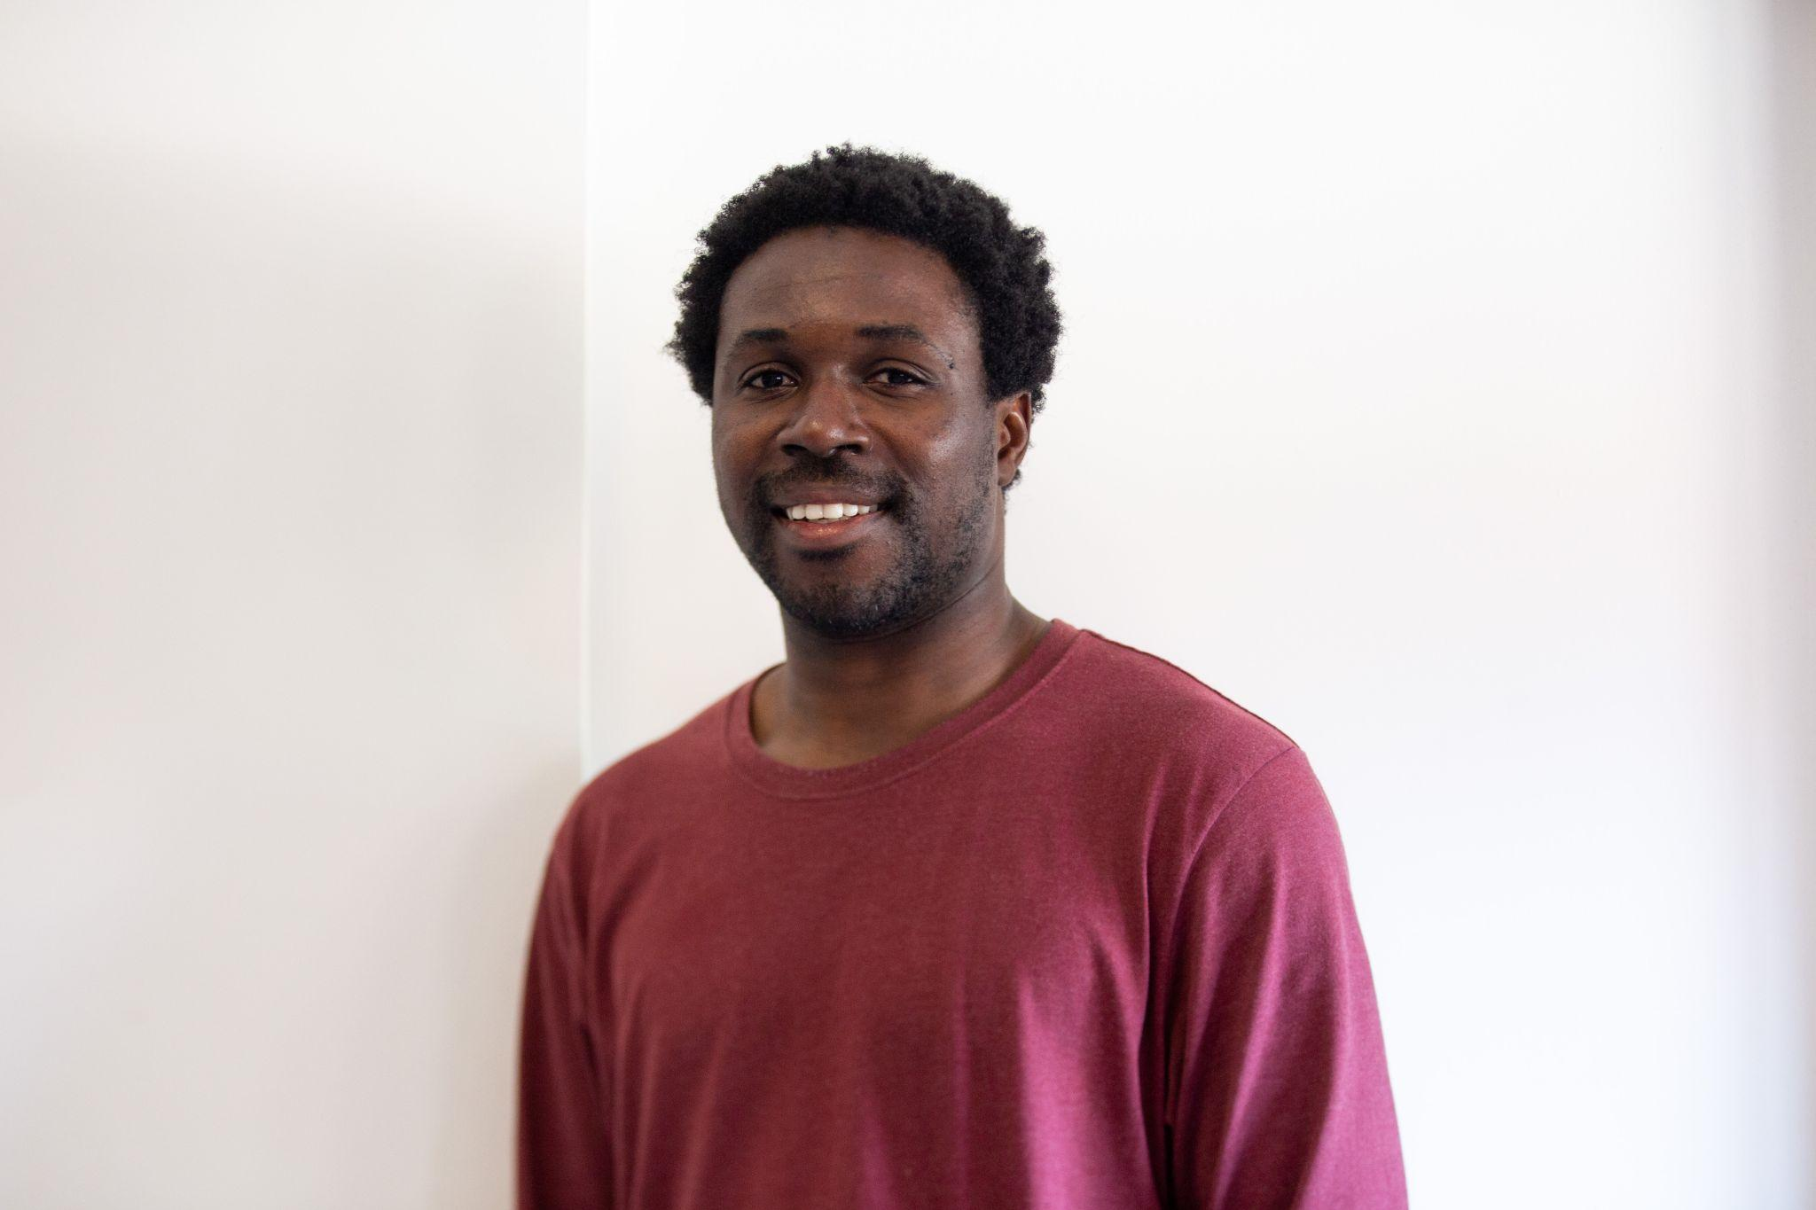
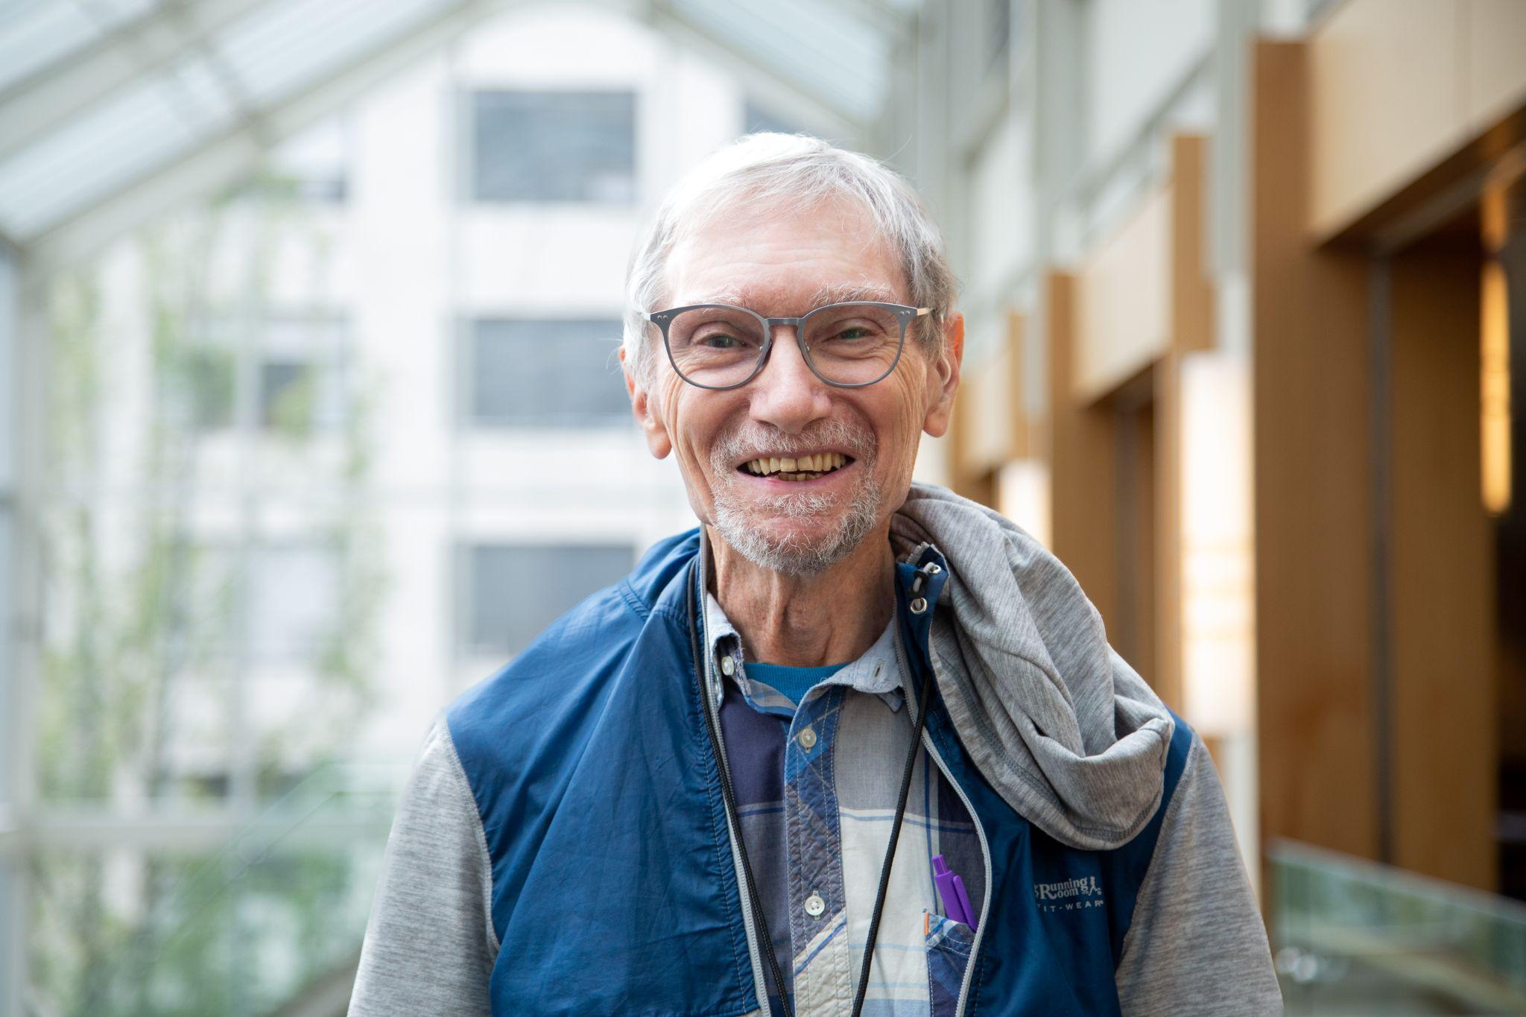
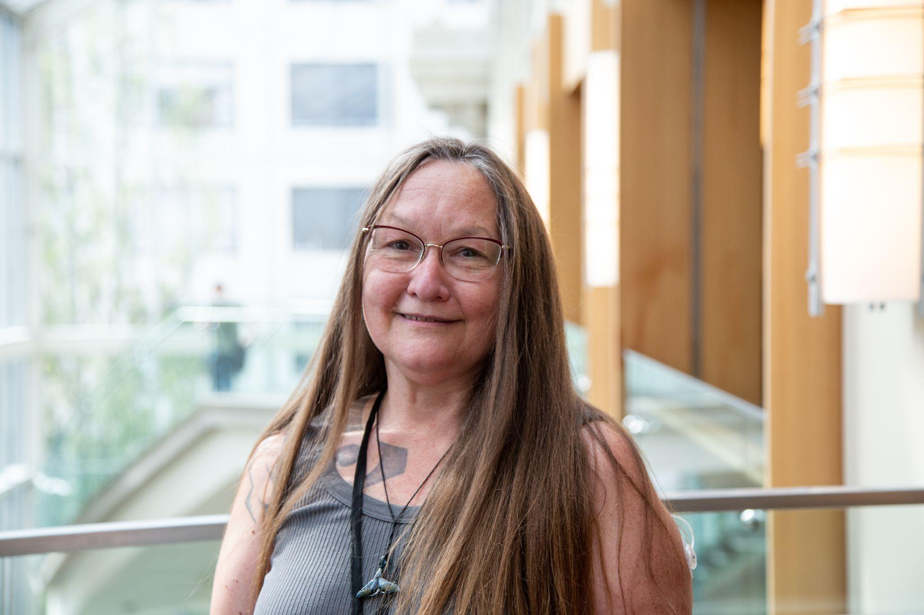
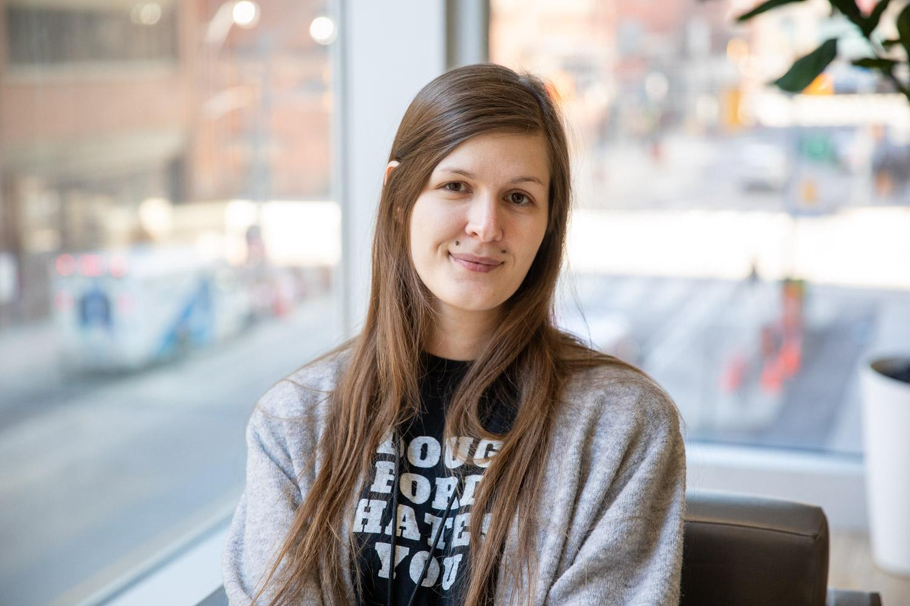
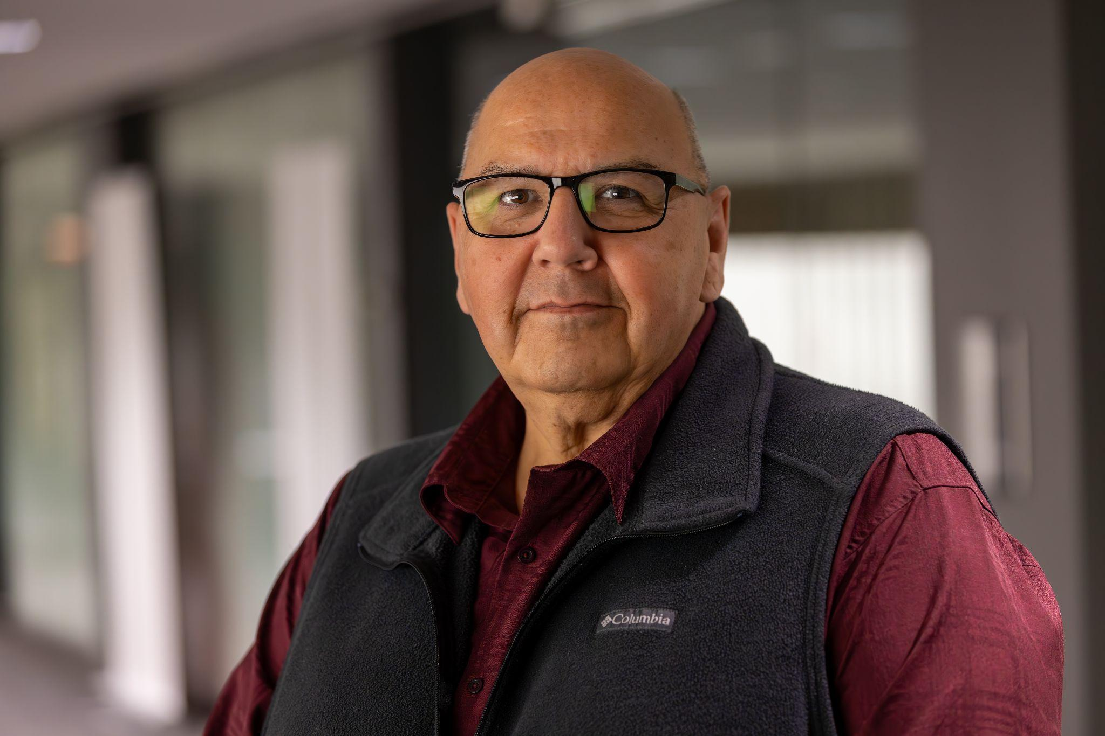
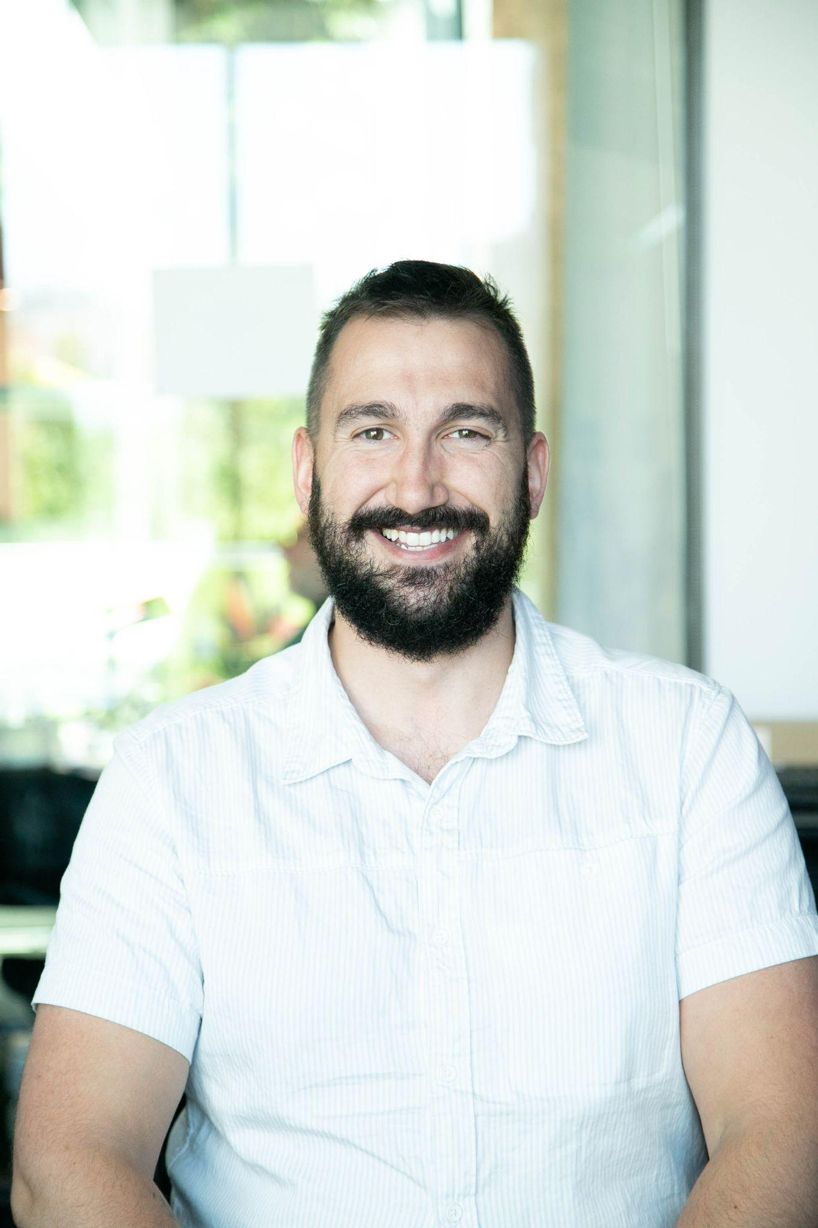
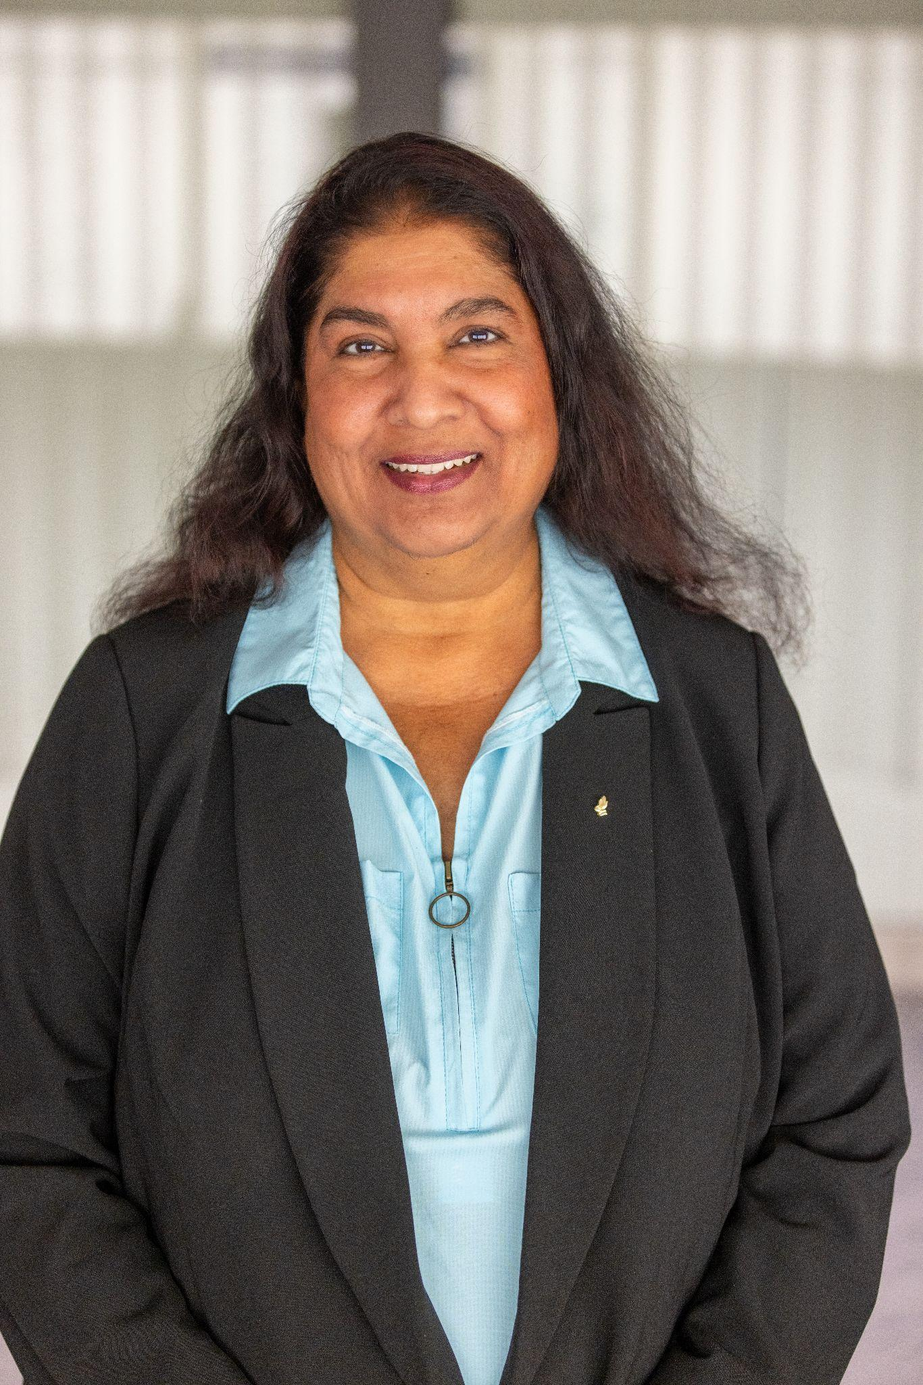
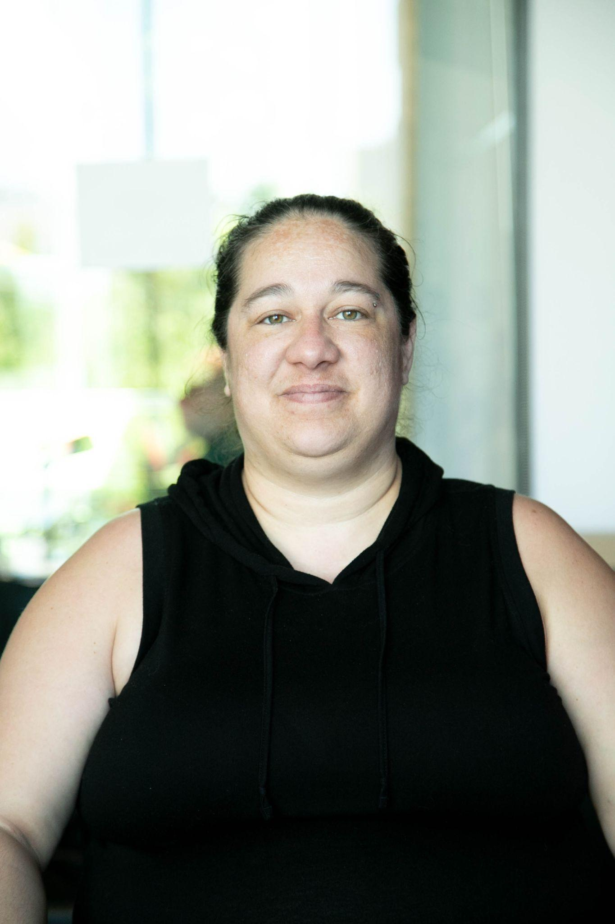
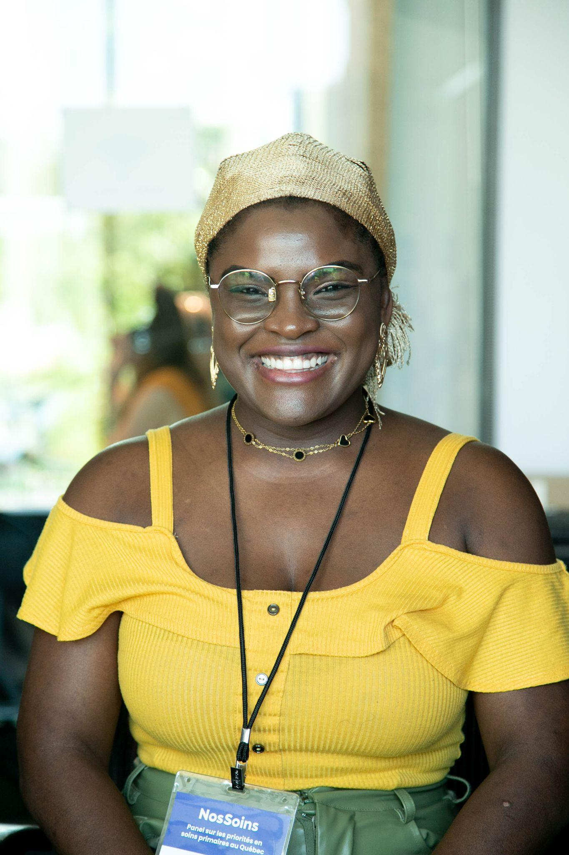
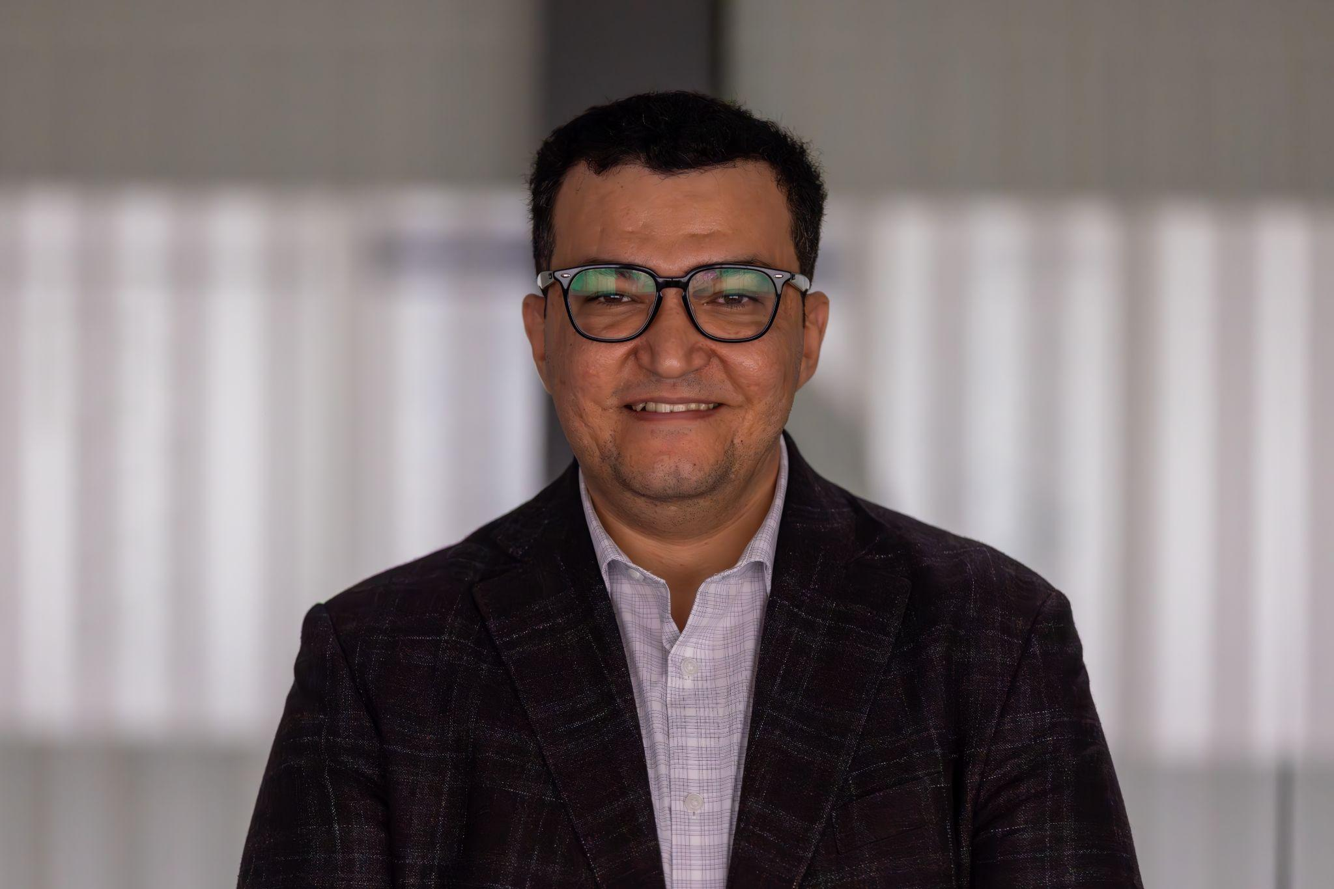
Notes:
National version

Slide 3
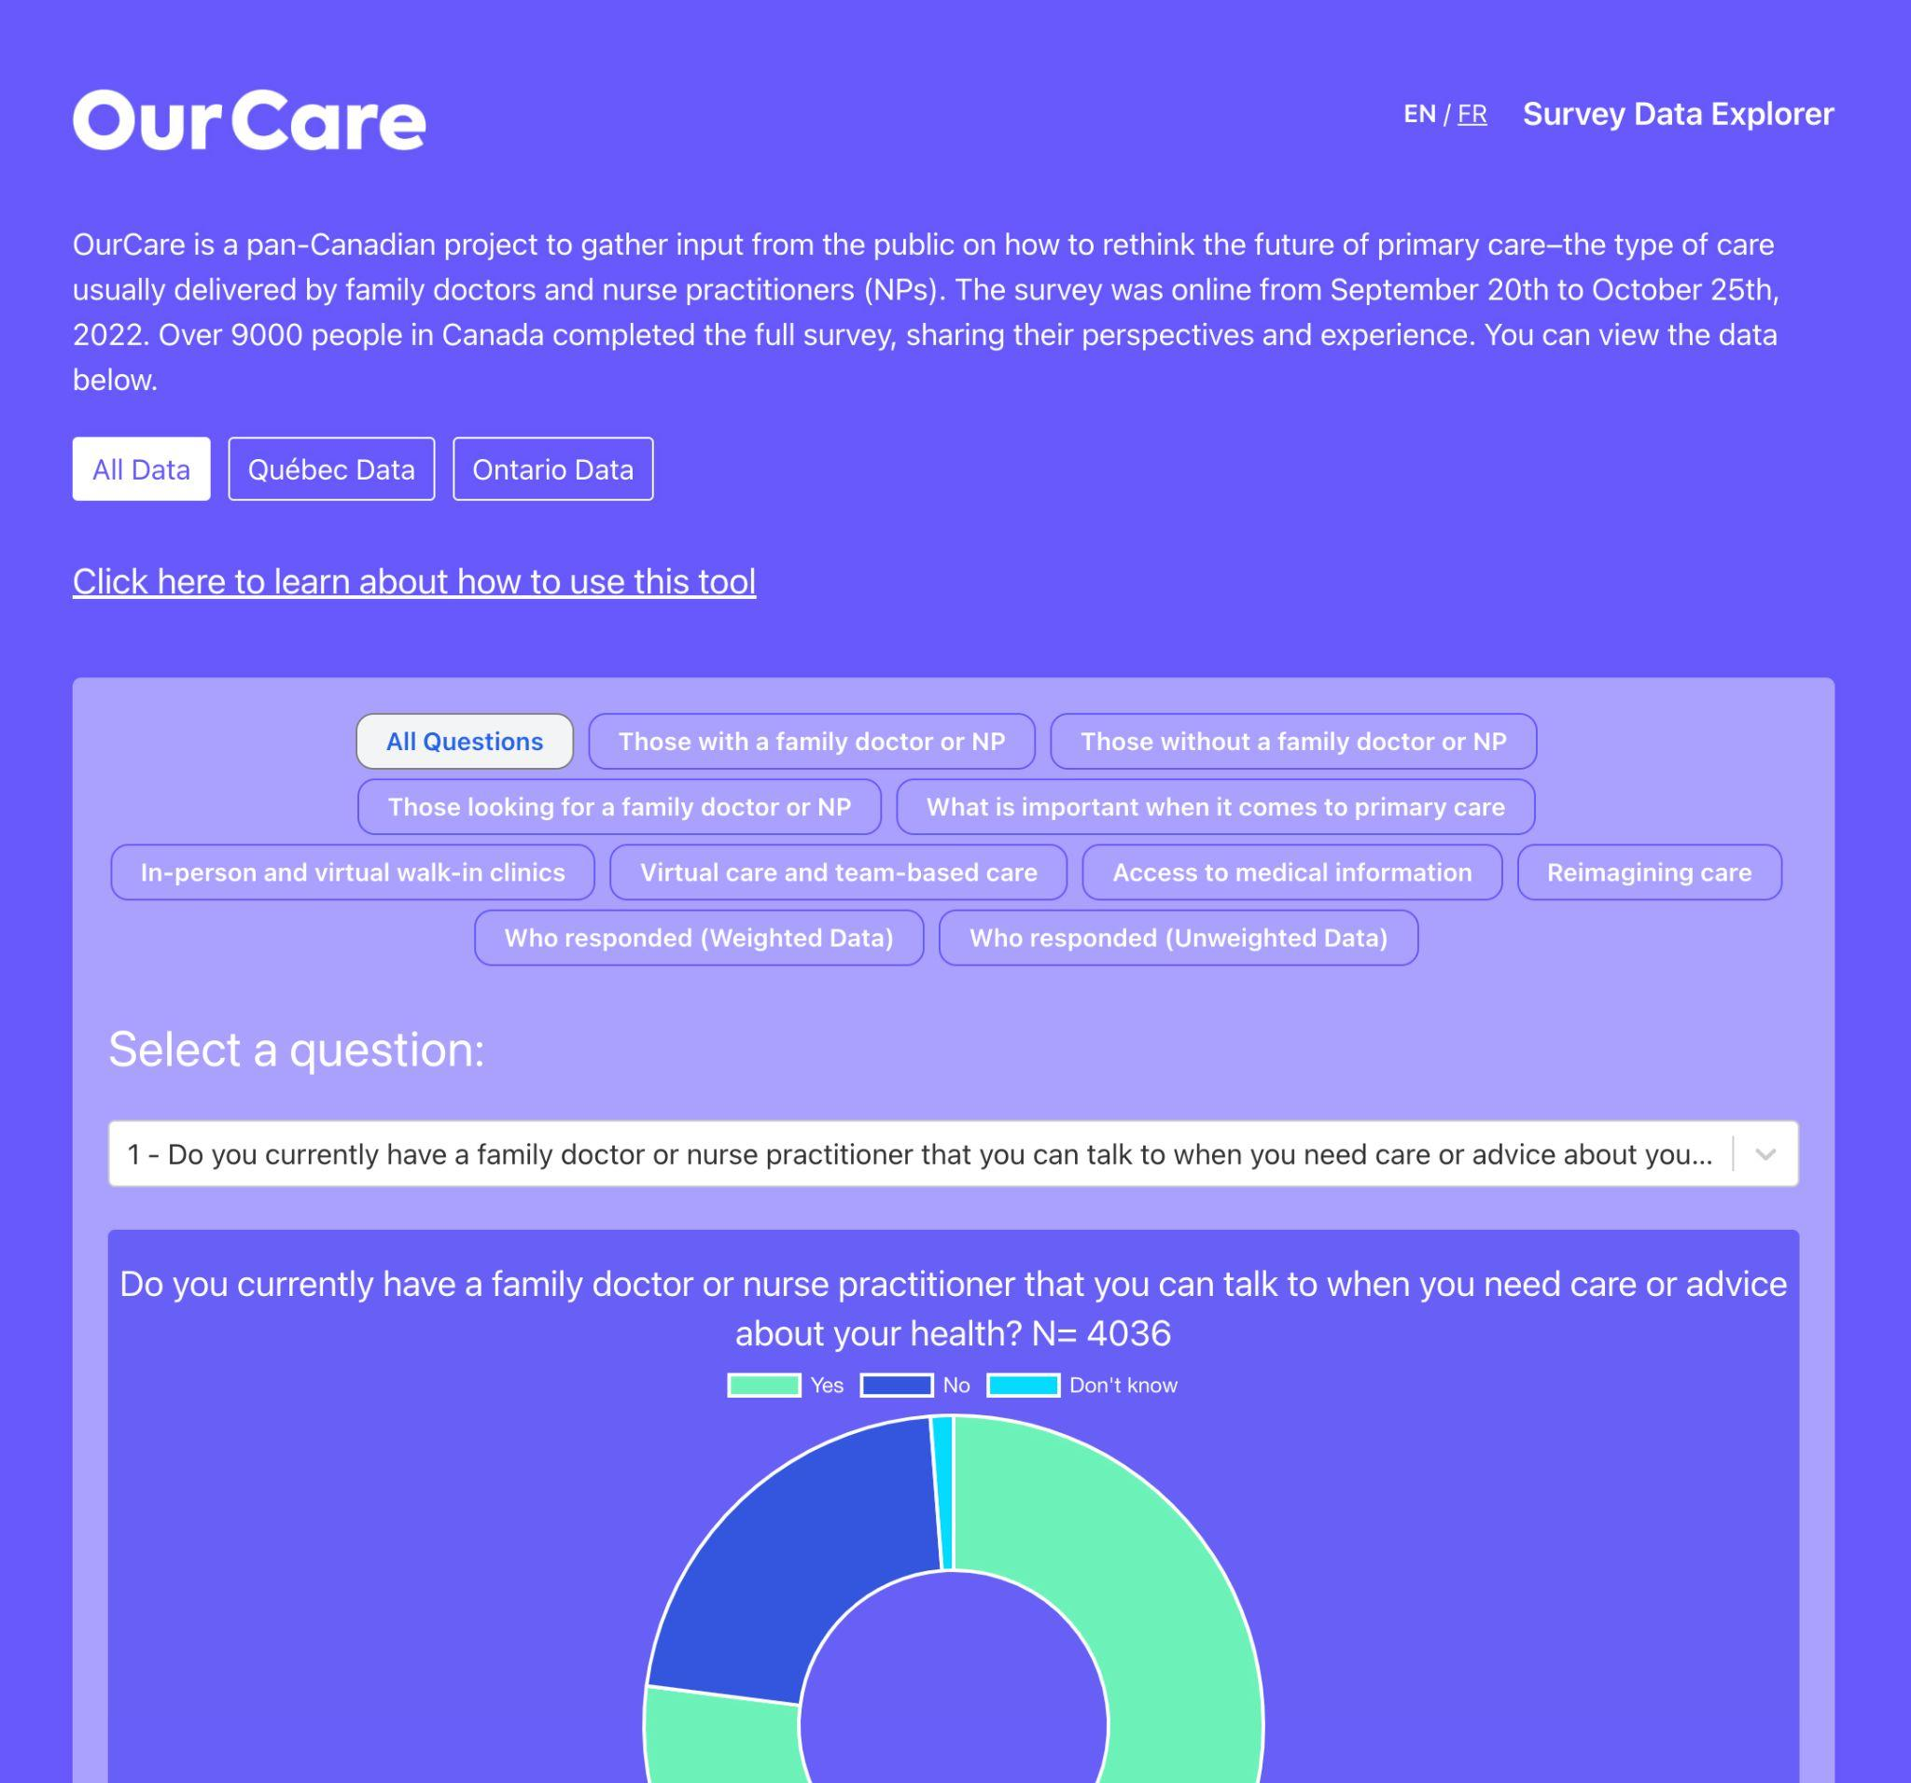
One National Survey
9000+ responses
OurCare | NosSoins
ourcare.ca

Slide 4
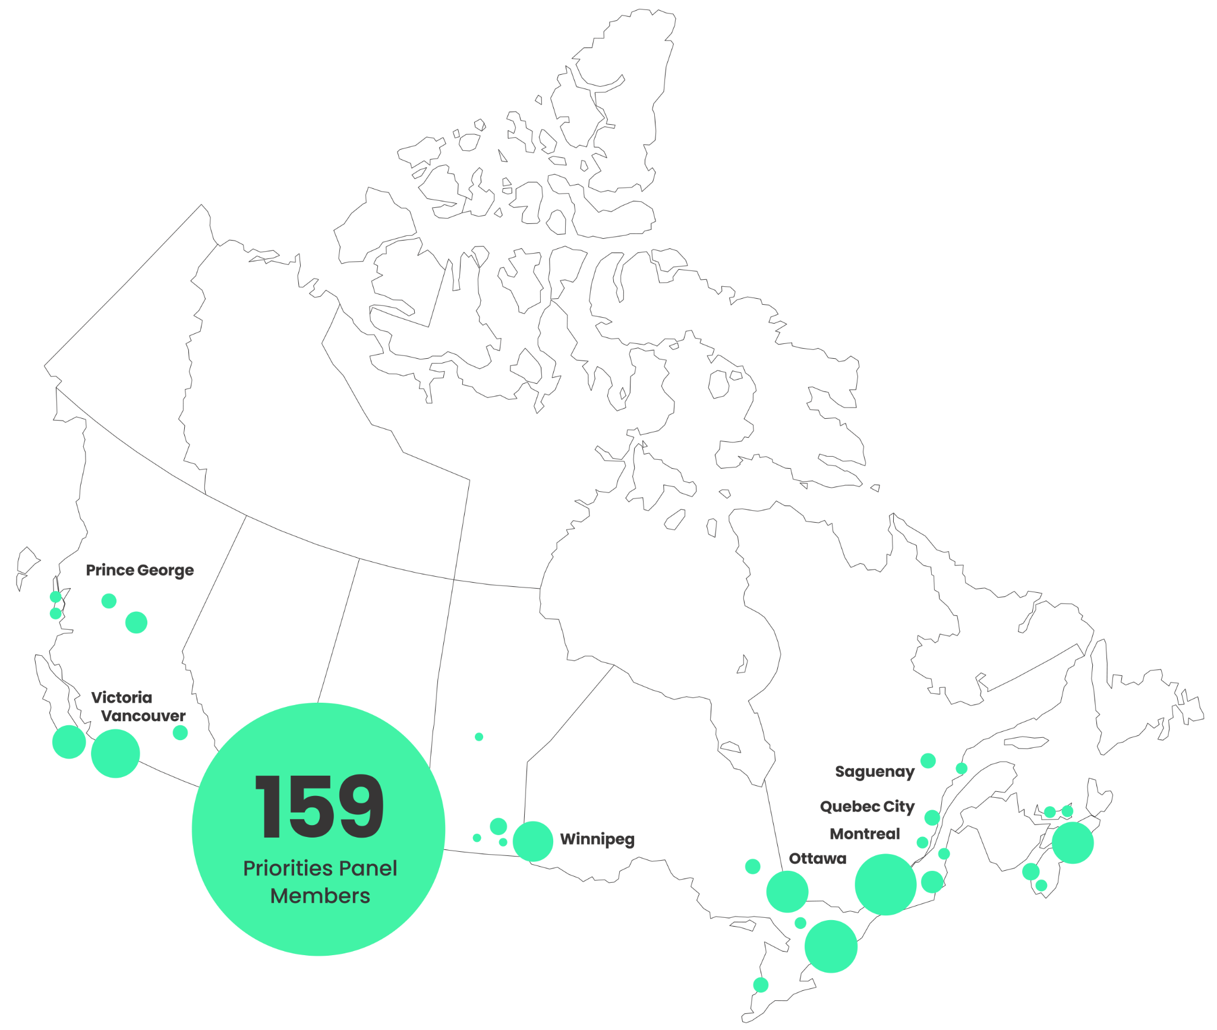
Five Provincial
Panels
150+ participants
OurCare | NosSoins
ourcare.ca

Slide 5
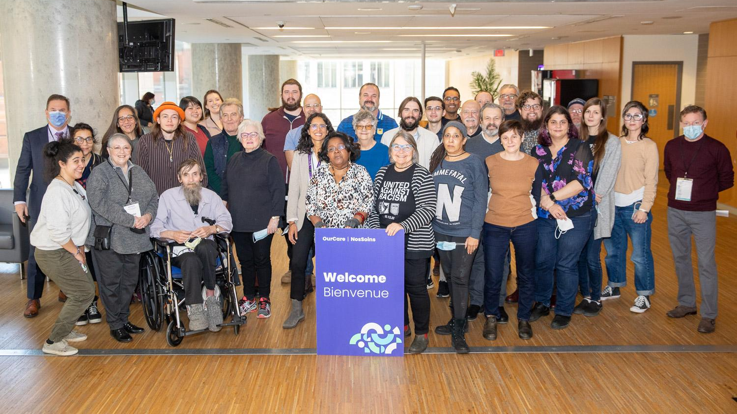

Slide 6
Ten Community
Roundtables
190+ participants
British Columbia
People with Disabilities
Newcomers
Manitoba
Indigenous Youth
Newcomers
Ontario
African, Caribbean & Black Community
Newcomers
Quebec
Newcomers & Low-Income
Racialized & Newcomer LGBTQIA+
Nova Scotia
Refugee Claimants
Black Nova Scotians of African Descent
OurCare | NosSoins
ourcare.ca

Slide 7















Ten Community Roundtables, 190+ participants
British Columbia
People with Disabilities
Newcomers
Manitoba
Indigenous Youth
Newcomers
Ontario
African, Caribbean
& Black Community
First Nations, Inuit
& Métis
Quebec
Newcomers & Low-Income
Racialized & Newcomer LGBTQIA+
Nova Scotia
Refugee Claimants
Black Nova Scotians
of African Descent
OurCare | NosSoins
ourcare.ca

Slide 8


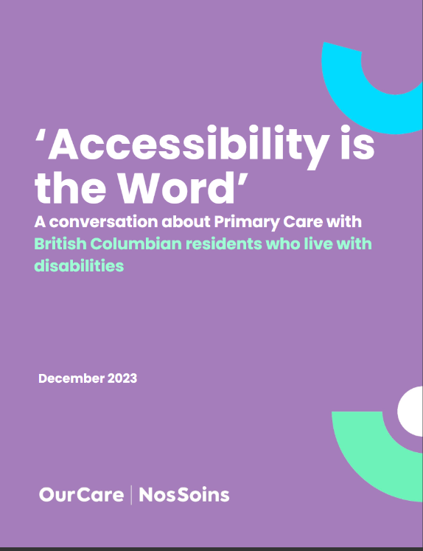
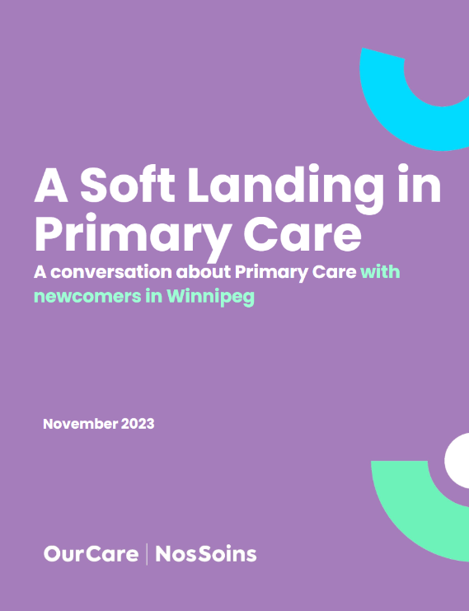


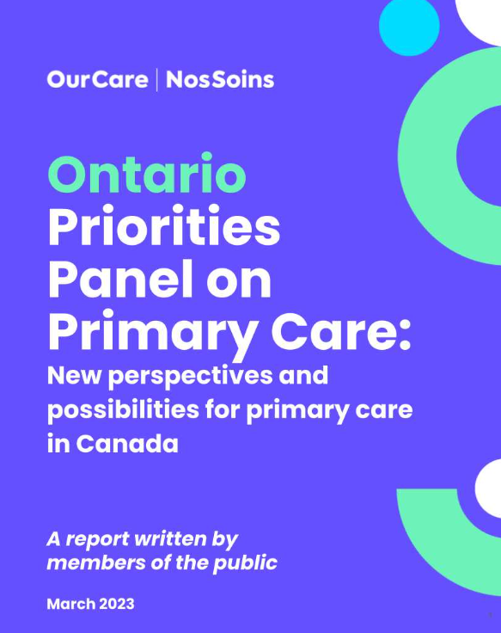
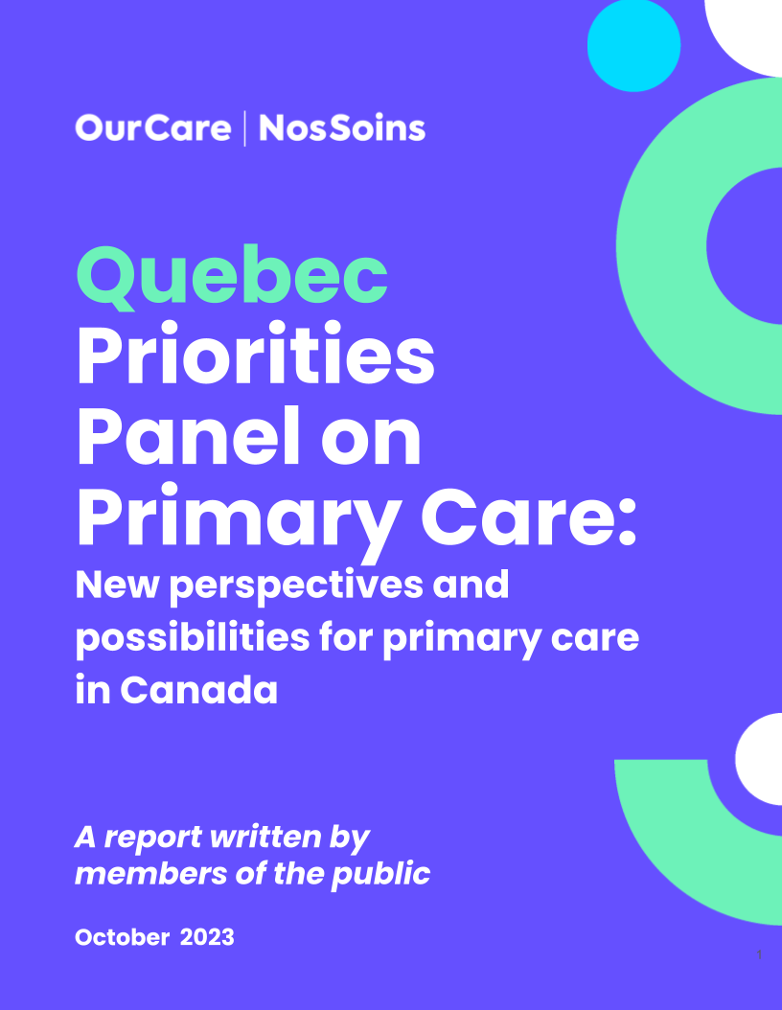

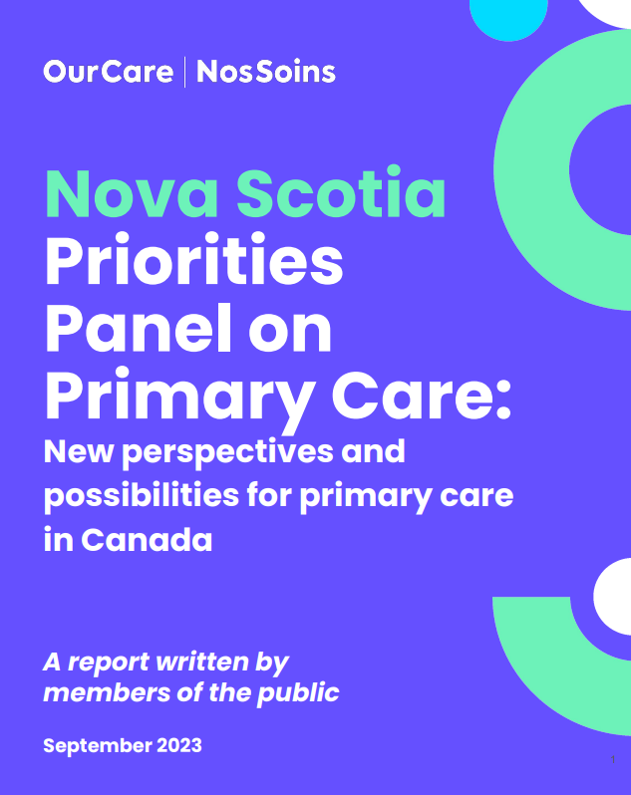
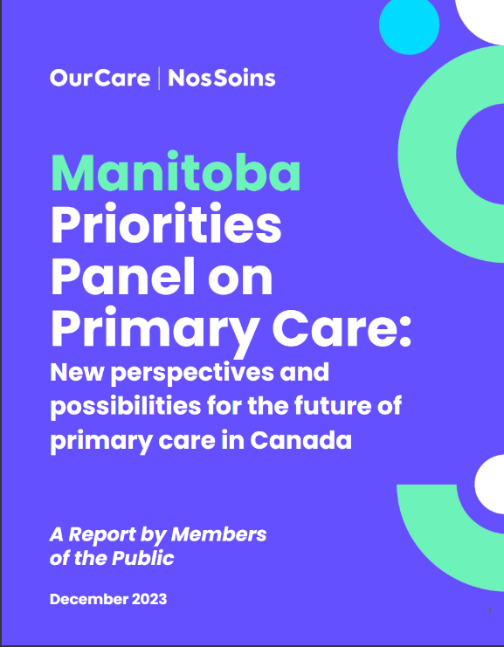

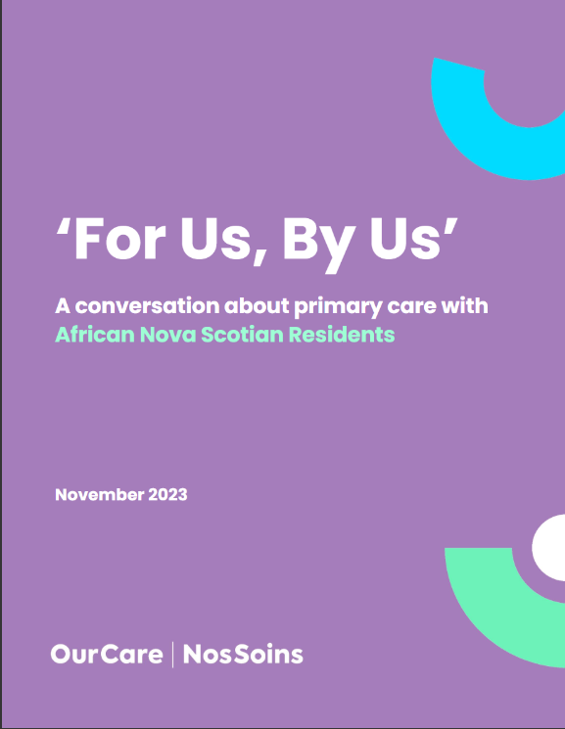

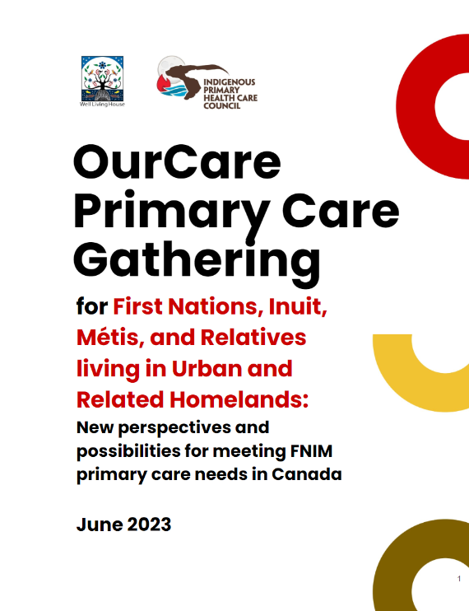


Slide 9

A Standard
for the Future
of Primary Care
OurCare | NosSoins
ourcare.ca

Slide 10
The OurCare Standard
1. Everyone has a relationship with a primary care clinician who works with other health professionals in a publicly funded team.
2. Everyone receives ongoing care from their primary care team and can access them in a timely way.
4. Everyone can access their health record online and share it with their clinicians.
3. Everyone’s primary care team is connected to community and social services that together support their physical, mental and social well-being. ​
5. Everyone receives culturally safe care that meets their needs from clinicians that represent the diversity of the communities they serve.
6. Everyone receives care from a primary care system that is accountable to the communities it serves.

Slide 11
The OurCare Standard
Ontario’s Primary Care Act
1. Everyone has a relationship with a primary care clinician who works with other health professionals in a publicly funded team.
1. Province-wide: Every person across the province should have the opportunity to have ongoing access to a primary care clinician or team.
2. Everyone receives ongoing care from their primary care team and can access them in a timely way.
2. Convenient: Every person should have access to timely primary care..
3. Everyone’s primary care team is connected to community and social services that together support their physical, mental and social well-being. ​
3. Connected: Every person should have the opportunity to receive primary care that is coordinated with existing health and social services.
4. Empowered: Every person should have the opportunity to access their personal health information through a digitally integrated system that connects patients and clinicians in the circle of care.
4. Everyone can access their health record online and share it with their clinicians.
5. Everyone receives culturally safe care that meets their needs from clinicians that represent the diversity of the communities they serve.
5. Inclusive: Every person should have the opportunity to receive primary care that is free from barriers and free from discrimination.
6. Everyone receives care from a primary care system that is accountable to the communities it serves.
6. Responsive: The primary care system should respond to the needs of the communities it serves and everyone should have access to information about how the system is performing and adapting.

Slide 12
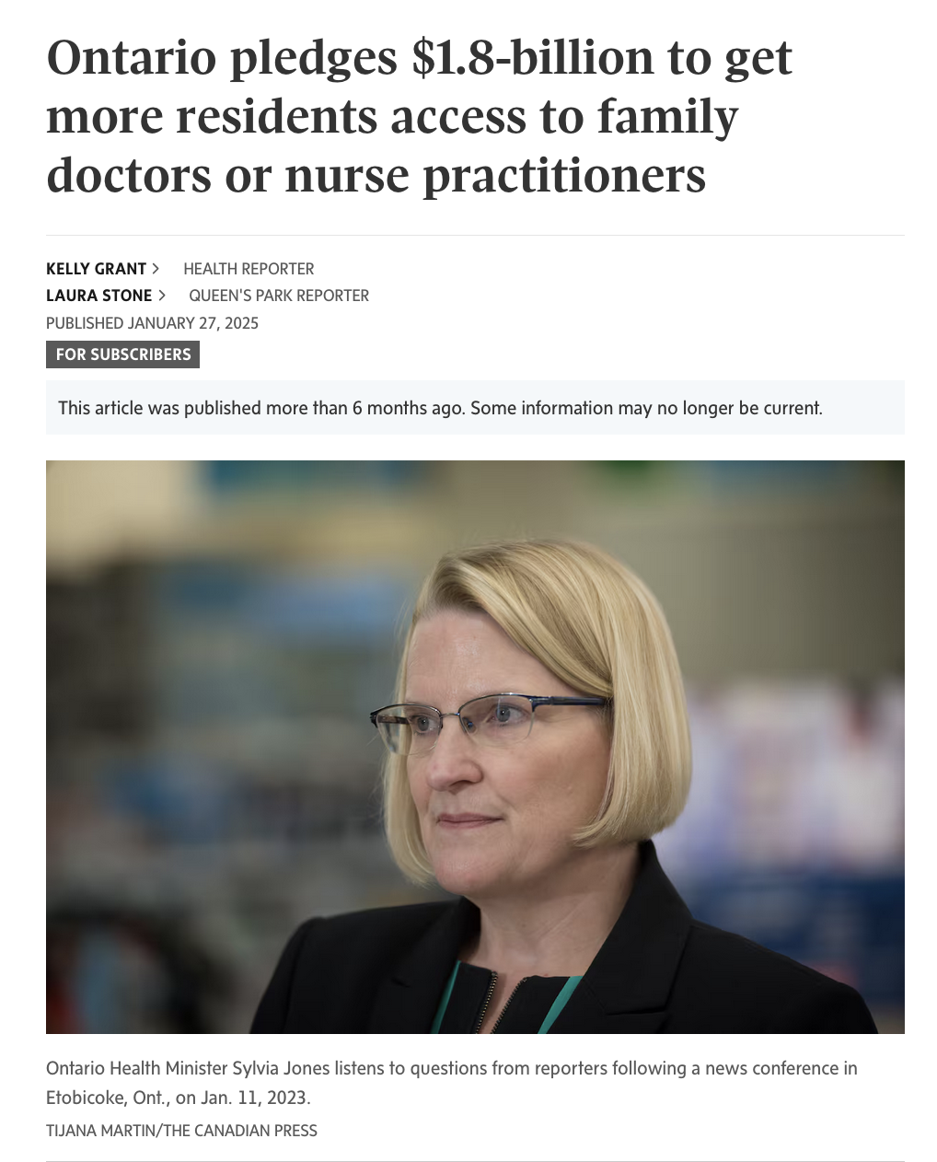

Slide 13
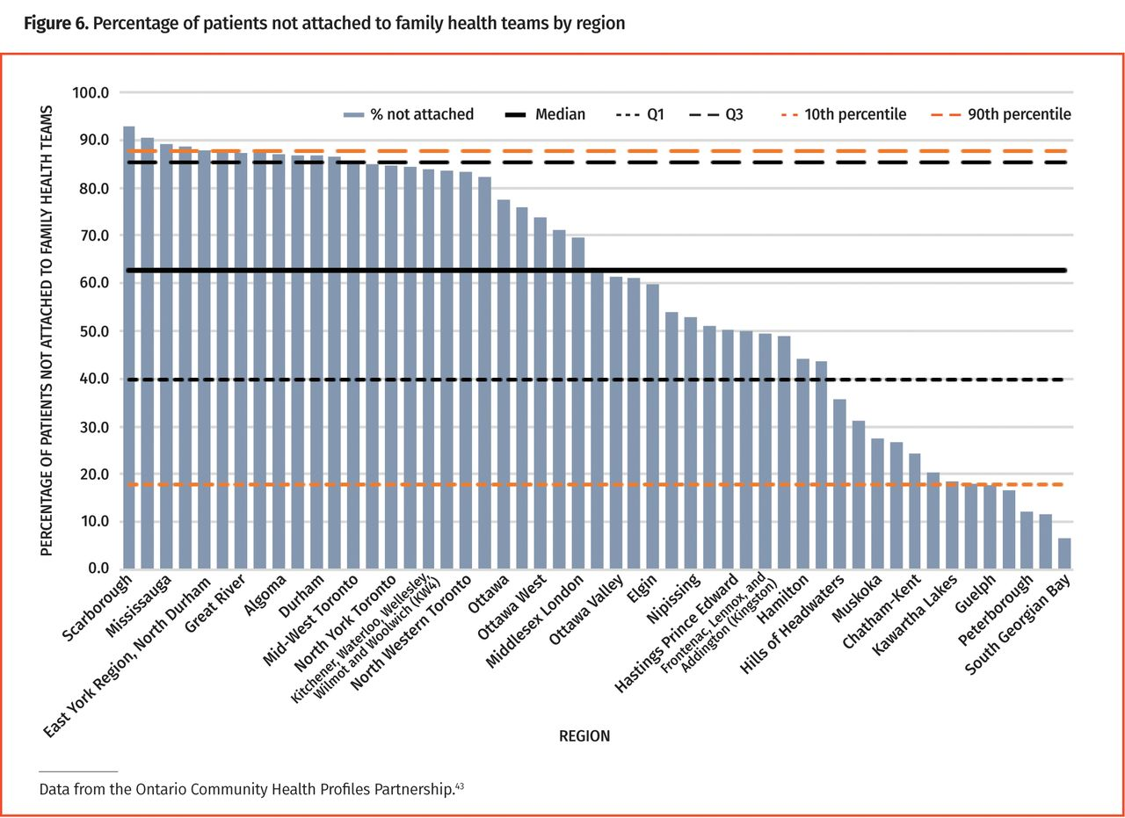
There is marked variation in access to teams by region
Martin 2025 Canadian Family PhysicianMedicine 2025

Slide 14
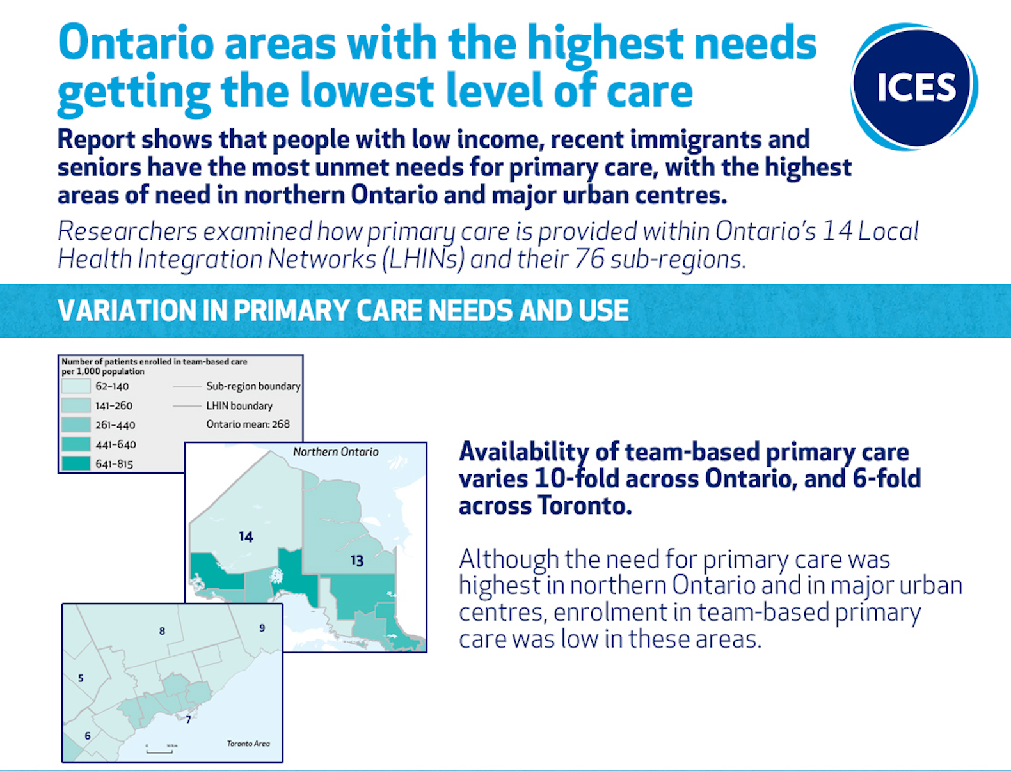


Slide 15
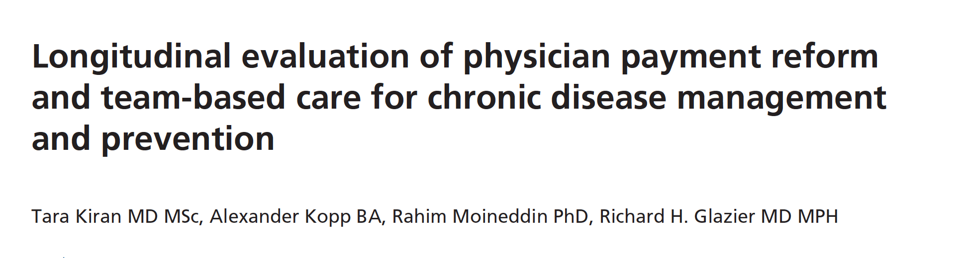
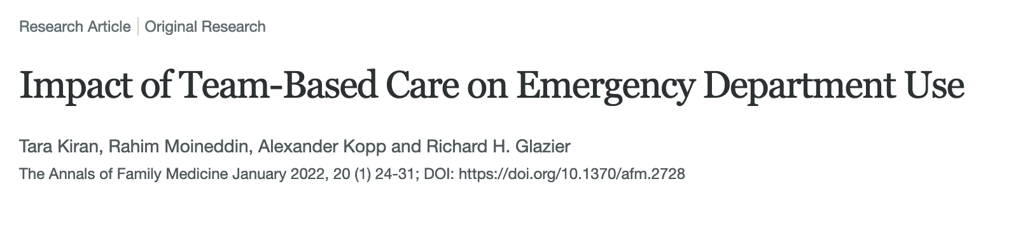
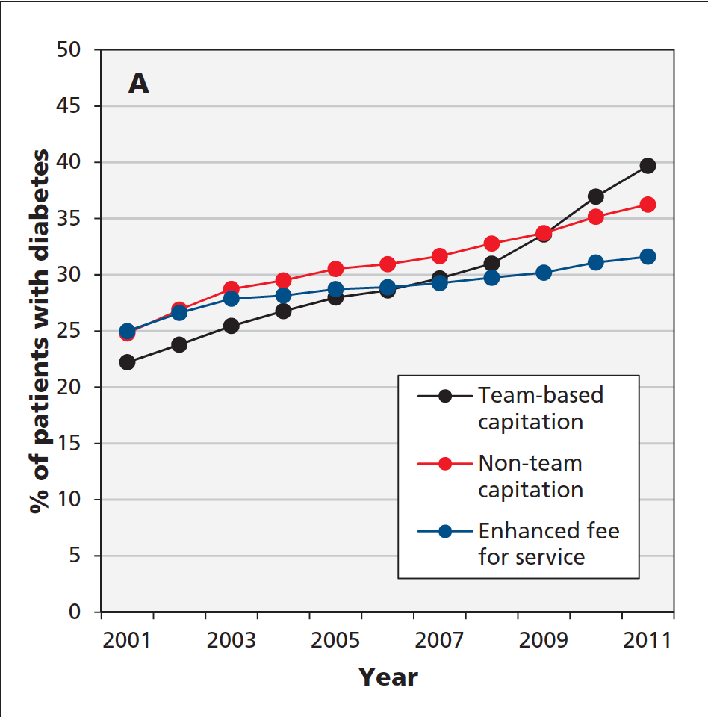
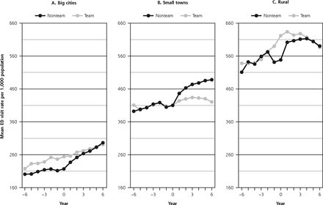
Patients in team-based practices were more likely to get recommended diabetes care and less likely to visit the emergency department

Slide 16
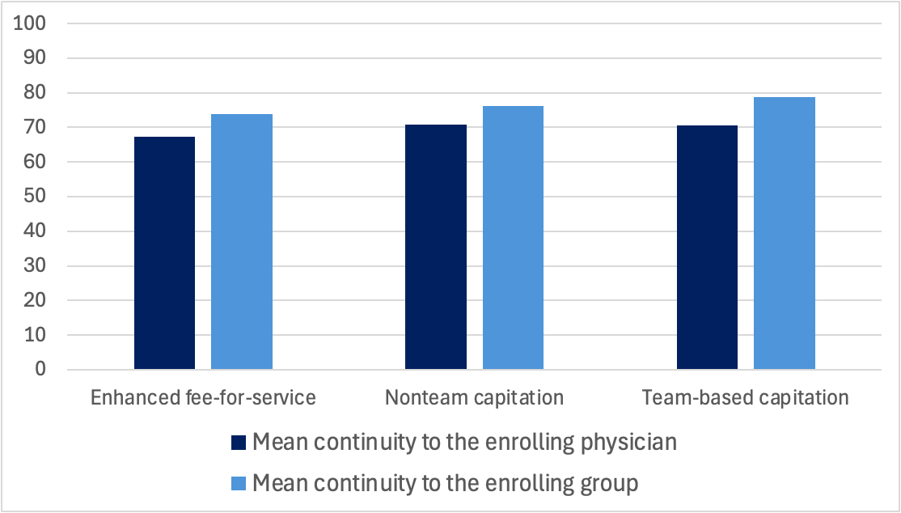
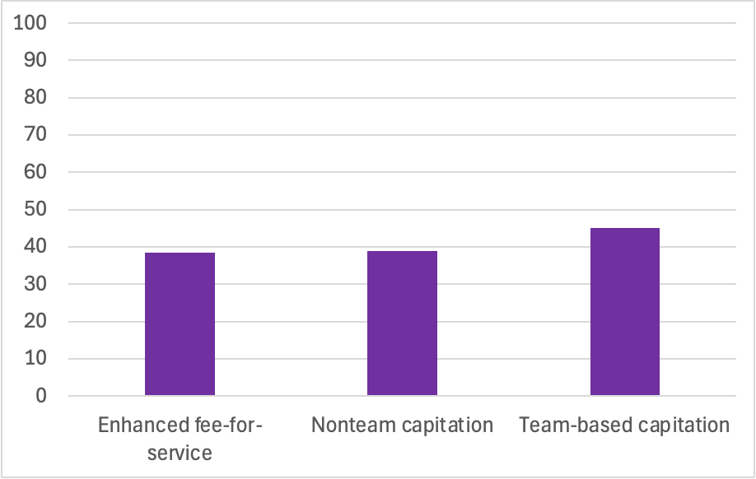
Continuity is relatively high but timely access is relatively poor across all models
Mean continuity to physician and group
Same or next day access when sick
Kiran 2023 JABFM
Kiran 2020 CMAJ Open

Slide 17
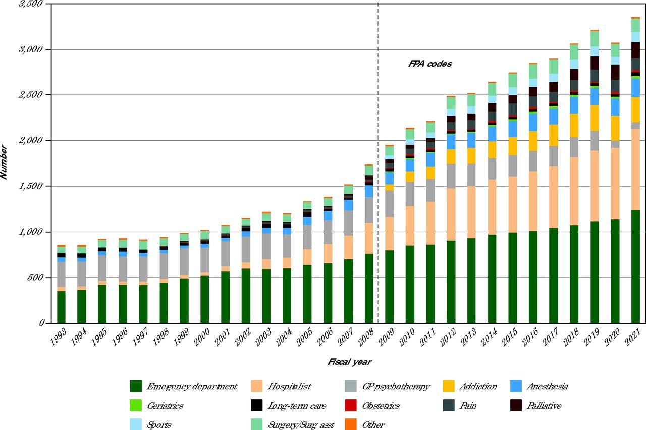
An increasing proportion of family doctors in Ontario are doing focused practice
Ansari 2025 Annals of Family Medicine

Slide 18
Lessons from Ontario:
Physicians need to work effectively in a group
  shared records with cross coverage
Specify objectives
  In Canada, teams need to be implemented with the goals of improving timely access and growing clinician capacity
Measure and Report on key indicators
  attachment, timeliness, continuity, equity
Standardization with some flexibility
  Patients should know what to expect
Design for Equity
  start where the need is highest, incentivize complexity

Slide 19
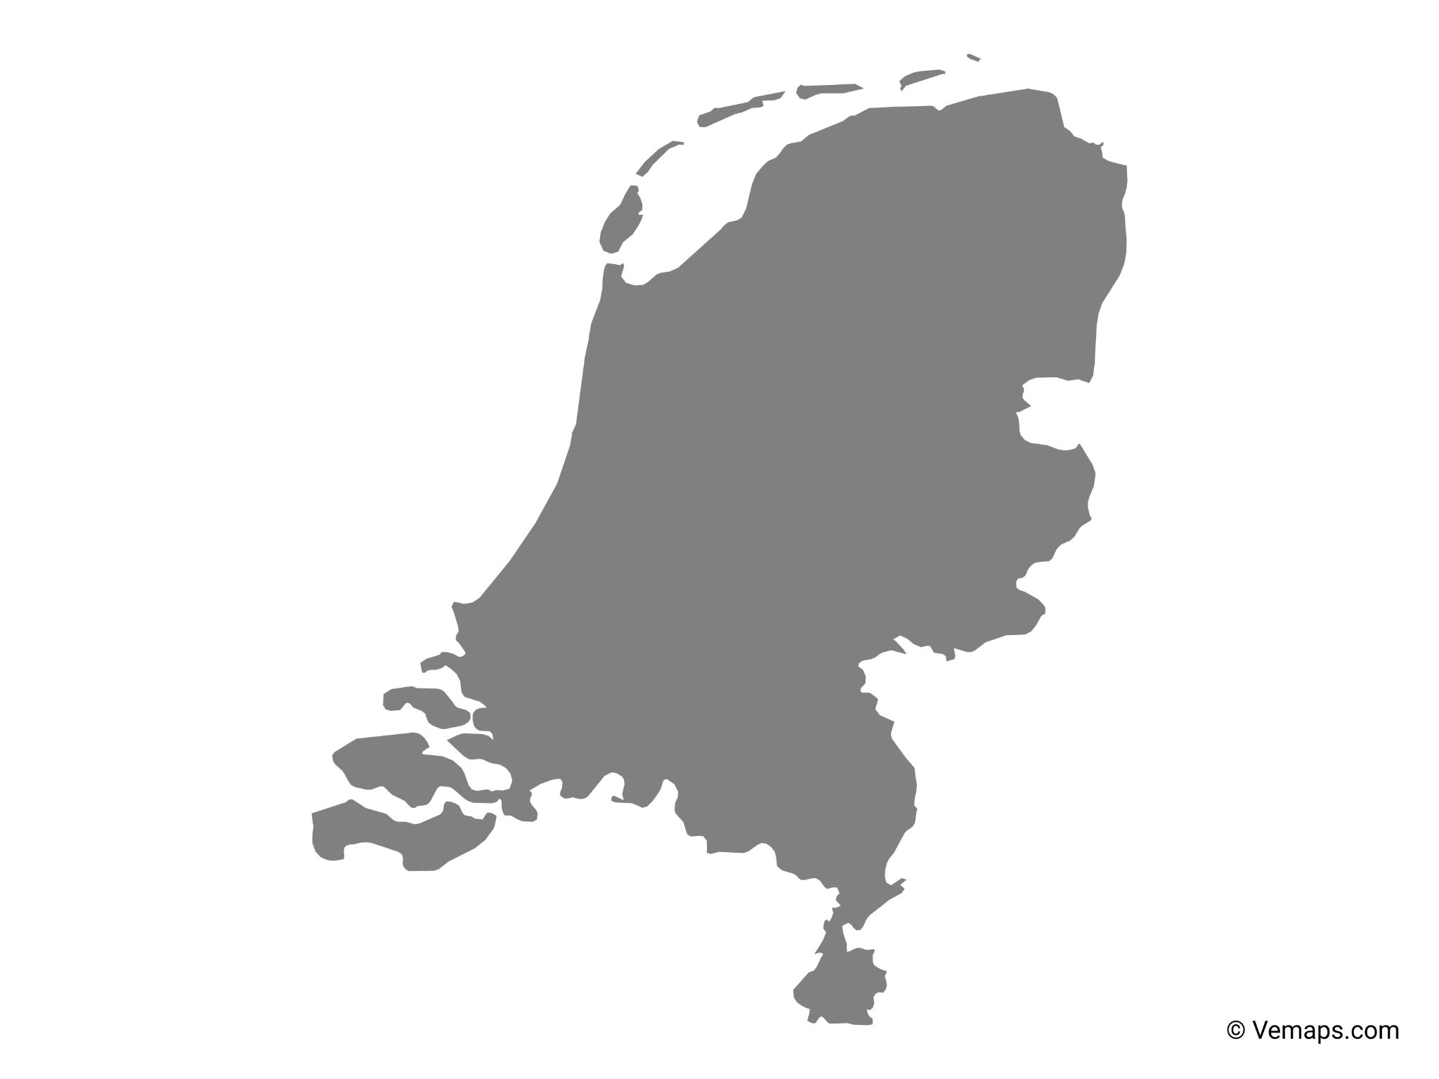
What should we thinking about?
Demand management
Working at top of scope
Patient empowerment
Family doctor leadership
Workplace flexibility
OurCare | NosSoins
ourcare.ca

Slide 20
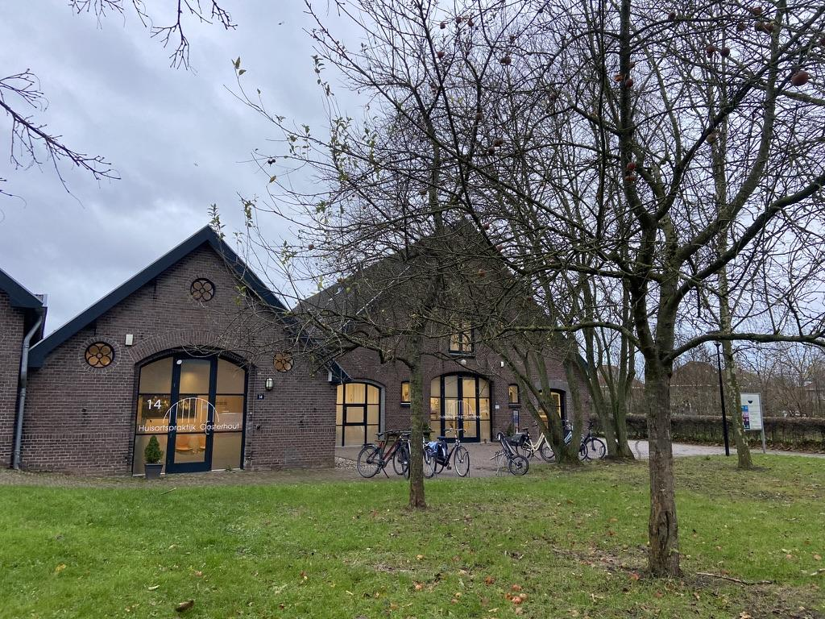
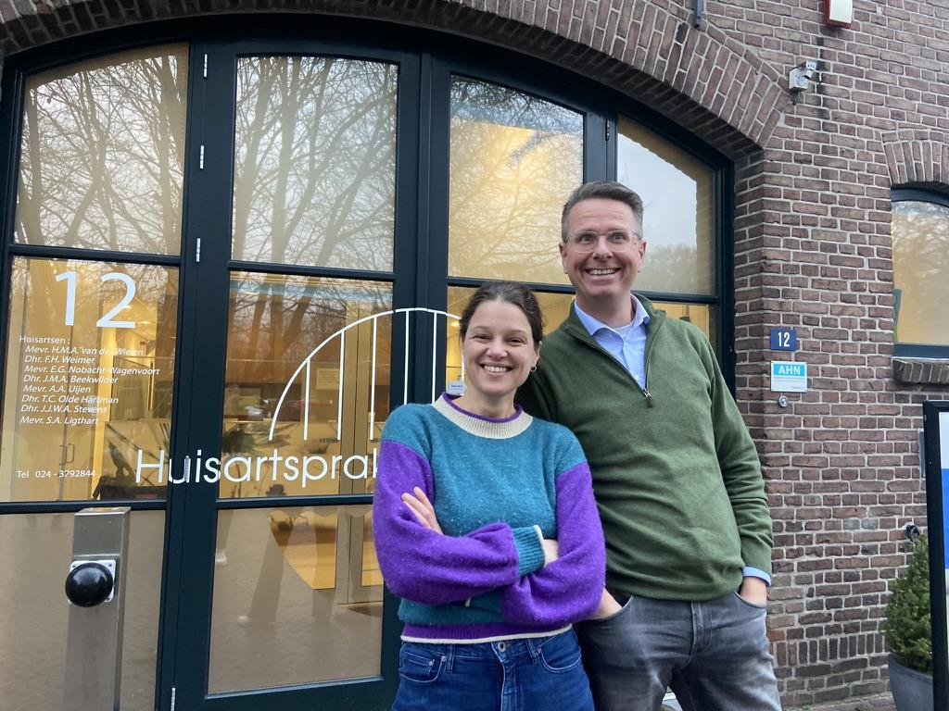
Learning from GPs Netherlands
Suzanne Ligthart and Tim Olde Hartman
Notes:
Spent time in Tim Olde Hartman, most primary care delivered by GPs who own their practices, average roster 2300, 70% capitation

Slide 21
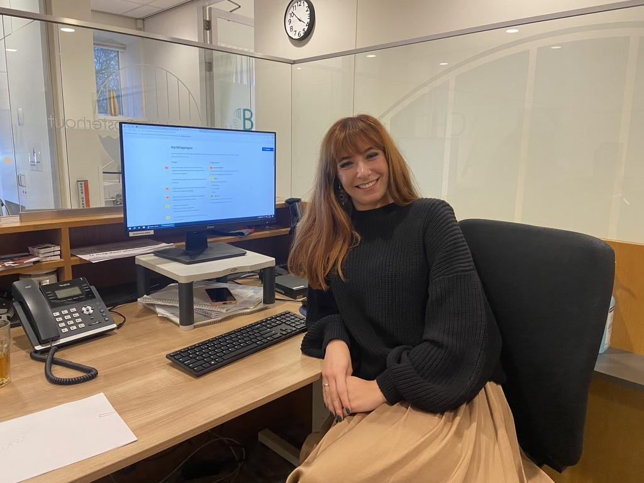
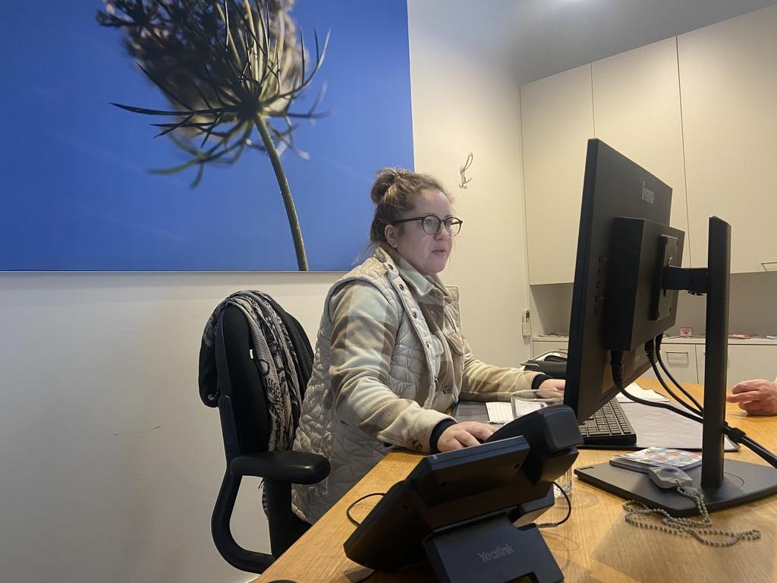
Demand management
Practice assistants
Nurses
Notes:
Standard training and roles

Slide 22





Working at top of scope
GPs in the Netherlands
Family doctors in Canada
Acute/urgent care
Complex medical/social care
Stable chronic conditions
Preventive care
Home visiting
End of life care
Acute/urgent care
Complex medical/social care
Stable chronic conditions
Preventive care
Home visiting
End of life care

Slide 23
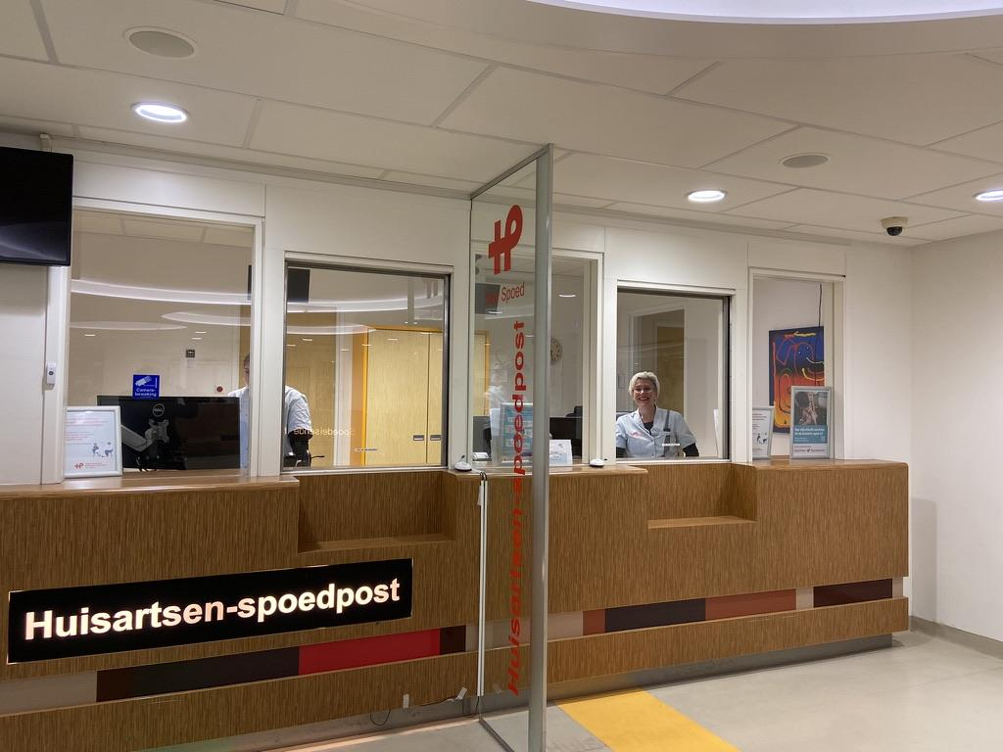
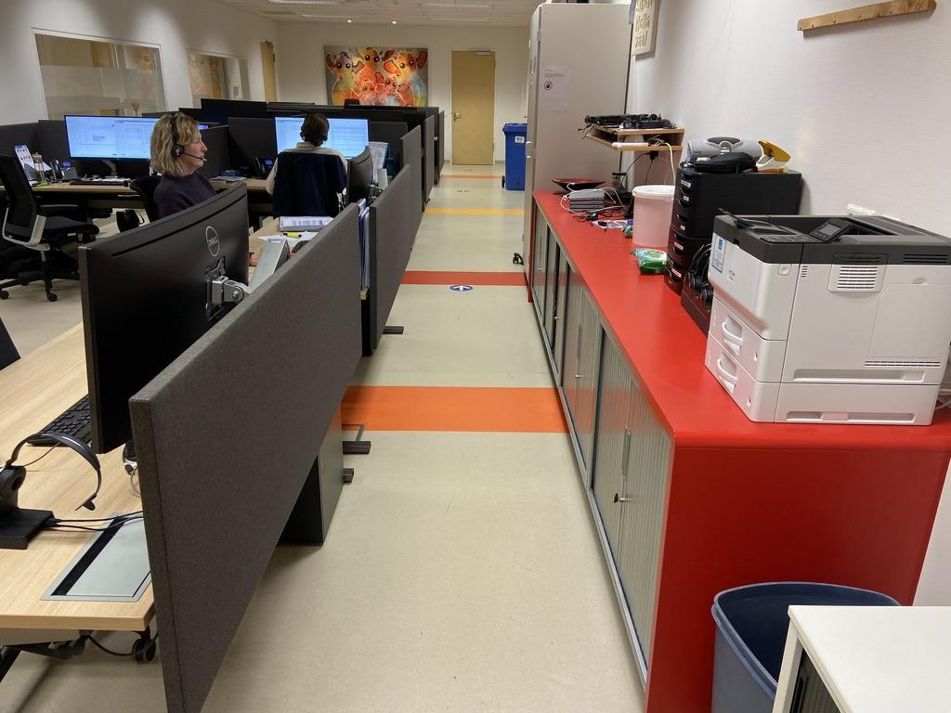
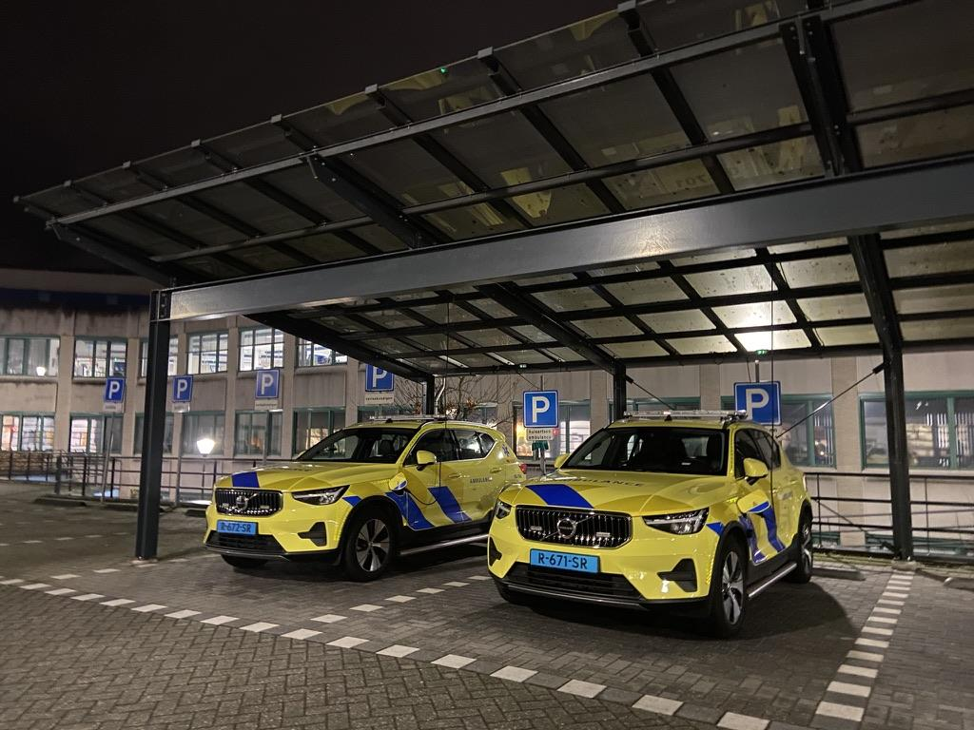
GP leadership
Regional after-hours centre in Nijmegen

Slide 24

Public empowerment
https://www.thuisarts.nl/

Slide 25
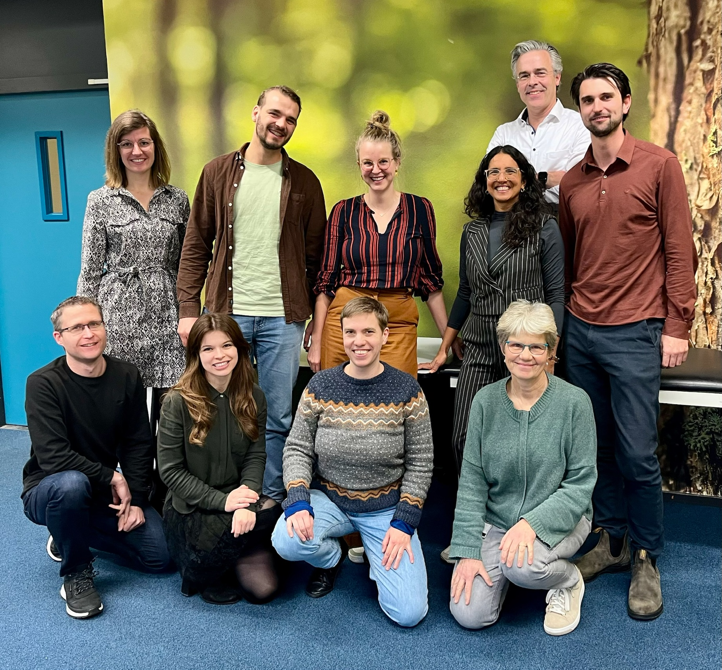
Workplace flexibility
GP trainees in Nijmegen University

Slide 26

Learn from what’s working
Subscribe wherever you get your podcasts. Search “Primary Focus” or “Tara Kiran”
Visit www.primaryfocus.ca
OurCare | NosSoins
ourcare.ca

Slide 27



Thank you to our team, collaborators & funders and the many participants from across the country who volunteered their time
Visit OurCare.ca to learn more
Subscribe to the podcast at primaryfocus.ca
In partnership with:
MASSLBP
Email: tara.kiran@utoronto.ca

Slide 28

 | Canada | USA
Total health spending per capita ($US) (2022) | $6,319.04 | $12,555.26
% of total health spending that is public (2022) | 71% | 53%
No. of hospital beds per 1000 people (2021) | 2.58 | 2.77
No. of physicians per 10,000 people (2020) | 24.3 | 35.6
% who have a regular clinician or place of care (2023) | 86.2% | 86.9%
% who have a regular clinician (2023) | 73.5% | 60.9%
% who have a regular place of care (2023) | 12.7% | 26.0%

Slide 29
OurCare Partners
Ontario Advisory Group
Alliance for Healthier Communities
Association for Family Health Teams of Ontario
Black Physicians Association of Ontario
Canadian Institutes of Health Research
Carea Community Health Centre
College of Family Physicians of Canada
Health Commons Solutions Lab, Sinai Health System
Indigenous Physicians Association of Canada
Indigenous Primary Health Care Council
Department of Family Medicine, McMaster University
Department of Family Medicine, University of Ottawa
Department of Family Medicine, Queen's University
Dalla Lana School of Public Health, University of Toronto
Department of Family and Community Medicine, University of Toronto
Northern Ontario School of Medicine
Nurse Practitioners’ Association of Ontario
Ontario College of Family Physicians
Ontario Health
Ontario Medical Association
Ontario Ministry of Health
Restore Medical Clinics
Upstream Lab
Women’s College Hospital
National Collaborating Organizations
Black Physicians of Canada
Canadian Institute for Health Research
Canadian Medical Association
College of Family Physicians of Canada
Health Canada
Healthcare Excellence Canada
Indigenous Physicians Association of Canada
National Primary Care Leaders
Canadian Association for Health Services & Policy Research
Dalhousie University
University of Alberta
University of British Columbia
University of Saskatchewan
ourcare.ca

Slide 30
OurCare Partners (Cont’d)
Quebec Advisory Group
Association québécoise des medecins du sport et de l'exercice (AQMSE)
Cree Board of Health and Social Services of James Bay
Collège Québécois de Médecins de Famille
Commissaire à la santé et au bien-être (CSBE)
Département régional de médecine générale (DRMG) Montréal
Direction de santé publique de l'Estrie
Fédération des médecins omnipraticiens du Québec
McGill University
Ministère de la Santé et des Services sociaux (MSSS)
Ordre des infirmières et infirmiers du Québec (OIIQ)
Ordre des pharmacists du Québec
Universite de Montreal
Université Laval
Université de Sherbrooke
British Columbia Advisory Group
BC Association of Community Health Centres
BC College of Family Physicians
BC Family Doctors
BC Patient Safety & Quality Council
Canadian Medical Association
Centre for Health Services and Policy Research
Doctors of BC
First Nations Health Authority
Interior Health
Island Health
North Shore Division of Family Practice
Nurses and Nurse Practitioners of British Columbia (NNPBC)
Providence Health Care
Rural Coordination Centre of BC
Simon Fraser University
University of British Columbia
BC Ministry of Health
Family Practice Services Committee (FPSC)
Fraser Health
Vancouver Division of Family Practice
Nova Scotia Advisory Group
Dalhousie Medical School, Dalhousie University
Department of Health and Wellness, Government of Nova Scotia
Department of Family Medicine, Dalhousie University
Doctors Nova Scotia
IWK Department of Family Medicine
Mi’kmaw Native Friendship Centre
Nova Scotia Health Authority
Nova Scotia College of Family Physicians
Pharmacy Association of Nova Scotia
Nurse Practitioner Association of Nova Scotia
Primary Health Care and Chronic Disease Management Network, Nova Scotia Health Authority
Tajikemɨk
Manitoba Advisory Group
Department of Family Medicine, University of Manitoba
Doctors Manitoba
First Nations Social Secretariate of Manitoba
Interlake-Eastern Health Authority
Manitoba Association of Senior Communities
Manitoba College of Family Physicians (MCFP)
Manitoba Health
Northern Health Authority
Nurse Practitioner Association of Manitoba
Patient Network
Prairie Mountain Health
Province of Manitoba
Office of community Engagement, University of Manitoba
Ongomiizwin Institute of Health and Healing, University of Manitoba
Shared Health
Winnipeg Regional Health Authority (WRH)
ourcare.ca

Slide 31

Thank you to our funders
The OurCare initiative is made possible through financial contributions from Max Bell Foundation, Even the Odds, and Health Canada. The views expressed herein do not necessarily represent the views of our funders.
NosSoins est rendue possible grâce aux contributions financières de la Fondation Max Bell, d'Even the Odds et de Santé Canada. Les opinions exprimées ici ne représentent pas nécessairement celles de nos bailleurs de fonds.

