Slide 1
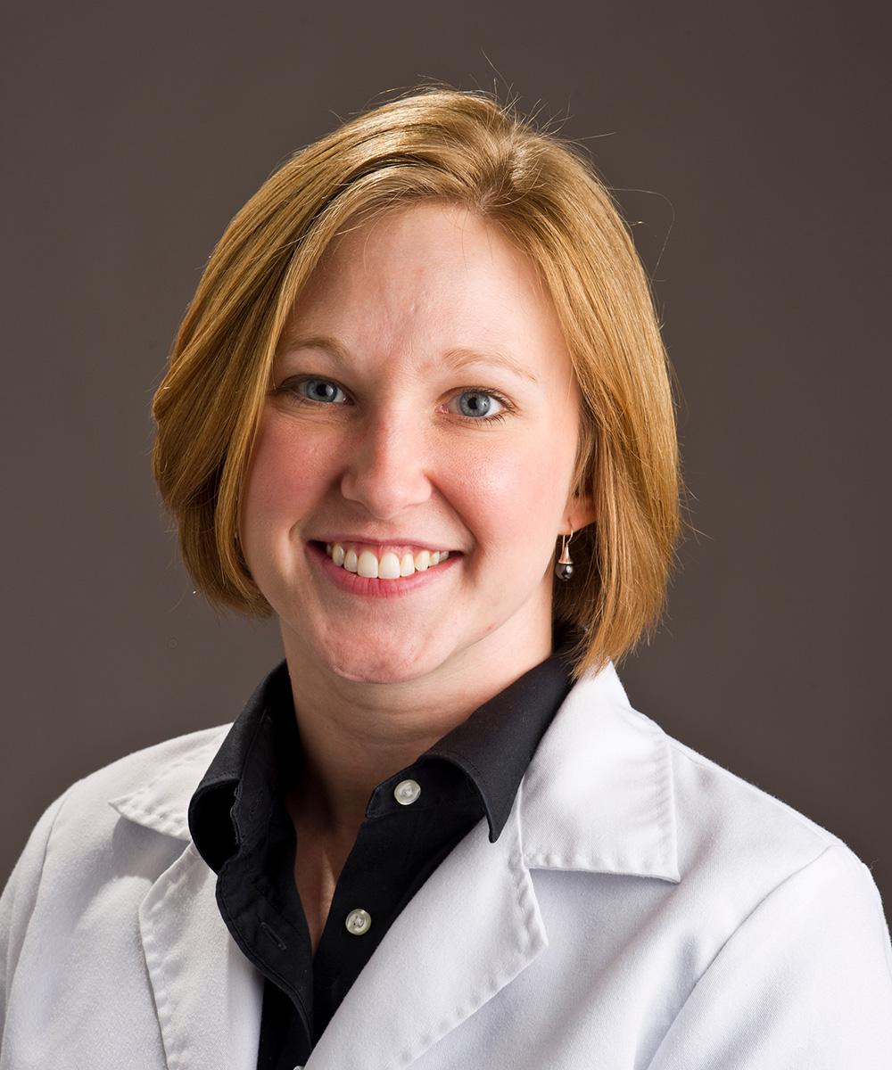
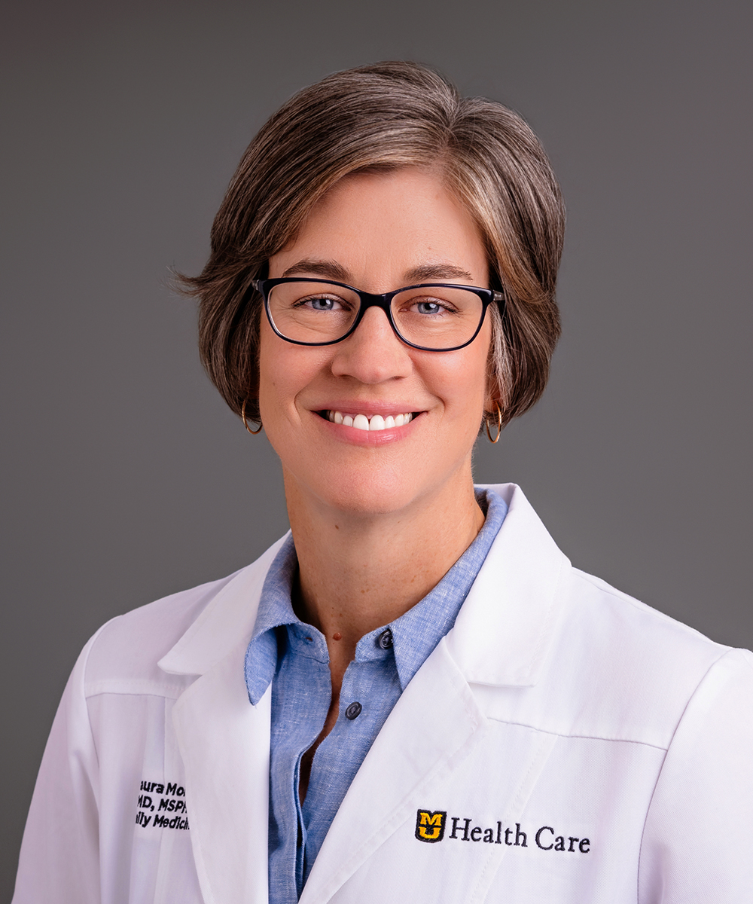
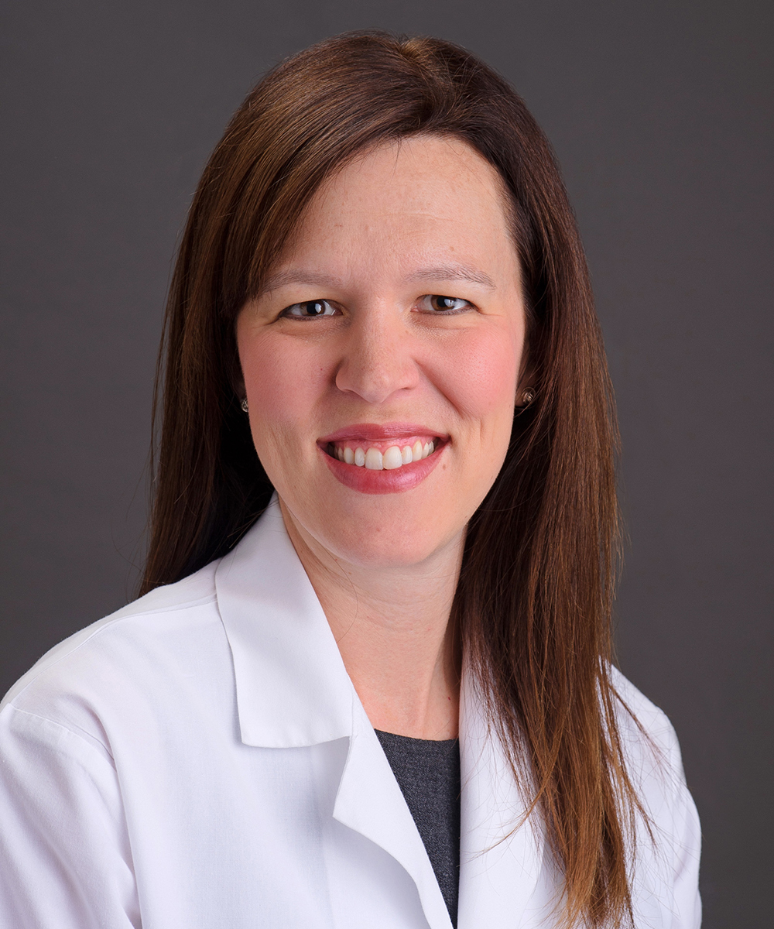
Integrating Virtual, Urgent Care into Continuity of Care
Richelle J. Koopman, MD, MS
Jack M. and Winifred S. Colwill Chair, Department of Family and Community Medicine
Immediate Past President, NAPCRG
FMLC August 2025
Margaret Day, MD, MSPH Laura Morris, MD, MSPH Sarah Swofford, MD, MSPH
Professor, Vice Chair Professor, Chief Medical Professor, Chief of Staff
for Clinical Affairs Officer Ambulatory Director of Virtual Health
MU Healthcare MU Healthcare

Slide 2
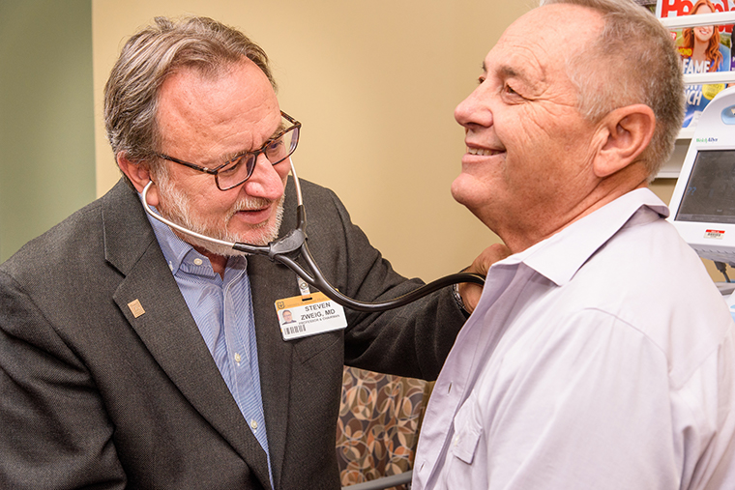
Our Why:
Continuous, Person-Centered,
Relationship-Based Care
Comprehensive approach to patient and their history
Considers patient needs and preferences
Improves trust
Highest quality care
Searching for the Family Doctor (Hoff, 2020)
Implementing High-Quality Primary Care (NASEM, 2021)

Slide 3
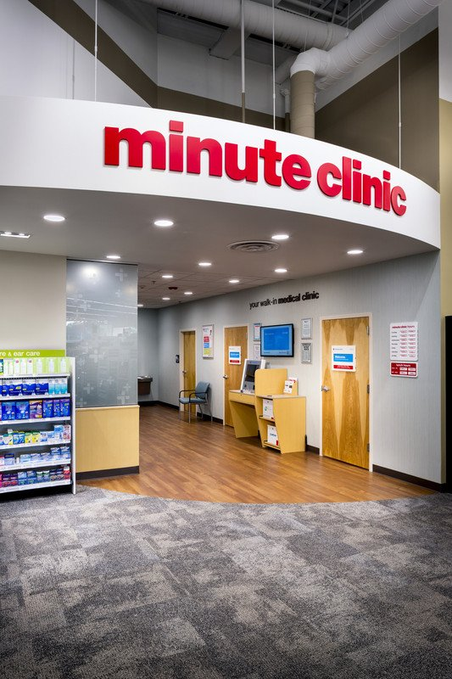
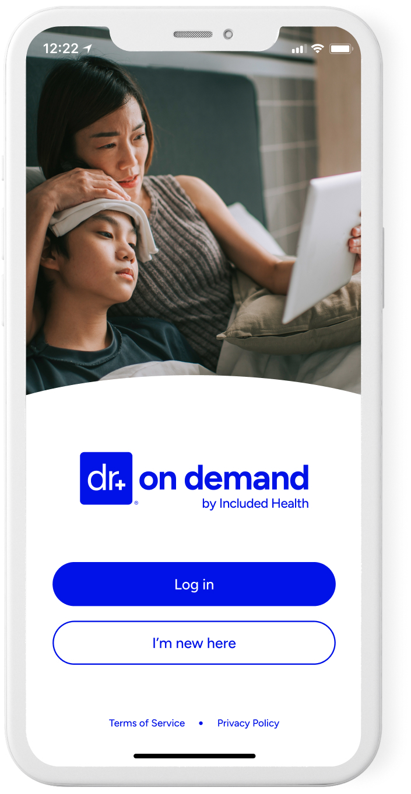
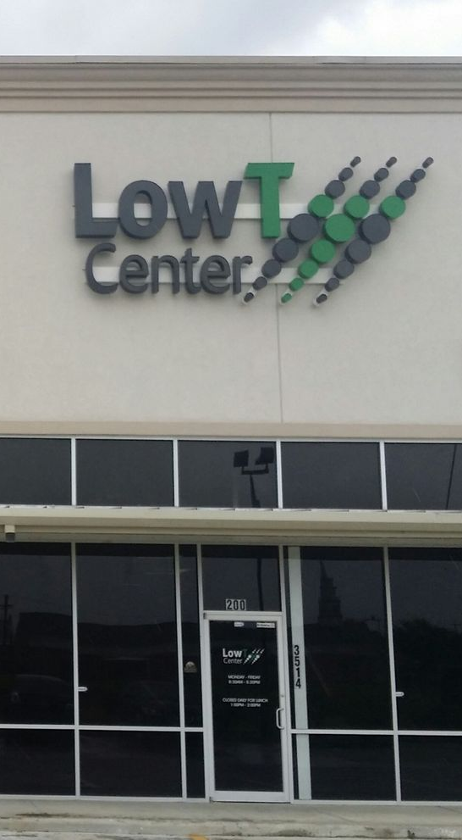


Where have we failed our patients?
Today’s fast-paced world demands quick, convenient, accessible solutions
These solutions increase fragmentation of care, and can decrease quality and increase cost
Commercial solutions may be costly and dangerous

Slide 4

How do we compete in the virtual and quick care space?
What do patients want from us?
High quality care when they need it, in the way they want it
Convenience, convenience, convenience
  Easy access
  On demand
  Seamless
Circumscribed vs. comprehensive
Connect if they don’t have a doctor
Connect if they do have a doctor
Transparent pricing

Slide 5
How can we be superior in the virtual and quick care space?
We own and trade on relationships
What do we offer over these other options?
Trusted relationship
On demand care
Continuity of data and care
Whole person care congruent with their other health conditions
We’ll be there if things go badly
Advocate to state legislatures about degrading local medical infrastructure

Slide 6
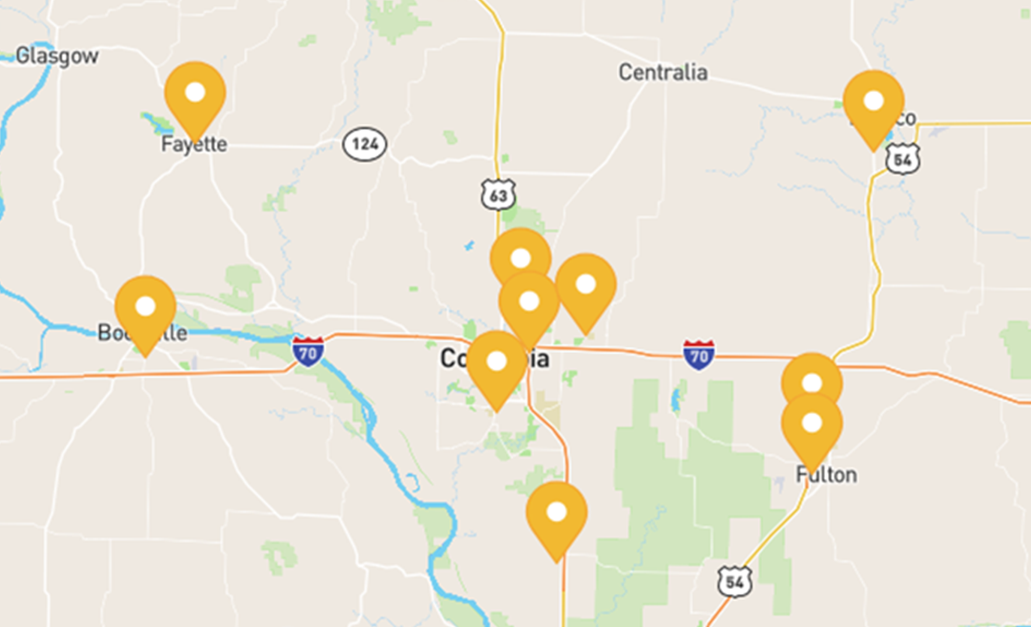
Context of our work
MU Family Medicine, an academic setting maybe not so different from an employed physician model
Faculty practices in 10 clinics in communities across 5 counties
68,000 unique patients and over 200,000 patient visits
Largest primary care entity in the 5 counties
Integration of APPs into practice and inpatient care
Inpatient, palliative, sports med, geriatrics care
Integrated EHR across specialties, ER, clinics, hospitals
Market share – we are indispensable
Physician/department not in control of clinic staffing, operations, strategy

Slide 7
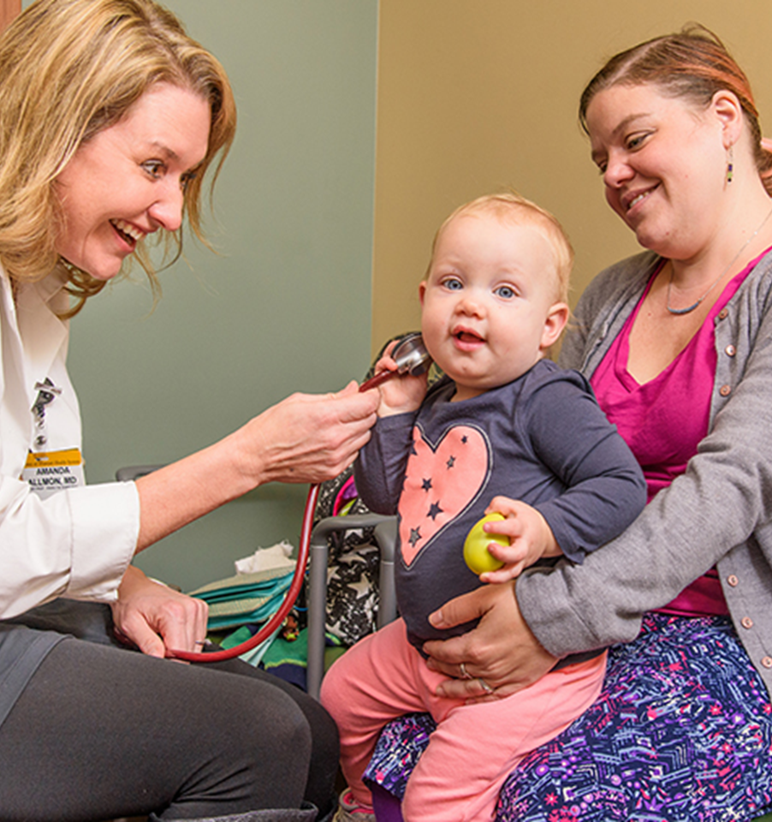
Our Interventions
3 Quick Cares in local HyVee grocery stores
Usual plus “on-the-fly” telehealth appointments
Clinic staffing project
AI-assisted documentation

Slide 8
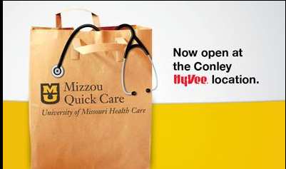


1. Mizzou Quick Care
3 locations at HyVee grocery stores
Greatly diminished other urgent care and minute clinics in Columbia Missouri
A collaboration with Columbia HyVee grocery stores for almost 10 years
Integrated EHR with MU Healthcare
Same copay as primary care visit

Slide 9
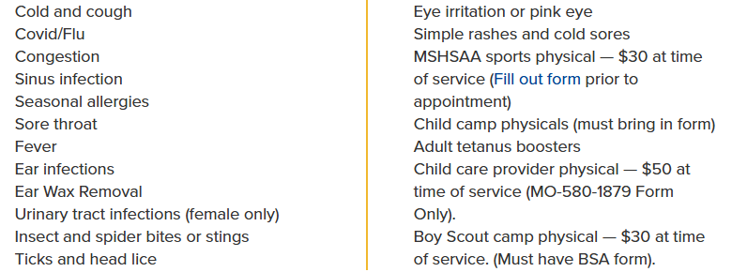

Mizzou QuickCare – How does it work?
Partnered with 3 Hy-vee grocery stores for more than 10 years now
Staffed by APPs with FM collaborating physician
Same co-pay as primary care visit for custom network patients
Referrals to MU primary care for people who don’t have a doctor/need more care
Limited menu of conditions, age 2 and above
Walk in or reserve same day online
Same EHR as larger health system
16,795 visit last year

Slide 10
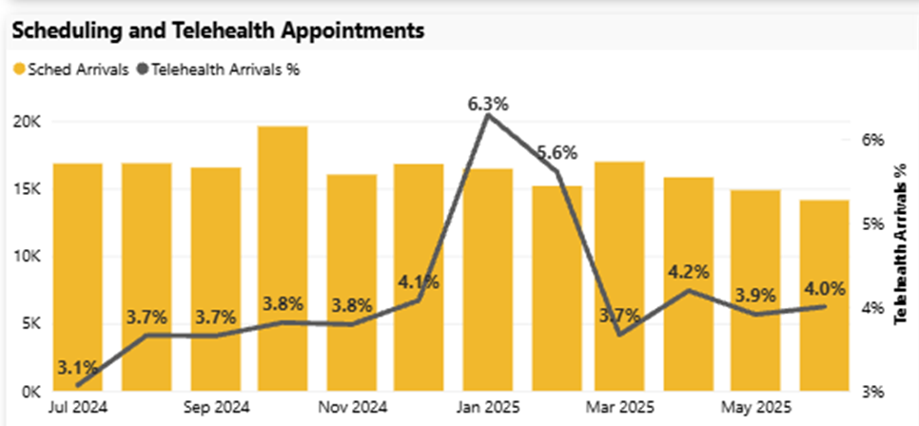
2. Telehealth – How does it work?
“On the Fly” - Physician/APP can “order” a visit and create a telehealth encounter at will
Scheduled
Currently, about 4% of our visits, 8105 visits (of 200,000 total)
Online scheduling
Option for return visit
Integrated with EHR, no separate log-on
Integrated with patient portal
Very popular for weight management
Helps with space crunch

Slide 11
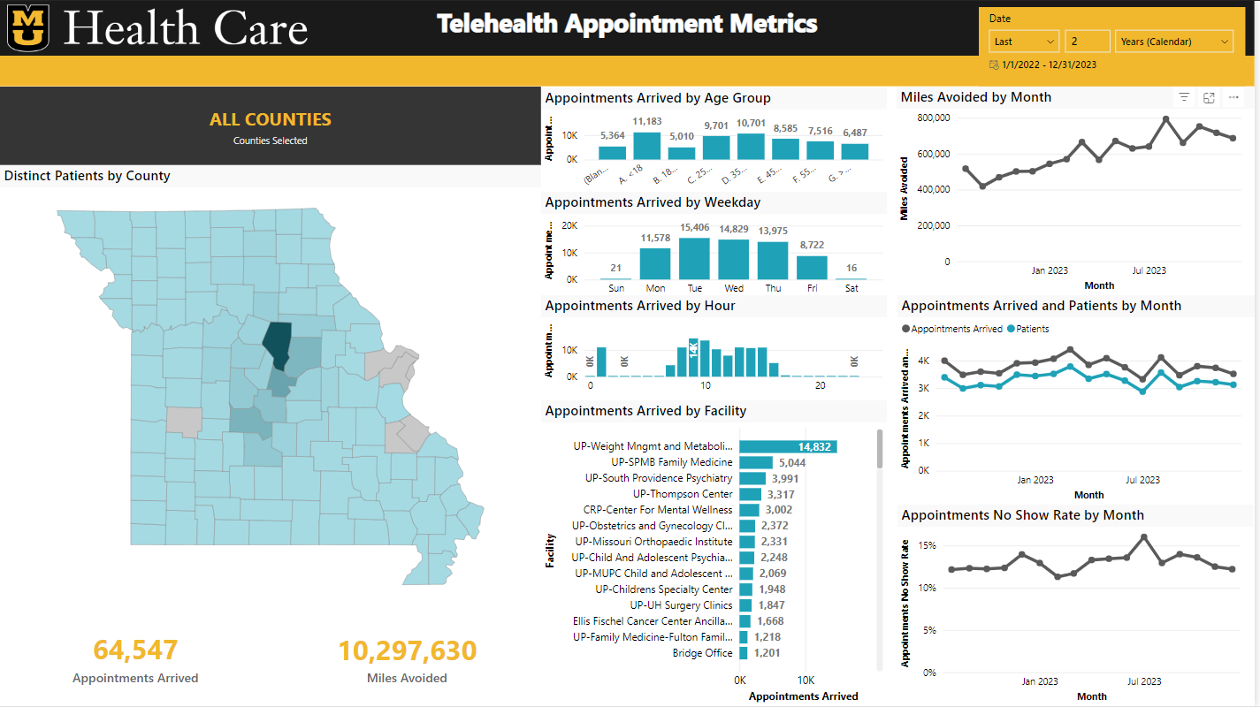

Slide 12
Virtual APP Clinic – Coming soon
APP = Advanced Practice Professional (nurse practitioner, physician assistant)
New patient bridge clinic
School-based visits for one of our school districts
Medicare Advantage Annual Wellness Visits

Slide 13
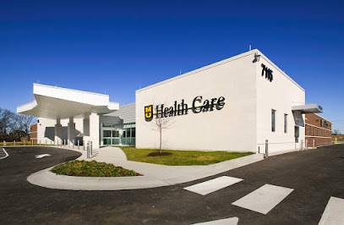
3. Primary Care Staffing Project
Interventions
Confirm appointments
Collect Co-pays
Transition care management visits (TCM -hospital f/u)
Nurse-led medicare wellness visits
Re-direct portal messages

Slide 14
Participating Clinic locations
First Pilot – January 2023 | Additional positions, Total | Clerical | Clinical | Clinical | Vizient Percentile FY24
Fairview IM | 5 | 2 PSRs | 2 RNs | 1 CMA/LPN | 51
Battle Ave FM | 6 | 2 PSRs | 4 RNs |  | 51
SP Gen Peds | 2 |  | 2 RNs |  | 25
Second Pilot – July 2024 | Additional positions, Total | Clerical | Clinical | Clinical | Vizient Percentile FY24
Ashland FM | 1 |  | 1 RN |  | 74
South Providence FM Gold Team | 4 |  | 4 RNs |  | 36
Notes:
MD speaks

Slide 15
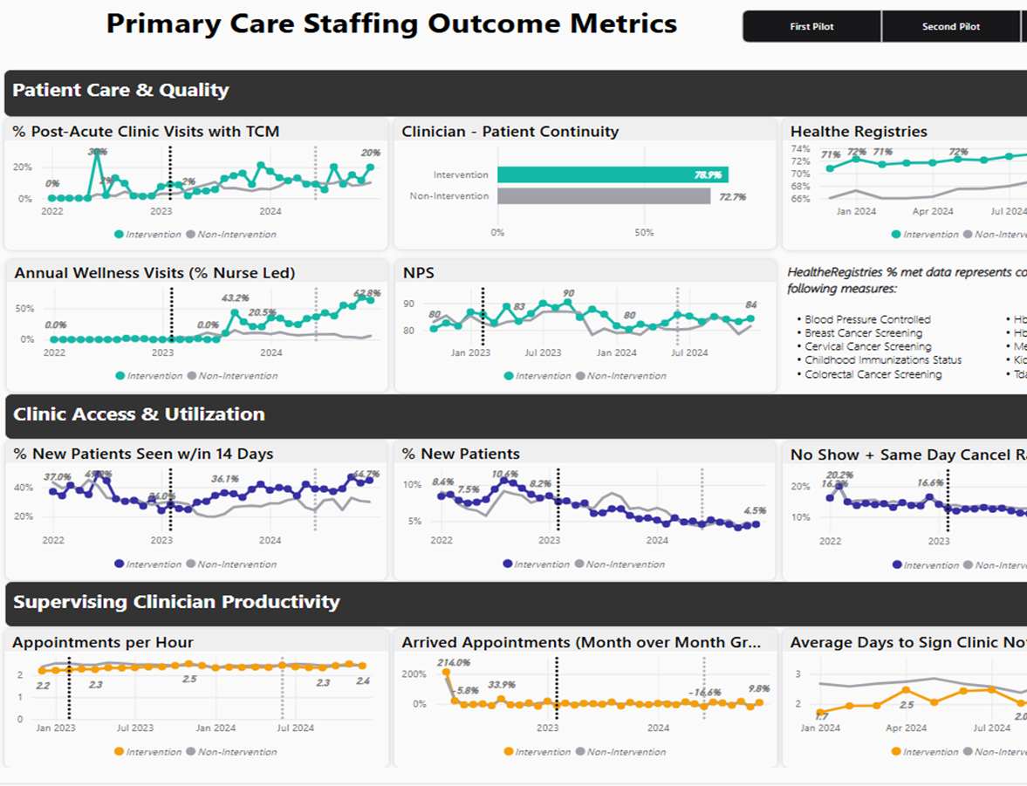
Outcomes
Incredibly Positive
Cost effective

Slide 16
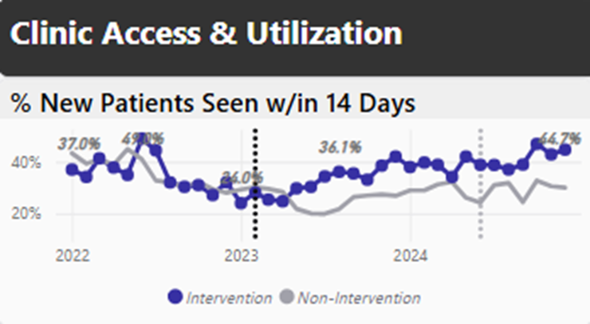
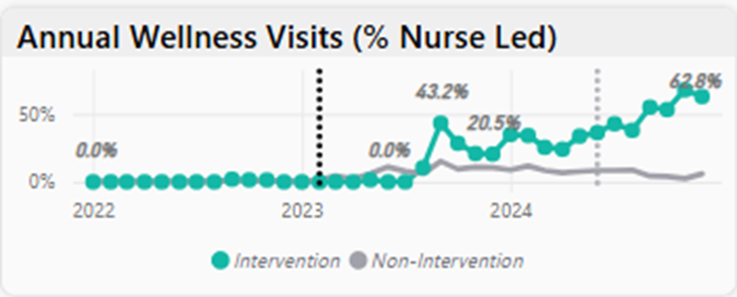
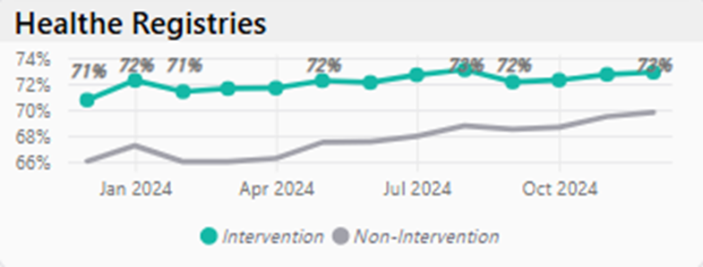
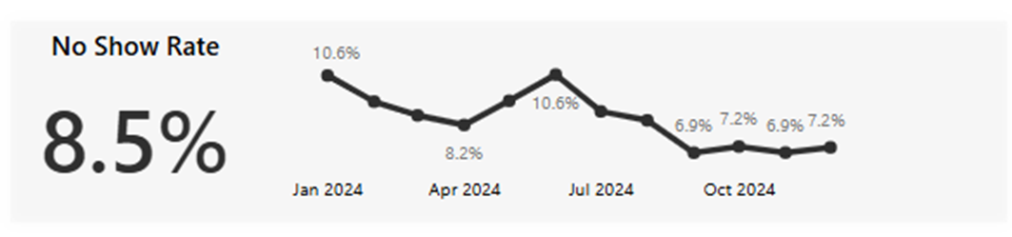
Outcomes – Improving Everything

Slide 17
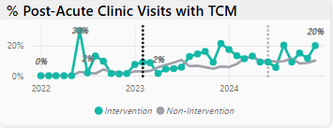
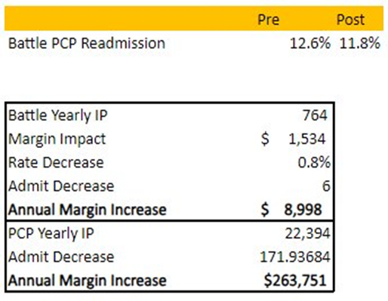
Transition Care Management & Readmissions
Notes:
MD speaks
TCM services are utilized to transition a patient’s care from hospital services to a community setting. Requires a team workflow to coordinate follow up care, including a nursing note in the chart within 2 days of hospital discharge. TCM visits reimburse at a higher rate than “traditional” office visits and are a strategy to lower readmission rates.
TA speaks
To analyze the impact of increased TCM visits on readmission rates, we analyzed the readmission rate of patients with a battle Primary Care Physician as the clinic improved monthly TCM visits. In the study, you can see a decrease in readmission rate of 0.8% or 6 patients on an annualized basis. During this, post-pilot time, there was actually a slight increase in readmission rate across the rest of our patient population with a PCP. If you were to decrease readmission across all of our patient population with an internal PCP at 0.8%, the decrease would be 172 patients. I simultaneously calculated that a readmission patient results in around $1,500 less margin than patients who are not re-admits. Multiply that by the total of 172 patients, we would realize around $265k in additional margin by filling those beds with non-readmits. Note, the readmission decrease was closer to 2% before clinicians left the clinic
For reference
99495 – mod complexity, w/in 14 days, 2.78 wRVUs
99496 – high complexity, w/in 7 days, 3.79 wRVUs
99213 – 1.30
99214 – 1.92

Slide 18
Pilot outcomes
Decreased
Increased
Direct cost per visit
DNKA rate
Pajama time/after-hours portal messages
Burnout
Clinician administrative burden
Contribution margin per visit
Net Revenue
HealtheRegistries
Access
NPS scores
RN-led AWV
TCM
Clinician support
Top of license work
Portal inbox management

Slide 19
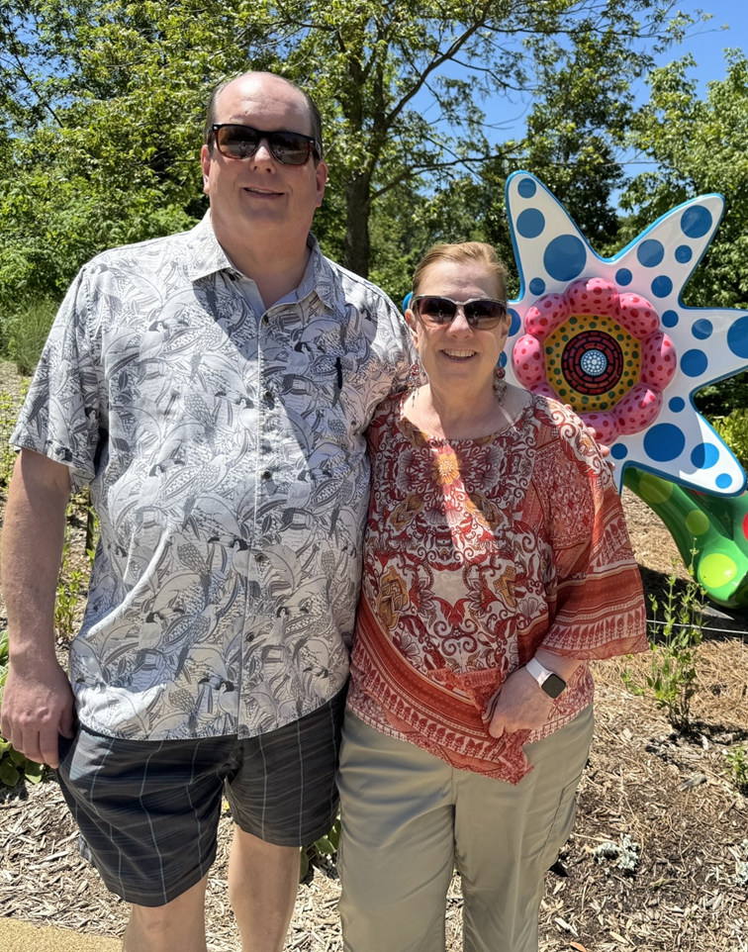
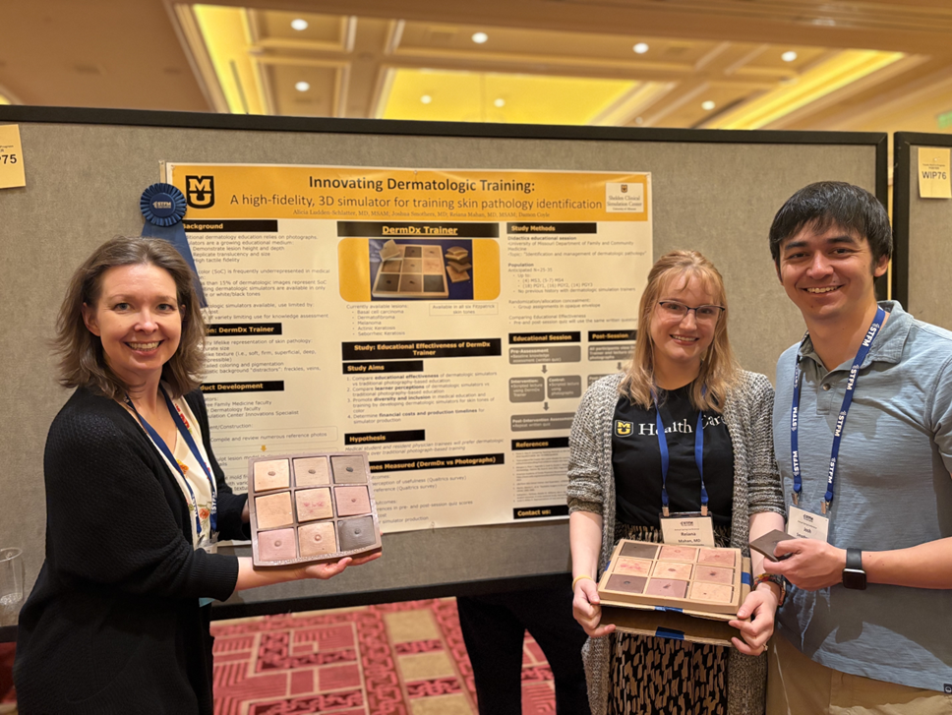
4. AI-Assisted Documentation
It’s about decreasing pajama time
System-wide implementation August 4, 2025
Following 15-month pilot of two different options

Slide 20
“Building the nurse-led Annual Medicare Wellness program at FFH was fulfilling and has provided patient satisfaction to the community. It helps our team work together to ensure patients receive the best care and improve patient engagement. I am able to build trust with my patients, understand their situations, provide education and streamline workflows.”
“Good morning all! Just wanted to reach out and express my gratitude for the hard work you have done to improve the nursing and messaging. Over the last 2 weeks, I have been able to take care of people timely, get my notes completed, add extra people into my schedule and see my job satisfaction exponentially improve!
This is perhaps the best job satisfaction I have had in a long time, so I just wanted to tell you that and thank you so much!!”
(Average portal messages/day 30 → 4)
“Just wanted to take a moment to thank you both for putting so much towards getting the AI dictation/note writing set up.
I've been home 30 mins earlier all week, to the delight of my wife and kids, and got to fit an extra skin procedure into clinic today since I had time to do it.”
- physician faculty father of twin toddlers

Slide 21
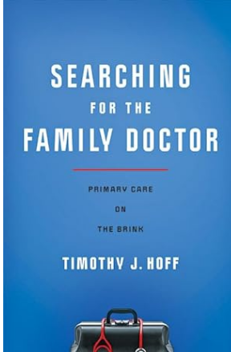
Searching for the Family Doctor
Top 10 List for Saving the Family Doctor
#10 Embrace Virtual Care check
#9 Remain the Patient’s Chief Data Sentinel trust
#8 Make patients your partners engage with them
#7 Organize locally and create advocacy armies state advocacy
#6 Create strategic alliances like the grocery store
#5 Expand the work of family medicine creatively and relationally
#4 Change how family doctors are trained
…
#1 Something else radical the specialty can think up

Slide 22
Own Primary Care
Be there
When the patient wants
How they want to see you
Over time
With high quality care
Questions?

