Slide 1
Surviving & Thriving in Rural
Family Medicine
Summer 2024

Slide 2
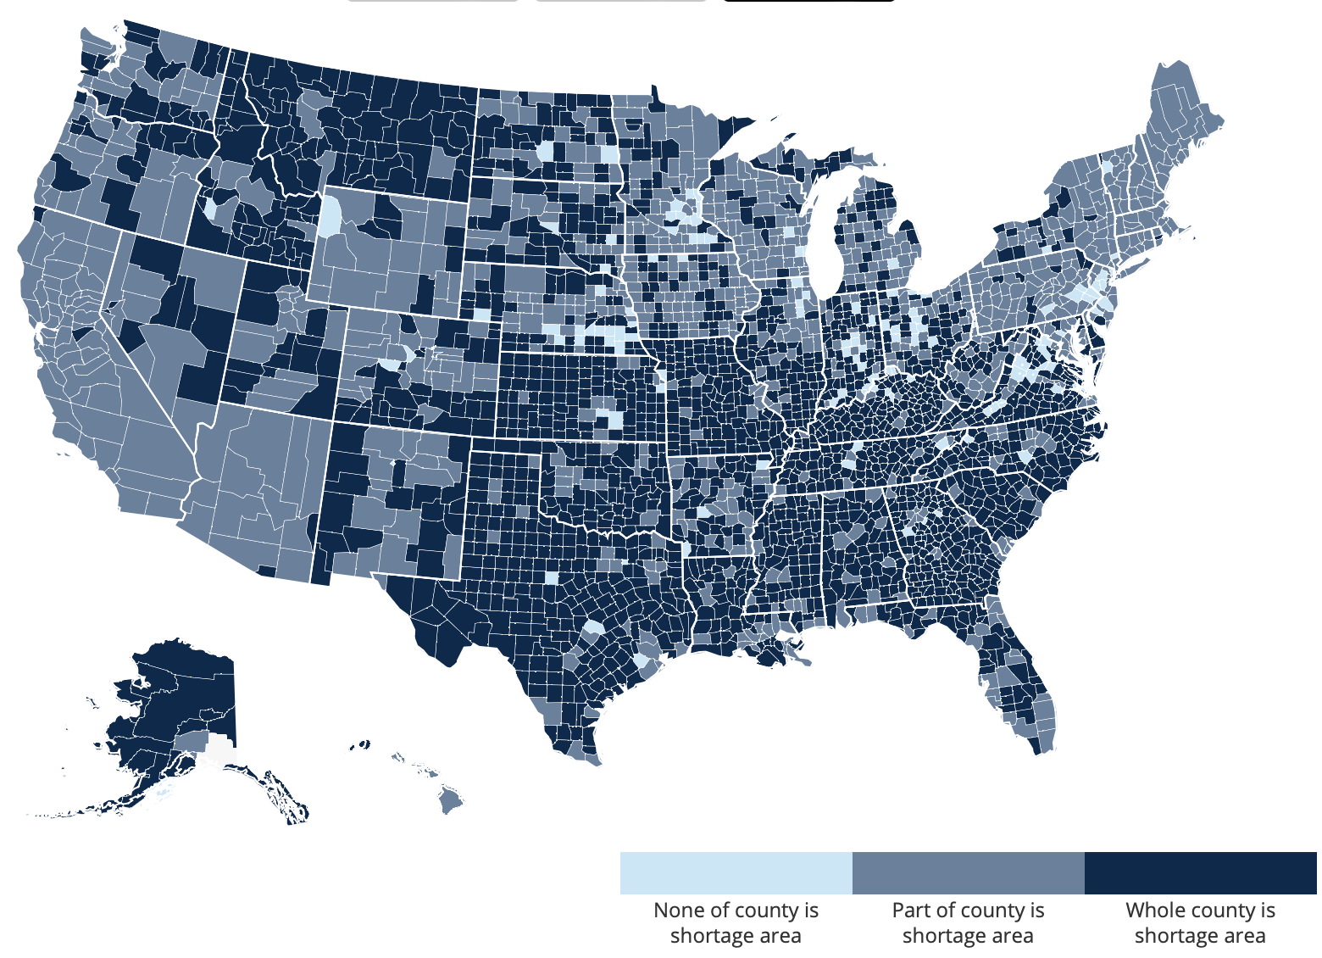
Primary Care Shortage Areas by County
Rural is a commonly overlooked health inequity:
Source: data.HRSA.gov, May 2023.

Slide 3
Problems Are Exacerbated in Rural Settings
Rural Residents are Older…
…Sicker…
…and have Less Access to Care than other Americans
Population Over 65
Mortality Rate
Specialists per 100k Residents
23%
Higher
Rural healthcare providers face numerous unique challenges
engaging with patients and ensuring their healthiness
Source: CMS, Health Affairs.

Slide 4
Rural PCPs’ reactions to “primary care value-based payment models”
“The theory that we’ll just change how we pay and miraculously have all this free time in the day is silliness. That was how it [PC-VBP] was billed originally.”
“[VBC] is just [FFS] with this extra layer of reporting & accountability that the system is not structured to support.”
“When I hear the term [value-based payment], I think ‘great on paper, impossible to implement in reality.’”
The Commonwealth Fund: Link

Slide 5
3 key barriers to participation
PCPs’ enthusiasm for VBP models is tempered by:
Workforce Shortage
Imperfect Performance Measures
Financial Barriers
CMS: Link

Slide 6
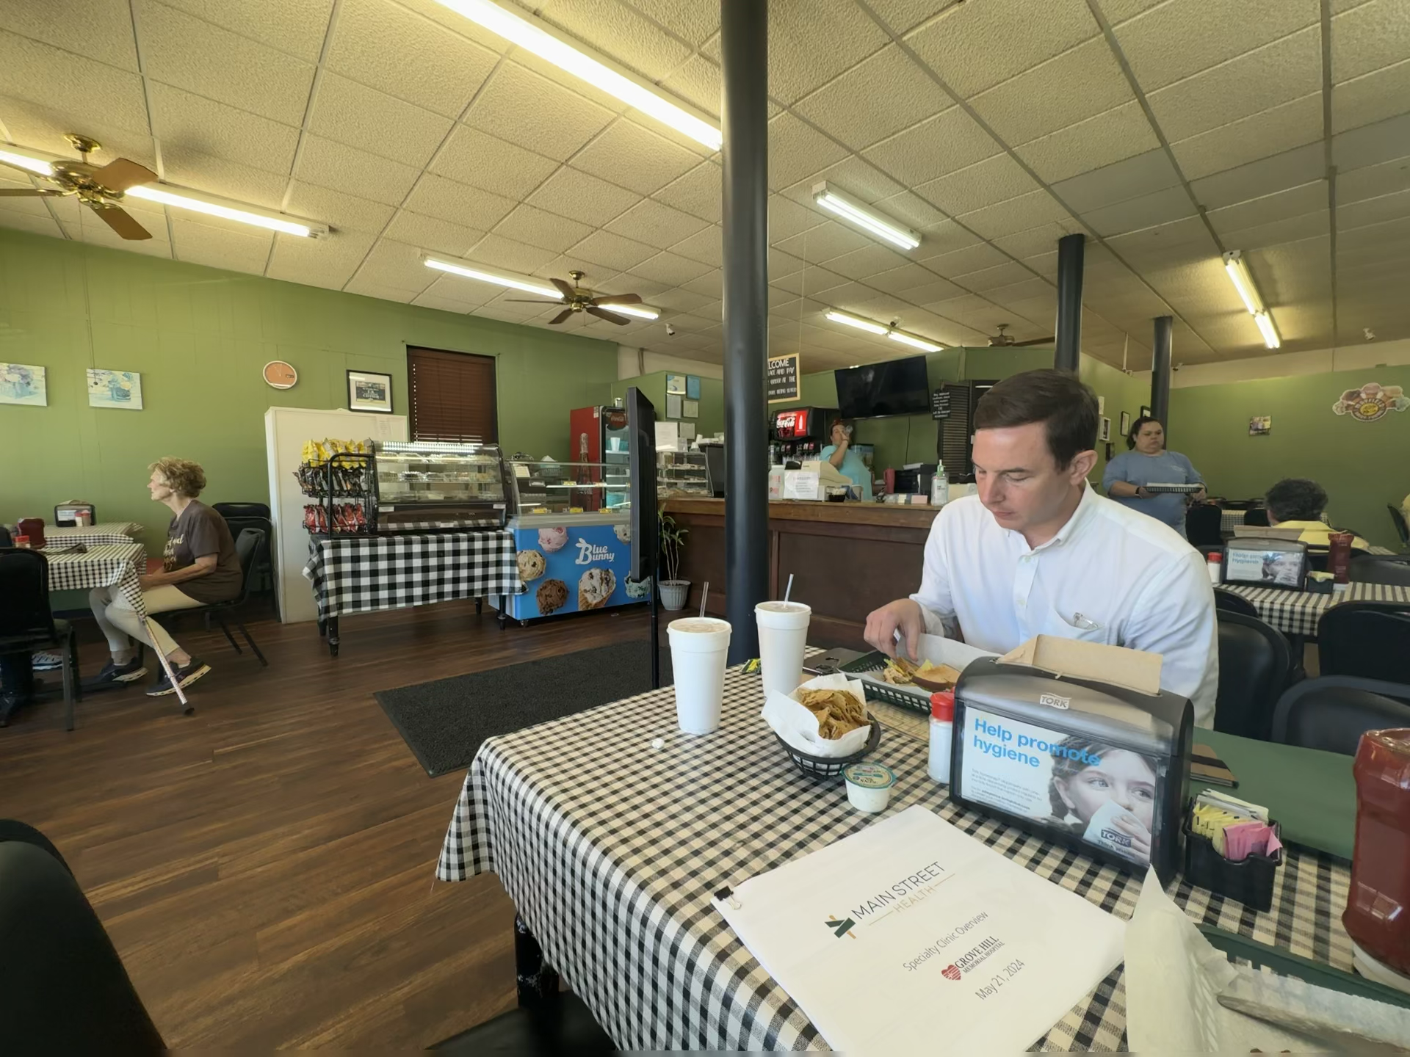
1. Trusted Relationships

Slide 7
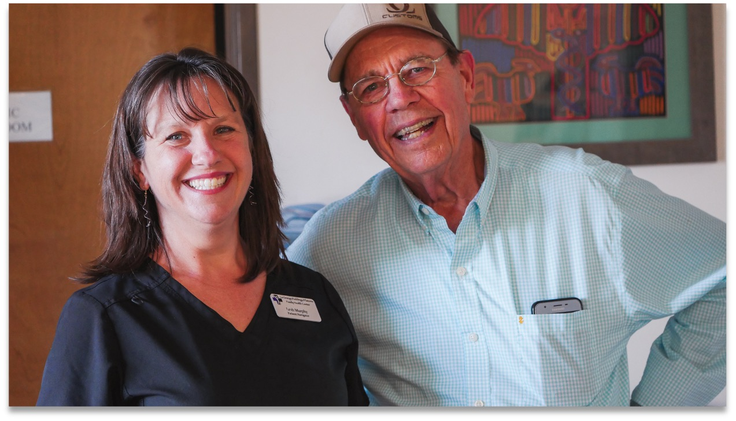
1. Trusted Relationships

Slide 8
2. It Takes a Village - Team Based Approach
Additions to Primary Care Team
Main Street Health Navigators
Care Coordinators
Population Health Navigators
Clinical Pharmacists
Social Workers
Behavioral Health
Recruited locally from the community *
Functions like a Community Health Worker with expertise in Medicare
Employed by Main Street Health and joins your staff at no cost to the clinic
Main Street Health Navigator Support
General Team Optimizations
Provides “first-class” assistance to seniors
Reduces burden on clinic staff with an extra set of hands
Addresses quality measure gaps (e.g., HEDIS)
Assists patients with non-clinical (SDOH) barriers to care
Answers Medicare and insurance questions
Daily huddles | Med sync
Pre-visit planning | Panel management | Annual wellness visits
* All potential hires will be approved by clinic

Slide 9
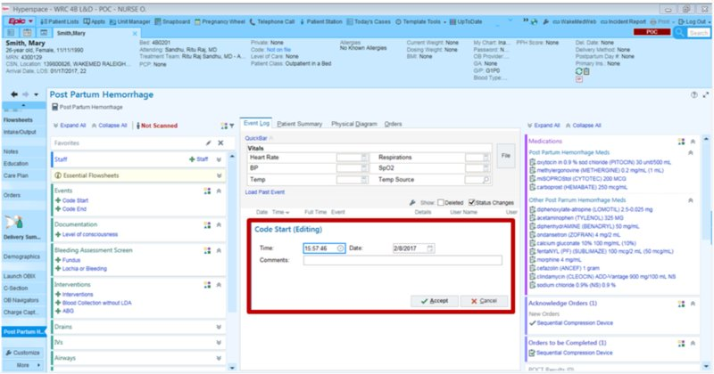
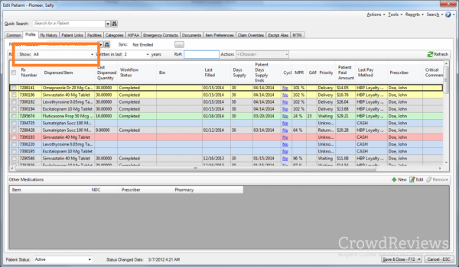
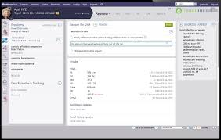
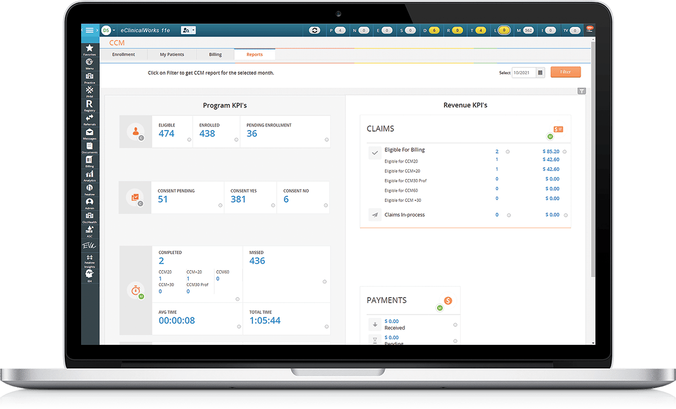
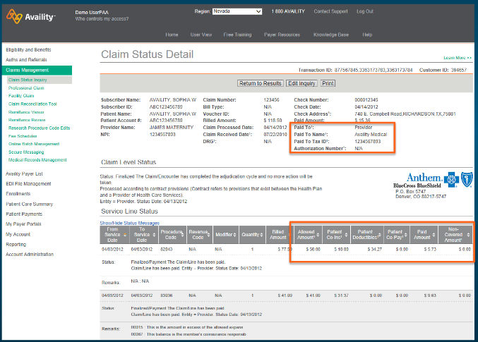
3. Sweat the Small Stuff – Workflow Design Matters

Slide 10
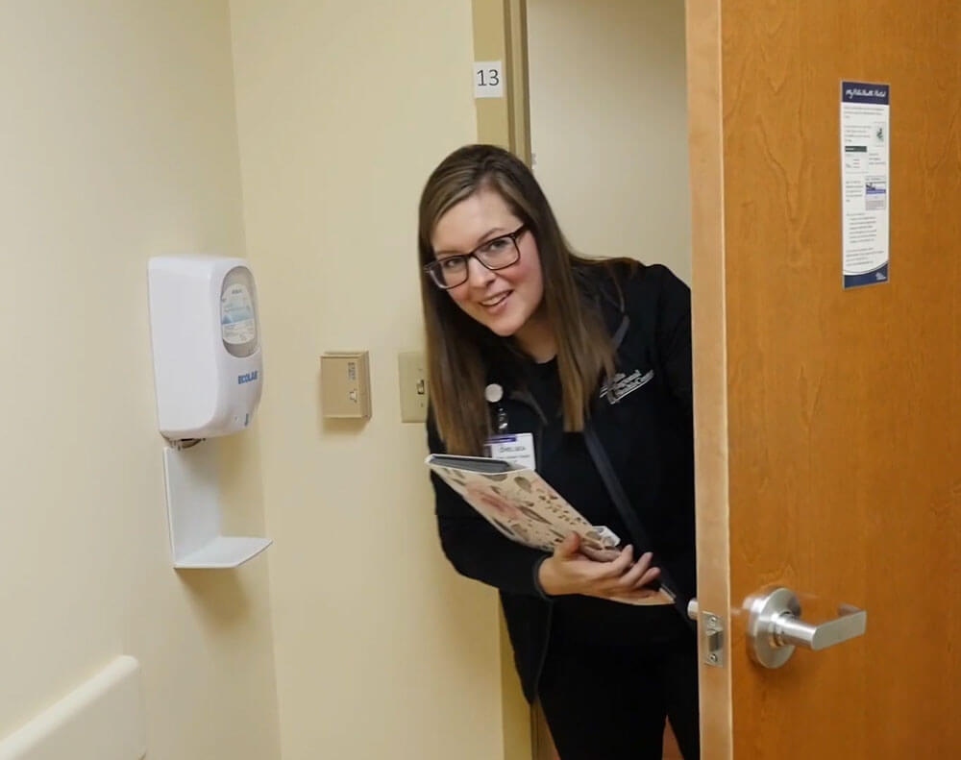
3. Sweat the Small Stuff – Workflow Design Matters

Slide 11
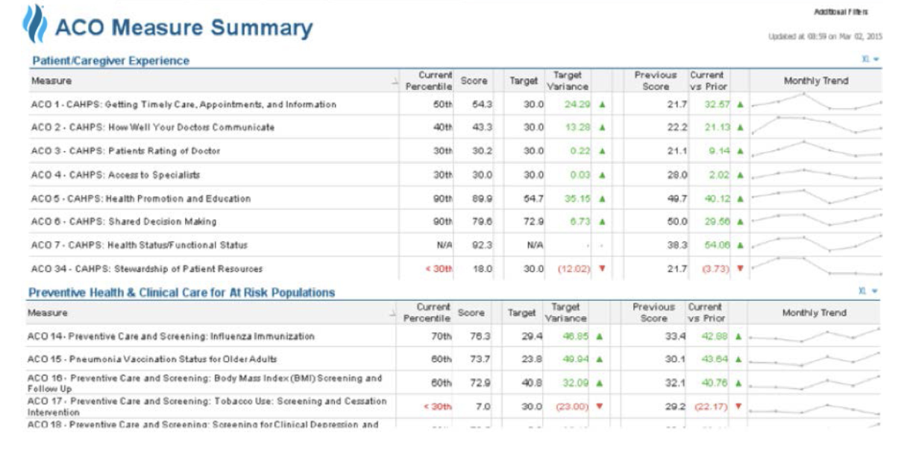
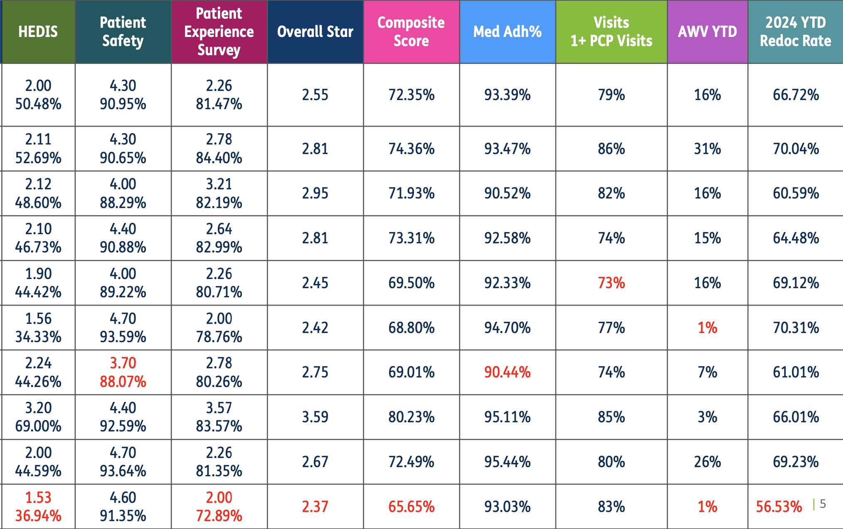
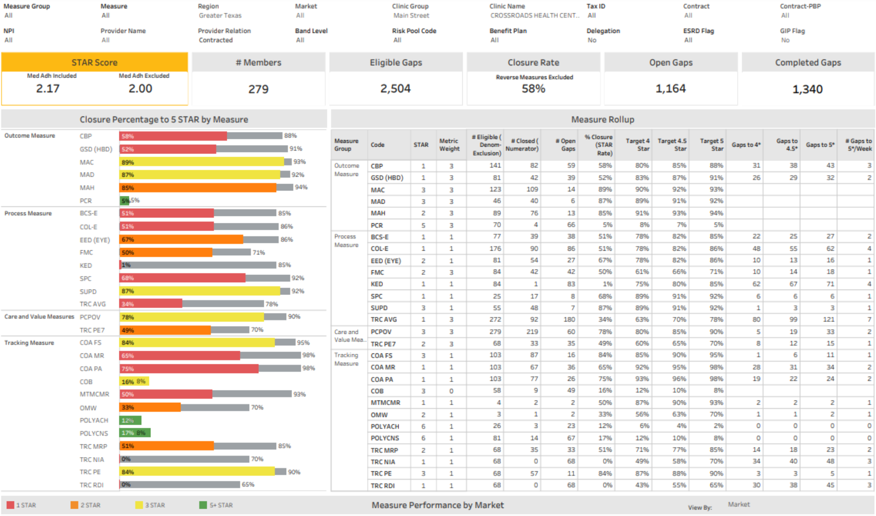
4. Simplify Behavioral Economics

Slide 12
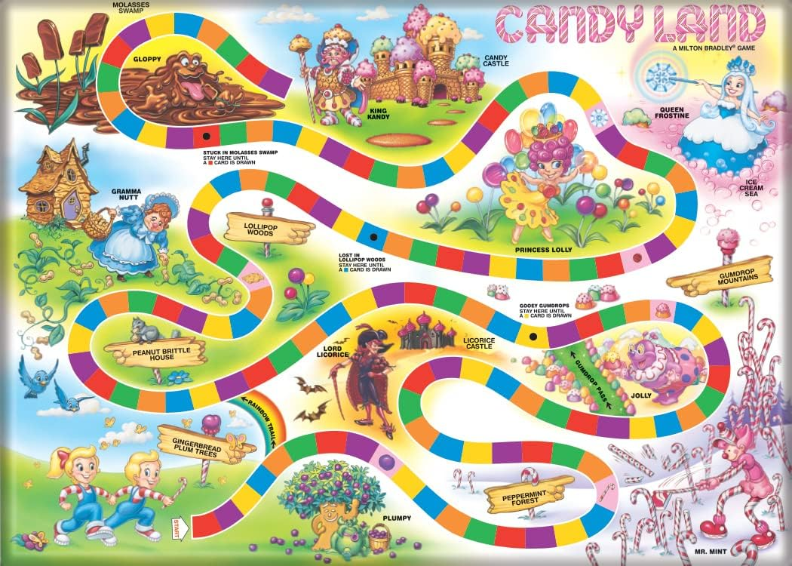
4. Candy Land

Slide 13
Clinical Model Design Principles
Meet patients where they are or prefer to receive care
Reduce the burden on clinic providers and staff
Design workflows with simplicity in mind
Create simple, transparent financial incentives

Slide 14
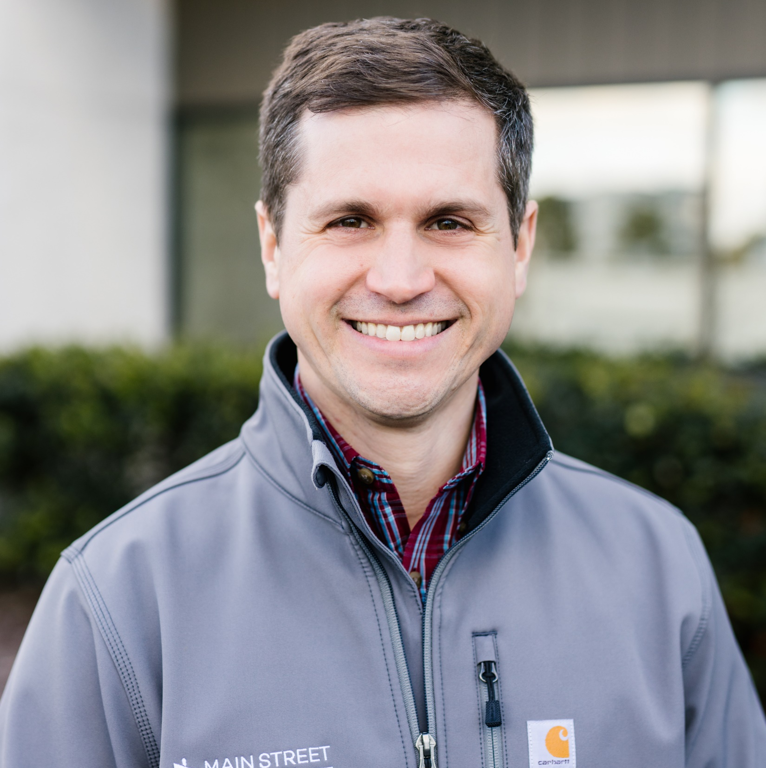
Contact Information
Bennett Graham
President, Main Street Health
bgraham@mainstreetruralhealth.com

