Slide 1
Systemic Approaches to Dealing with Burnout in a Primary Care Service Line
Grant M. Greenberg MD, MA, MHSA
Chief Medical Executive, Primary Care
Leonard Parker Pool Endowed Chair, Family Medicine Lehigh Valley Health Network
Professor of Medical Education and Family Medicine, University of South Florida Morsani College of Medicine

Slide 2
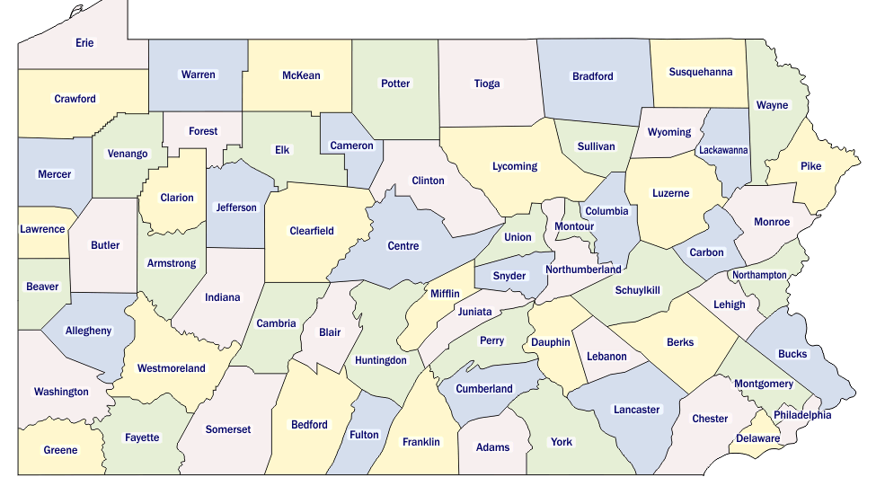

Notes:
1.2 million visits in FY24 in Primary Care

Slide 3

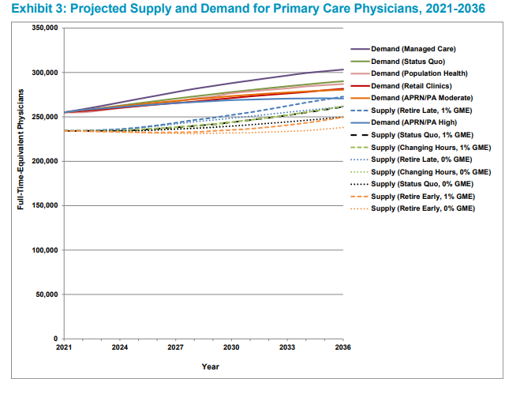
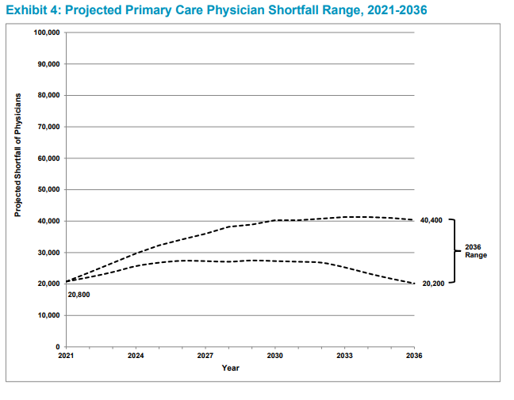
https://www.aamc.org/media/75236/download?attachment

Slide 4

Challenges we face, exacerbated by burnout
Recruitment (workforce shortage)
Retention
Reduction in FTE (aka death by 1000 paper cuts)
Patient experience challenges
Workload/Patient care expectations
Workplace culture and environment
JOY

Slide 5
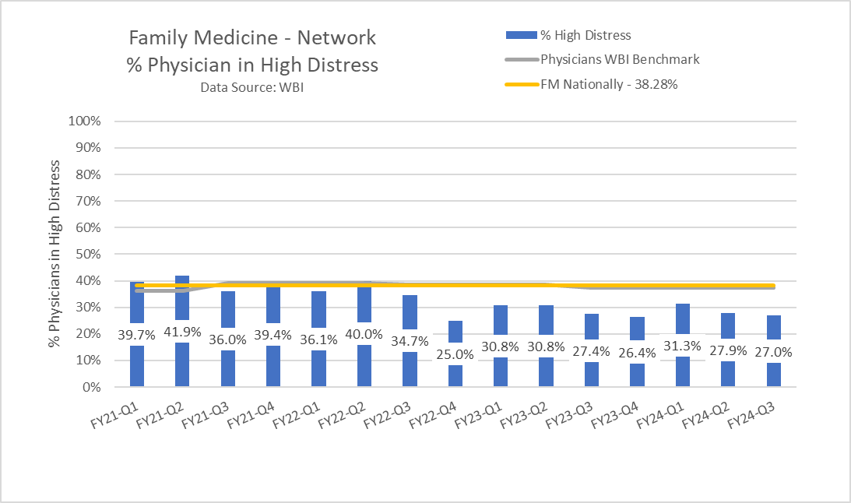
Wellbeing Index
Notes:
Don’t expect improvement if you don’t measure something. We measure burnout in many ways and formats. Note we HAVE improved over the past 2 years, we have been steady but consistently doing better than the national benchmark. Not good enough I fear.

Slide 6
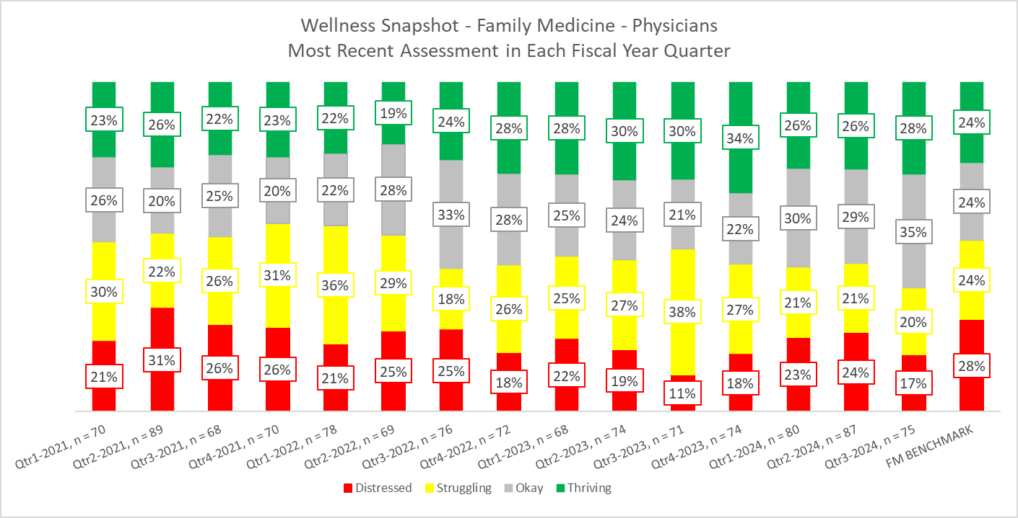

Slide 7



Wellness Triad
"balance scale" by winnifredxoxo is licensed under CC BY 2.0.
"heart is in my hands" by shimelle is licensed under CC BY 2.0
Tank Man Published by The Associated Press, originally photographed by Jeff Widener
Notes:
Well-being triad (I made up): 3 main components drive wellbeing in my opinion:
-striking a comfortable balance between career and family (different set point for everyone, and this set point evolves and changes situationally)
-intrinsic value: medicine is an art, and performing clinical is an act of love. Rewards are relationships, purpose, beneficence. Not transactional
-autonomy:

Slide 8
Countermeasure:
Compensation Plan Adjustment

Slide 9
Move away from Transactional Model
Transactional compensation rewards things, not outcomes
Believed to contribute to burnout
Created barriers to engagement
Fear around not meeting productivity created anxiety
No acknowledgment of the real work (outside the transaction)
Created barriers to necessary workforce expansion (fear of dilution of compensation with a new hire)

Slide 10
Clinical Salary Tables
Differences in amounts by specialty based on historic benchmarks
Also, a $10K differential per 1.0 FTE for those covering inpatient service for a substantial portion of effort
Prior approval from Chair/AMD required to be released from call duties (i.e., not a unilateral decision)
Notes:
Lots of detail behind how this was developed. Including benchmarking, legal review, fair market review, financial analysis, and setting minimum expectations for performance when moving away from wRVU transactional model.

Slide 11
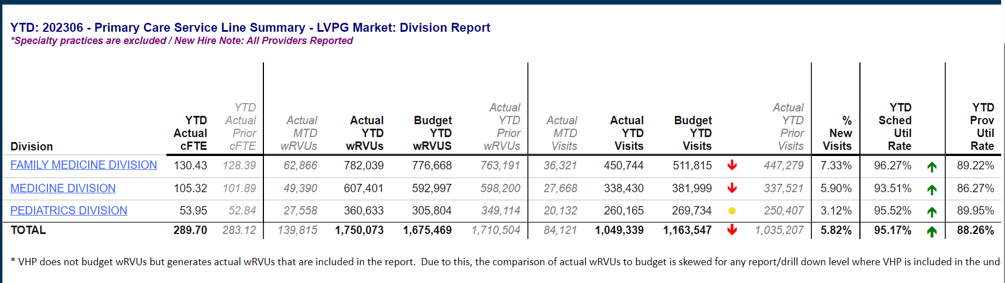
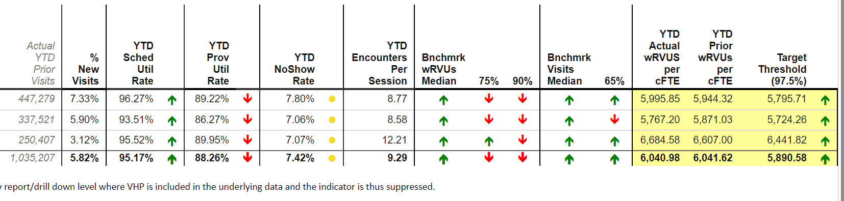
Notes:
YOY productivity increased in FM, Peds. Slight decrease in GIM (cultural challenges- they were not at the time part of primary care service line)

Slide 12
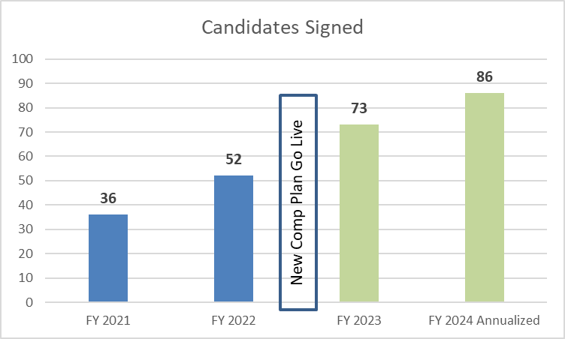
Recruitment

Slide 13
Countermeasure:
Administrative Burden Mitigation

Slide 14
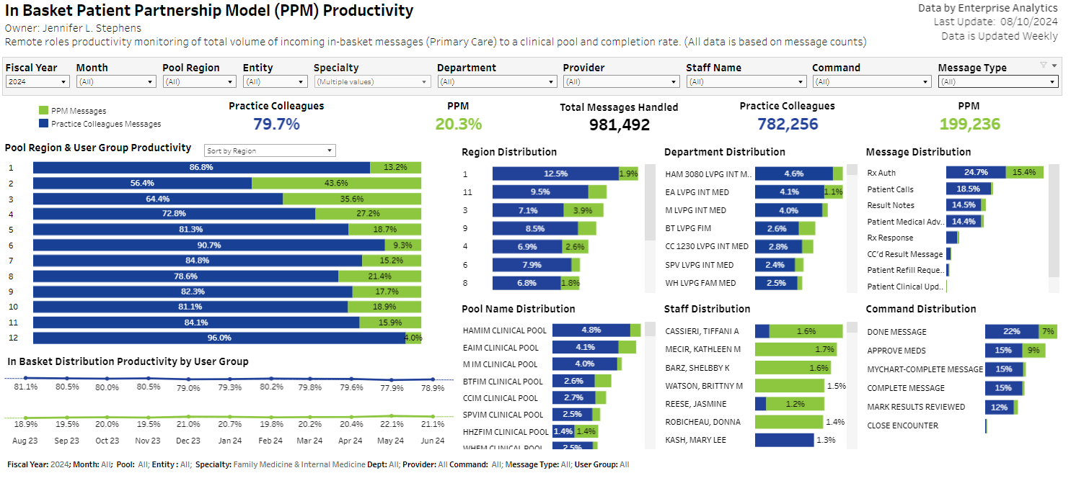
Inbasket Support

Slide 15
Inbasket Support

Slide 16
After-Hours Nurse Triage
Month | Total Incoming Calls | Total Calls escalated to On-Call Clinician | Total % of calls managed independently by the RNs
J-23 | 3057 | 303 | 89.5%
A-23 | 2668 | 269 | 89.2%
S-23 | 2879 | 314 | 88.3%
O-23 | 2861 | 255 | 90.4%
N-23 | 3177 | 305 | 89.6%
D-23 | 3952 | 457 | 87.3%
J-24 | 4357 | 353 | 90.8%
F-24 | 4471 | 313 | 92.0%
M-24 | 3427 | 273 | 91.4%
A-24 | 2527 | 174 | 93.0%
M-24 | 2434 | 187 | 92.0%
J-24 | 2366 | 200 | 90.9%
TOTAL | 38176 | 3403 | 91.8%

Slide 17
Scribes
Historically, the cost of scribes was deducted from clinician compensation, with LVPG subsidizing a portion of the cost in some cases
With the implementation of the redesigned compensation plan, virtual scribe services are provided to primary care clinicians at no direct cost to the clinicians

Slide 18
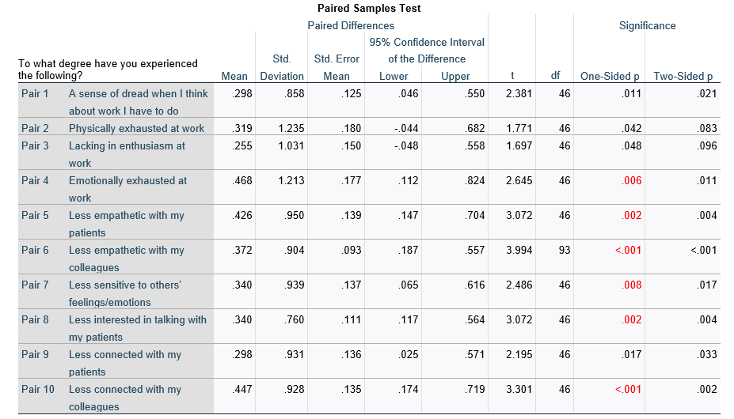
Stanford Professional Fulfillment Index Evaluation Pre/Post Scribe Engagement at 12 months
Notes:
Pre compared to 12 months post-scribe implementation. Sample size: 46

Slide 19
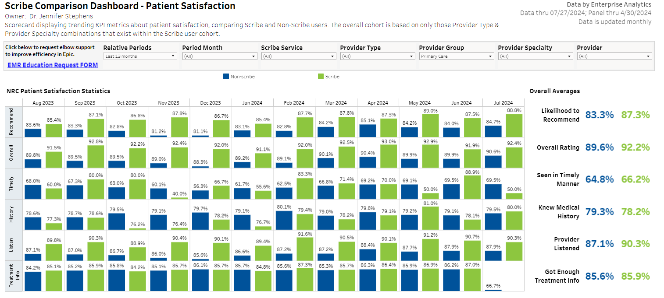

Slide 20
Cultural Connectivity

Slide 21
Structured 1:1 “Interviews”
Once a year, structured data gathering for delegated meetings
Overall improved sense of connectivity
>98% participation
Identified 3 individuals at risk for resignation/reduction PRIOR to them taking action (we saved them)
Enables us to identify systemic concerns leading to distress

Slide 22
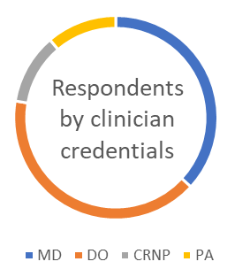
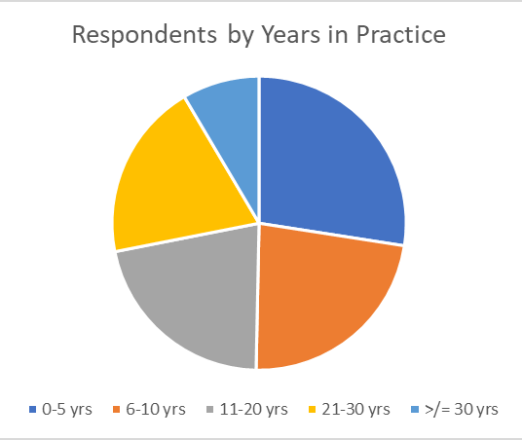
Table 1: Clinician Demographics and Characteristics from 1:1 Clinician Meetings Survey Responses
Clinician Type |  |  |  |  |  | N (%)
 | MD |  |  |  |  | 56 (36.8)
 | DO |  |  |  |  | 62 (40.8)
 | CRNP |  |  |  |  | 17 (11.2)
 | PA |  |  |  |  | 17 (11.2)
Years in Practice
 | 0-5 yrs |  |  |  |  | 42 (27.4)
 | 6-10 yrs |  |  |  |  | 35 (22.9)
 | 11-20 yrs |  |  |  |  | 33 (21.6)
 | 21-30 yrs |  |  |  |  | 30 (19.6)
 | >/= 30 yrs |  |  |  |  | 13 (8.5)
cFTE
 | <0.30 |  |  |  |  | 1 (0.7)
 | 0.31-0.50 |  |  |  |  | 26 (17.1)
 | 0.51-0.99 |  |  |  |  | 60 (39.5)
 | 1.00 |  |  |  |  | 65 (42.8)
Non-Clinical FTE
 | Yes |  |  |  |  | 49 (37.1)
 | No |  |  |  |  | 83 (62.9)

Slide 23
Volunteer Activities
 | Yes |  |  |  |  | 84 (56)
 | No |  |  |  |  | 66 (44)
Publications in the Last Year
 | Yes |  |  |  |  | 37 (23.4)
 | No |  |  |  |  | 121 (76.6)
Committee Participation
 | Yes |  |  |  |  | 145 (91.8)
 |  | Grand Rounds |  |  |  | 107(73.8)
 |  | Town Hall |  |  |  | 127(87.6)
 |  | Med Staff |  |  |  | 37(25.5)
 |  | LVPG Member |  |  |  | 122(84.1)
 |  | PCSL Town Hall |  |  |  | 90(62.1)
 |  | Huddle |  |  |  | 108(74.5)
Scribe Utilization
 | Yes |  |  |  |  | 53 (34.4)
 |  | Nuance
 |  | Scribble
 | No |  |  |  |  | 101 (65.6)
 |  | Concern quality |  |  |  | 12(11.9)
 |  | Concern turnaround |  |  |  | 9(8.9)
 |  | Don't feel it will help |  |  |  | 57(56.4)
 |  | Interested in learning more |  |  |  | 15(14.9)

Slide 24
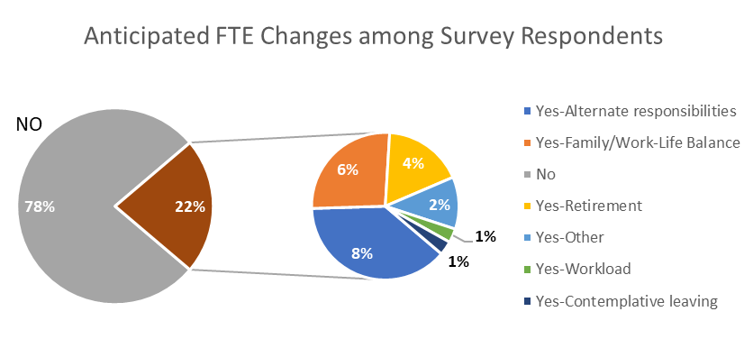
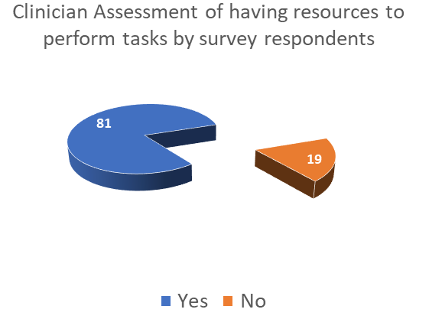
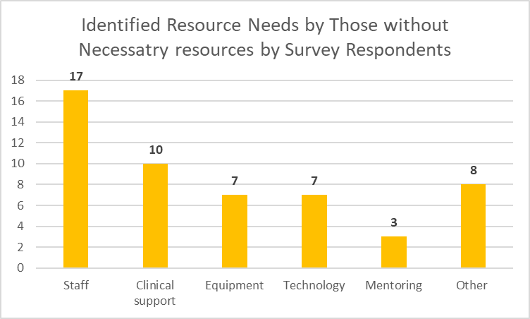
Table 2: Operational Demographics from 1:1 Clinician Meetings Survey Responses
Anticipated FTE Changes
 | Yes |  |  |  |  | 32 (21.3)
 |  | Alternate responsibilities |  |  |  | 13(40.6)
 |  | Retirement |  |  |  | 6(18.8)
 |  | Family/Work-Life Balance |  |  |  | 9(28.1)
 |  | Workload |  |  |  | 1(3.1)
 |  | Contemplative leaving |  |  |  | 1(3.1)
 |  | Other |  |  |  | 2(6.3)
 | No |  | 118 |  |  | 118 (78.7)
Do you have resources to perform daily tasks
 | Yes |  |  |  |  | 124 (81.0)
 | No |  |  |  |  | 29 (19.0)
 |  | Staff |  |  |  | 17(58.6)
 |  | Clinical support |  |  |  | 10(34.5)
 |  | Equipment |  |  |  | 7(24.1)
 |  | Technology |  |  |  | 7(24.1)
 |  | Mentoring |  |  |  | 3(10.3)
 |  | Other |  |  |  | 8(27.6)
Areas for Clinical/Practice Improvement
 | Staff Support |  |  |  |  | 79(50.0)
 | Inbasket Support |  |  |  |  | 89(56.3)
 | Specialty consult/access |  |  |  |  | 90 (57.0)
 | Compensation/benefits |  |  |  |  | 26 (16.5)
 | Nonclinical role development |  |  |  |  | 18 (11.4)
 | Career Development |  |  |  |  | 28 (17.7)
 | Other |  |  |  |  | 38 (24.1)
 |  | Space |  |  |  | 4(10.5)
 |  | Education |  |  |  | 6(15.8)
 |  | QI/Dashboard simplification |  |  |  | 5(13.2)
 |  | AI/Technology |  |  |  | 6(15.8)
 |  | Staff/HR |  |  |  | 6(15.8)
Resource Needs Amongst Clinicians by Survey Respondents

Slide 25
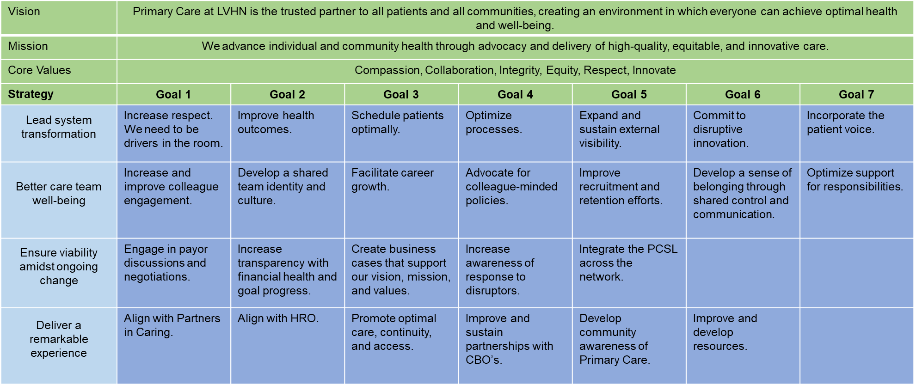
Cohesive Culture: Strategic Alignment, Engagement, and Consensus Development

Slide 26
Bottom Line: How did we do with retaining our workforce?

Slide 27
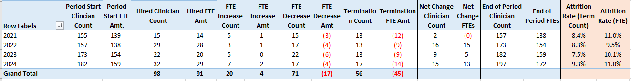
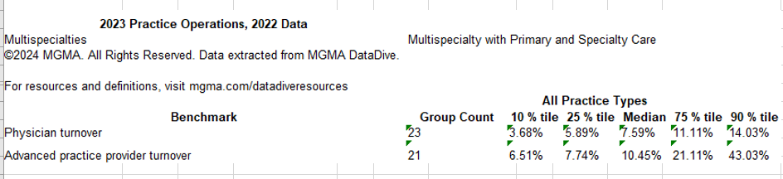

Slide 29
Notes:
2021-2024

Slide 31
Summary
Burnout is multifactorial
Comprehensive work and attention is essential
Factors beyond our system may be driving some of the challenges (lifestyle, respect, generational differences)
Challenges remain: FFS, transactional culture outside of primary care, pressure for access, constraints for space and staffing

