Slide 1
Reflections, Goals, & Objectives – Oh My!
Best Practices for Creating Individualized Learning Plans
Notes:
Do you currently have an ILP program in place?

Slide 2
Poll Questions
1. What is your role:
Program Director
Associate Program Director
Core Faculty
Program Coordinator
Other
2. Time in GME?
Less than five years
5-10 years
10-20 years
>20 years

Slide 3
What the ACGME says about ILPs:
The program director or their designee, with input from the Clinical Competency Committee, must:
assist residents in developing individualized learning plans to capitalize on their strengths and identify areas for growth;
create and document an individualized learning plan at least annually; and,
provide a system to assist residents in the individualized learning plan process, including:
faculty mentorship to help residents create learning goals, as well as educational experiences to meet those goals; and,
systems for tracking and monitoring progress toward completing the individualized learning plan.
Accreditation Council for Graduate Medical Education. ACGME Program Requirements for Graduate Medical Education in Family Medicine. July 1, 2023.
Notes:
But what is required of us?

Slide 4
Objectives
Participants will be able to:
Describe the difference between remediation plans and individual learning plans (ILPs).
List components of individual learning plans.
List three pearls to developing individual learning plans.
Notes:
Use examples!

Slide 5
Interactive Time!
Are you confident you could explain the difference between a remediation plan and a learning plan?
Absolutely – I teach this to our residents annually!
I think so, but don’t ask me to answer out loud
There’s a difference?

Slide 6
But what’s the difference?
Isn’t this just a remediation plan with a new name?
Moneika – PGY-3 Chief Resident
Steve – PGY-2 on ITE remediation (again)

Slide 7
Remediation Plan vs Learning Plan
Remediation Plan
Learning Plan
Responds to deficiency
Only for some learners
Limited to training requirements
Focused only on gaps
Prevents a deficiency
Helpful for all learners
Recognizes personal learning styles
Focused on end goals, skills for future practice
Outlines ways to improve
Uses concrete benchmarks of achievement
Notes:
RPs are reactive, made in response to a deficiency in learner performance or knowledge
RPs are only for some, creating a “less than” stigma, and focus on the gaps, using minimum training requirements to graduate as a goal
ILPs are for everyone, eliminating that stigma, and are intended to be proactive to help prevent the deficiency in the first place
ILPs focus on the end result, rather than minimum standards, and take into account how a resident learns best
They do have some commonalities – both outline routes to improvement and concrete benchmarks of achievement so everyone knows what is expected and when it is accomplished
BOTH are necessary, but historically we have used RPs much more than ILPs – aren’t we all about preventative care in family medicine?
This does require a culture shift that starts from the top, with faculty using this shared language to familiarize and normalize ILPs as helpful, not just re-named RPs

Slide 8
Know your audience…
Characteristic | Traditionalist (1922-1945) | Baby Boomers (1946-1964) | Generation X (1965-1980) | Millennials (1981-2000)
Work ethic/values | Hard work, sacrifice, discipline, rules | Drive, efficiency, personal fulfillment | Self-reliance | Multitasking ability, entrepreneurial spirit, goal orientation, realism
View on authority | Respectful | Pay your dues | Competence | Collaborative
Communication | Formal memo or rotary phone | In person | Email or voicemail | Text, skype, instant message
Interactive style | Individual | Team player, meetings | Entrepreneur | Participative
Feedback preference | No news is good news | Annual review | Frequent and honest | Whenever they want
Work-life balance | Don’t have it | Work to live | Want balance now | Want flexibility and options
Message that motivates | “Your experience is respected” | “You are valued and needed” | “Do it your way” | “You will work with other bright and creative people”
Schwartz, Ann et al. "Keeping Up With Changing Times in Education: Fostering Lifelong Learning of Millennial Learners." Focus: Journal of Lifelong Learning in Psychiatry, vol. 16, no. 1, Jan. 2018, pp. 74-79.
Notes:
When creating ILPs, we need to keep our audience in mind – on BOTH sides of the ILP
Physicians from all four generational groups are actively seeing patients right now, good to know how these views impact their learning or supervising.
2018 study in psychiatry – don’t want to make it a generational debate, but it’s important to understand who we are working with
Majority of learners now are millennial generation – programs must be able to adapt to their learners or risk becoming outdated
There are good and challenging components to every generation
Particular attention to Feedback Preference and Work-life Balance

Slide 9
Outcomes are paramount
Support learner progression
Flexibility for individuals
Tied to graduate abilities
Coaching
Responsive to learner needs
Multimodal assessment
Notes:
Also important to keep in mind the pillars of CBME as we create ILPs…
Does your ILP meet each of these?
(separate webinar for coaching skills)

Slide 10
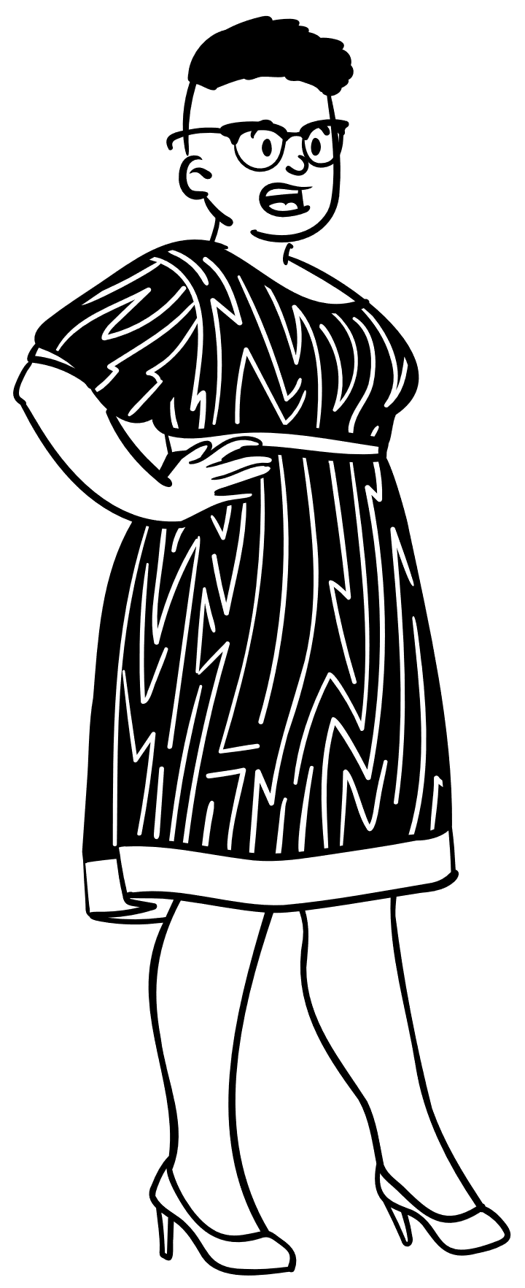
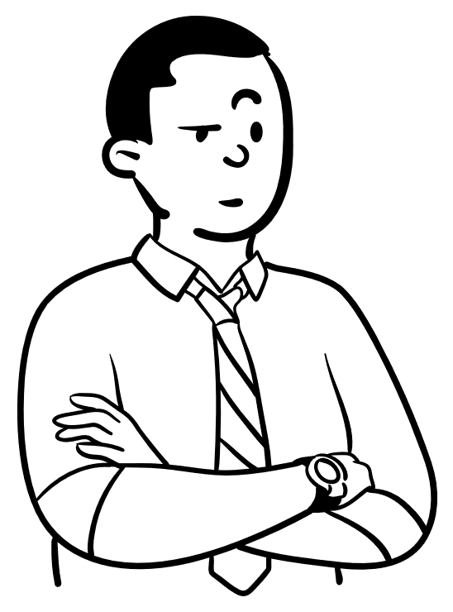
So what’s in an ILP?
Dr. Hugh Grumpe – core faculty
How much more work is this gonna cause me?
Dr. Anita Winn – program director

Slide 11
Interactive Time!
How do you feel about your current ILP format?
It’s great! I’m just here to humor the presenters.
It’s good, but I think it could be better.
We have one…
I think we might have one somewhere…
Ummm…I was hoping to avoid this question entirely.

Slide 12
Components of Individualized Learning Plans
Self-reflection
Strengths/struggles
Knowledge/skills needed for future practice
Goals with SMART(IE) objectives for next steps
Notes:
So – with all that in mind, what really needs to be included in an ILP? Keeping in mind “simpler is better…”
1. Millennial learners prefer multiple learning formats, are more engaged when they have choices (Mill Med Student Learning – AMEP 2017) – time for self-reflection, with coaching, helps with that discovery
2. We know from child development studies that process praise yields growth mindset more than person praise (Child Dev 2013 “Parent Praise”) – that doesn’t change as we become adults! Acknowledging their strengths and struggles can help reinforce behaviors you want to continue and identify behaviors that need to change to be successful
3. Merge the learning/practice divide (True Continuum of CBME – Acad Med 2019) – tie the ILP in with their future practice needs
4. Clear expectations w/freq individual feedback from multiple sources helps (Am Psych 2018) – but what are SMARTIE objectives? (next slide)

Slide 13
Notes:
The SMART portions are pretty familiar at this point
Making objectives specific and measurable ensures the learner can demonstrate competence achieved
They need to be attainable and relevant to bring purpose and motivation to their learning
Put a timeframe to the objective or it will never get done
Encourage learners as much as possible to keep inclusivity and equitability in their goals – consider all affected populations and get their input
Examples – Complete all clinic notes within one business day, seeking input from preceptors and nursing staff on how to be more efficient with time
Within 3 months, improve recognition of malignant skin lesions by 50% on derm case studies including at least 20% of lesions on darker skin tones

Slide 14
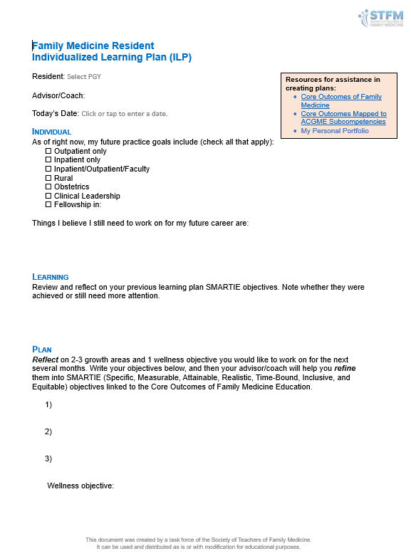
A Starting Point…
I = Individual
Long-term career/ training goals
L = Learning
Strengths/struggles
Progress last time
P = Plan
SMART(IE) Objectives
Linked to C.O.’s
stfm.org/cbmetoolkit
Notes:
This is a basic template created by the STFM CBME Task Force
Meant as a starting point
Can be found at the toolkit website and adapted for your program

Slide 15
ABFM Core Outcomes
15 Core Outcomes of Family Medicine Residency Training (proposed ABFM)
1 | Develop effective communication and constructive relationships with patients, clinical teams, and consultants
2 | Practice as personal physicians, providing first-contact access, comprehensive, and continuity care, to include excellent doctor-patient relationships, excellent care of chronic disease, routine preventive care and effective practice management
3 | Diagnose and manage acute illness and injury for people of all ages in the emergency room or hospital
4 | Provide comprehensive care of children, including diagnosis and mgt of the acutely ill child and routine preventive care
5 | Model professionalism and be trustworthy for patients, peers, and communities
6 | Practice as personal physicians, to include care of women, the elderly, and patients at the end of life, with excellent rate of continuity and appropriate referrals
7 | Provide care for low-risk patients who are pregnant, to include mgmt of early pregnancy, medical problems during pregnancy, prenatal care, postpartum care and breastfeeding, with or without competence in labor and delivery
8 | Diagnose and manage common mental health conditions in people of all ages
9 | Perform the procedures most frequently needed by patients in continuity and hospital practices
10 | Model lifelong learning and engage in self-reflection
11 | Practice as personal physicians, to include MSK health and sports medicine, appropriate medication use and coordination of care by helping patients navigate a complex health system
12 | Provide preventive care that improves wellness, modifies risk factors for illness and injury, and detects illness in early, treatable stages for people of all ages while supporting patients’ values and preferences
13 | Assess priorities of care for individual patients across the continuum of care—in-office visits, emergency, hospital, and other settings, balancing the preferences of patients, medical priorities, and the setting of care
14 | Evaluate, diagnose, and manage patients with undifferentiated symptoms, chronic medical conditions, and multiple comorbidities
15 | Effectively lead, manage, and participate in teams that provide care and improve outcomes for the diverse populations and communities they serve
Notes:
Goals always geared toward one or more of the ABFM Core Outcomes
STFM Toolkit has a mapping project that links Core Outcomes to the Milestones which are more directly observable behaviors

Slide 16
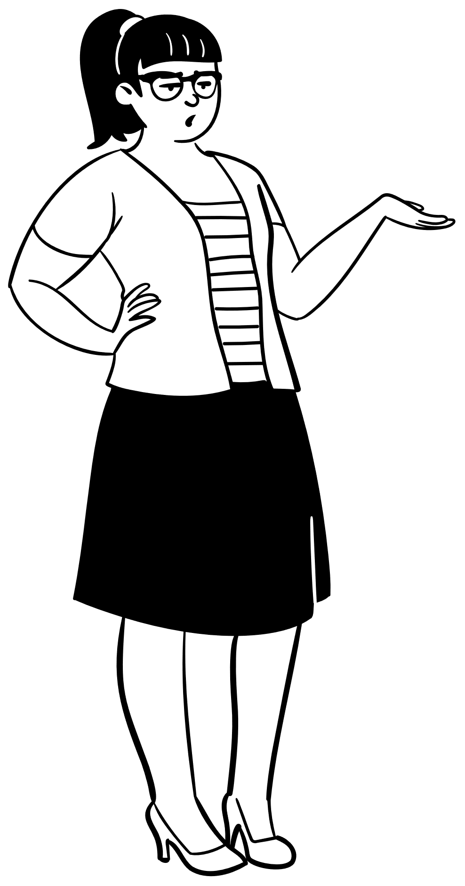
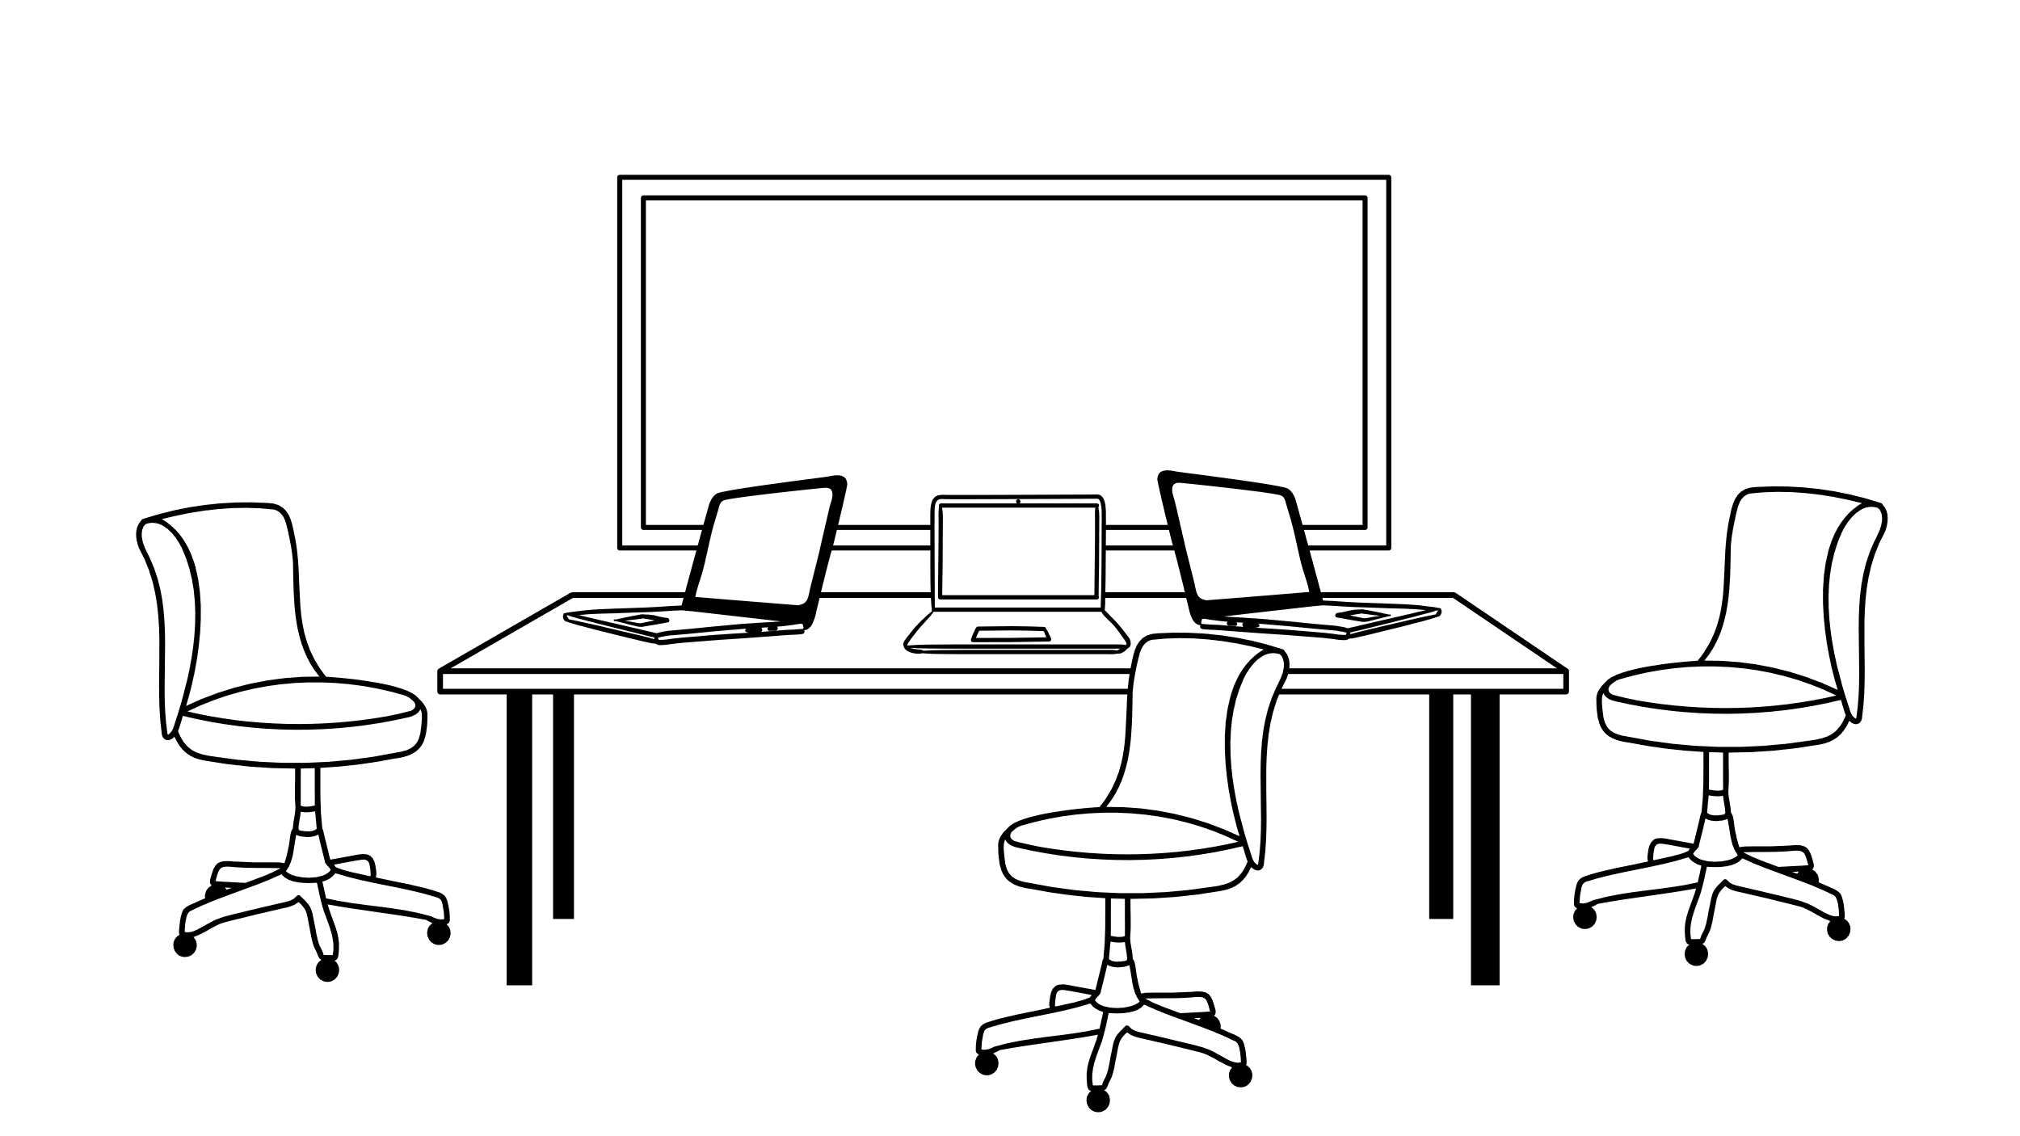
Do you have any tips for getting started?
I think we can do this!
May Goforeite – Program Coordinator
Notes:
[Transition to Pamela]

Slide 17
Pearls for Developing ILPs
Collaborate with the resident – guided self-reflection
Make connections to why each learning is important
Easily accessible to both learner and advisor/coach
Notes:
Coach them to self-identify strengths and struggles
Link to CO’s, future practice goals – not just checking off boxes – gets more resident buy-in
MedHub, NI, Office 365 – real-time, one document

Slide 18
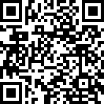
Questions?
Aaron Lambert, MD, FAAFP
Robert.Lambert@atriumhealth.org
Pamela Anne MacMillan
PMac@uwyo.edu
Priyanka Tulshian, MD, MPH
priyanka.tulshian.md@gmail.com
Please fill out this quick,
4-question survey whether you are participating live or asynchronously.

Slide 19
Presentation Abstract
Historically, most programs implemented individual learning plans (ILPs) for residents needing remediation. With the ACGME requirements and ABFM expectations for competency-based medical education (CBME), there is a shift from limited learning plans for underperforming residents to more comprehensive plans for all residents – both to mitigate the stigma of having an ILP and to recognize that progression of learning is unique to each individual learner. While the former remediation plans were driven by faculty, ILPs are ultimately meant to be resident driven. This presentation will help participants understand the components of an ILP, how they differ from remediation plans, and pearls for getting started with their own residents.

