Slide 1
Maximizing continuity and minimizing delay across a large health system
Implementing open access across a large health system
Sam Weir, MD
System Executive Medical Director
Care Access

Slide 2

UNC Health was just a single campus 24 years ago and has grown to 18 hospitals with over 900 clinics and 50K employees
Hospitals across the state (18)
10
UNC Health Rockingham
2018 (Rockingham)
Owned Hospitals (7)
Managed/JOA Hospitals (11)
2
UNC Health Rex
2000 (Wake)
1
UNC Hospitals
1952-2000 (Orange)
5
UNC Health Caldwell
2013 (Caldwell)
7
UNC Health Nash
2014 (Nash)
14
UNC Health Appalachian
2022 (Watauga, Avery)
8
13
UNC Health Wayne
2016 (Wayne)
UNC Health Blue Ridge
2021 (Burke)
9
UNC Health Lenoir
2016 (Lenoir)
3
UNC Health Chatham
2008 (Chatham)
4
UNC Health Pardee
2011 (Henderson)
6
UNC Health Johnston
2014 (Johnston)
Legend for Hospital Region:
11
Triangle West (3 hospitals)
Onslow Memorial Hospital
2019 (Onslow)
Triangle East (4 hospitals)
12
UNC Health Southeastern
2021 (Robeson)
Statewide Network (11 hospitals)

Slide 3
Maximizing continuity and minimizing delay across a large health system—context
Family Medicine Practices as ecosystems
Medical Directors as ecologists
Our ecosystem is under threat
Increasing demand
Decreasing supply

Slide 4
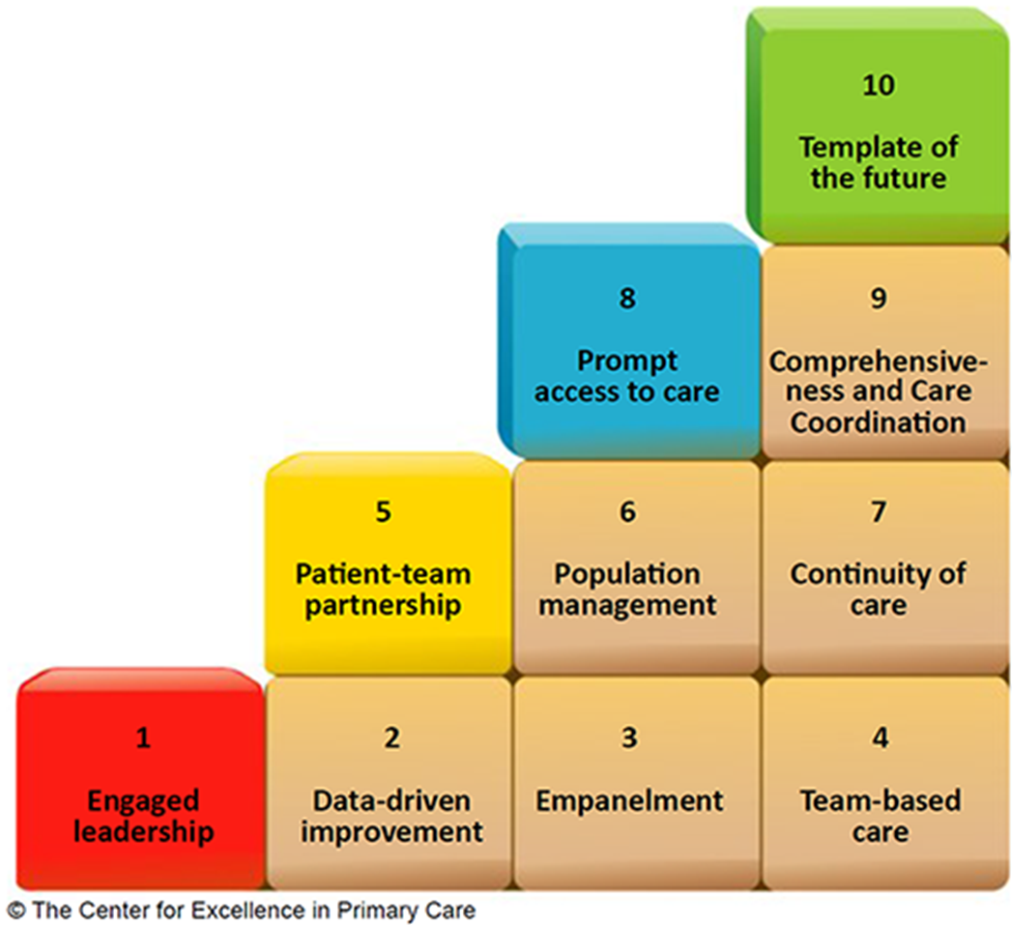
Our conceptual model:
Ten building blocks of effective primary care
Empanelment and panel size management are
foundational for continuity of care
and prompt access to care
Notes:
Blocks 3 and 7 are key to making block 8 work

Slide 5
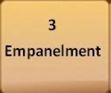
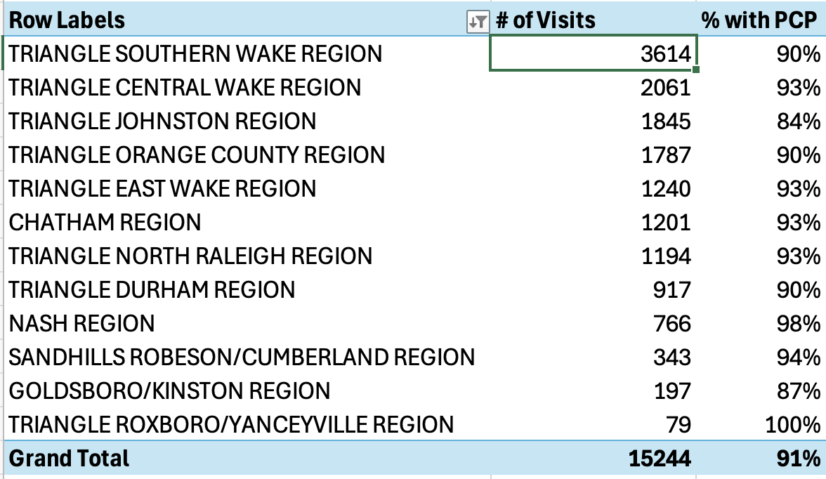
The Percentage of patient visits with PCPs that were with patients with a PCP and the PCP is in that practice
If a patient is not on a panel, they can’t enjoy continuity

Slide 6
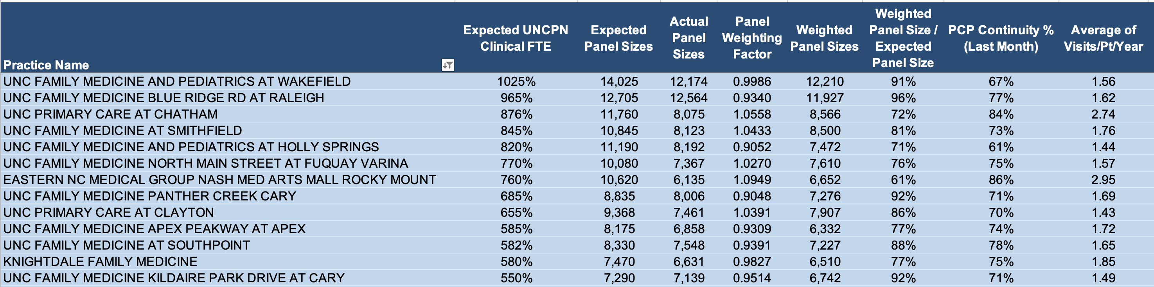
Panel Management with a patient panel report (updated monthly)
Three panel sizes: expected, actual, & weighted
Decisions to close panels based on Weighted / Expected panel size
Includes last month’s PCP continuity and average visits / patient in the past year

Slide 7
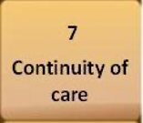
Demand Streams, continuity goals & visit types
Demand Stream
Continuity Goal
Visit Type
Follow-up of ongoing
health issue
PCP Continuity
Reserved for PCP’s panel
Return continuity
Return care transitions
Wellness/preventive
care
PCP Continuity
Reserved for PCP’s panel
Physical/Well woman
Well child visit
Annual wellness visit
Short term acute
demand
Team Continuity
Depending on availability
Return general
Return symptomatic
New patients (if panel
is open to new pts)
New general
New care transitions
Establish a relationship
Notes:
New patient visits also include new open access (online scheduling), new video and new telephone. Video is preferred over telephone and scheduled as such if possible

Slide 8
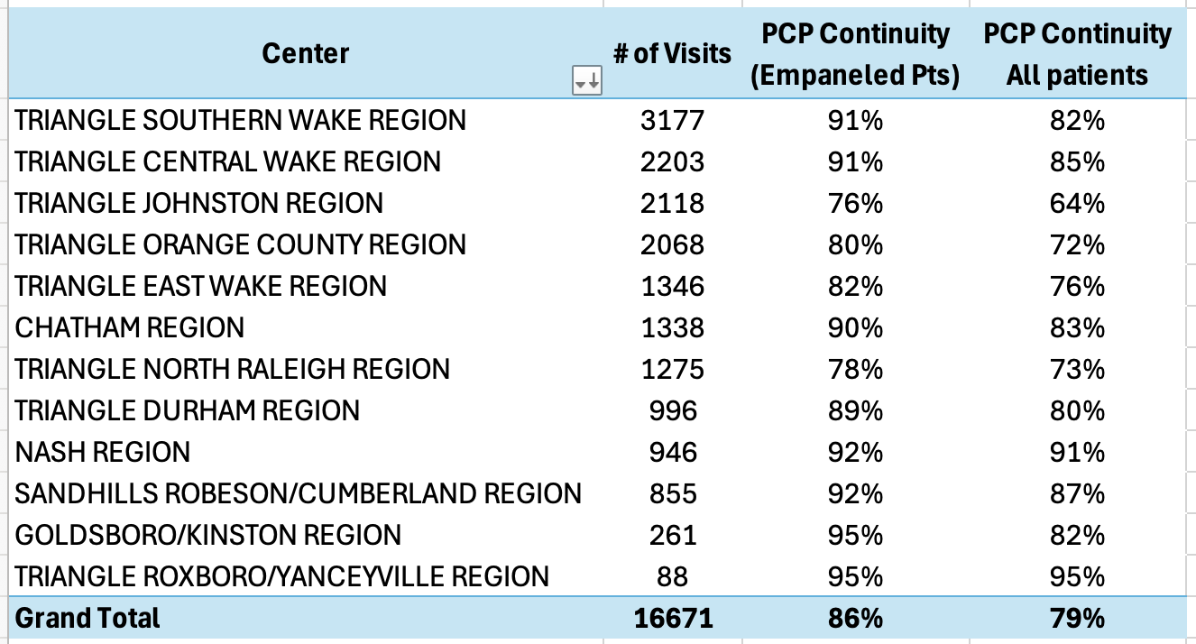
What percentage of patient visits by patients on a PCP’s panel were with the PCP? (UPC) What % of continuity visits by any patient in the practice?
*Adjusted for empanelment %

Slide 9
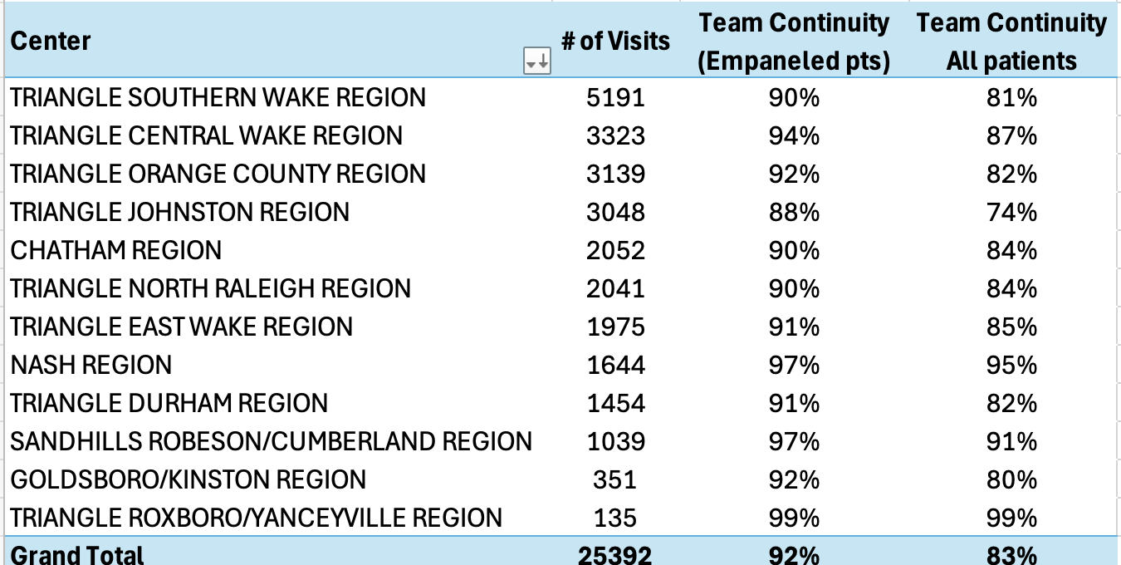
What percentage of patient visits by patients on my panel were either with me or members of my team? (team continuity)

Slide 10
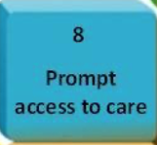
The return continuity visit type is for a PCPs continuity patients

Slide 11
The return general visit type is for urgent needs that can’t wait for the PCP

Slide 12
Key tactics to maximize continuity and minimize delay
Maximize continuity
Increase empanelment – incent panel size
Right size panel sizes – close panels if needed
Specific visit type reserved for continuity patients
Partner with strategy
Minimize Delay
Optimize Appointment Supply
Minimize no shows
Maximize slot recycling
Online scheduling
Access Center scheduling
Demand reduction strategies
Extend visit intervals
Make the most of each visit
Team based care
Integrate with virtual care

Slide 13
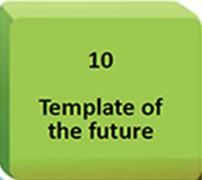
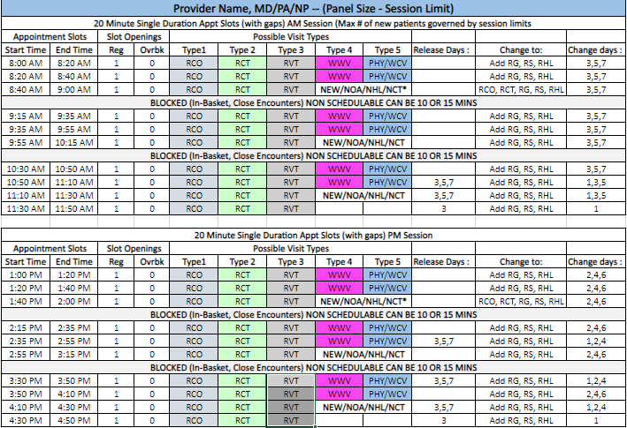
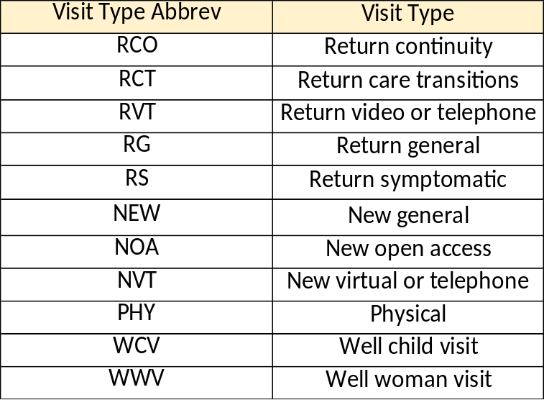
Single duration 20 minute template – for physicians and APPs
Gap time available and can move it around as desired

