Slide 1

Team-Based Care: Foundational Principle or Contextual Strategy in Family Medicine?
Andrew Bazemore MD MPH
SVP, Research & Policy, ABFM
Co-Director, Center for Professionalism & Value in Healthcare

Slide 2
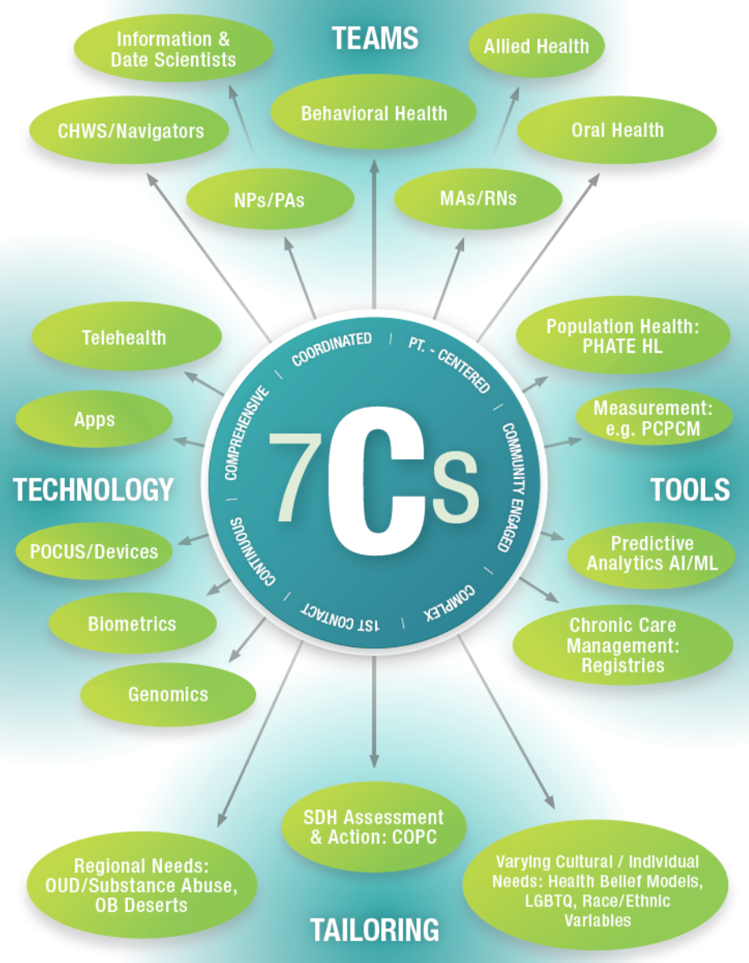
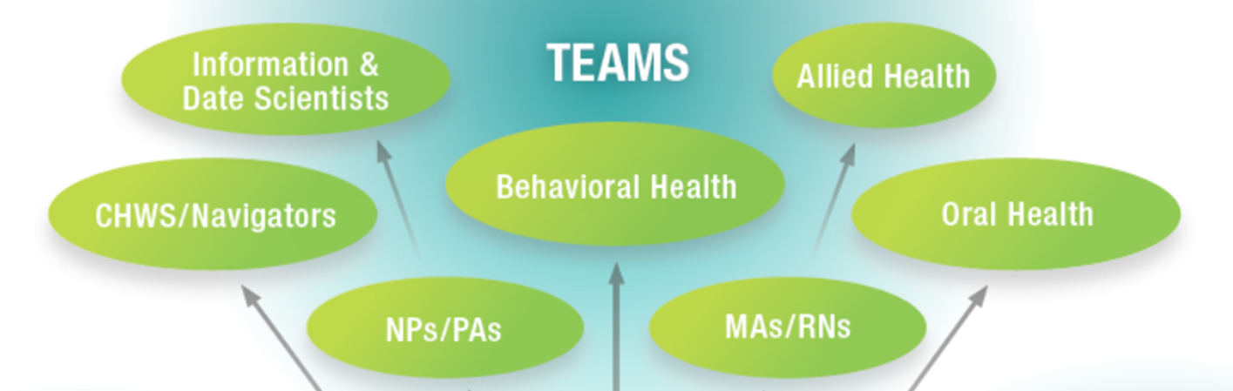
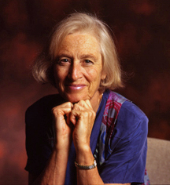
The Problem:
FPs obligated to a growing number of “C’s” that explain primary care’s salutary effects need help (“T’s”)

Slide 3
Conceptual Model: Teams & Increased efficiency
Worker is under trained for the work
Unsafe
Complexity of work
Sweet spot: worker and work are well matched
Inefficient
Worker is over trained for the task
From Mulley, Sinsky/NAM 2018, Phillips
Training

Slide 4
Conceptually: FP teams & increased access, value
Bio/psycho/social integration
Shared decision making
High value
Good match
Chronic illness care
E/M acute sx
Team leadership
Care Coordination
End of Life Care
Same day access
Complexity of work
High value
Good match
Registry
Self Mgmt
Case mgmt
Hospital to home
PAs
Script renewals
Vitals
MA
RN
RN
NP
PA
MD
Training
Notes:
Highly trained worker, low complexity work

Slide 5
 | Continuing Certification Questionnaire (CCQ) | Initial Certification Questionnaire (ICQ) | National Graduate Survey (NGS) | Practice Demographic Survey (PDS) | National Resident Survey (NRS)
Timing | 3-4 months prior to examination date or beginning FMCLA | 3-4 months prior to examination date | Calendar Year | Calendar Year | With In-Training Examination
Cohorts | 10 years after residency; regularly returning cohorts | Residency graduates from that year | 3 years after residency graduation (2020 graduates in 2023) | End of each 3-year Continuous Certification Cycle | Residents
Business Requirement | Yes | Yes | No | No | No
Implemented | 1980s | 2014 | 2016 | 2019 | 2023
Who is on the FP Team?
“Which of the following types of health professionals work (collaboratively) with you at your principal practice site?”

Slide 6
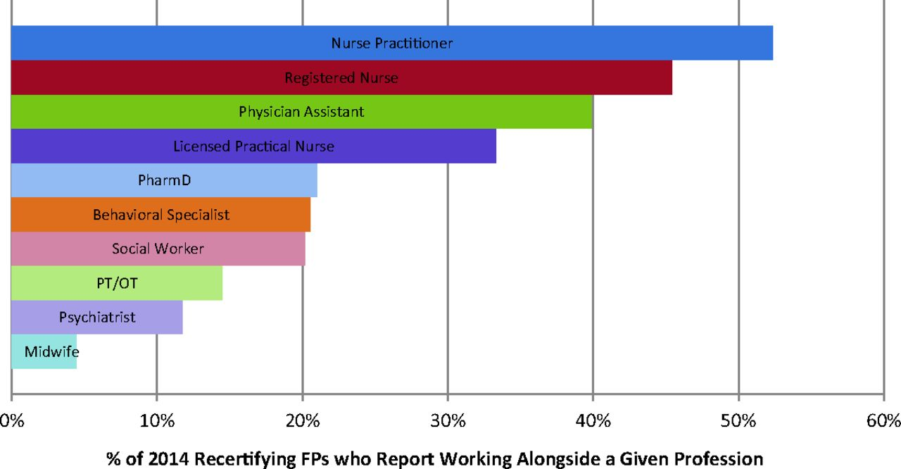
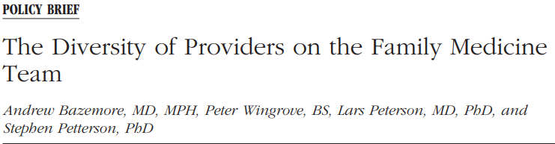
Members of FP Teams

Slide 7
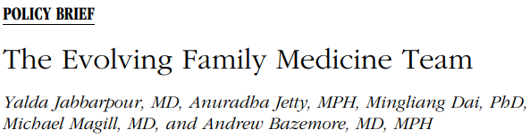
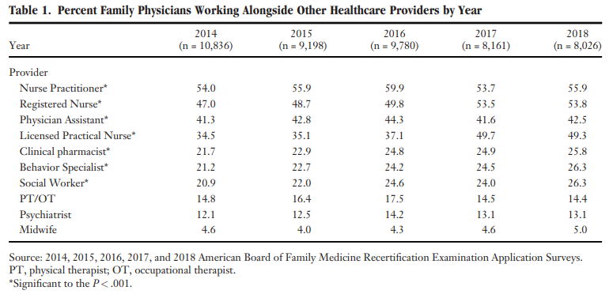
Members of FP Teams

Slide 8
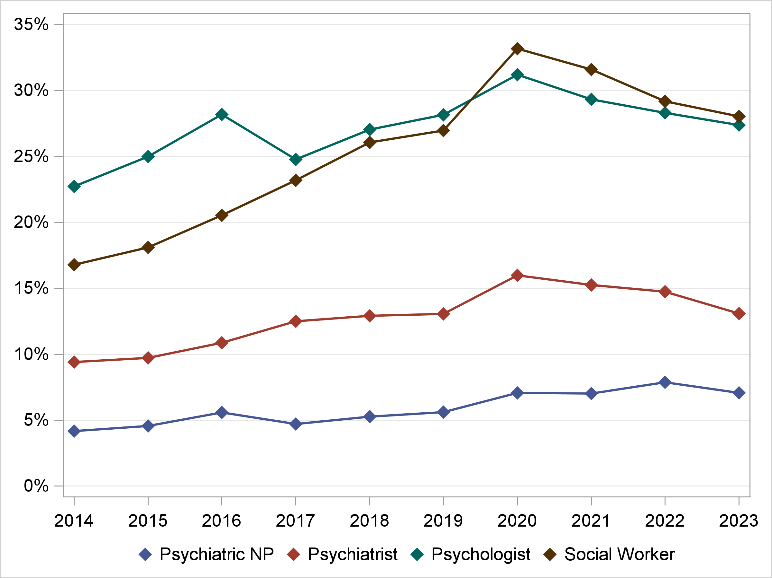
FP Teams - recent emphasis
Integrated Primary Care
(Mental Health Professionals in FP Practices)
Data only from CCQ

Slide 9
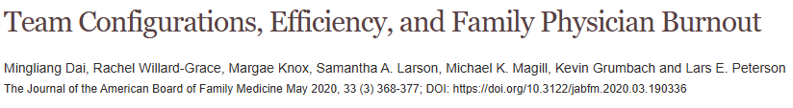
FM Teams & Burnout
Most FPs practice in multidisciplinary teams.
  22% worked collaboratively with MA/nurse only;
  40% with MA/nurse and NP/PA or specialist; and
  38% with MA/nurse, NP/PA, and specialist.
Distribution of perceived teamwork efficiency not statistically different across configurations
  FPs who perceived their teams as having greater efficiency were less likely to be burned out in all types of team configurations.
Smaller, well-defined teams with clear roles and efficient workflows associated with lower burnout in FPs.
Large or loosely organized team configurations correlated with increased complexity & higher FP burnout
J Am Board Fam Med. 2020 May-Jun;33(3):368-377

Slide 10
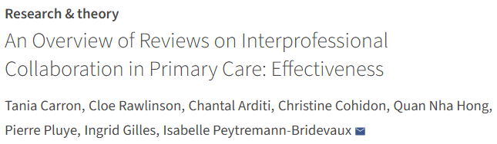
Other Evidence for Team- based care in FM?
2021: Cochrane-styled summary of 34 systematic reviews of interprofessional collaboration (IPC) in primary care
  Across 6 IPC types—including broad primary care teams, physician–nurse, physician–pharmacist, and physician–mental health collaborations
Findings
IPC consistently improved care processes and patient satisfaction, best when implemented using collaborative care models that are
  Pre‑defined (Roles, workflows, and goals are deliberately planned in advance—not improvised)
  High‑intensity (Team members are actively and regularly involved (vs just consulted occasionally).
Mixed or insufficient: impacts on clinical outcomes, healthcare utilization, and cost-effectiveness
Notes:
Study from Unisante/Swiss & McGill Dept Family Medicine teams: https://ijic.org/articles/10.5334/ijic.5588
Did a Cochrane-styled umbrella review
Analyzed 34 systematic reviews of interprofessional collaboration (IPC) across six IPC types—including broad primary care teams, physician–nurse, physician–pharmacist, and physician–mental health collaborations. Overall, it found that IPC consistently improved care processes and patient satisfaction, particularly when implemented using pre‑defined, high‑intensity models such as collaborative care, though results were more frequently mixed or insufficient for impacts on clinical outcomes, healthcare utilization, and cost-effectiveness

Slide 11

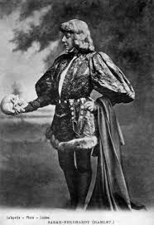
To Team or not To Team?
Pathway to greater access and efficiency?
⤷ Teams can help manage larger panels and extend reach via role delegation.
Supports/enhances comprehensiveness of primary care
⤷ Brings diverse skills (e.g., pharmacy, behavioral health, care coordination) into the visit or care plan.
May reduce physician burnout
⤷ Properly structured teams reduce documentation burden and task overload.
Aligns with complex care needs
⤷ Effective for chronic disease, behavioral health, and social determinants, which require interprofessional solutions.
Positive patient experience
⤷ Team members can provide more touchpoints and availability.
Evidence-based models exist
⤷ Collaborative care and PCMH frameworks show measurable improvements in process and some outcomes

Slide 12
To Team or not To Team?
Increases cost and complexity without consistent return
⤷ Require added staff, coordination, & management, yet outcomes are mixed and context-dependent
Fragmentation & loss of personal accountability
⤷ Pts unsure who is responsible for their care, compromising trust)
Continuity can suffer
⤷ Strongest when a single FP is clearly accountable
Payment systems don’t support it well
⤷ CMS/Commercial payers don’t consistently reimburse infrastructure/roles required for effective teams)
Training and support are lacking
⤷ in most practices, leads to parallel workflows and inefficiency).
Not scalable across all settings
⤷ Solo, rural, and under-resourced clinics?
Contrary models (Direct Primary Care/micropractice) are growing & show promise
⤷ Emphasize lo overhead, high-access, & strong continuity, promise hi patient & physician satisfaction
Notes:
While team-based care has potential benefits, Family Medicine should be cautious about embracing it as a universal model. It stands in tension with proven, sustainable approaches like direct primary care and micropractice, which emphasize low overhead, high-access, and deep personal continuity between patient and physician. Team-based models often raise costs and administrative burdens without reliably improving outcomes, and current payment systems—particularly CMS and most commercial insurers—do not consistently support the infrastructure required to make teams function well. Without explicit commitment from payors and educators to support and train true interprofessional teams, practices tend to default to parallel workflows rather than cohesive collaboration, undermining the intended value of team-based care. For patients, these loosely coordinated arrangements can cause confusion about who is responsible for their care and reduce the clarity and trust that come from a single, consistent clinician relationship. Continuity of care—central to better outcomes, lower costs, and patient satisfaction—is often strongest in models without teams, where one physician is clearly accountable and deeply familiar with the patient’s story.

