Slide 1
Let’s Talk About Entrustment
KrisEmily McCrory, MD, MS MedEd, FAAFP
Lauren Anderson, PhD
Notes:
KEM

Slide 2
Audience Poll 1: Finding out who’s here?
What’s your primary role:
Time in GME?
Program Director
Associate Program Director
Core Faculty
Program Coordinator
Other
Less than five years
5-10 years
10-20 years
>20 years
Notes:
KEM

Slide 3
Audience Poll 2
Have you attended either of the previous two webinars?
Both
Just the first one
Just the second one
Neither
Notes:
KEM

Slide 4
CBME Webinar Series
December 8, 2023: Core Outcomes, Milestones, Competencies, and CBME: Understanding the Charge from the ABFM & the ACGME
February 14, 2024: Let’s Talk About Entrustment
April 10, 2024: Assessment Tools for CBME and the Core Outcomes
May 15, 2024: Building CBME Into Faculty Development
June 12, 2024: Advisors and Coaches: The Evolving Role of Faculty and Resident Relationships
July 10, 2024: How to Have Reflective Feedback Conversations and Develop a Culture of Effective Feedback
August 14, 2024: Fostering Master Adaptive Learning and a Growth Mindset in Your Program
September 18, 2024: How to Effectively Use Electives to Help Residents Attain Competency in the Core Outcomes
October 9, 2024: The Role of Resident Portfolios in Competency-Based Assessment
November 13, 2024: Managing Assessment Burden in CBME
January 10, 2024: Reflections, Goals, & Objectives-Oh My! Best Practices for Creating Individualized Learning Plans
Notes:
KEM

Slide 5
STFM CBME Taskforce: Charged with responsibility to develop faculty development and best practices for CBME implementation in family medicine residency
National Guidelines for Implementation of CBME in Family Medicine
Presentations on implementing CBME at RLS and STFM Annual Conference
CBME Webinar series
CBME Tool Kit including assessment and implementation tools
Direct observation tool integrated into current residency electronic management software (IN DEVELOPMENT)
“Faculty Development Delivered” Workshops
Notes:
KEM

Slide 6
Learning objectives
Define entrustment as it relates to CBME.
01
Describe components of entrustment decisions linked to milestones.
03
Describe the different levels in a 5-level entrustability scale.
02
Notes:
KEM

Slide 7
What does Entrustment mean to YOU?
Notes:
KEM

Slide 8
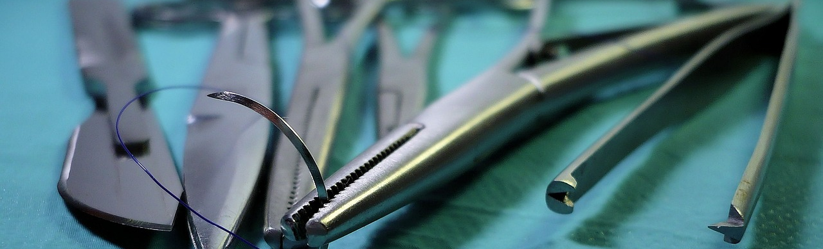
Consider a specific procedure or other patient care activity you currently assess residents in.
What would a resident need to show or demonstrate for you to feel comfortable, or even confident, in saying that this resident could perform that activity unsupervised from now on?
Notes:
KEM

Slide 9
Traditional Progression
Time = Competence​
"Scheduled Entrustment"​
Senior residents = night float
Notes:
Lauren

Slide 10
Definition of Entrustment
Intentional decision that a learner has sufficient experience, possess adequate knowledge, and demonstrates the necessary skills to be permitted to practice without supervision
(ten Cate, 2013)
Notes:
Lauren

Slide 11
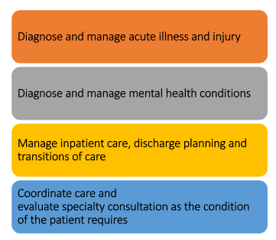
Entrustable Professional Activities (EPA)
EPA
Routine professional activities of physicians based on their specialty
Tasks that can be entrusted to a trainee once sufficient, specific competence is reached to allow for unsupervised practice
(ten Cate et al 2007)
Notes:
Lauren

Slide 12
Types of Entrustment
Summative (Structural)
Grounded in sufficient and robust assessment.
Leads to change in supervision, licensing and/or certification decision.
Ad Hoc
“In the moment” Does not necessarily set precedent for future decisions.
Ten Cate et al 2016, Ten Cate 2013
Notes:
Lauren

Slide 13
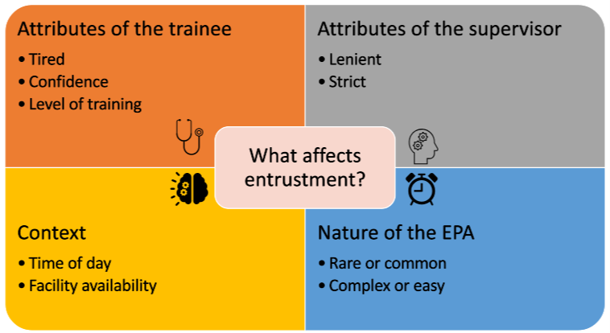
Ten Cate 2013
Notes:
Lauren

Slide 14
Competency-Based Approach Recap
Time ≠ Competence ​
Authentic assessment (real tasks) ---> entrustment decisions
Kogan & Holmboe 2013
Notes:
Lauren

Slide 15
Entrustment Scales (independence rating scales)
Behaviorally anchored scales that are used to measure the progression to competence (independence)
Rekman et al 2016
Notes:
Lauren

Slide 16
Examples of Entrustment Scales
Zwish Scale
O-SCORE
Show and Tell (observe only, faculty narrates and demonstrates)
Active Help (actively assists and does non-critical steps, faculty guides and coaches)
Passive Help (resident control the flow, anticipates next steps and critical steps with minimal assistance, faculty actively assists and refines skills, coaches)
Supervision Only (performs with minimal faculty assistance, faculty monitors progress and safety)
I had to do it (requires complete hands-on guidance, did not do or was not given opportunity to do it)
I had to walk them through (able to perform tasks but requires constant direction)
I had to prompt from time to time (demonstrates some independence, but requires intermittent direction)
I needed to be in the room just in case (independence but unaware of risks and still requires supervision for safe practice)
I didn’t need to be there (complete independence, understands risks and performs safely, practice ready)
Rekman et al 2016; Gofton et al 2012; George et al 2014
Notes:
Lauren

Slide 17
Entrustment Scales vs. Traditional Assessment Scales
Is this resident a 1 or a 2 or a 3?
Is this resident at, above or below expected level of training?
Does this resident require direct supervision (stay in the room), indirect supervision (stay nearby) or can the resident do this by themself?
Rekman et al 2016
Notes:
Lauren

Slide 18
Benefits of Entrustment Scales
Focus on readiness for independent practice, not on deficiencies ​
Easier for residents to interpret the assessment ​
Reliability ​
Easy to see progress over time
Rekman et al 2016; Gofton et al 2012
Notes:
Lauren

Slide 19
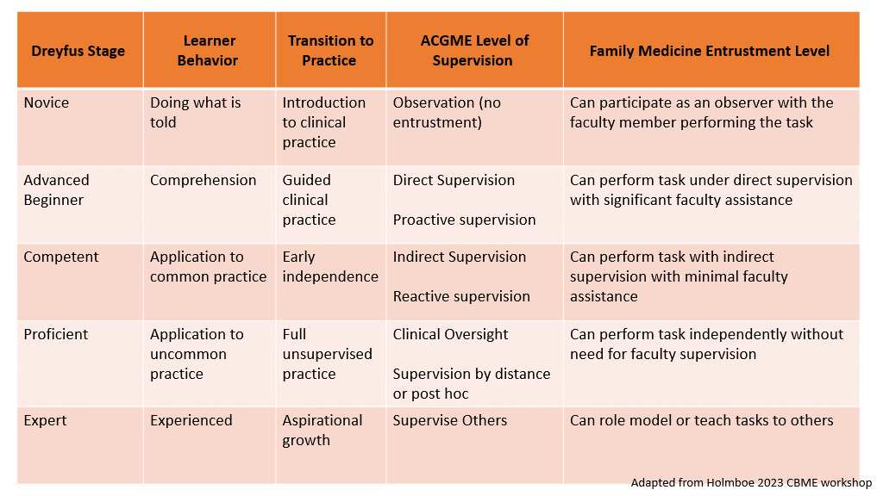
Notes:
Lauren

Slide 20
Entrustment
A decision about resident’s readiness to perform some aspect of professional practice without supervision.
Notes:
KEM

Slide 21
Let’s talk about SUPERVISION
CMS Billing Requirements
Patient safety
Direct observation & feedback

Slide 22
ACGME Levels Of Supervision
Direct Supervision:
Attending physically in the room with resident.
Indirect Supervision:
(direct supervision available)
Attending out of the building, available by phone* and available to provide direct supervision.
Indirect Supervision:
(direct supervision immediately available)
Attending physically in the building and immediately able to provide direct supervision.
Oversight:
Attending reviews encounter or procedures and provides feedback after the fact.
(ACGME, 2011)
Notes:
KEM

Slide 23
Our Job
Provide appropriate training environment to acquire expected skills, knowledge, & attitudes.
Supervise residents at appropriate levels until they have demonstrated readiness to perform professional activities independently.
Attest to that readiness for independent practice at the end of training.
(ACGME, 2023)

Slide 24
Assessment OR Entrustment?
Assessment
Entrustment
Looks at a single instance of the learner’s performance, knowledge and/or attitude.
Purpose: To provide feedback, guide individual learning plans, and identify where learners stand.
Using multiple assessments, over time, from multiple assessors to look at pattern of performance.
Purpose: To make at determination of learner’s readiness to practice independently.
Notes:
LOTS of assessment (Everyday!)
Fewer Entrustments

Slide 25
Small Scale Entrustment
Incoming interns have varying experience with speculum exams.
Entrustment question: Is this intern ready to perform this professional activity without an attending in the room?

Slide 26
Small Scale Entrustment
Minimum number of directly observed speculum exams.
Assess: knowledge of procedure, counseling patient, procedural skills, management of results.
Resident receives FB after each direct observation.
Faculty reviewed assessments and determined readiness to perform future speculum exams without direct observation.

Slide 27
The individual assessments
PCAT
Simulation
Multisource Feedback
Assessment Clinical Reasoning
Procedural Skills
Procedural Skills
Managing results
Counseling Patients

Slide 28
Applying Entrustment Scale
Levels of Supervision
Observation, no enactment
Act under direct, proactive supervision
Act under indirect, reactive supervision
Oversight only
Provide supervision to others
(ten Cate, 2020)

Slide 29
You do this already, right?
Every day we make these
small-scale entrustment decisions.
We assess a resident’s performance in the moment.
We consider the overall pattern of performance by looking at multiple assessments over time.
We make decisions about how much we need to be in the room.
Notes:
KEM

Slide 30
So, let’s take it up a notch
“Practice as personal physicians, providing first contact, comprehensive and continuity care, to include excellent doctor-patient relationships, excellent care of chronic disease and routine preventive care and effective practice management.”

Slide 31
The ask from the ABFM:
At the END of training, attest that a resident can be entrusted (IS READY) to perform each core outcome independently (WITHOUT SUPERVISION).

Slide 32
What would a resident need to show or demonstrate for you to feel comfortable, or even confident, in saying that this resident could perform that activity unsupervised from now on?

Slide 33
BUT WHAT IF I AM WRONG?!

Slide 34
Remember, you already do this
PC2: Care of patients with Chronic Illness
SBP2: System navigation for patient centered care
PBLI1: Evidence based and Informed practice
ICS1: Patient and family centered communication
PC3: Health promotion & wellness
PC5: Management of procedural care
MK1: Demonstrates medical knowledge of sufficient breadth & depth to practice FM

Slide 35
How do you assess these milestones?
ITE
Work based assessment tools
Assessment of reasoning tools
Faculty Assessments
Peer Assessment
Audit of Medical Record
Clinical Performance audit
Multisource Feedback
Simulation

Slide 36
Final Entrustment Decision
Looking at all the assessment data available, is it reasonable to say that this resident can practice independently?
If not, why not?

Slide 37
If you remember nothing else…
Competency cannot be determined by time alone.
Entrustment is a discrete decision based on multiple assessments.
Entrustment scales allow for gradual decrease in supervision until ready for fully independent practice.
You already do a lot of this! Don’t let perfect get in the way of good!

Slide 38
Bring it Home
Engage your residents and faculty:
Start a conversation about entrustment with faculty and residents.
Is there a difference between resident and faculty viewpoints on entrustment?
What do they identify as the challenges for determining entrustability?
Notes:
KEM

Slide 39
Wait…what about the EPAs!?!
Notes:
KEM

Slide 40
References
Ten Cate O, Scheele F. Competency-based postgraduate training: can we bridge the gap between theory and clinical practice?. Academic medicine. 2007 Jun 1;82(6):542-7.
Ten Cate O. Nuts and bolts of entrustable professional activities. Journal of graduate medical education. 2013 Mar 1;5(1):157-8.
Rekman J, Gofton W, Dudek N, Gofton T, Hamstra SJ. Entrustability scales: outlining their usefulness for competency-based clinical assessment. Academic Medicine. 2016 Feb 1;91(2):186-90.
Kogan JR, Holmboe E. Realizing the promise and importance of performance-based assessment. Teaching and learning in medicine. 2013 Jan 1;25(sup1):S68-74.
Ten Cate O, Hart D, Ankel F, Busari J, Englander R, Glasgow N, Holmboe E, Iobst W, Lovell E, Snell LS, Touchie C. Entrustment decision making in clinical training. Academic Medicine. 2016 Feb 1;91(2):191-8.
Gofton WT, Dudek NL, Wood TJ, Balaa F, Hamstra SJ. The Ottawa surgical competency operating room evaluation (O-SCORE): a tool to assess surgical competence. Academic Medicine. 2012 Oct 1;87(10):1401-7.
George BC, Teitelbaum EN, Meyerson SL, Schuller MC, DaRosa DA, Petrusa ER, Petito LC, Fryer JP. Reliability, validity, and feasibility of the Zwisch scale for the assessment of intraoperative performance. Journal of surgical education. 2014 Nov 1;71(6):e90-6.
Ten Cate O, Schwartz A, Chen HC. Assessing Trainees and Making Entrustment Decisions: On the Nature and Use of entrustment-supervision scales. Academic Medicine. 2020 95(11): 1662-1669
https://www.acgme.org/globalassets/pdfs/jgme-11-00-39-451.pdf (accessed 2/13/2024)
https://www.acgme.org/globalassets/pfassets/programrequirements/120_familymedicine_2024.pdf (accessed 2/14/2024)
Notes:
KEM

