Slide 1
Comprehensive Team Based Care Model
Preliminary Results
Jason D. Ramm, MD, FAAFP
Chair, Department of Family Medicine
Baylor College of Medicine- Temple
Baylor Scott & White Health

Slide 2
Agenda
Overview of Project
Preliminary Results
Discussion/Questions

Slide 3
Overview of Project
Time period: 6/1/2024 – 5/31/2025
Comparing a team of one MD and three APPs vs. a single MD
Two different clinics in similar geographic area
Data captured for this analysis:
    Age, Gender, Race/Ethnicity
    # of ED visits, # of hospitalizations, Recent lipid screening (y/n), BP category, HGBA1C category
    Time from appt made to appt completed (crude measure of access)
    Proportion of visits going to MD in team (crude measure of capacity)
    Encounter type (tele, office)

Slide 4
Team approach
Team approach –
  Physicians decrease in amount of patients/day by 30 to 40% (depending on #of APPs)
  APP visits stay at current level (≈18 per day)
  Physician supervision of APPs in real time with fewer delays
  Physician co-visit with APPs on previously identified patients
  Physician manages high-risk patients – chronic and acute
  APPs see stable chronic and well care w/physician oversight
  Utilize collaborative care managers (RNs) to help with less than optimally managed chronic disease patients
  Utilize CMAs and PSS staff in expanded roles above checking in/out and rooming patients
Addition of nonclinical team members to improve patient care such as social workers, pharmacists, dieticians, community health workers, etc.

Slide 5
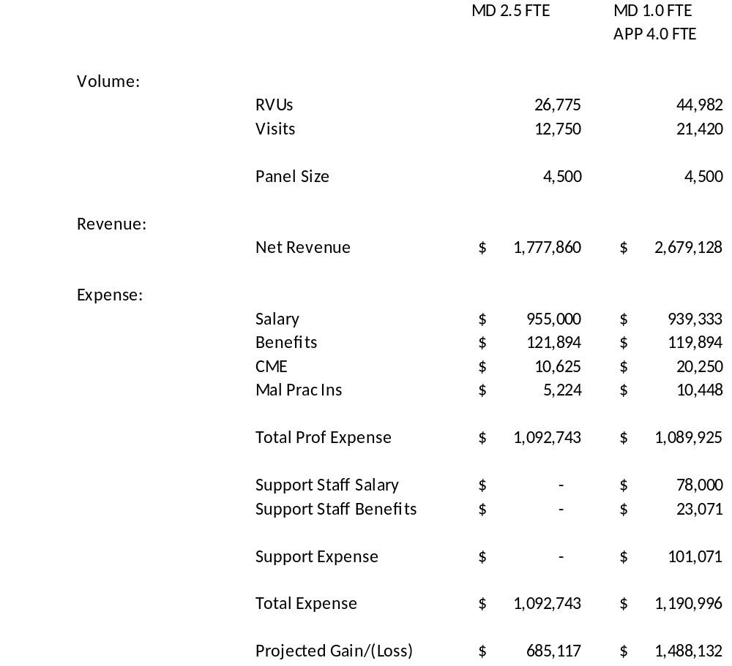
Financial comparison of 2.5 MDs vs 1:4 MD to APP
Margin comparison

Slide 6
Preliminary Results 1
Table 1. Panel Characteristics
Variable | Team (N=2100 PTs ; N=5155 encounters) | Single MD (N=1284 PTs ; N=3176 encounters)
Age | 55 years (SD=18) | 64 years (SD=17)
Sex
Female | 55% | 47%
Male | 45% | 53%
Race/Ethnicity
White | 71% | 83%
Black | 6% | 3%
Hispanic/Latino | 19% | 11%
Asian | 1% | <1%
Native American | <1% | <1%
Other | 2% | 1%

Slide 7
Preliminary Results 2
Table 2. Outcome comparisons (Highlights)
Variable | Team (N=2100 PTs ; N=5155 encounters) | Single MD (N=1284 PTs ; N=3176 encounters)
Encounter type (% telemedicine) | 8% | 2%
Lipid screening (% with panel within study period) | 54% | 66%
HGBA1C (% normal ; elevated ; managing diabetes) | 76% ; 19% ; 5% | 84% ; 15% ; 1%
BP control (% normal ; elevated ; HTN) | 35% ; 15% ; 50% | 28% ; 19% ; 53%
# of ED visits | 1.7 (SD=1.67) | 1.4 (SD=0.81)
# of Hospitalizations | 1.5 (SD=1.22) | 1.3 (SD=0.63)
Turnaround time to appt (access) | 5.1 (SD=7.50) | 7.0 (SD=8.04)
Proportion of MD visits (capacity for team MD) | 36%
*Team has 10% new patients, and single MD is not accepting new patients

Slide 8
Preliminary Results 3
Table 3. Third Next Available patient comparison
Third Available Appt | Comprehensive Team Based Model |  |  |  |  |  |  |  | Solo Physician
as of 8/8/25 | MD |  | NP 1 |  | NP 2 |  | NP 3 |  | MD
New Patient | 1/30/2026 |  | N/A |  | N/A |  | 11/24/2025 |  | No New Pts
New Patient Acute | 8/21/2025 |  | N/A |  | N/A |  | 8/8/2025 |  | No New Pts
New to Provider | 9/2/2025 |  | N/A |  | N/A |  | 12/15/2025 |  | No New Pts
New Medicare Wellness | 9/2/2025 |  | N/A |  | N/A |  | 12/16/2025 |  | No New Pts
Medicare Wellness | 9/6/2025 |  | 10/8/2025 |  | 9/12/2025 |  | 8/18/2025 |  | 10/7/2025 | Will exceed session limits
Physical | 9/6/2025 |  | 9/4/2025 |  | 9/5/2025 |  | 8/19/2025 |  | 10/7/2025
Hospital Discharge | 8/21/2025 |  | 8/21/2025 |  | 8/11/2025 |  | 8/8/2025 |  | 8/14/2026
Office Visit | 9/6/2025 |  | 8/13/2025 |  | 8/11/2025 |  | 8/11/2025 |  | 9/8/2025
Established Video | 8/20/2025 |  | 8/13/2025 |  | 8/11/2025 |  | 8/9/2025 |  | 9/2/2025
PreOp | 9/6/2025 |  | 8/21/2025 |  | 8/8/2025 |  | 8/11/2025 |  | 9/08//25
Well Child | 9/6/2025 |  | 8/22/2025 |  | 8/11/2025 |  | 8/12/2025 |  | 10/7/2025

Slide 9
Discussion/Questions
Thank you!
Jason.Ramm@BSWHealth.org

