Slide 1

The Meaning of Professionalism among Physicians and Patients
Annie Koempel PhD, RD
Anthropologist
American Board of Family Medicine
akoempel@theabfm.org
Notes:
Line spacing + Page numbers

Slide 2
When you hear the word “professionalism” what comes to mind?
What does professionalism mean to you?

Slide 3
Commonly understood meanings of professionalism
2. Three key components

Slide 4


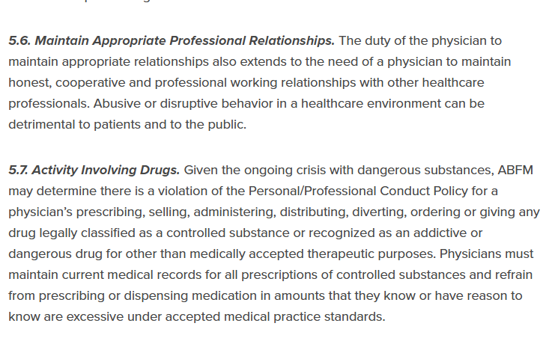

Slide 5

We don’t need to qualify professionalism as positive.
It already, inherently, is.

Slide 6



Key Components of Professionalism
Focused on providing best possible patient care
Basic job duties
Values and ethics
Communication

Slide 7
Key Components of Professionalism
Focused on providing best possible patient care
Basic job duties
On time
Charting
Lab results
Inbox management
Building connection and confidence

Slide 8
Key Components of Professionalism
Focused on providing best possible patient care
Values and ethics
Ethics in tension with certain understandings of professionalism:
Issues where politics, values, and medical care are at odds.
Some physicians described providing the patient care they felt aligned with their own political or religious morals.
Empathy
Integrity
Respect
Ethics

Slide 9
Key Components of Professionalism
Focused on providing best possible patient care
Communication
More important than the details of what was shared was the feeling that the details could be shared.
Patient
Clinic team
One’s self
Listening to understand

Slide 10
Key Components of Professionalism
Focused on providing best possible patient care
Moral injury
& Burn out
Lack of Time
Basic job duties
Values and ethics
Communication
Admin pressures
Profit Motives

Slide 11

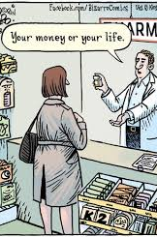

Key Components of Professionalism
Focused on providing best possible patient care
Basic job duties
Values and ethics
Communication

Slide 13
When you hear the word “professionalism” what comes to mind?
What does professionalism mean to you?
Annie Koempel PhD, RD
akoempel@theabfm.org

