Slide 1

Individual performance improvement in population quality metrics should neither be required for board certification nor remain a priority for the specialty of family medicine.
Sarah Cole, DO, FAAFP

Slide 2
Performance improvement is a form of QI, just more narrowly focused.
Aspect | Quality Improvement | Practice Improvement
Question | How can we improve a population outcome? | How can I improve my score?
Focus | A systematic, continuous process to improve quality & efficiency of health care delivery for patients of a team, clinic or health system | An episodic activity intended to improve one metric measured from an individual physician’s patient panel
Method | Formal QI tools (i.e.,PDSA, Lean, etc) | Self-reflection>>data collection>>intervention
Audience | Clinic, system, population | An individual clinician
Example | How can this clinic reduce barriers to follow-up for patients with new diagnosis of HTN? | How can I get more patients on my panel to have a last recorded BP <140/90?
Notes:
PI projects are small scall QI efforts with personal accountability

Slide 3
Current individual PI measures are ineffective & inaccurate in reflecting quality.
Team-based care
MIPS
SDOH
Bond AM, Schpero WL, Casalino LP, Zhang M, Khullar D. Association Between Individual Primary Care Physician Merit-based Incentive Payment System Score and Measures of Process and Patient Outcomes. JAMA. 2022;328(21):2136–2146.
Baker, D. W., & Chassin, M. R. (2017). Holding providers accountable for health care outcomes. Annals of Internal Medicine, 167(6), 418-423.
Notes:
1) A cross-sectional observational study of 80,246 US primary care physicians participating in the Medicare Merit-based Incentive Payment System (MIPS) program in 2019 revealed that MIPS scores were inconsistently associated with performance on a broad range of clinical process and patient outcome measures.
◦ Physicians with low MIPS scores (those subject to penalties) sometimes demonstrated significantly better mean performance on certain process measures, such as influenza vaccination and tobacco screening rates, compared to physicians with high MIPS scores.
◦ Similarly, MIPS scores were inconsistently associated with risk-adjusted patient outcomes. For example, physicians with low MIPS scores had significantly better mean performance on emergency department visits per 1000 patients compared to high-scoring physicians.
◦ There was significant discordance between physician MIPS scores and actual patient outcomes. Among physicians with low MIPS scores, 19.0% had a composite clinical outcome score in the top quintile, indicating high-quality care despite a poor MIPS score. Conversely, 20.5% of physicians with high MIPS scores had a composite clinical outcome score in the bottom quintile. This discordance suggests that the MIPS program is "approximately as effective as chance at identifying high vs low performance".
2) Physicians are an important member of a team that may include nurses, social workers, care managers, community health workers, pharmacists, behavioral health scientists. Individual performance improvement may fail to account for the work of team members.
3) Social determinants of health (e.g., income, education, housing, language barriers) significantly impact outcomes. Physicians may be penalized for things they can’t influence—like patient non-adherence, missed appointments, or poor health literacy.
Quality care often involves a broader care team (nurses, social workers, administrative staff, etc.).
Holding only the physician accountable ignores this shared responsibility.

Slide 4
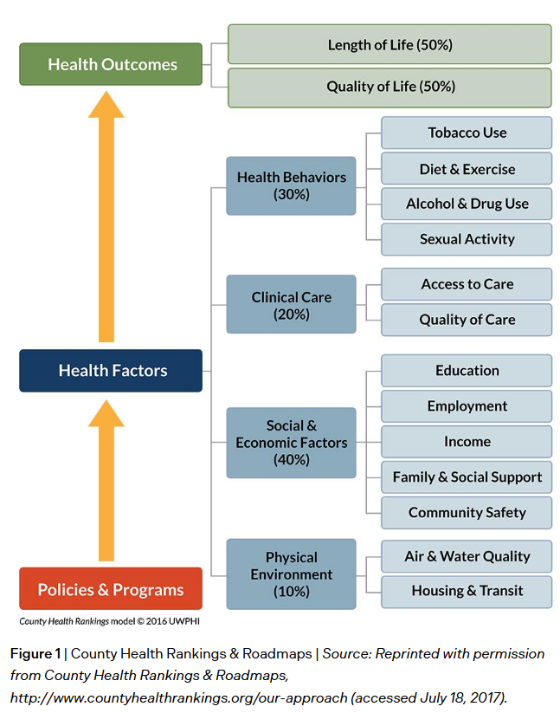
One physician can only affect outcomes so much.
Medical care accounts for only 20% of the modifiable contributors to healthy outcomes for a population.
Hood, C. M., K. P. Gennuso, G. R. Swain, and B. B. Catlin. 2016. County health rankings: Relationships between determinant factors and health outcomes. American Journal of Preventive Medicine 50(2):129-135. https://doi.org/10.1016/j.amepre.2015.08.024
Notes:
Social determinants of health (e.g., income, education, housing, language barriers) significantly impact outcomes.
Physicians may be penalized for things they can’t influence—like patient non-adherence, missed appointments, or poor health literacy.

Slide 5


PI requires substantial administrative & financial burden for little apparent gain.
Wadhera RK, Figueroa JF, Joynt Maddox KE, Rosenbaum LS, Kazi DS, Yeh RW. Quality Measure Development and Associated Spending by the Centers for Medicare & Medicaid Services. JAMA. 2020;323(16):1614–1616
Notes:
The administrative burden and financial costs associated with quality improvement initiatives are significant. In 2019, practices reportedly spent over $12,000 per physician and more than 200 hours per physician on MIPS-related activities. Such substantial investment of time and resources for compliance can divert attention and resources from direct patient care.
◦ The current approach to quality measurement is too labor-intensive, contains significant data lags, and lacks sufficient standardization for rapid data sharing. This was starkly highlighted during the COVID-19 pandemic when the Centers for Medicare & Medicaid Services (CMS) suspended quality reporting requirements, acknowledging the system's lack of resilience when resources are strained. Delayed data (e.g., 12-month lags for claims-based measures) are less meaningful and actionable for improvement.
◦ Real-life quality improvement efforts involve substantial tangible and intangible costs, including dedicated QI personnel, support from various internal departments (e.g., biostatistics, EMR teams), external reporting and accreditation fees, infrastructure for data management, and the development and maintenance of digital clinical decision support systems. Studies evaluating the return on investment for such efforts are scarce, and many show recurring barriers like insufficient financial support and poor data collection

Slide 6
PI creates unintended consequences & ethical dilemmas.
Penalization for vulnerable populations
Patient
autonomy
Gaming
the system
Bond AM, Schpero WL, Casalino LP, Zhang M, Khullar D. Association Between Individual Primary Care Physician Merit-based Incentive Payment System Score and Measures of Process and Patient Outcomes. JAMA. 2022;328(21):2136–2146.
Notes:
The MIPS scoring system disproportionately affects physicians who care for more medically complex and socially vulnerable patients. Physicians with low MIPS scores but superior outcomes were more likely to care for medically complex and socially vulnerable patients (e.g., dual-eligible, Black, and Hispanic patients). This suggests that MIPS scoring can penalize physicians caring for vulnerable populations, even when they deliver relatively high-quality care, potentially exacerbating health inequities by transferring resources away from safety-net organizations.
◦ Many clinical quality measures are flawed, and there is limited evidence that they lead to improved health outcomes. Implementation of flawed measures can have harmful and unintended consequences, such as inappropriate intensification of treatment to meet arbitrary targets, and opportunity costs by focusing on measured outcomes at the expense of more important goals.
◦ Poorly designed measures can create ethical dilemmas by pitting the interests of doctors against those of patients. Some measures fail to preserve patient autonomy, such as those with specific blood pressure targets that don't allow for shared decision-making regarding potential harms, or breast cancer screening measures that penalize clinicians for thoughtful collaboration that results in patients declining screening.
◦ Physicians often experience pressure to alter patient care to optimize performance on measures, leading to "gaming" of the system, such as patient selection or adjusting diagnostic coding.
◦ Some measures fail because they are not within the clinician's locus of control or are heavily confounded by social determinants of health. The "paradox of primary care" highlights that disease-specific measures, by their nature, miss and devalue the higher-level, integrative functions of primary care

Slide 7
Individual PI deprioritizes the progression to systems-level, value-based, or patient-centered approaches that are in development.
Person-Centered Primary Care Measure
A New Comprehensive Measure of High-Value Aspects of Primary Care Rebecca S. Etz, Stephen J. Zyzanski, Martha M. Gonzalez, Sarah R. Reves, Jonathan P. O’Neal, Kurt C. Stange
The Annals of Family Medicine May 2019, 17 (3) 221-230
Notes:
As the American Board of Internal Medicine (ABIM) initially stated, "what difference individual physicians can make is limited, that the burden is substantial and that systems change is more important" [Prompt].
◦ The quality improvement movement has struggled to demonstrate clear accomplishments over decades, with "little information about which mechanisms for improving quality work better than others". There is a critical need to move beyond "quality improvement" to "improving value," which integrates both quality and cost considerations. This requires evaluating the greatest return on investment in healthcare, often at an organizational or national level.
◦ Instead of focusing on narrow, disease-specific metrics that contribute to fragmentation and devalue primary care's holistic nature, the specialty should prioritize measures grounded in the combined experience of patients, clinicians, and payers.
◦ The Person-Centered Primary Care Measure (PCPCM), developed through extensive stakeholder engagement (including patients, clinicians, and payers), offers a promising alternative. It concisely assesses 11 domains critical to high-value primary care, such as accessibility, comprehensiveness, continuity, integration, coordination, relationship, and health promotion, emphasizing what patients report as valuable. The PCPCM aims to assess primary care "as a whole" and reduce measurement burden. It can be used in quality improvement efforts to understand how primary care affects outcomes for patients, health systems, and populations, by focusing on what truly matters beyond narrow disease or satisfaction measures.
◦ Efforts to improve quality measurement should prioritize automated data capture, reduced data lags (leveraging EHRs), and standardized data for better comparisons, rather than relying on manual abstraction and claims data.

Slide 8


Graduate medical education does not demand individual PI
Milestones/Program Requirements
Core Outcomes
Practice based learning & improvement
+
Systems based practice
≠
Individual physician performance improvement
To effectively lead, manage, and participate in teams that provide care and improve outcomes for the diverse populations and communities they serve
≠
Individual physician performance improvement
Notes:
Milestones ask residents to seek performance data with humility and use it to inform their ILP
Program requirements ask residents to reflect on their performance
Core outcomes ask residents to effectively lead teams to provide care and improve outcomes
IF, and that’s a big if, a resident measures a short-term improvement in a patient outcome during residency, is that really due to an episodic intervention? Might it be a natural effect of the routine acquisition of knowledge and skills during training? Or progressive continuity and responsibility for a panel?

Slide 9
Considerations for individual PI in GME
If a resident measures a short-term improvement in a patient outcome during residency, is that really due to an episodic intervention?
  Might it instead be a natural effect of the routine acquisition of knowledge and skills already embedded in training? Or progressive continuity and responsibility for a panel?
Residents can and should learn transferable QI skills using formal tools such as PDSA or Lean in a team-based setting, rendering individual performance improvement unnecessary.
What harm occurs when there isn’t an improvement at the individual level?
  Do residents perceive that as their failure? Does that contribute to resident burn-out or hinder their early-career confidence?

Slide 10
Individual performance improvement should not be embraced in either practice or residency education.
Individual physicians should instead be involved in quality improvement efforts and measured on quality, with accountability that is fair, contextualized, and part of a team-based, system-aware approach.

Slide 11
Resources
Brook RH. The End of the Quality Improvement Movement: Long Live Improving Value. JAMA. 2010;304(16):1831–1832. doi:10.1001/jama.2010.1555
Austin JM, Kachalia A. The State of Health Care Quality Measurement in the Era of COVID-19: The Importance of Doing Better. JAMA. 2020;324(4):333–334. doi:10.1001/jama.2020.11461
Shrank WH, Rogstad TL, Parekh N. Waste in the US Health Care System: Estimated Costs and Potential for Savings. JAMA. 2019;322(15):1501–1509. doi:10.1001/jama.2019.13978
Grady D, Redberg RF, O’Malley PG. Quality Improvement for Quality Improvement Studies. JAMA Intern Med. 2018;178(2):187. doi:10.1001/jamainternmed.2017.6875 https://jamanetwork.com/journals/jamainternalmedicine/fullarticle/2664062
Wadhera RK, Figueroa JF, Joynt Maddox KE, Rosenbaum LS, Kazi DS, Yeh RW. Quality Measure Development and Associated Spending by the Centers for Medicare & Medicaid Services. JAMA. 2020;323(16):1614–1616. doi:10.1001/jama.2020.1816
Bond AM, Schpero WL, Casalino LP, Zhang M, Khullar D. Association Between Individual Primary Care Physician Merit-based Incentive Payment System Score and Measures of Process and Patient Outcomes. JAMA. 2022;328(21):2136–2146. doi:10.1001/jama.2022.20619
Baker, D. W., & Chassin, M. R. (2017). Holding providers accountable for health care outcomes. Annals of Internal Medicine, 167(6), 418-423.

