Slide 1
Anchored in Integrity:
Why Professionalism is the Foundation of Family Medicine’s Future
Andrea Anderson MD, M,Ed., FAAFP
Immediate Past Chair, ABFM
Past Chair, ABFM Professionalism Committee
The Geroge Washington School of Medicine and Health Sciences
Washington, DC
Notes:
Not Just How We Work—Who We Are

Slide 2
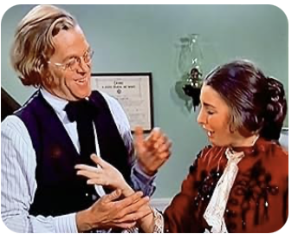
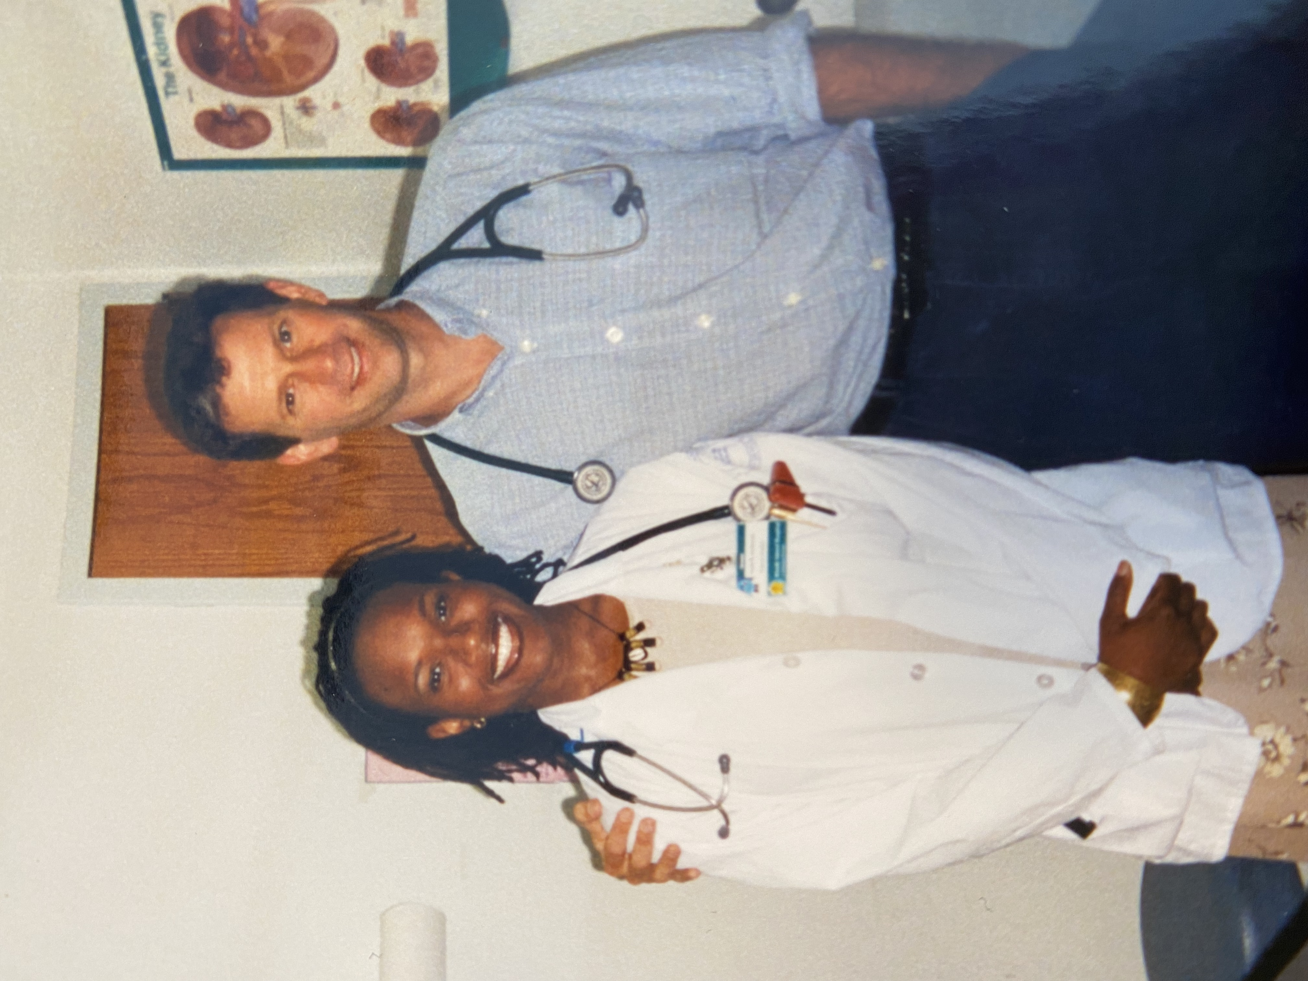
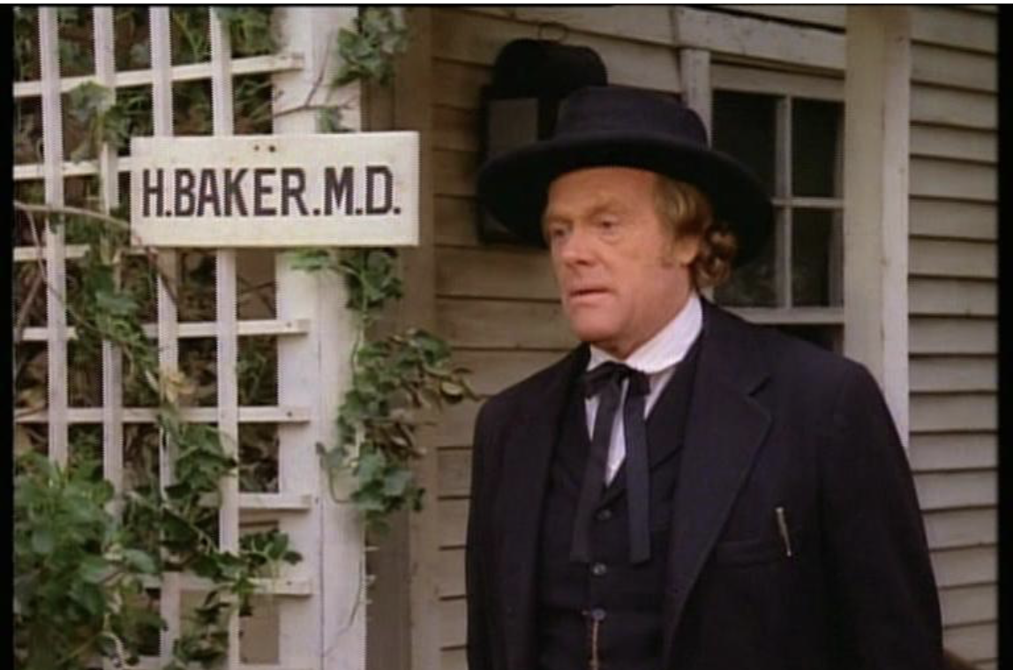
How it started
Notes:
Or learning to care for the underserved under my forever chief resident

Slide 3
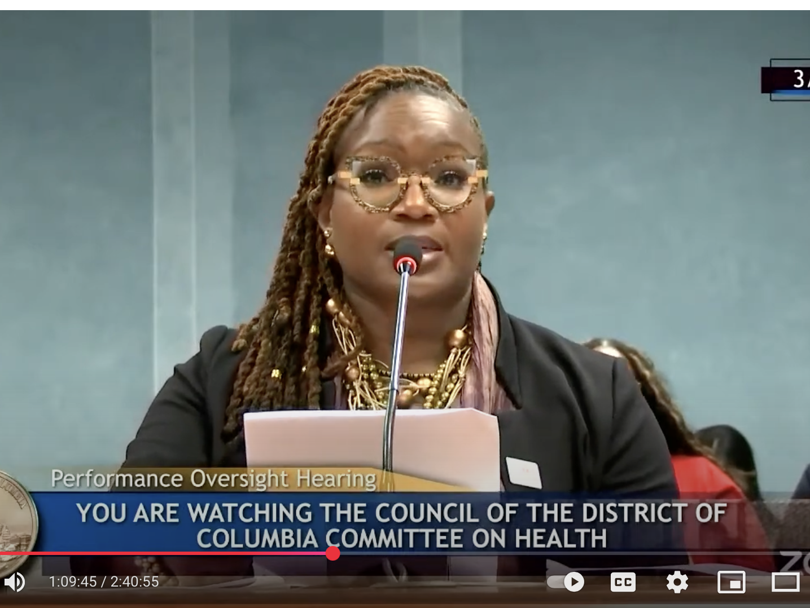
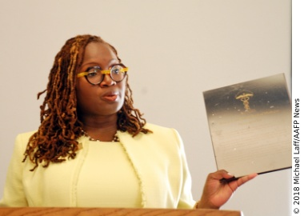
Notes:
Advocacy, Board of Medicine, deterring and writing ethics and professionalism competencies for the USMLE and serving as chair of the ABFM professionalism committee. for me got me interested in how we teach and define to your best selves, not just discipline to our worst moments

Slide 4
Pro·fes·sion·al·ism
pro·fes·sion·al·ism
/prəˈfeSHənlˌiz(ə)m,prəˈfeSHnəˌliz(ə)m/
noun
noun: professionalism
the competence or skill expected of a professional.

Slide 5
What we are NOT talking about
Professionalism vs Professional Misconduct
Notes:
Professionalism ensures patient trust, safety, and high-quality care.
Professional misconduct undermines patient well-being, erodes trust, and can result in disciplinary actions, loss of medical license, or even legal consequences.

Slide 6
Professionalism
The root word - "profess". It comes from the Latin word "profiteri,"
A declaration often involved a commitment to uphold certain standards or principles, especially within a specific vocation.
A public declaration or avowal of one's skills, beliefs, or commitment to a particular trade or field.

Slide 7
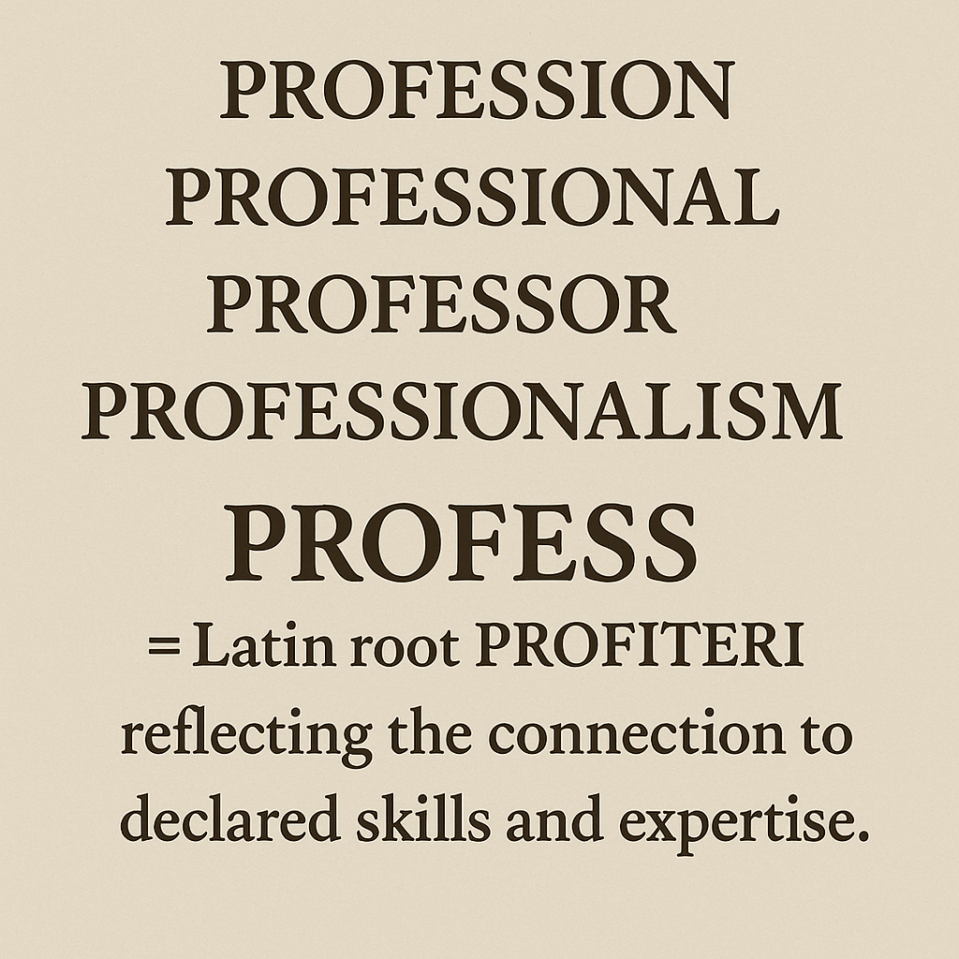
Notes:
Its not about what not to do – it is about what to do, about who we are

Slide 8
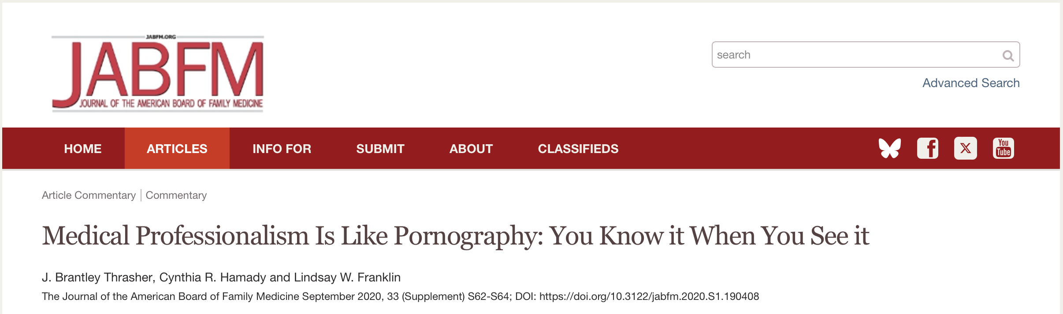
Notes:
Can we not only recognize it when we see it but can we be proactive and define it. Annie encouraged us to move past the individual

Slide 9

Notes:
Tatoos and dredlocks

Slide 10
Word Weaponization
strategic use of language to manipulate, control, or inflict harm on others. It involves using words to advance agendas, demonize opponents, or create divisions, rather than for genuine communication or understanding.

Slide 11
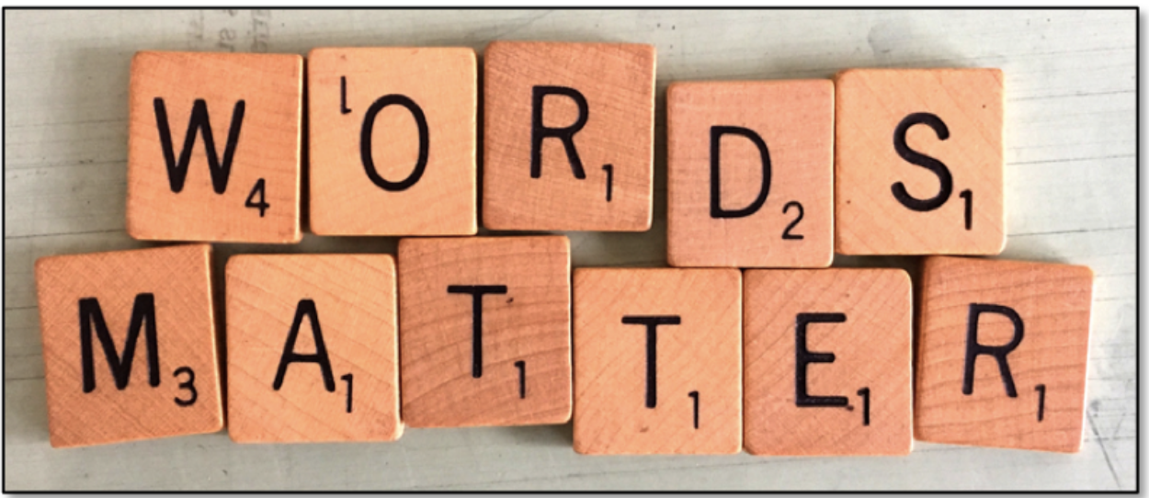
Weaponization

Slide 12
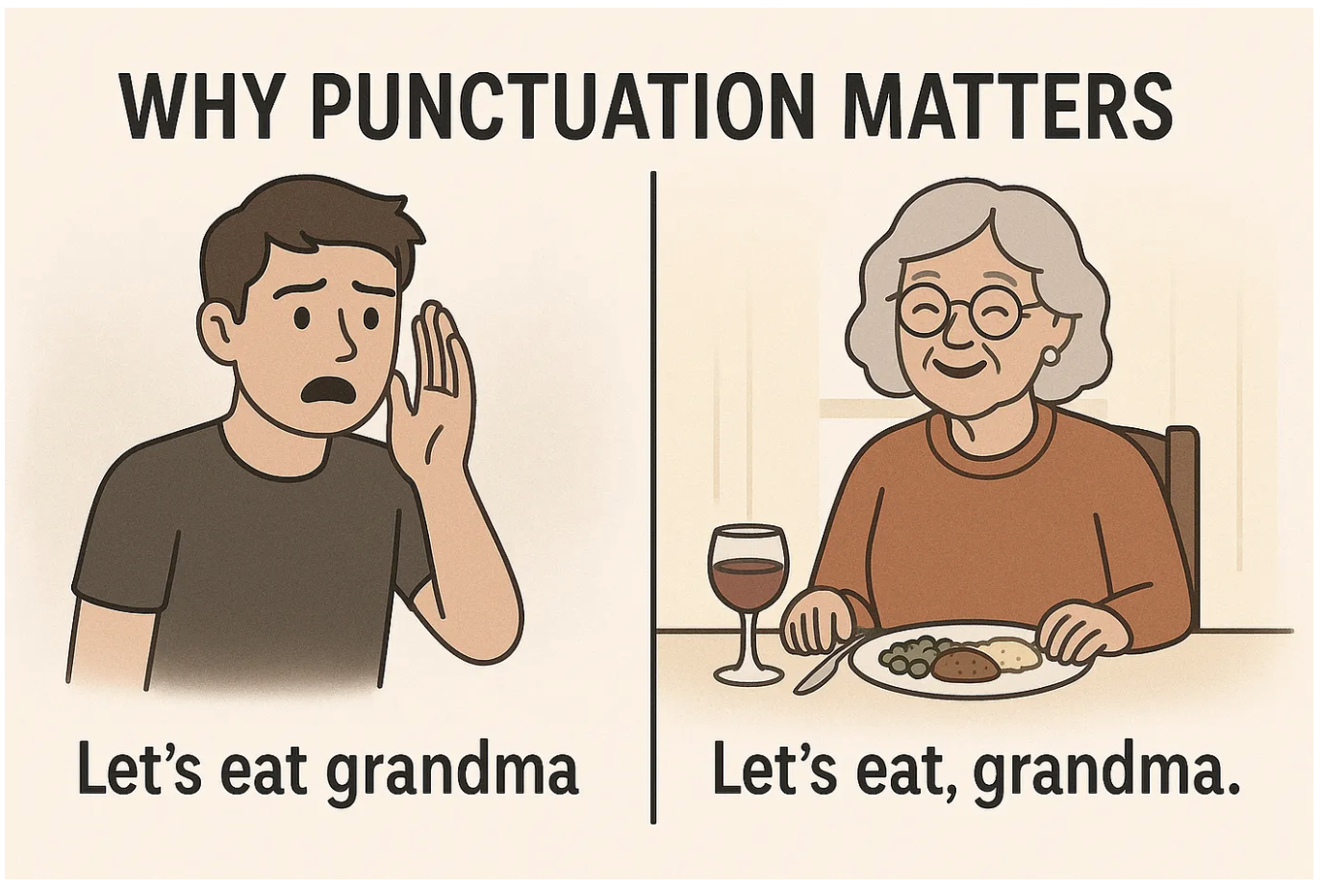
Nuance and Timing Also Matters
Notes:
If we are only talking about professionalism at certain times, especially when there are lapses or individual infractions then we miss the foundational systemic nature

Slide 13
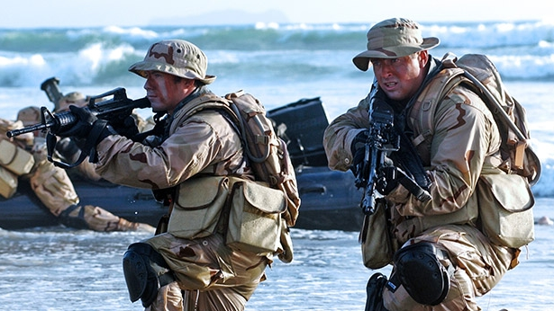
Navy Seals
This Photo by Unknown Author is licensed under CC BY-SA-NC
Notes:
Any military background in the room? What ideas come up?

Slide 14
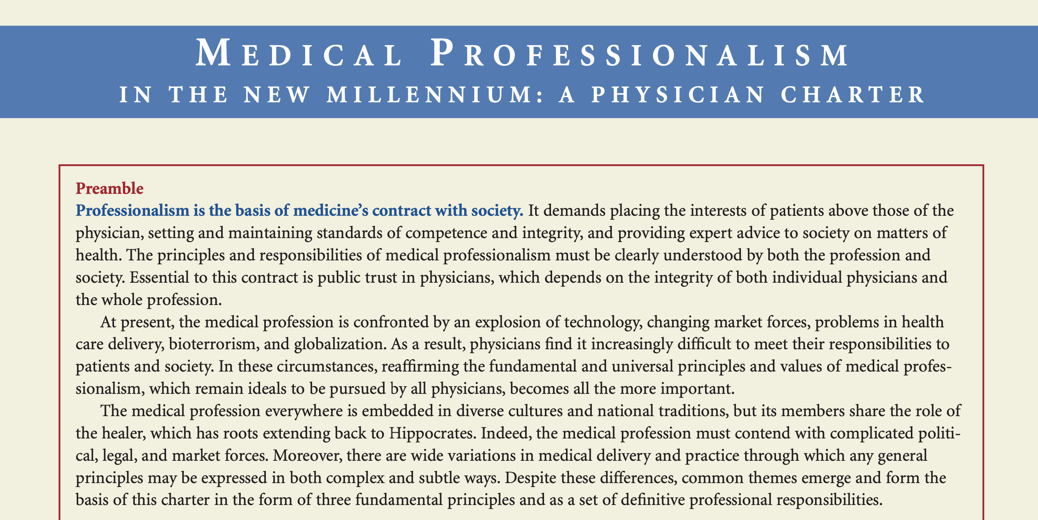
Notes:
2005, this was in the materials,

Slide 15
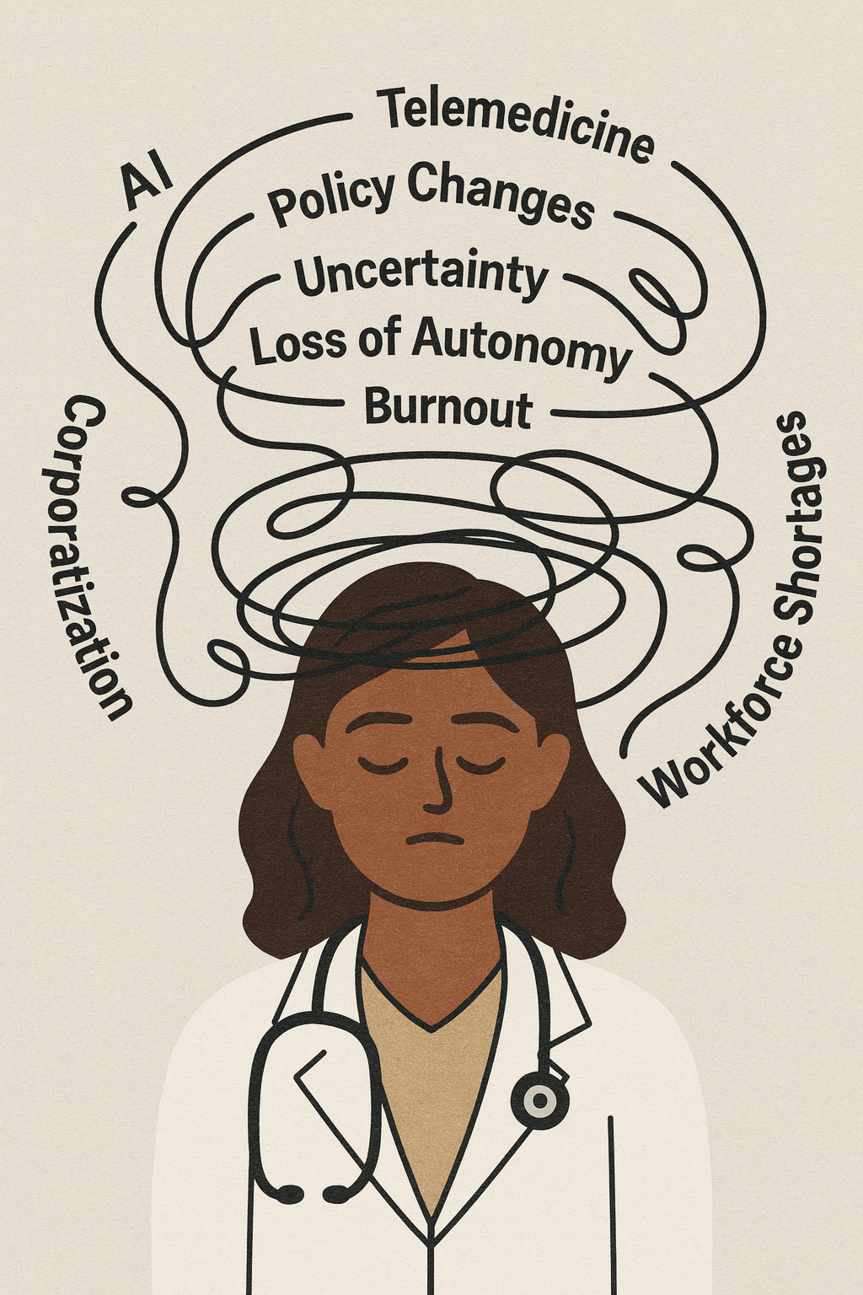

Slide 16
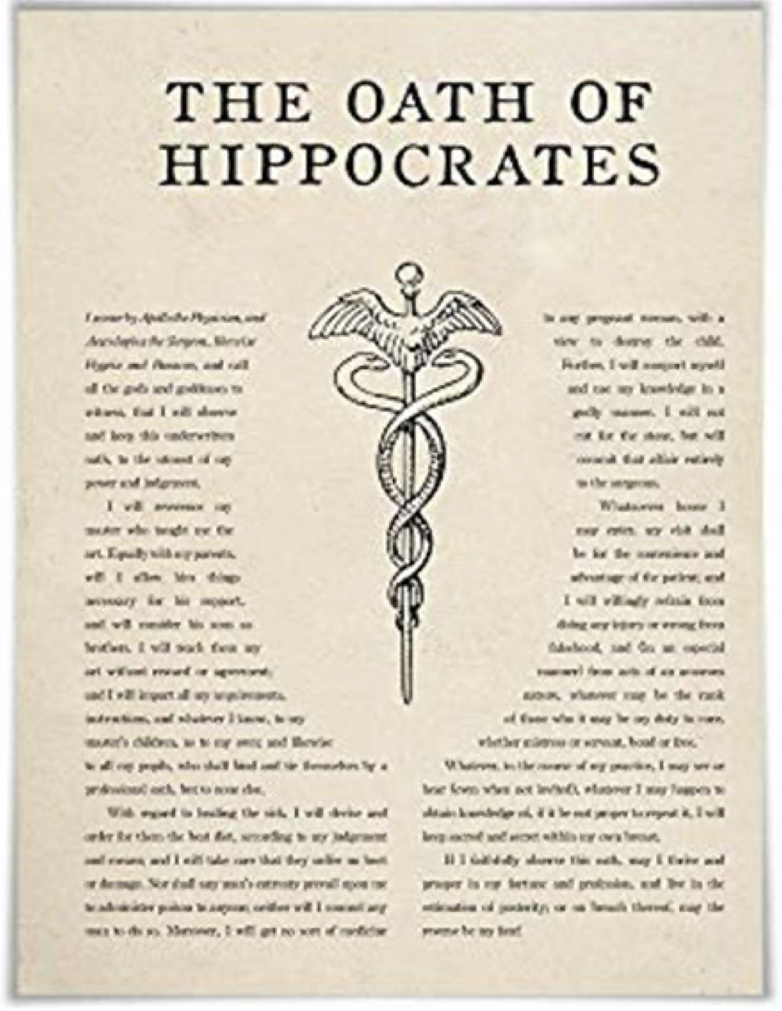

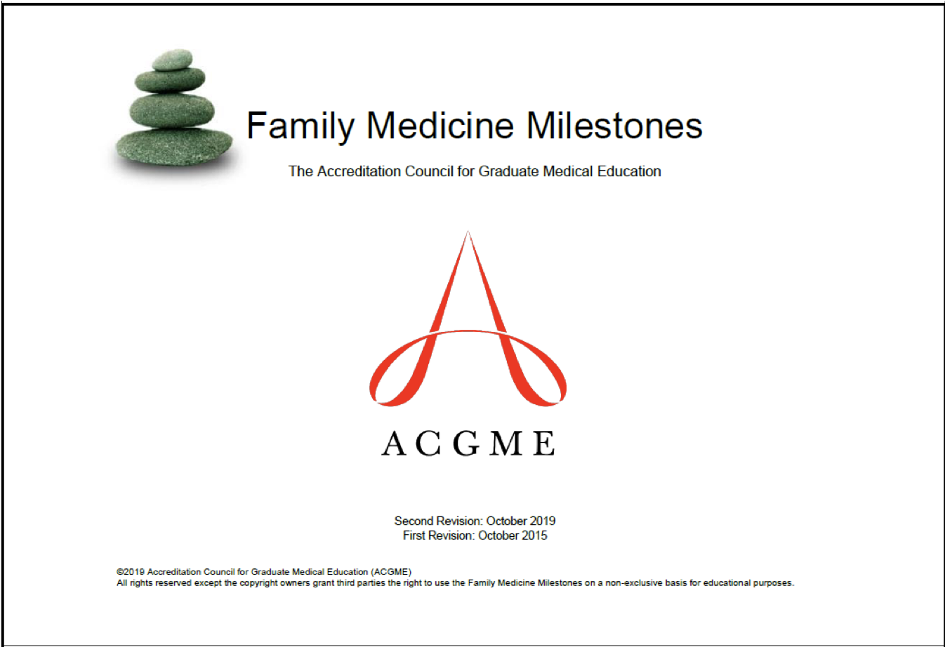



New Declaration of Family Medicine Professionalism
Notes:
It is hard. It will be hard. But we are family doctors. We can do hard things

Slide 17

Notes:
My opponent will argue that while professionalism is a nice to have but that there are many other pressing matters
That’s like saying oxygen is a nice to have but not the main thing
This is the Main thing
We can’t get to the other things until, we determine what the man thing is.
Is professionalism advocacy? Deserts of care? social determinants? Continuity? Core Values? Yes to all of it.

Slide 18
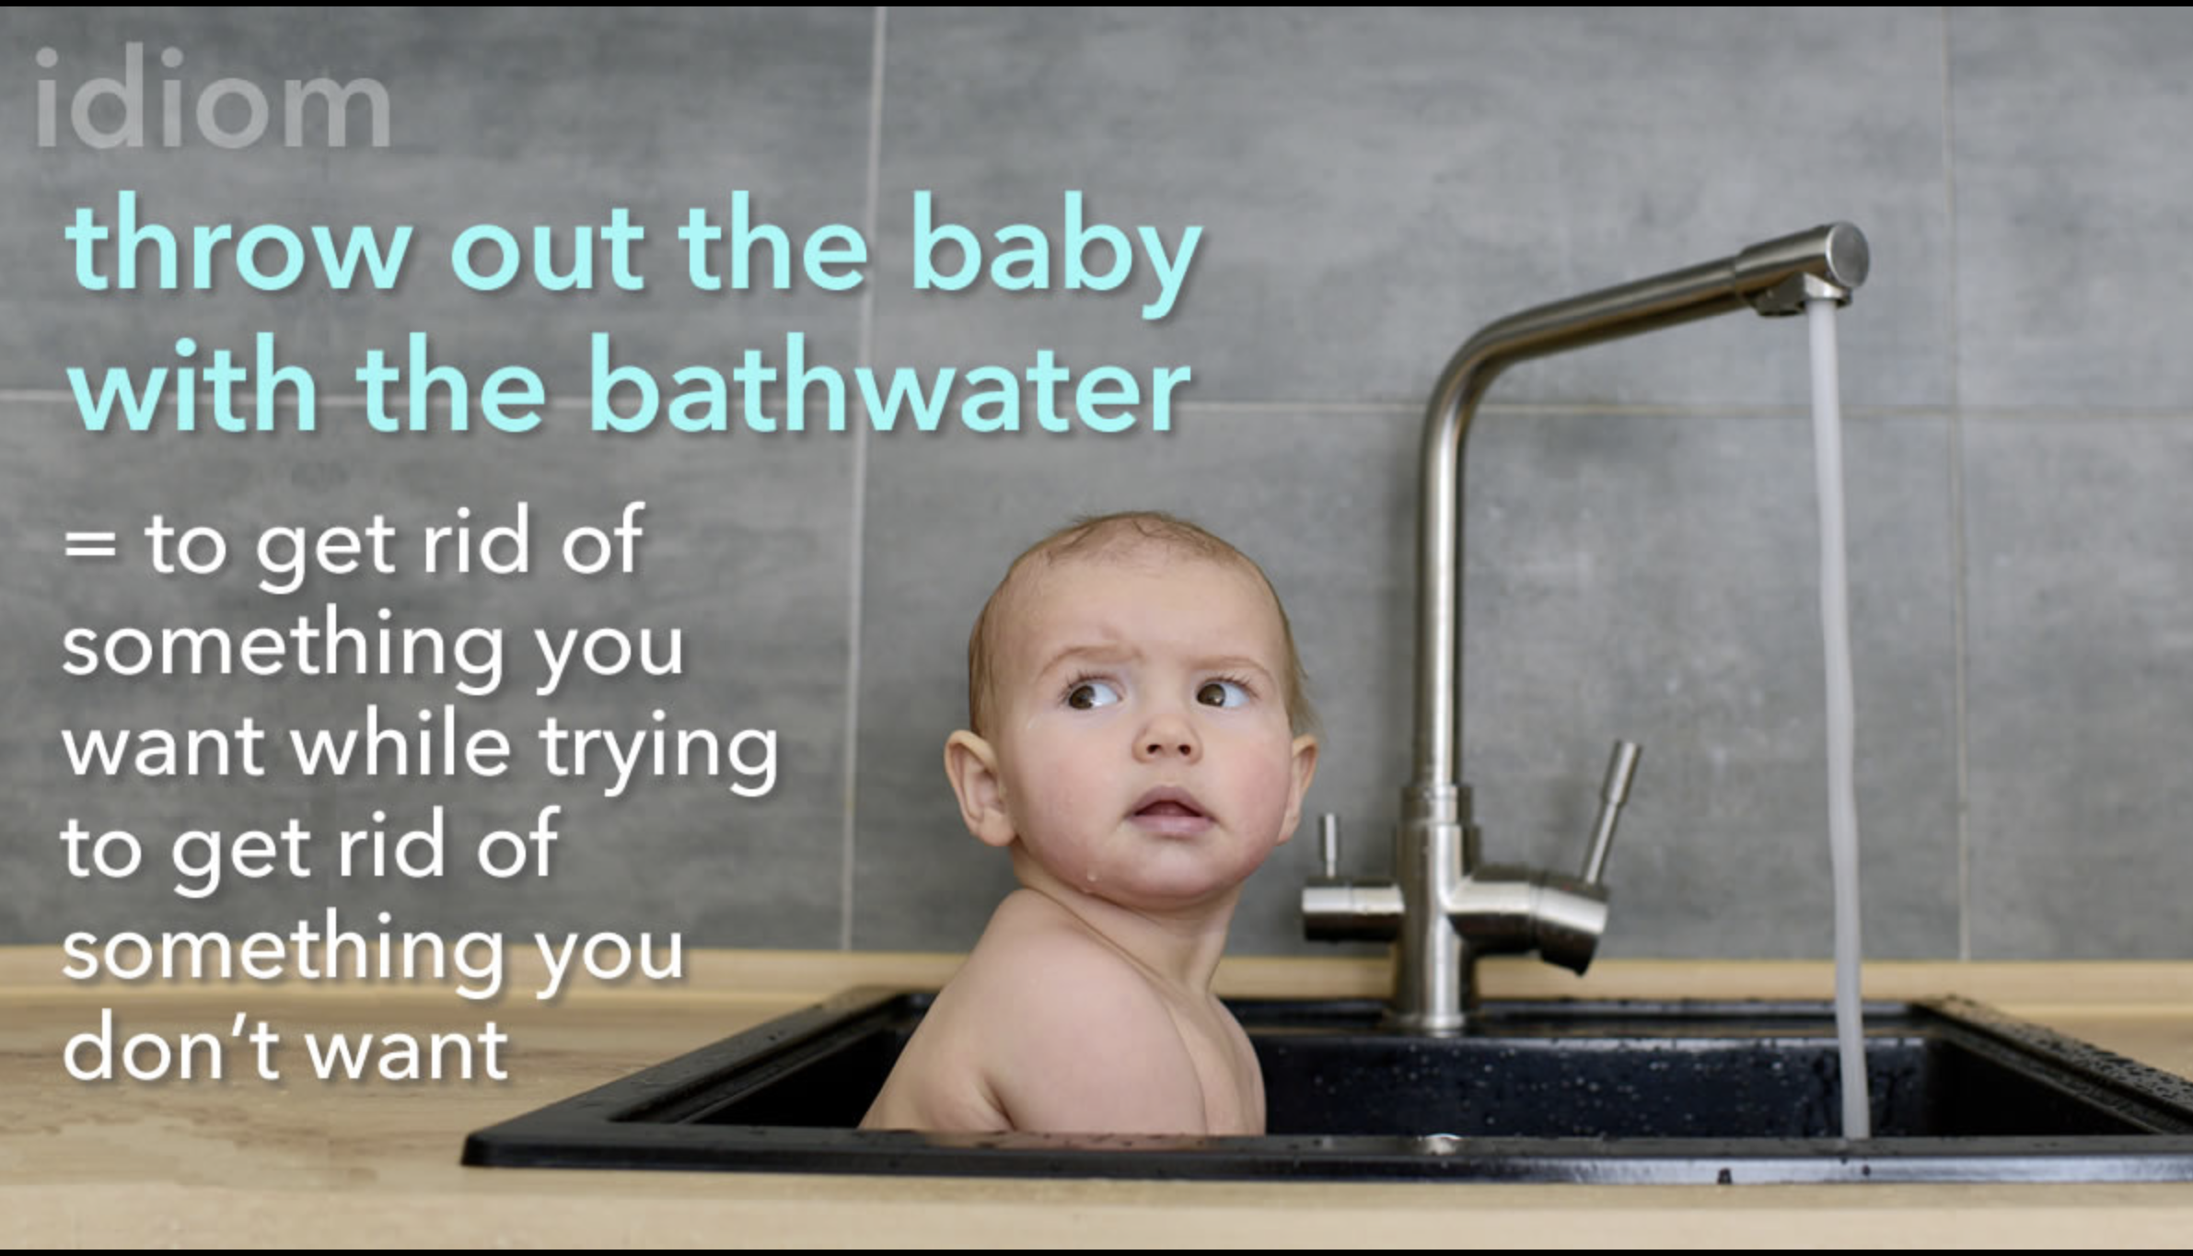
Notes:
Its hard. Its sticky. Its nuanced. But we are

Slide 19
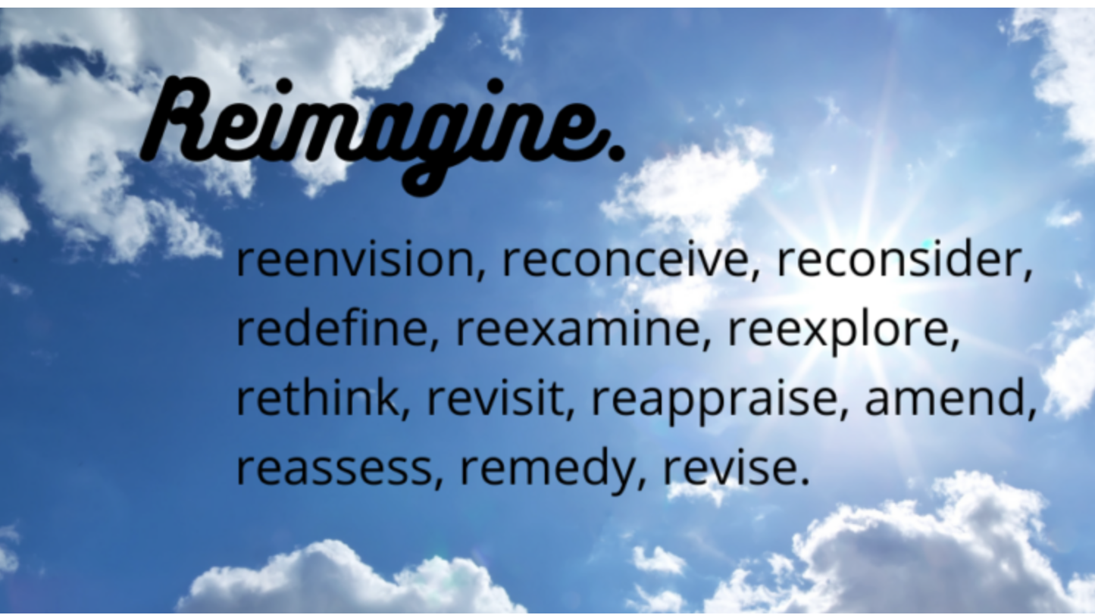

Slide 20

Notes:
The Professionalism Imperative: Sustaining Trust from Training to Legacy, Professionalism: The Core Value That Makes Family Medicine Matter
If we don’t define ourselves and what we embody, if we are just distracted – running around putting out fires, you best believe that others are defining it for us. They are limiting our scope, diminishing our light. They are telling out learners that they are just glorified nurse practitioners and just there to shuttle patients to the specialists.
Professionalism is foundational to who we are as Family Physicians, now more than ever. As Family physicians, we have to fight to define ourselves and our professionalism, what we profess, as if the survival of our specialty depended on it. It does.

