Slide 1
Should family medicine and the family physician be responsible for addressing population health and the social drivers of health?
Knowledgeable – Yes. Aware- Yes. Supportive- Yes. Responsible- No.
Joe Gravel MD FAAFP, Immediate Past President STFM and
Chair, Dept of Family & Community Medicine, Medical College of Wisconsin
FMLC
August 14, 2025

Slide 2
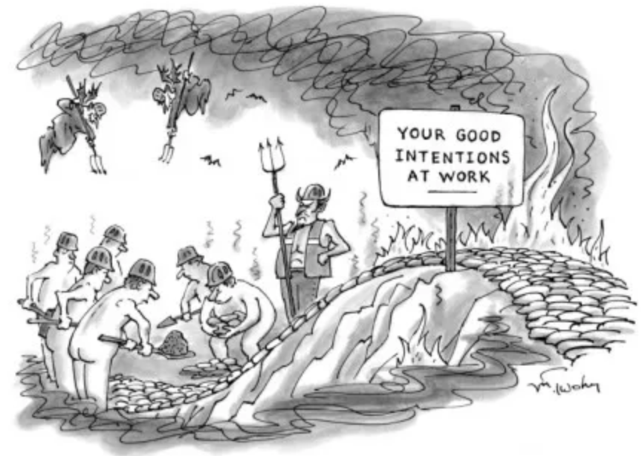
The Road to Hell is Paved with Good Intentions
L'enfer est plein de bonnes volontés et désirs. (Hell is full of good wishes and desires.) St Bernard of Clairvaux, mid-12th century
“the unhappy failure of pious resolves… Sir, hell is paved with good intentions.“ Samuel Johnson 1775
“The safest road to hell is the gradual one- the gentle slope, soft underfoot, without sudden turnings, without milestones, without signposts.” CS Lewis 1942

Slide 3

Social Drivers= Bright Shiny Objects?
Shiny object syndrome (SOS) is a psychological concept where people focus on a new and fashionable idea, regardless of how valuable or helpful it may ultimately be. While at the moment it seems to be something worth focusing one's attention upon, it is ultimately a distraction.
https://en.wikipedia.org/wiki/Shiny_object_syndrome

Slide 4
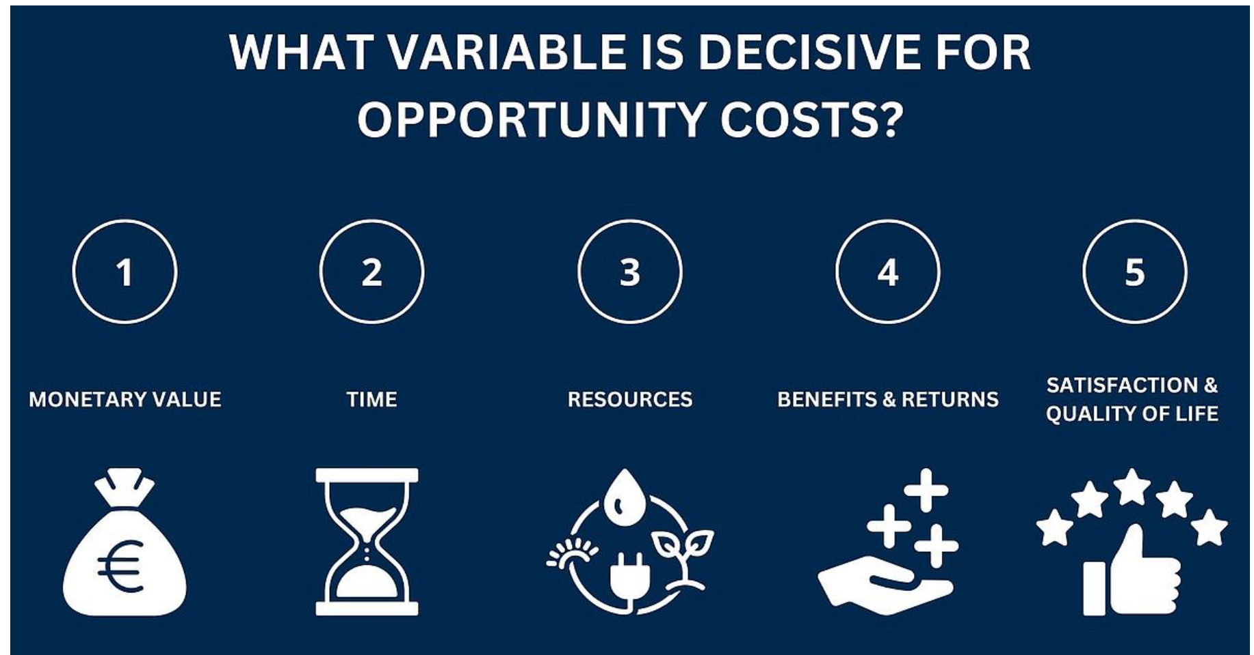
Opportunity Cost
Opportunity cost is the potential benefit that is lost when one alternative is chosen over another. It's the value of the next best thing you could have had, but didn't because you made a different choice. Essentially, it's what you give up when you decide to do one thing instead of something else.

Slide 5
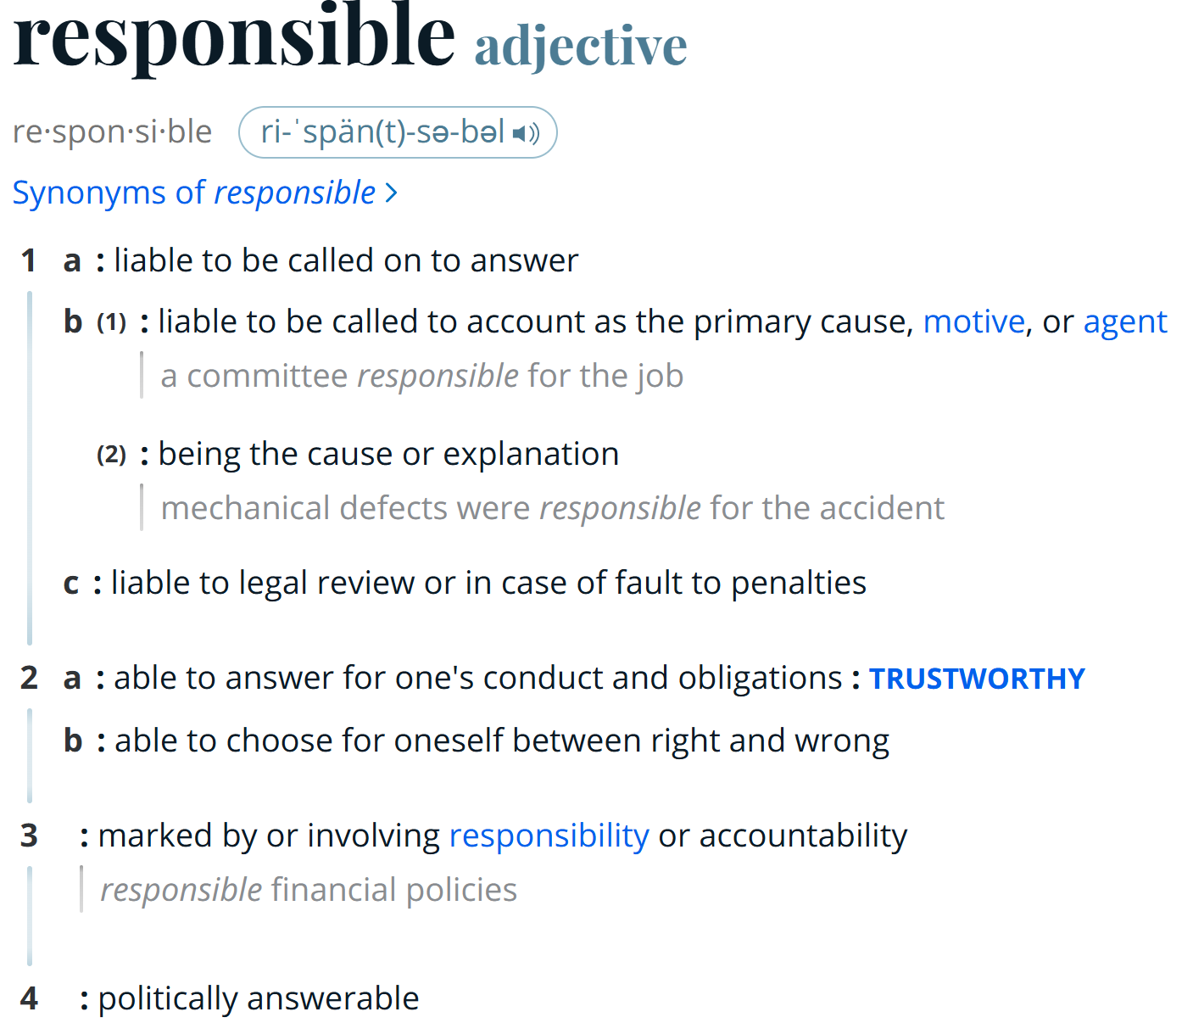
Source: Merriam-Webster dictionary

Slide 6
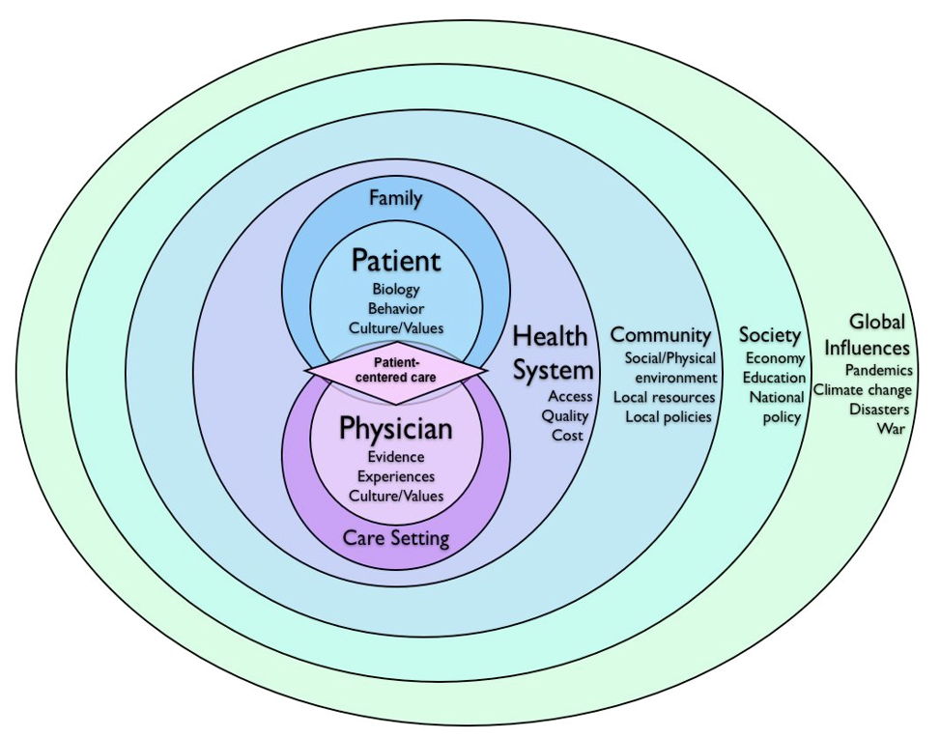
How are we (really) doing in “Patient-centered care”?

Slide 7
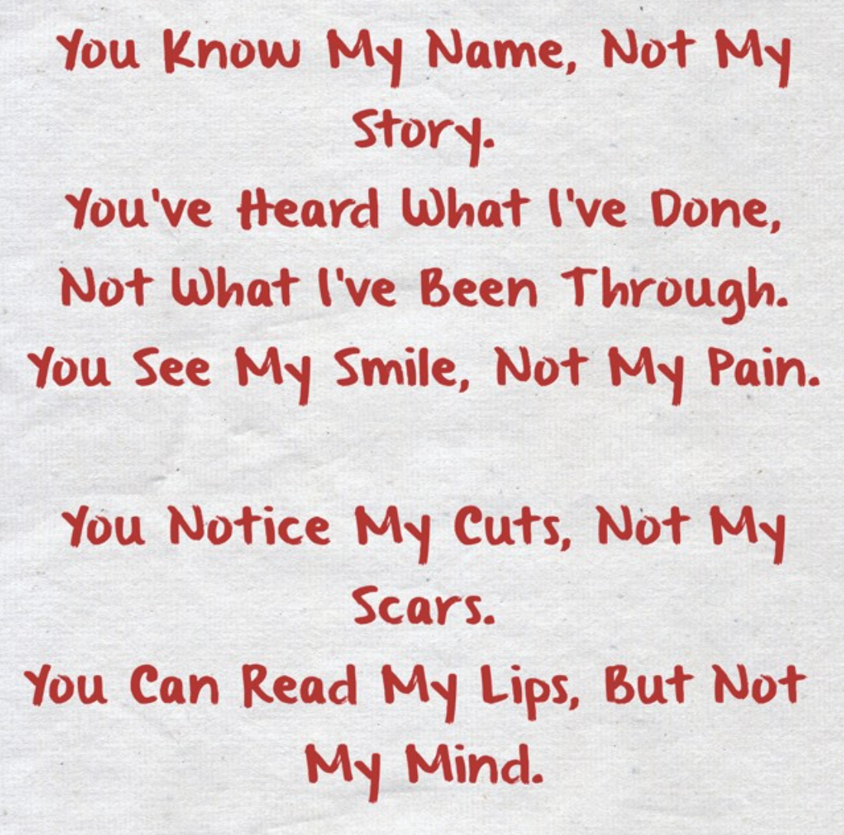

My Recent Precepting Experiences in 3 Programs

Slide 8
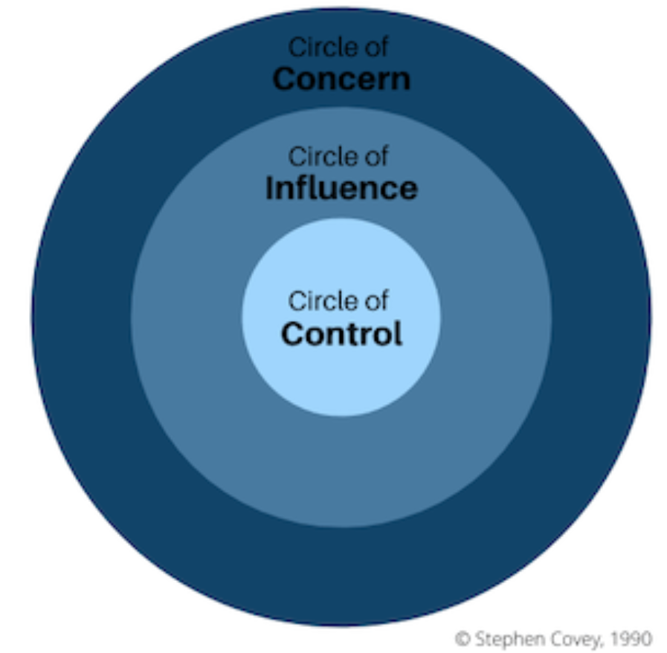
What circle is “addressing the Social Drivers of Health” for a Real-World FP?
Circle of Control- what we can directly control
Circle of Influence- the concerns we can do something about. We do not have control over the outcome but can influence it.
Circle of Concern- Wide range of concerns of which we have no or little control over the outcome.
Circle of No Concern – Everything outside Circle of Concern.

Slide 9
Where to Best Put our Finite Time and Energy?
(2) Circles of Concern
(2) Circles of Influence
Circle of Control

Slide 10
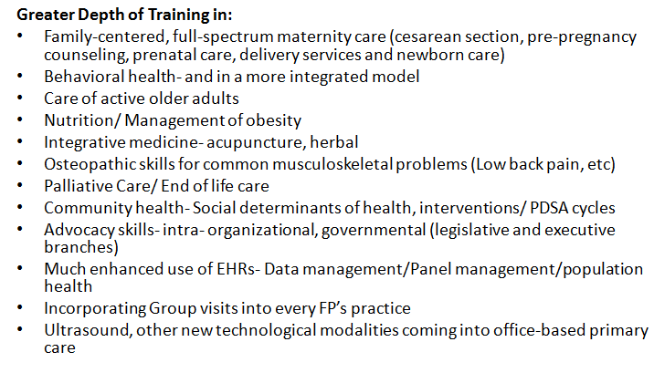
What Do You Wish You Got More Training in During Your FM Residency?

Slide 11
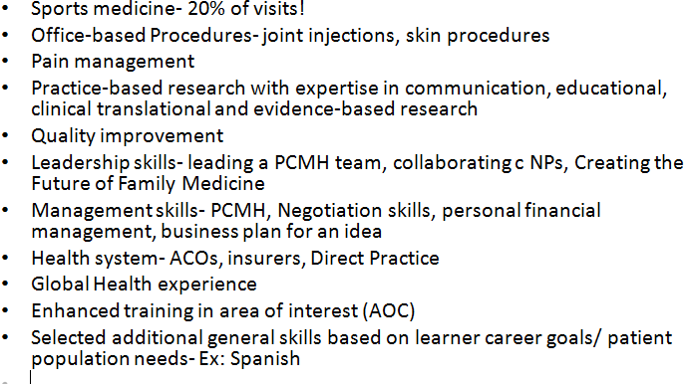
What Do You Wish You Got More Training In During Your FM Residency? (cont.)
Greater Depth of Training in:

Slide 12
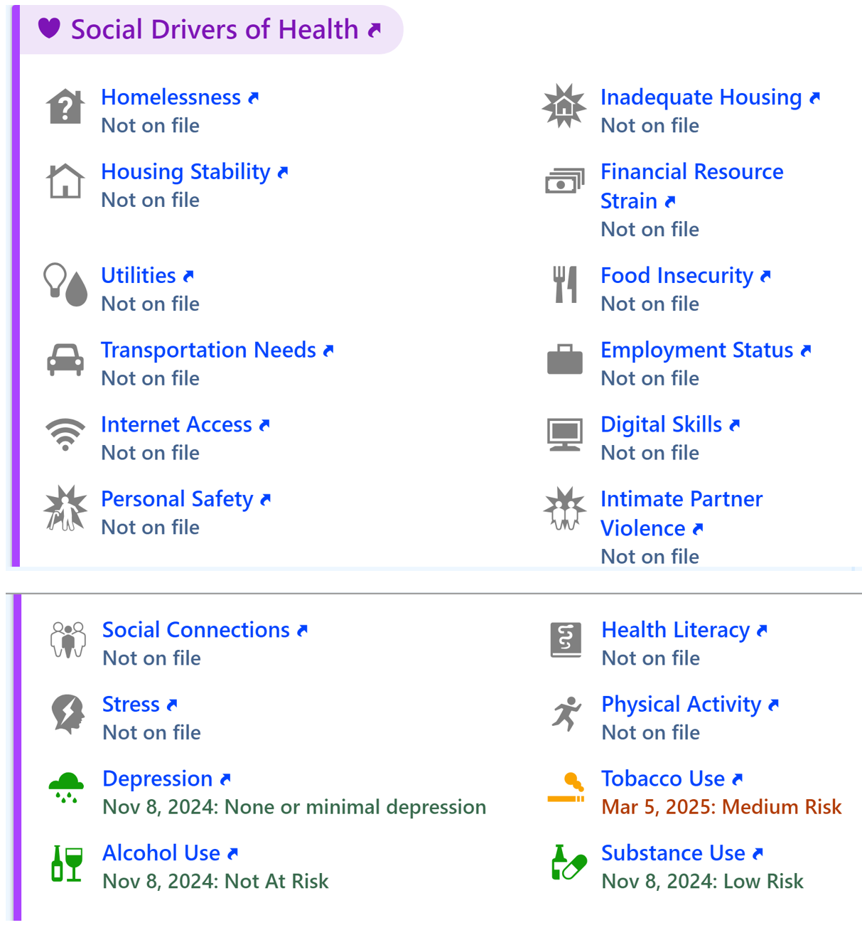
Our Epic’s Social Drivers tab

Slide 13
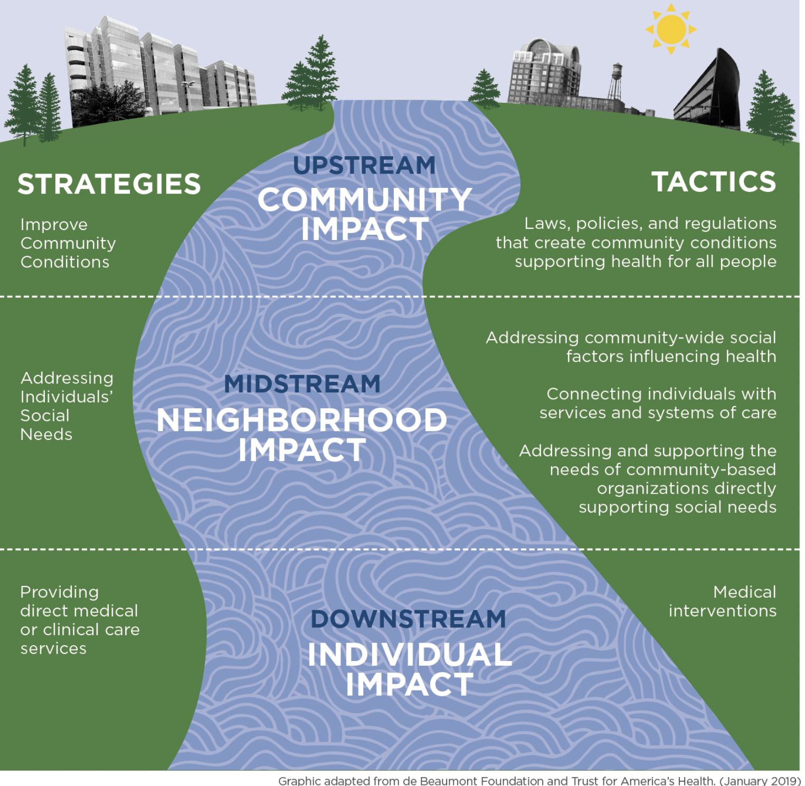

Slide 14
Arguments against expecting FPs to be held responsible for improved social outcomes
Mission Creep
Burnout and Emotional Exhaustion
Structural Problems Need Structural Solutions
Lack of Training and Resources
Medicalization of Social Issues
Inequity in Expectations

Slide 15
Mission Creep
It dilutes the core role of the physician.
Family physicians are trained to provide medical care, not to serve as social workers, housing advocates, or case managers.
Expanding their role into addressing SDOH may:
Blur professional boundaries
Create unrealistic expectations
Distract from their primary medical focus
Let doctors be doctors. Solving poverty is a societal obligation, not a clinical one.

Slide 16
Burnout and Emotional Exhaustion
Physicians already face high levels of burnout. Adding the burden of addressing deeply entrenched social issues—often without adequate tools or support—can contribute to:
- Moral injury (feeling helpless in the face of patient suffering)
- Overwork and stress
- Decreased job satisfaction
Example: A doctor spends their limited time coordinating a food pantry referral instead of learning more about patient’s goals, their work/interests, their family, their spiritual or cultural beliefs, or actually providing shared decision-making – things only they can do.

Slide 17
Structural Problems Need Structural Solutions
Many SDOH are systemic: poverty, racism, housing instability, etc. Individual physicians are not equipped to solve these problems alone or at scale.
This is a distraction from the need for policy-level reform. Physicians should advocate upstream, not try to fix everything downstream in a 15-minute visit.

Slide 18
Lack of Training and Resources
Most physicians receive minimal training in social care, public health systems, or community organizing. Even when they screen for social needs:
- There may be no/inadequate resources available
- Referrals may not be completed or followed up
- Health systems may not invest in support infrastructure
Outcome: Screening without follow-up can frustrate both patient and family physician.

Slide 19
Medicalization of Social Issues
Integrating SDOH into clinical care can unintentionally medicalize non-medical problems, shifting attention away from:
- Root causes (e.g., minimum wage, red-lining, poor education policy)
- Community-based leadership and solutions
- Collective responsibility
This lets society off the hook by turning social failure into a clinical issue.
Patient labeling has potential risks.

Slide 20
Inequity in Expectations
Family physicians—especially those in underfunded, underserved, or rural settings—are already asked to do more with less.
Adding SDOH work may:
- Widen inequities between affluent and safety-net practices
- Create moral distress in resource-poor areas
- Penalize doctors serving the most vulnerable populations

Slide 21
Avoiding the Unintended Consequences of Screening for
Social Drivers of Health
“Screening for any condition in isolation without the capacity to ensure referral and linkage to appropriate treatment is ineffective and, arguably, unethical.”
“Many validated screening tools … were created for research purposes. For clinical use, such tools should always be interpreted in the context of what is known about the patient and family. In 1 study, even though 106 of 340 families (31%) screened positive for food insecurity and 107 (31%) requested food assistance, there was only a 36% overlap (ie, 57 in both groups) between the 2 groups.
Clinicians should avoid recommending risk-stratification models that automatically refer patients without elicitation of patients’ opinions, concerns, and priorities and without shared decision making.”
Garg A, Boynton-Jarrett R, Dworkin PH. Avoiding the Unintended Consequences of Screening for Social Determinants of Health. JAMA. 2016 Aug 23-30;316(8):813-4. doi: 10.1001/jama.2016.9282. PMID: 27367226.

Slide 22
Did (the pre-MAHA) USPSTF Get it Wrong?
Conditions for USPSTF Recommendation
Screening Recommended: When a clinical practice has established systems for accurate diagnosis, treatment, and follow-up.
Screening Not Recommended: In the absence of these staff-assisted care supports, the USPSTF advises against routine screening due to potential harms and lack of benefits.
The USPSTF's recommendations emphasize the importance of the entire care pathway, not just the initial screening.
If a practice cannot provide accurate diagnosis, effective treatment, and consistent follow-up for individuals who screen positive, routine screening is not recommended.

Slide 23
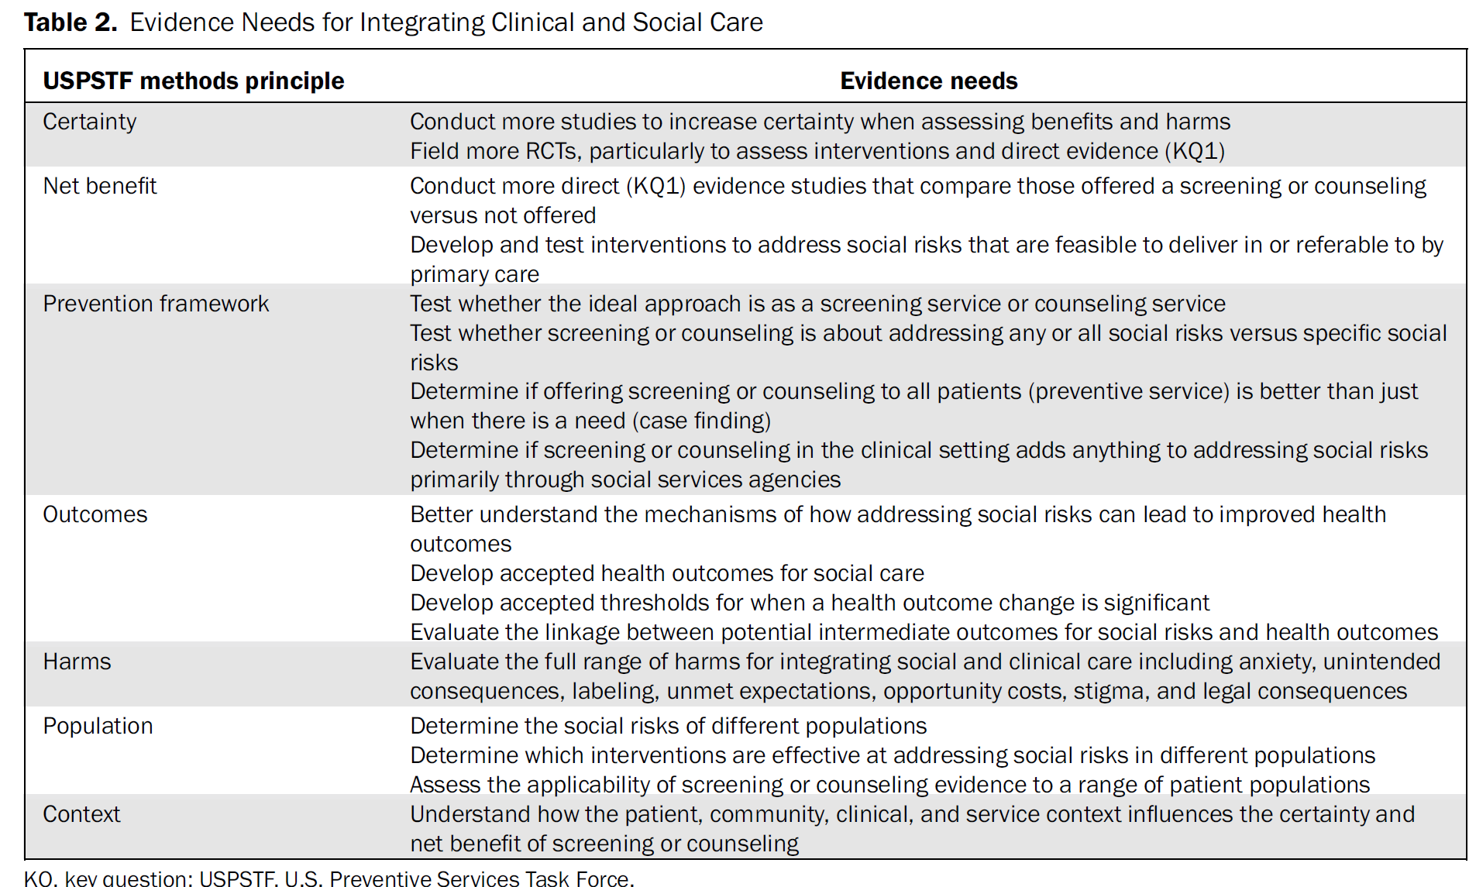
“Evidence is needed that clearly links whether addressing SDH improves health outcomes.”
Krist AH, Davidson KW, Ngo-Metzger Q, Mills J. Social Determinants as a Preventive Service: U.S. Preventive Services Task Force Methods Considerations for Research. Am J Prev Med. 2019 Dec;57(6 Suppl 1):S6-S12. doi: 10.1016/j.amepre.2019.07.013. PMID: 31753280.

Slide 24
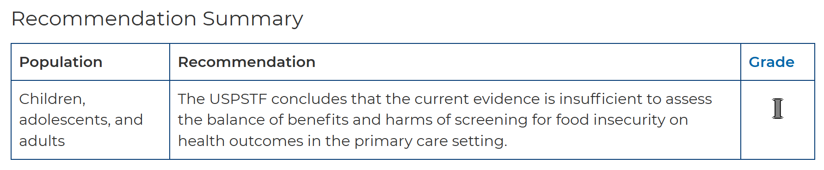
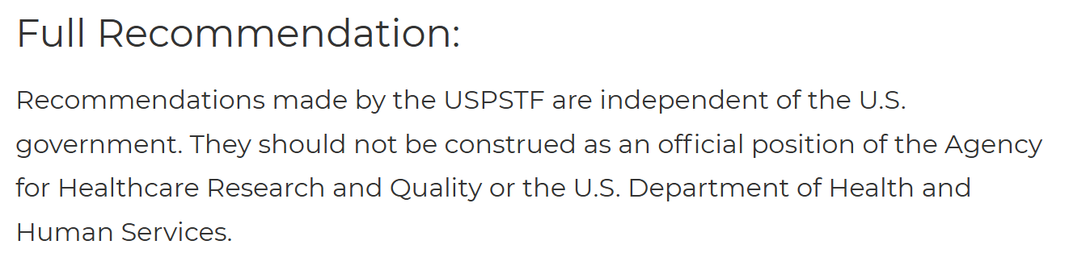
USPSTF Final Recommendation Statement- Food Insecurity: Screening
March 11, 2025

Slide 25
Actual Evidence is Very Limited
“Force-fitting strategies to address social determinants of health into
traditional models of clinical care risks misdirecting limited resources into
programs that may ultimately prove inefficient or ineffective.”
“To date, the preponderance of research on these social determinants has been observational. Of the published interventional studies relevant to health care delivery, few have examined health outcomes or costs. Thus, the evidence for addressing social determinants from within health systems is limited.”
Silverstein M, Hsu HE, Bell A. Addressing Social Determinants to Improve Population Health: The Balance Between Clinical Care and Public Health. JAMA. 2019;322(24):2379–2380. doi:10.1001/jama.2019.18055

Slide 26


Slide 27


Slide 28
Conclusions- FP’s and Social Drivers
Social drivers are societal and upstream. Downstream 15-20 minute individual patient visits is still the predominant model of care…
Teach advocacy skills and the responsibility to be an advocate (engaging those who actually have the power to change these social drivers).
We are not addressing our (relationship-based) Circle of Control all that well- Focus!!!!!
The evidence just isn’t there for most physician-level social interventions.
Knowledgeable –Yes. Aware- Yes. Supportive- Yes. Responsible- No.

Slide 29
Thanks

