Slide 2
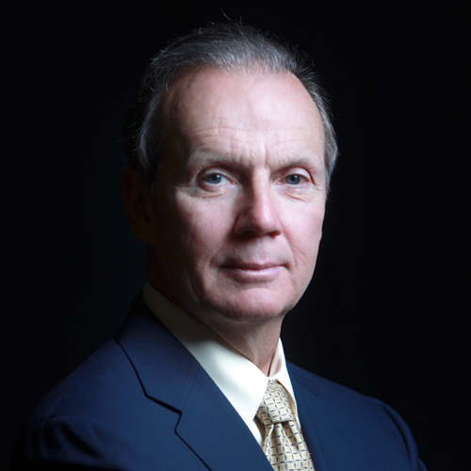
Will Family Medicine Lead Scientific Wellness?
Joseph S. Scherger, MD, MPH

Slide 3
Setting
Any Family Medicine Educational or Practice Setting

Slide 4
Disclosures
Dr. Scherger does not have any relevant financial relationships to disclose and does not intend to reference unlabeled/unapproved uses of drugs or products in this presentation

Slide 5
The main difference between General Practice and Family Medicine is Behavioral Science
Lynn Carmichael

Slide 6
The Myers-Briggs difference between GPs and FPs is that GPs were surgically oriented and FPs were behavior oriented.
Donna Harris

Slide 7
We have lost the time to create meaningful relationships with our patients in a way that facilitates their healing. We can treat their diseases, but we are not able to relieve their suffering. We are no longer able to take care of them as whole people.
Wayne Jonas

Slide 8
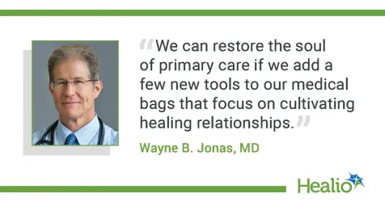

Slide 9
The Problems with Family Medicine today are Metaphysical

Slide 10
It is time for a radical transformation even greater than the transformation of general practice into family medicine

Slide 11
It is time for a radical transformation even greater than the transformation of general practice into family medicine If something cannot go on forever, it will stop
Herbert Stein

Slide 12
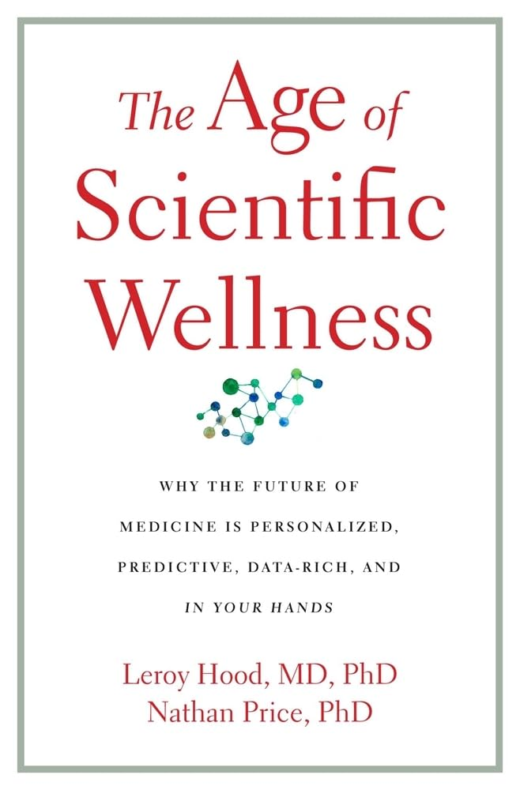

Slide 14
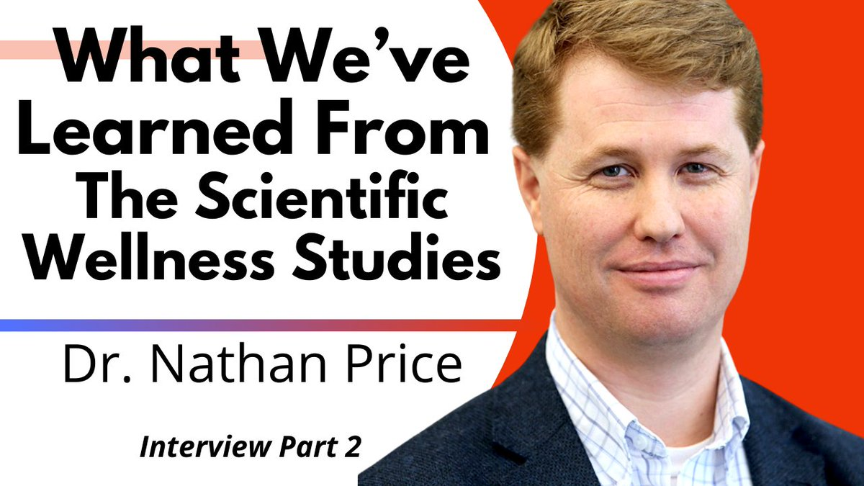

Slide 15
We should transition from a disease model of care to a wellness model using the new tools available to describe wellness

Slide 16
Scientific Wellness
Predictive
Preventive
Personalized
Participatory

Slide 17
Each Patient’s Health Plan
Genome
Phenome
Health Tracking

Slide 18
Family Medicine The home of whole person, whole family, whole community care
Larry Bauer

Slide 19
With Whole Person, Comprehensive and Relationship Centered Care, Family Medicine is ideally suited to lead Scientific Wellness

Slide 20
Medicine Advances Through Scientific Studies and Clinical Trials
Leroy Hood, MD, PhD

Slide 21
Family Medicine has been focused on Clinical Trials for Evidence Based Medicine but has not paid enough attention in advances in Human Biology

Slide 22
Examples
The carbohydrate insulin axis has become established as the pathway for visceral fat storage and insulin resistance (Ludwig, et al)
Inflammatory foods cause leaky gut and add credence to expression of Hippocrates that all diseases start in the gut (Chutkan, et al)
The Microbiome is a new organ where 70% of the immune system resides along with a determination of our mood (Mayer, et al). Dysbiosis is a leading determinant of disease.

Slide 23
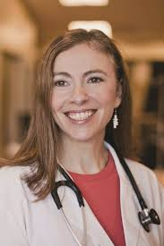

Slide 25
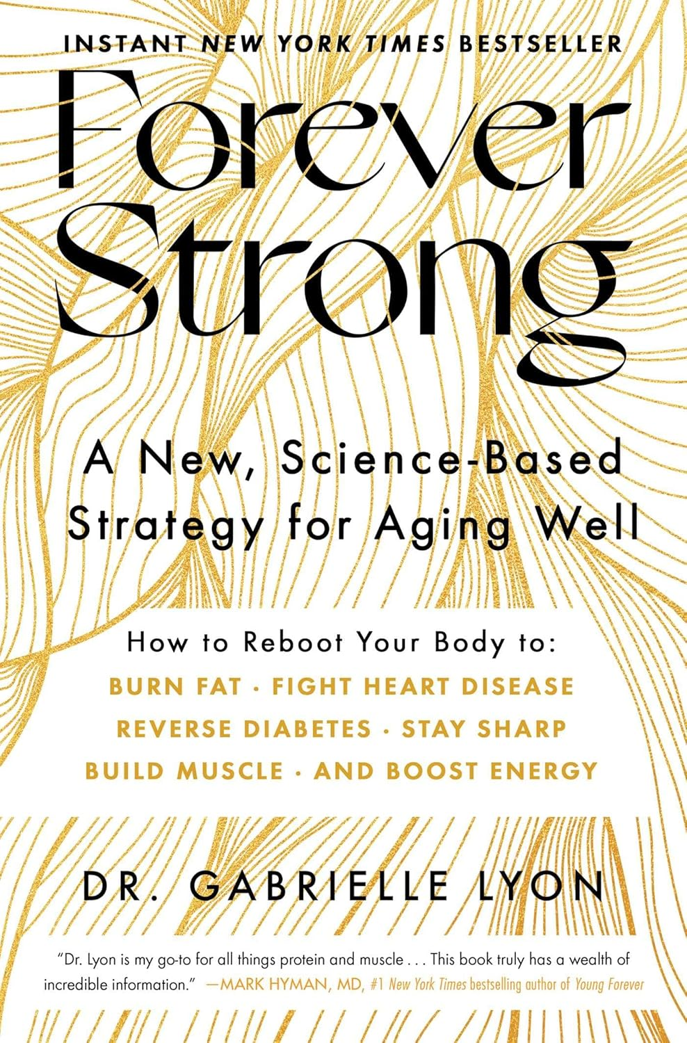

Slide 26
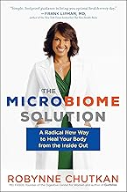

Slide 27
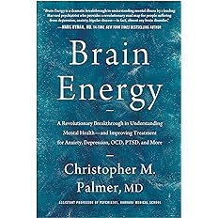
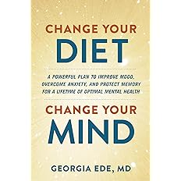

Slide 28
Tomorrow’s FPs will be Wellness Oriented Armed with New Science

Slide 29
To love what you do and feel that it matters -- how could anything be more fun?
Katharine Graham

Slide 30
Caring for patients is so meaningful I would pay to do it
Gayle Stephens

Slide 31
Evaluation
Please be sure to complete an evaluation for this presentation.

Slide 32
Thank You
Click to edit

Slide 33
Questions?

