Slide 1
Primary Care Deserts
Yalda Jabbarpour, MD
Director, Robert Graham Center
08.15.2025

Slide 2

A Definition
desolate and sparsely occupied or unoccupied; a place that is lacking in “something”
Geographic Deserts
Population Deserts
Care Deserts for Specific Conditions

Slide 3
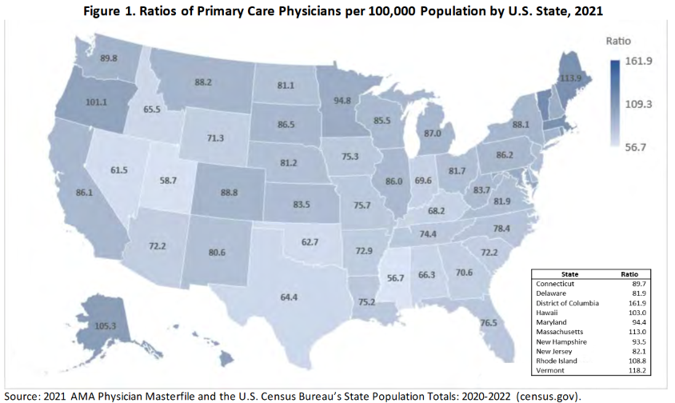
Geographic Deserts

Slide 4
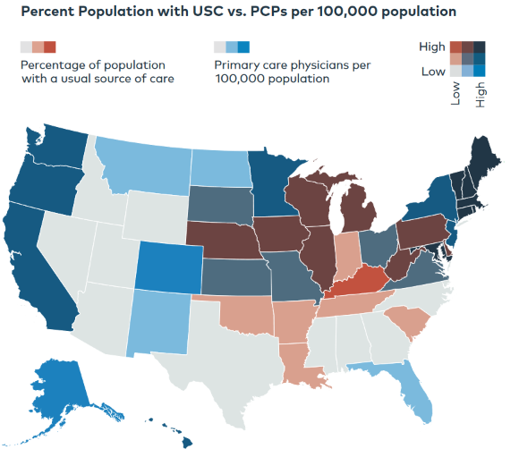
Geographic Deserts and Access
https://www.milbank.org/publications/the-health-of-us-primary-care-2024-scorecard-report-no-one-can-see-you-now/

Slide 5
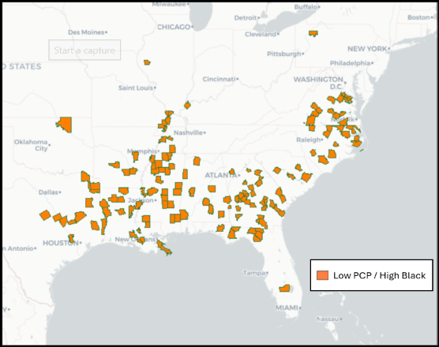
Population Deserts- Race
147 Low PCP / High Black Counties
Southeastern US
East Texas, Virginia
>3 million people
  >867K Black people
  ~50% Non-Metro
472 PCPs
6300:1 Pop/PCP Ratio
3500:1, 3000:1 [HPSA]
>20% of counties no PCP
Low PCP / High Black Counties Concentrated in South, Southeastern U.S.
Notes:
Top five states include MS, LA, GA, NC, VA

Slide 6
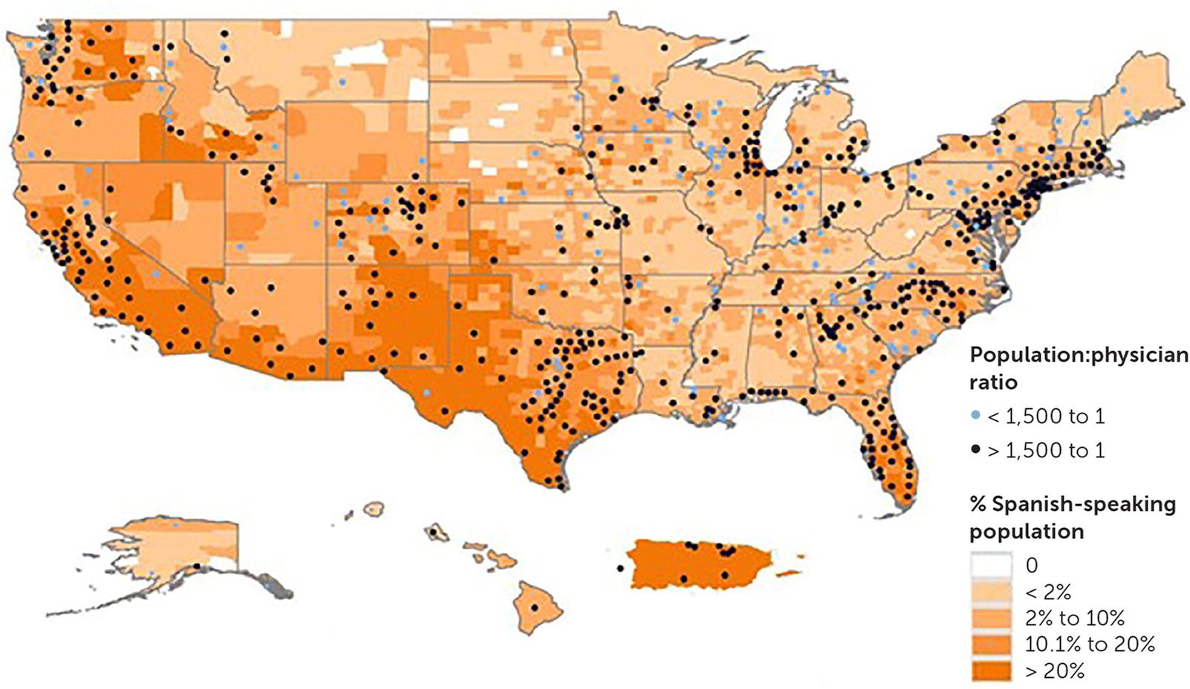
Population Deserts- Language
Flores-Rodarte J, Topmiller M, Jabbarpour Y. Distribution of Spanish-Speaking Family Physicians, 2013-2019. Am Fam Physician. 2022 Jun;105(6):654-655. PMID: 35713629.

Slide 7
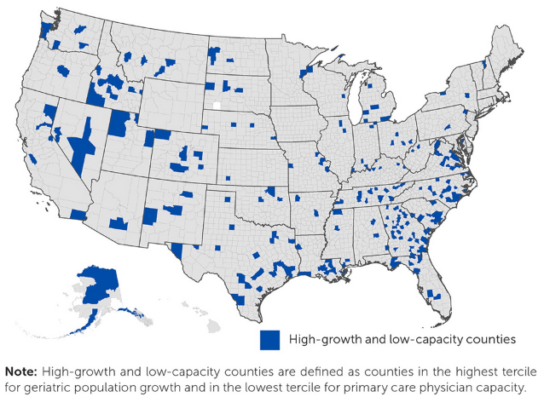
Population Deserts- Aging
https://www.aafp.org/pubs/afp/issues/2024/0400/graham-center-primary-care-access-aging-populations.html

Slide 8
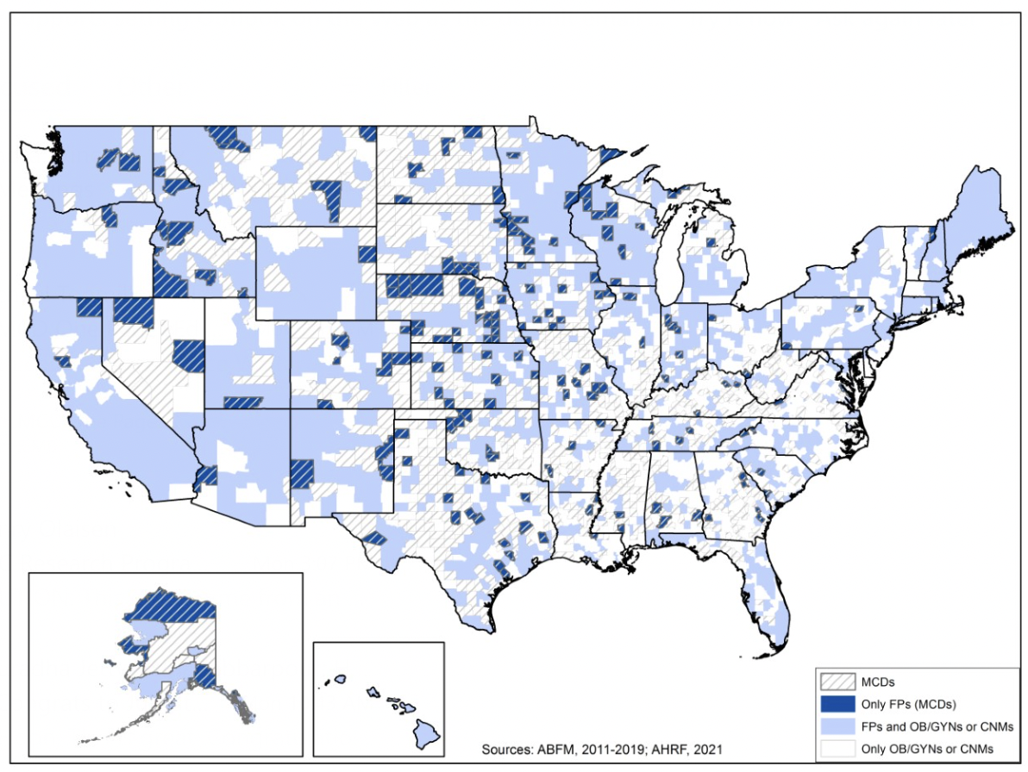
Care Deserts- Maternity Care
More than 1/3 of counties in the US have been identified as MCD
Greater than 80% of these are in non-metro areas
FPs deliver in more than 40% of US counties; more than 50% of these counties are non-metropolitan
FPs are the sole maternity care clinician in 181 MCD counties (16.2%), serving more than 400,000 women (Age 18-44)

Slide 9
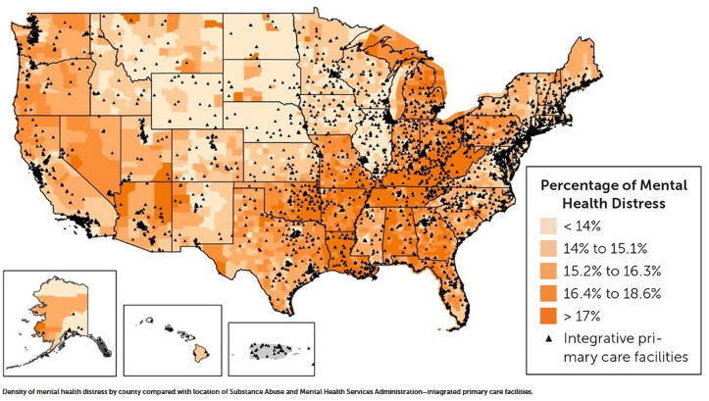
Care Deserts-
Integrative Behavioral Health & Mental Health Need
https://www.aafp.org/pubs/afp/issues/2023/0600/graham-center-behavioral-health-clinics.html

Slide 10

Can we fill these deserts?
Familiarity
Training
Familial Obligations
Autonomy
Politics

